Slide 1



Smart Expense Tracker
BY : Meher prasad janapareddy
Vinay akula

Slide 2
Key FEATURES
Automatically retrieve data from the invoices by scanning and identified important details
Dashboard to check all the expenses related information with analytics, monthly expenses and value proposition of different types of expenses
Expenses history with capabilities to filter and expenses based on tags for ex (fuel, groceries etc)
Simple and user friendlly UI

Slide 3
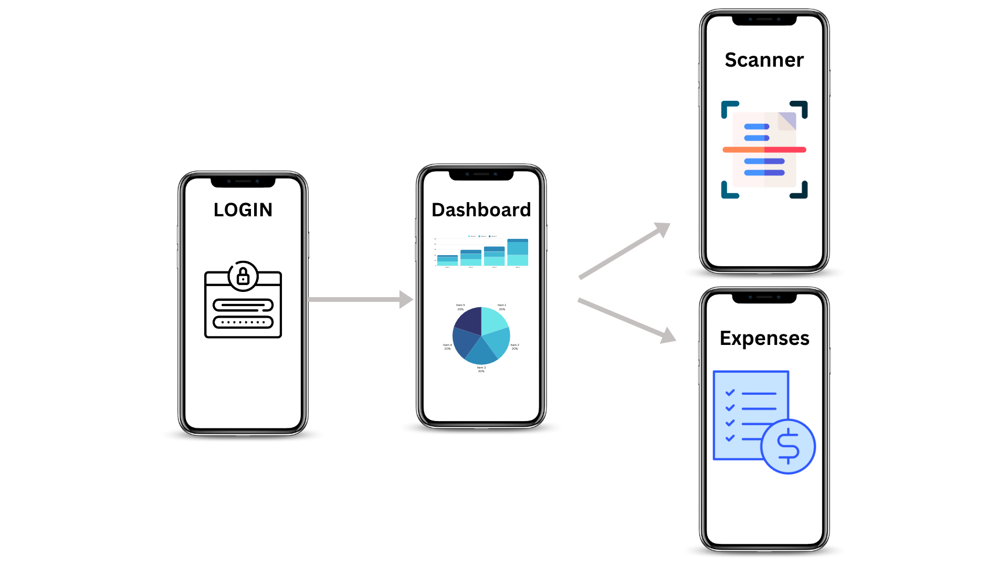
Activity DIAGRAM

Slide 4
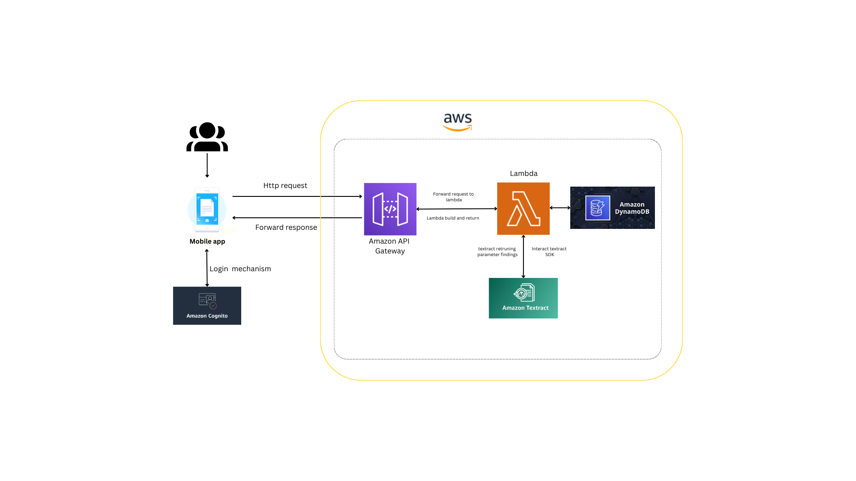
High Level Technical Design HIGH LEVEL

Slide 5

TARGET MARKET
App is basically a tool track expenses and understand the expense behaviour of the user.
Basic users are individuals who want to track their daily expenses.
Can also be used by small scale business entities to track their expenses

Slide 6
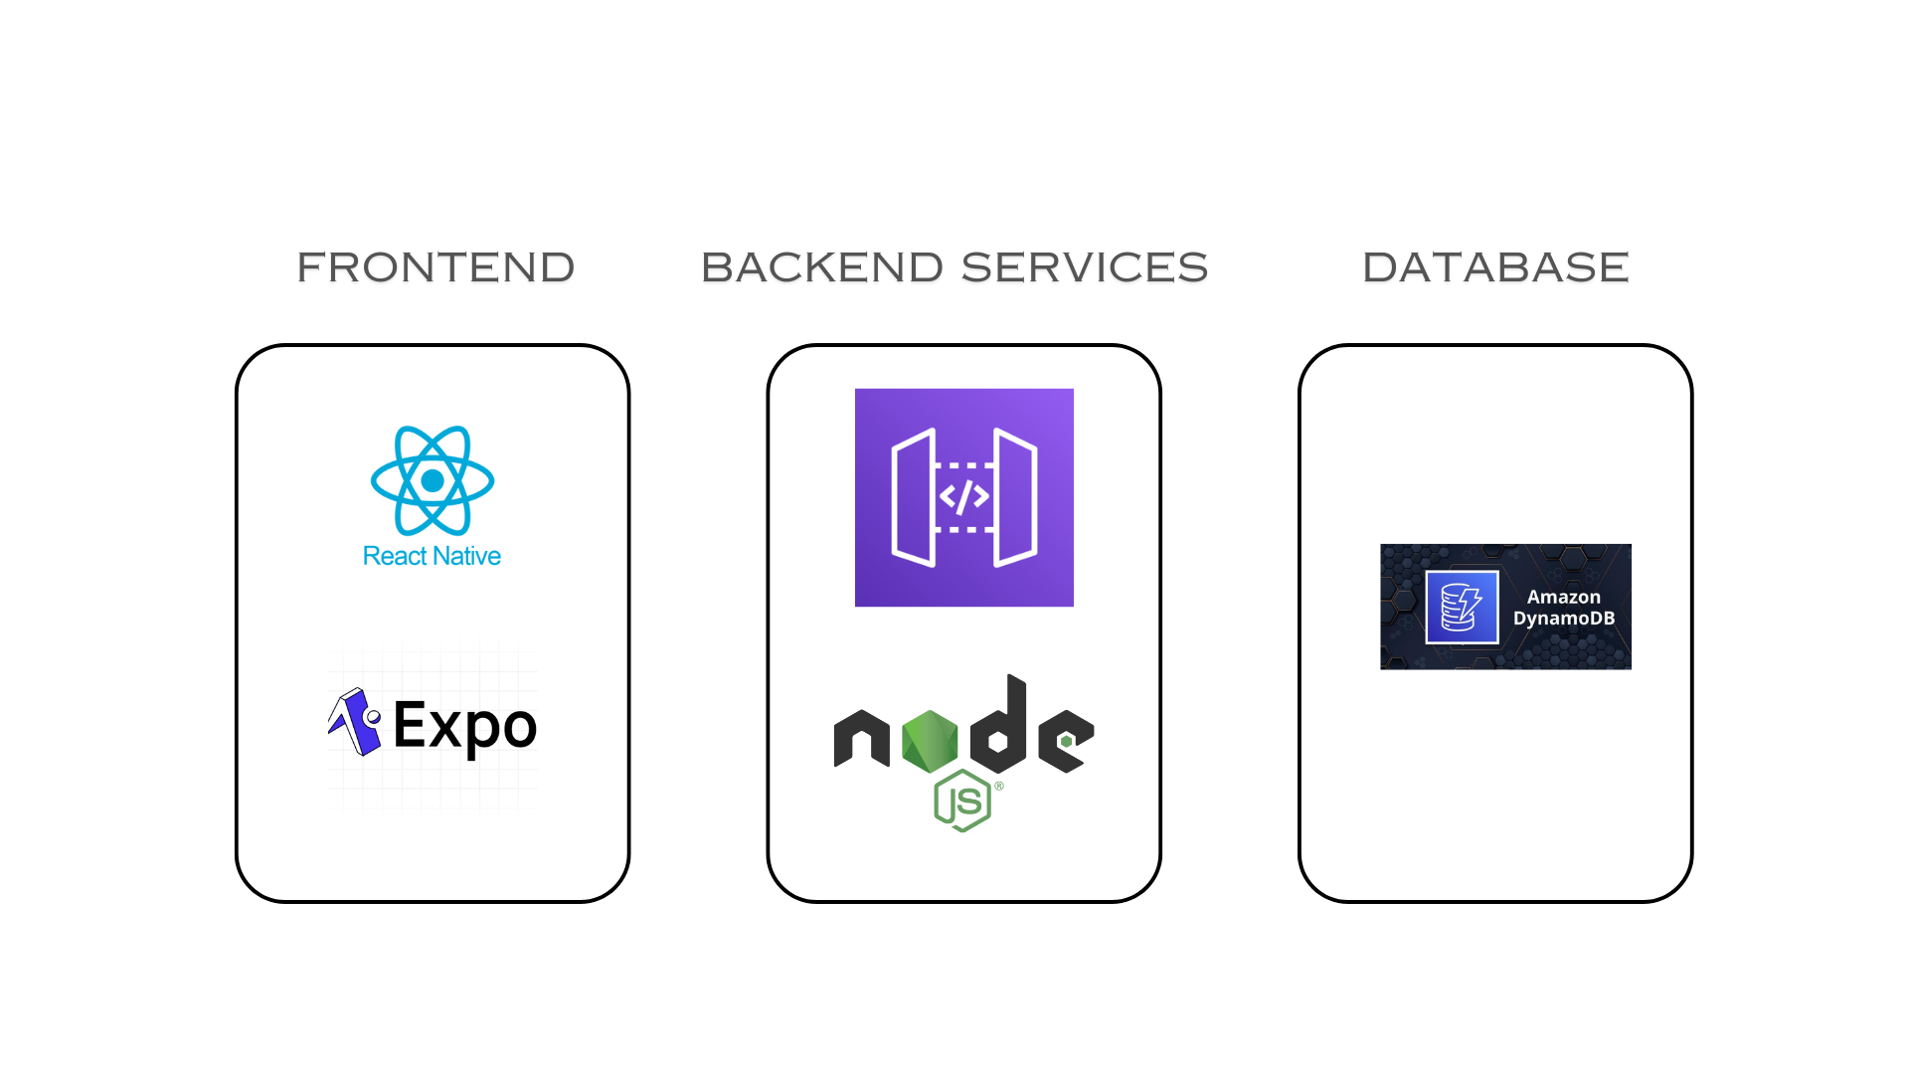
Tech Stack

Slide 7
THANK YOU

