Slide 1
PayPal as an Additional Payment Option
How to test your PayPal online payment set-up as a developer

Slide 2
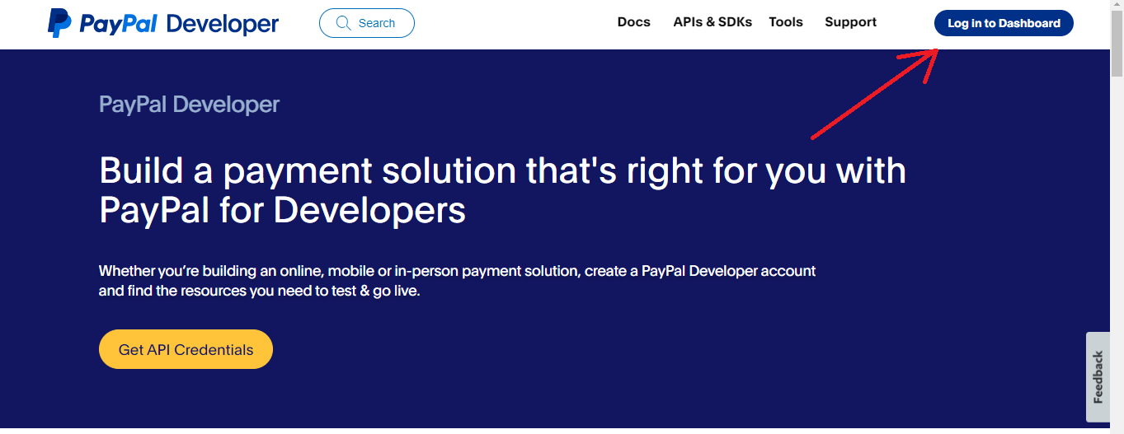
Testing with the PayPal sandbox gateway
To test your PayPal online payment set-up, you can use the gateway in test mode in combination with a PayPal developer account.
Presuming you have not used the PayPal sandbox before, log in to developer.paypal.com, using your normal PayPal credentials.

Slide 3
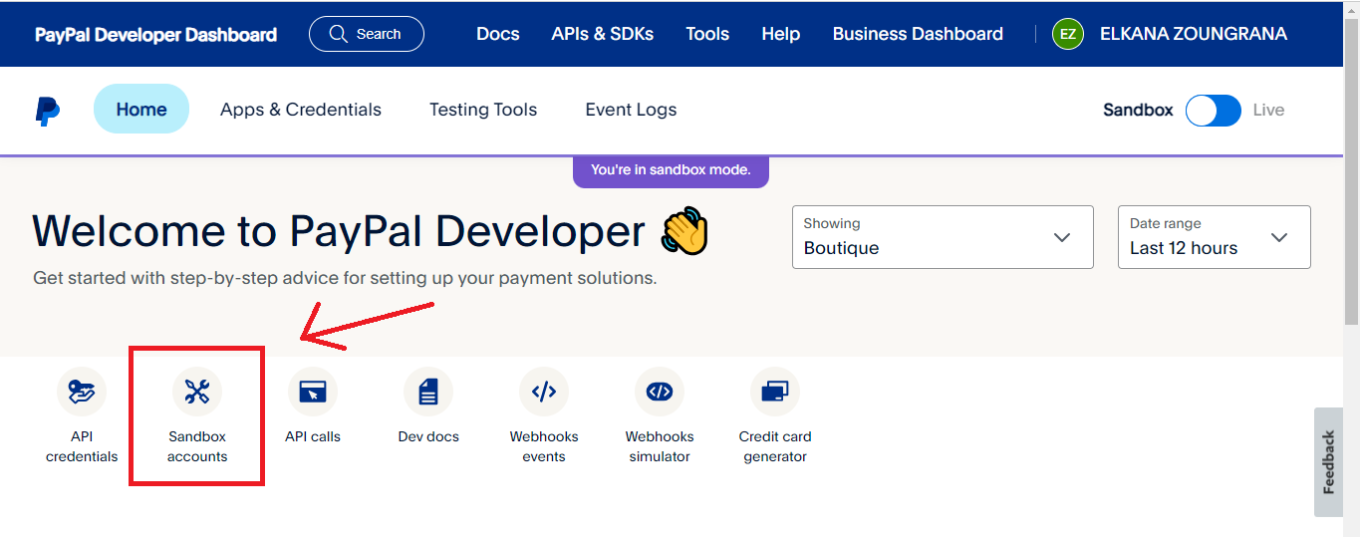
Testing with the PayPal sandbox gateway
Once logged in, click on the “sandbox accounts” button

Slide 4
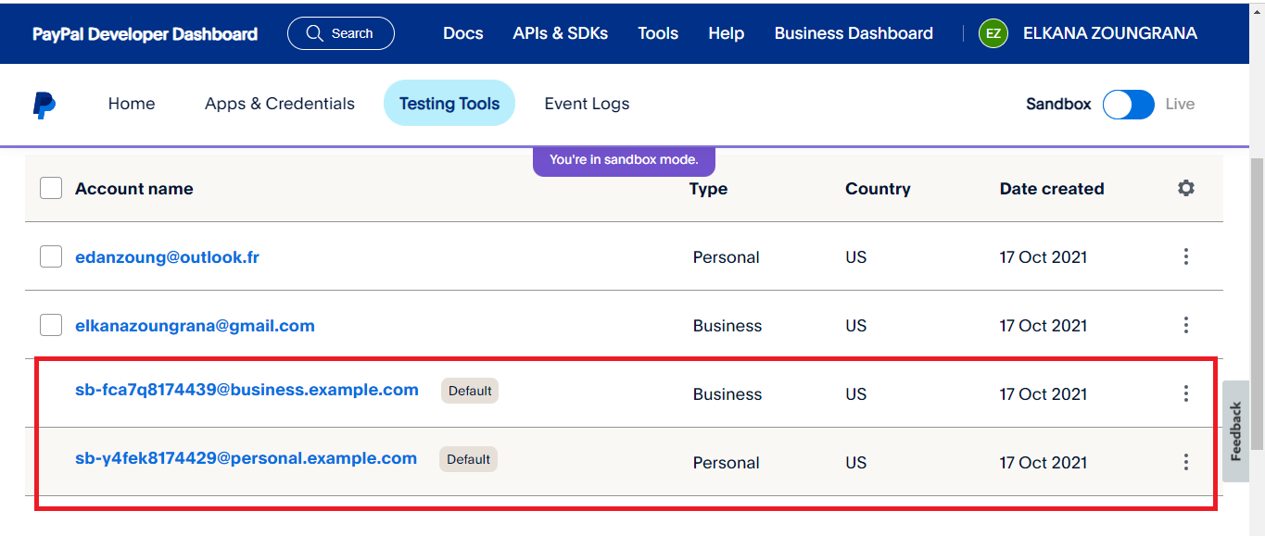
Accounts creation
Here you will see that a Business test account has already been created for you but you can create a new one. Next, create a Personal test account, which can be used to make test payments

Slide 5
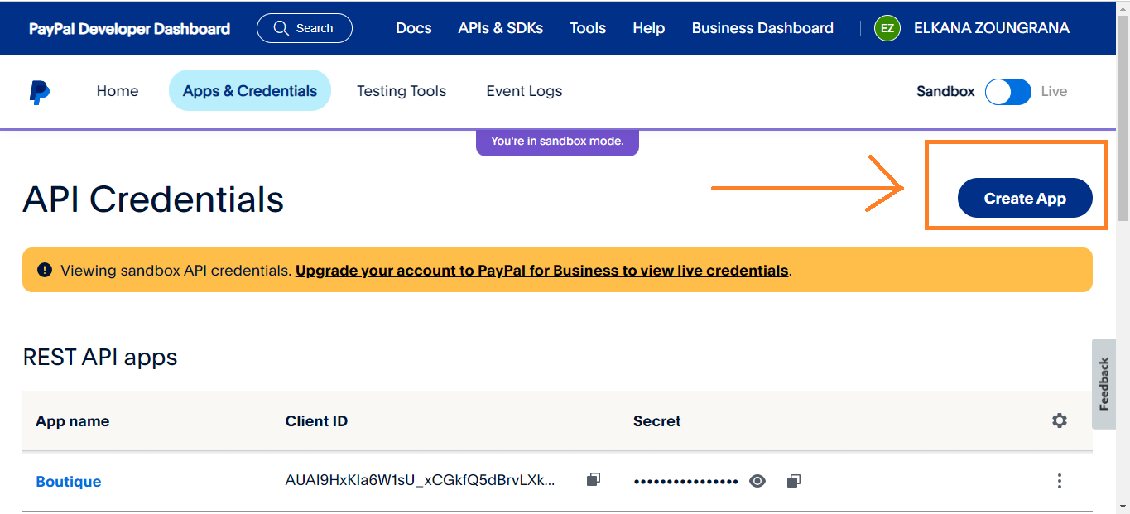
App & credentials
Here we will go to the page “App & Credentials” where you will create new App and then generate the client ID.

Slide 6
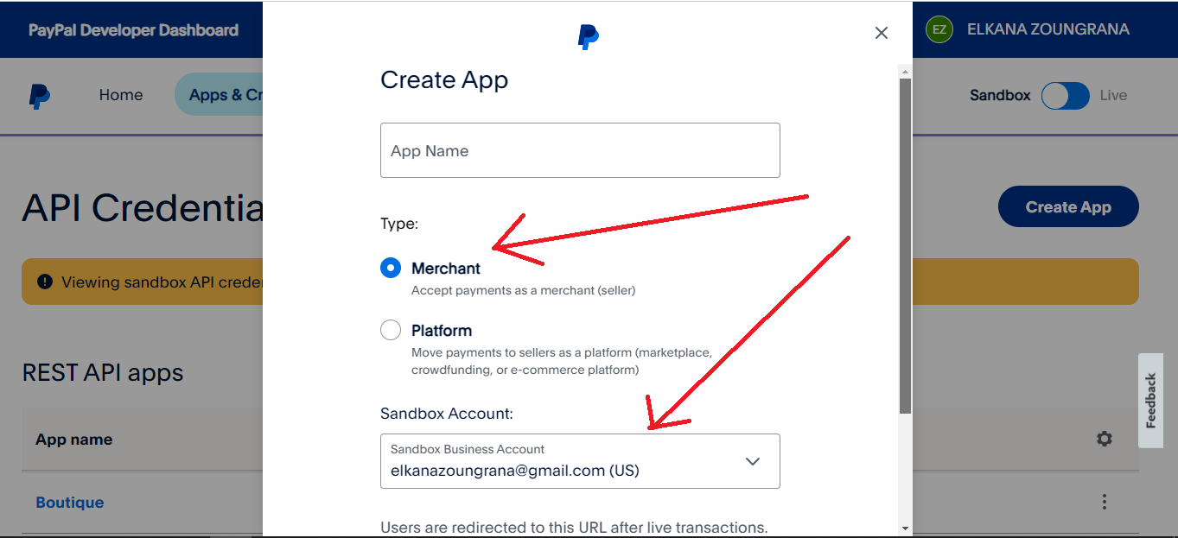
App & credentials
Enter your App name, then choose type “Merchant” and select your
Business account created earlier in “sandbox accounts” page.

Slide 7
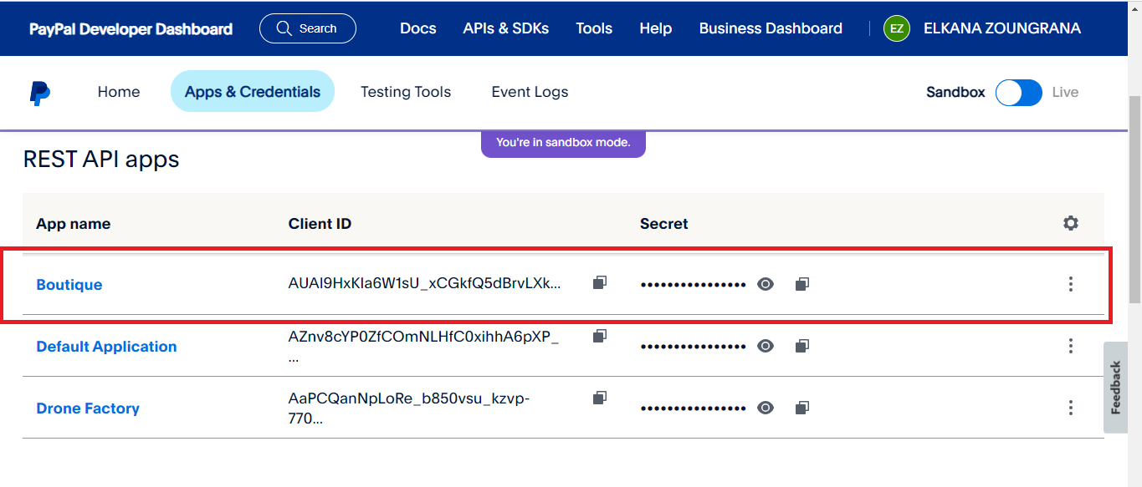
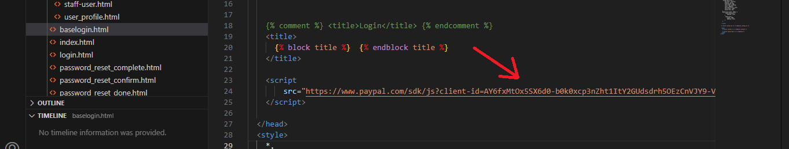
App & credentials
If your app created, you can copy your client ID and replace with one I used in the login-base.html file.

Slide 8
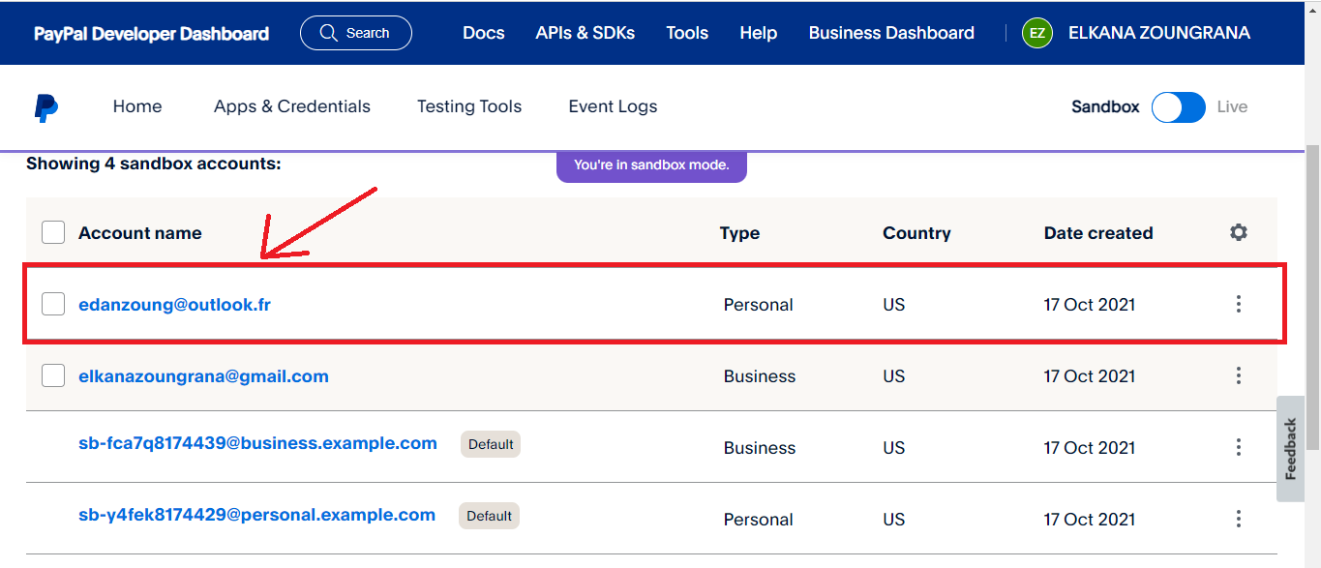
Balance Personal test account
Now we will add credit to our personal account balance which will allow us to make a payment from the site.
First click on your personal account.

Slide 9
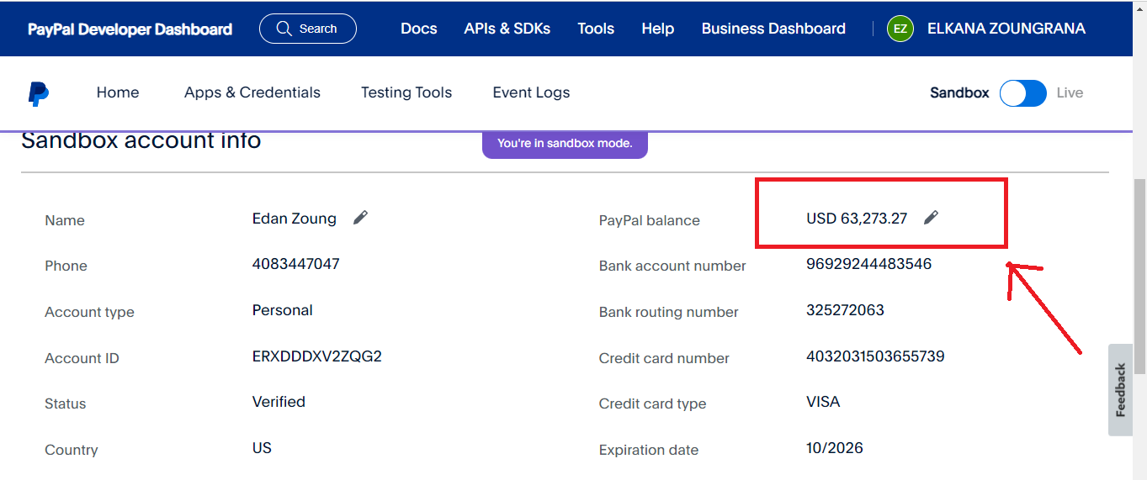
Balance Personal test account
Then scroll down to Sandbox account info. In paypal balance, click on the pencil icon.

Slide 10
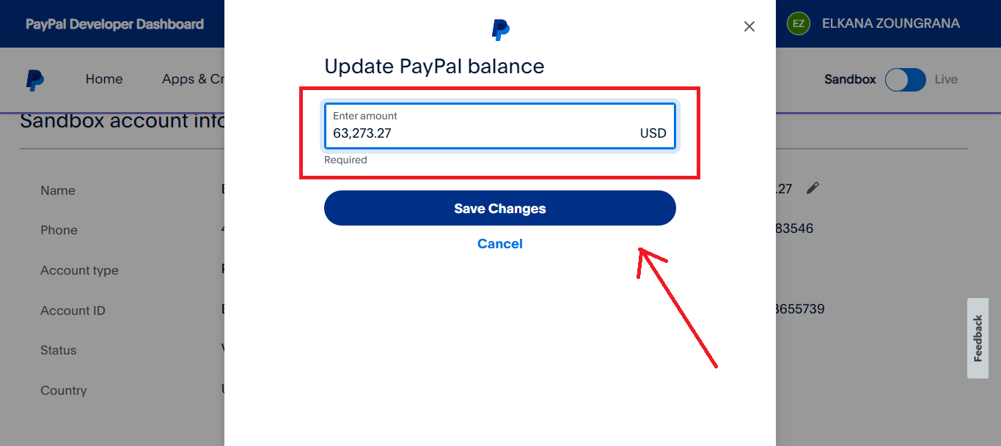
Balance Personal test account
Enter amount you want to your account balance and then click on save changes. You can update it any time.

Slide 11
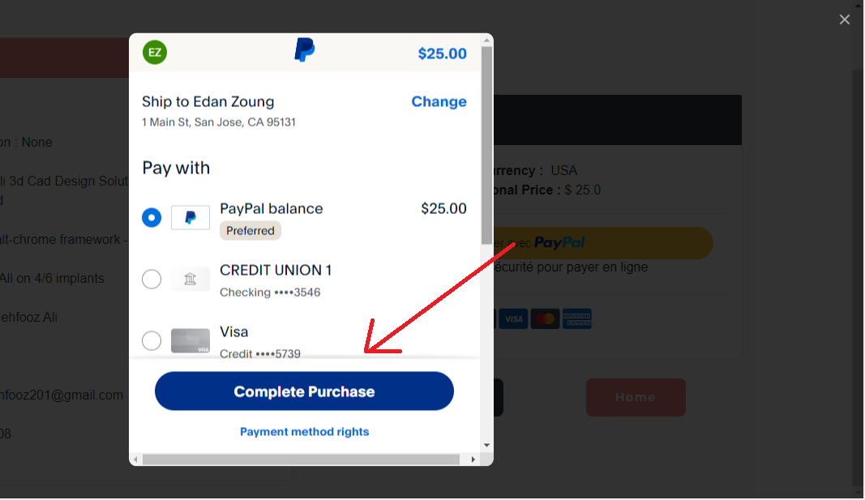
Balance Personal test account
You are ready to test a payment.

Slide 12
Happy if it helped you

