Slide 1
EE464
Static Power Conversion II
Hardware Project Feedback Presentation
Mehmet Emre Doğan
Metehan Küçükler

Slide 2
Outline
Problem Definition
Topology Selection
Plan B
Targeted Bonuses
Simulation Result
Component Selection
Thermal Calculation
Conclusion

Slide 3
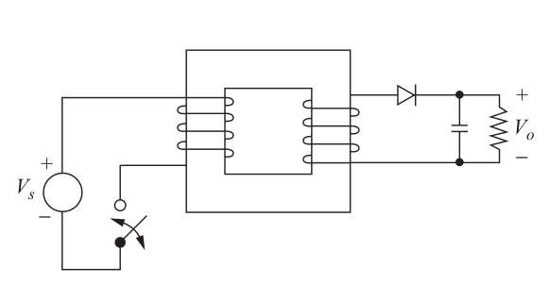
Problem Definition
→ Isolated DC-DC converter with specs:
Minimum Input Voltage: 12 V
Maximum Input Voltage: 18 V
Output Voltage: 48 V
Output Power: 48 W
Output Voltage P2P Ripple: 3%
Line Regulation: 3%
Load Regulation: 3%

Slide 4
Topology Selection
Available topologies:
Flyback converter
Forward converter
Push-Pull converter

Slide 5
Topology Selection
Flyback topology is chosen
Requires less turns ratio compared to forward converter
Requires more basic transformer compared to push-pull converter
Require less number of components
More importantly, we have found controller IC UCC2813DTR-1*
The IC has a base design on TI Webench
* https://www.ti.com/product/UCC2813%2D1

Slide 6
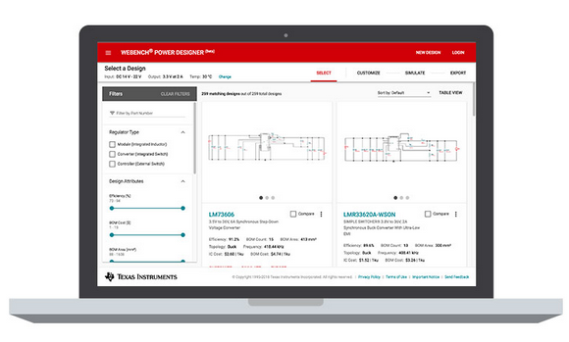
Topology Selection
TI Webench
Online tool to make power electronics circuit designs
https://webench.ti.com/power-designer/switching-regulator

Slide 7
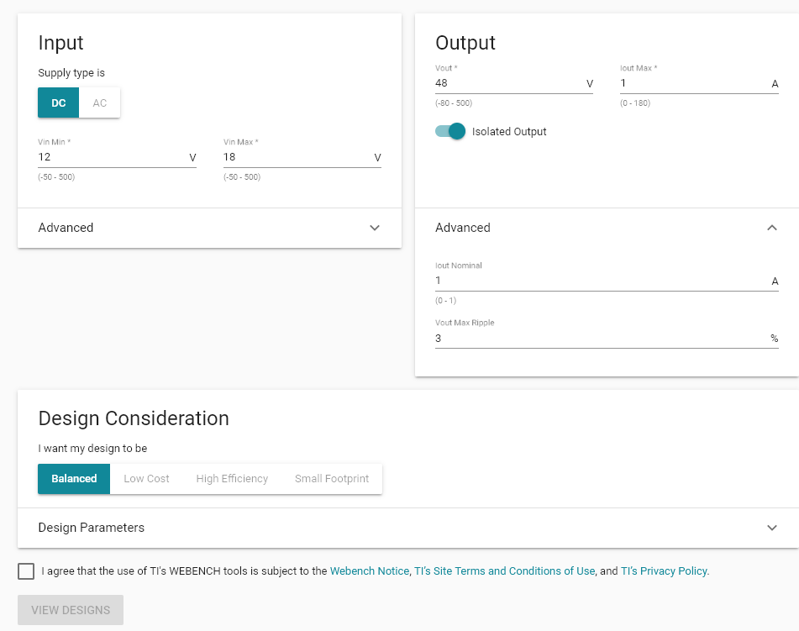

Slide 8
In Case Analog IC Cause Unsolvable Problems
Arduino (ESP8266) based solution
ROE series isolated converters
I2C ADC ADS1115
I2C Isolator ISO1642DWR
ESP in primary
Isolated ADC in secondary

Slide 9
Targeted Bonuses
Single Supply
Current Mode Control
Analog Controller IC
PCB
Industrial Design
Efficiency: Depends on other teams

