Slide 1
EE464
Static Power Conversion II
Hardware Project Feedback Presentation
Mehmet Emre Doğan
Metehan Küçükler

Slide 2
Outline
Problem Definition
Topology Selection
Plan B
Targeted Bonuses
Experimental Results
Simulation Result
Component Selection
Conclusion

Slide 3
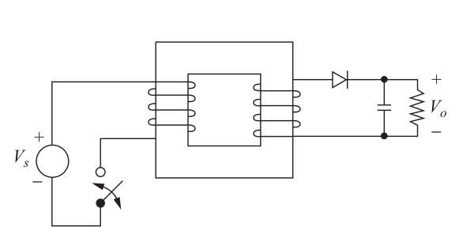
Problem Definition
→ Isolated DC-DC converter with specs:
Minimum Input Voltage: 12 V
Maximum Input Voltage: 18 V
Output Voltage: 48 V
Output Power: 48 W
Output Voltage P2P Ripple: 3%
Line Regulation: 3%
Load Regulation: 3%

Slide 4
Topology Selection
Available topologies:
Flyback converter
Forward converter
Push-Pull converter

Slide 5
Topology Selection
Flyback topology is chosen
Requires less turns ratio compared to forward converter
Requires more basic transformer compared to push-pull converter
Require less number of components
More importantly, we have found controller IC UCC2813DTR-1*
The IC has a base design on TI Webench
* https://www.ti.com/product/UCC2813%2D1

Slide 6
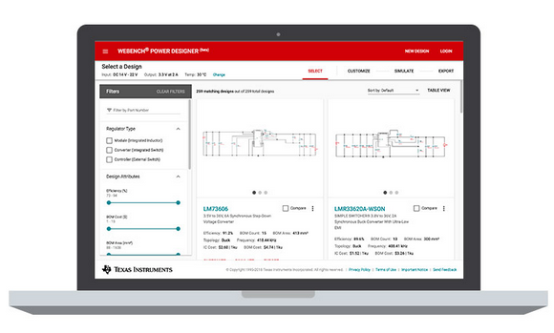
Topology Selection
TI Webench
Online tool to make power electronics circuit designs
https://webench.ti.com/power-designer/switching-regulator

Slide 7
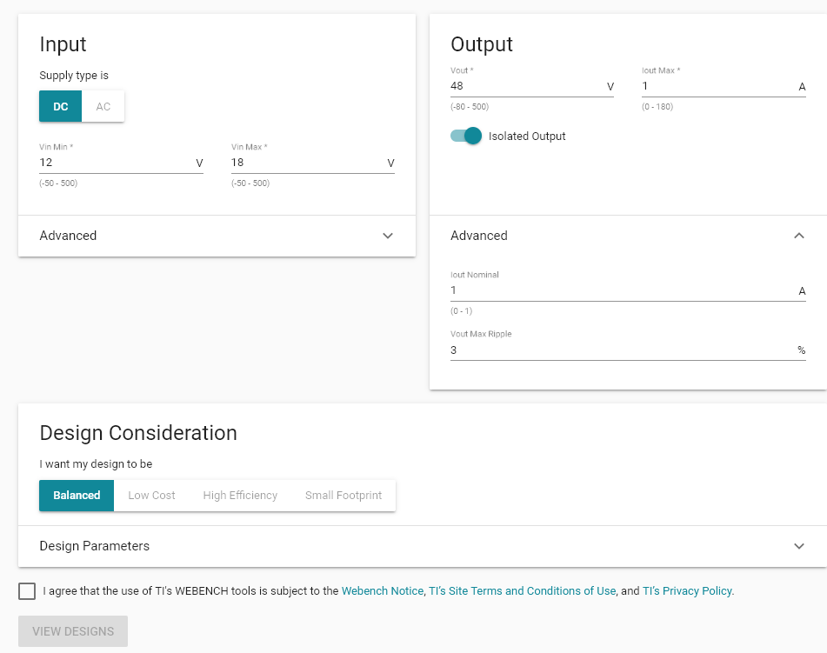

Slide 8
In Case Analog IC Cause Unsolvable Problems
Arduino (ESP8266) based solution
ROE series isolated converters
I2C ADC ADS1115
I2C Isolator ISO1642DWR
ESP in primary
Isolated ADC in secondary

Slide 9
Targeted Bonuses
Single Supply
Current Mode Control
Analog Controller IC
PCB
Industrial Design
Efficiency: Depends on other teams

Slide 10
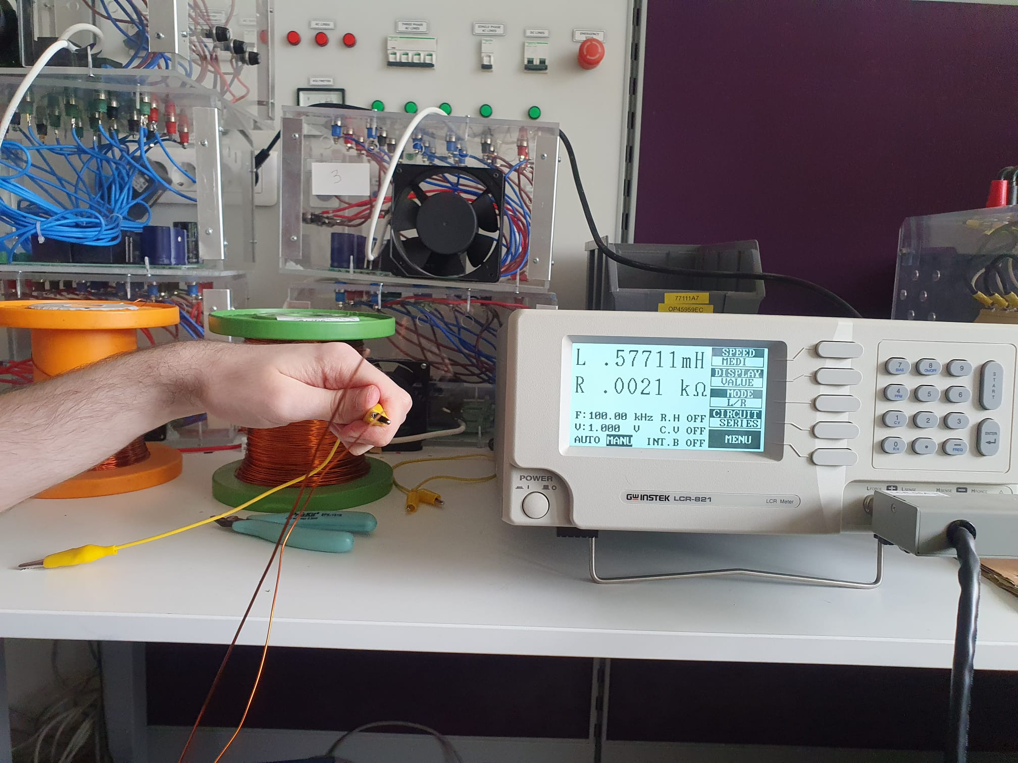
Experimental Results

Slide 11
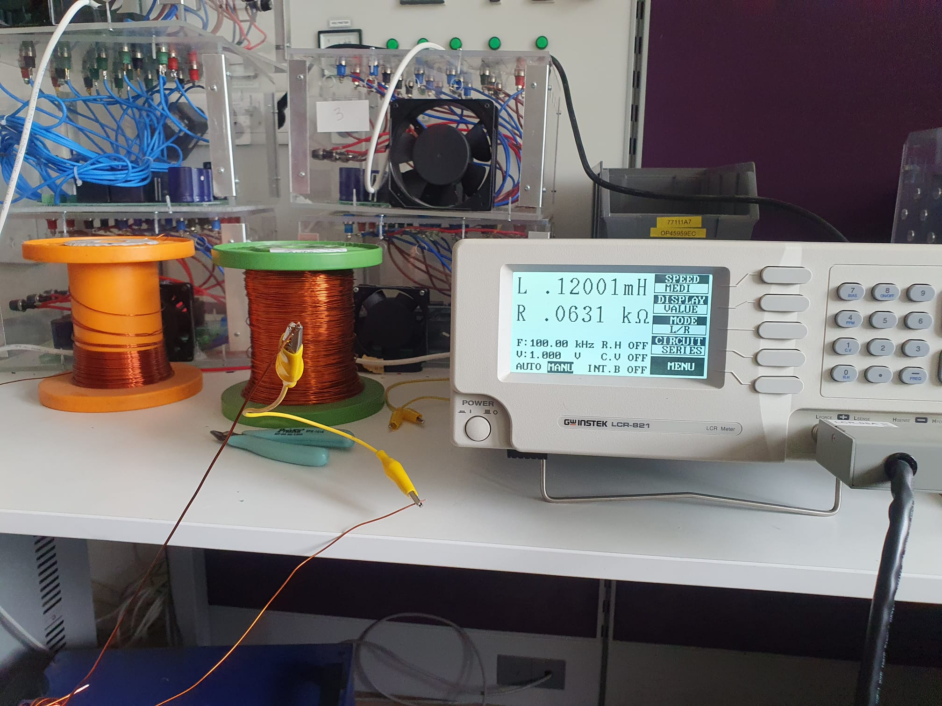
Experimental Results

Slide 12
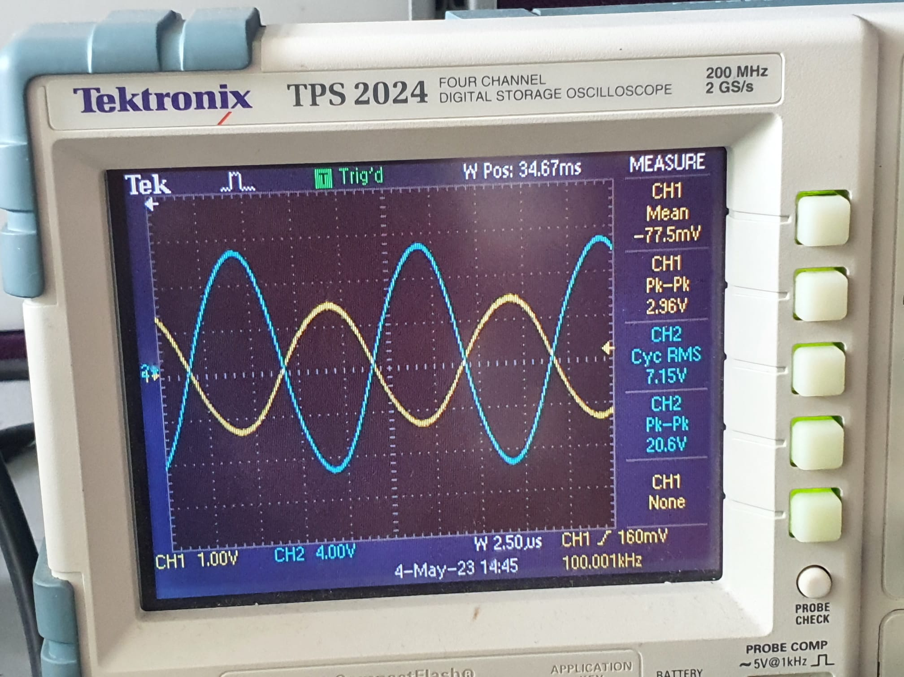
Experimental Results

Slide 13
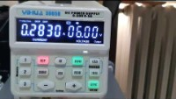
Experimental Results

Slide 14
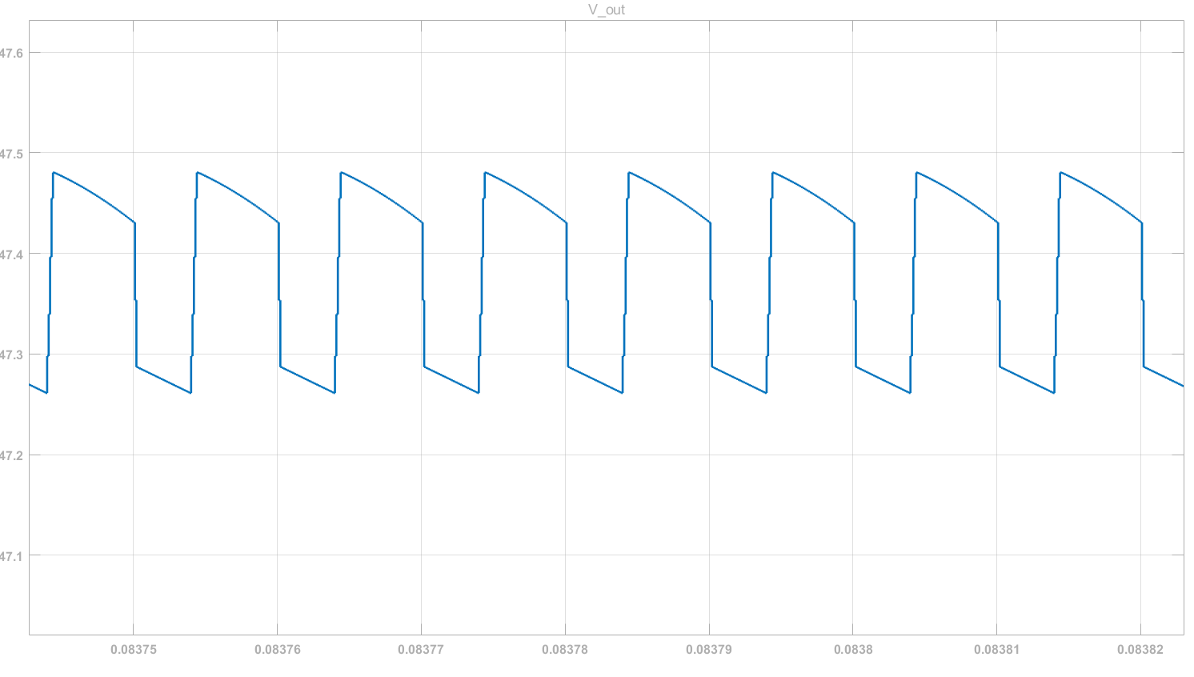
Simulation Results

Slide 15
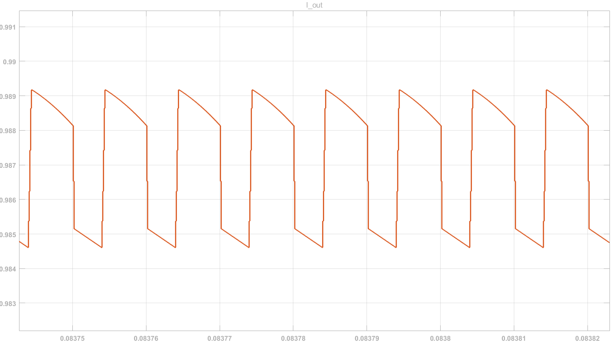
Simulation Results

Slide 16
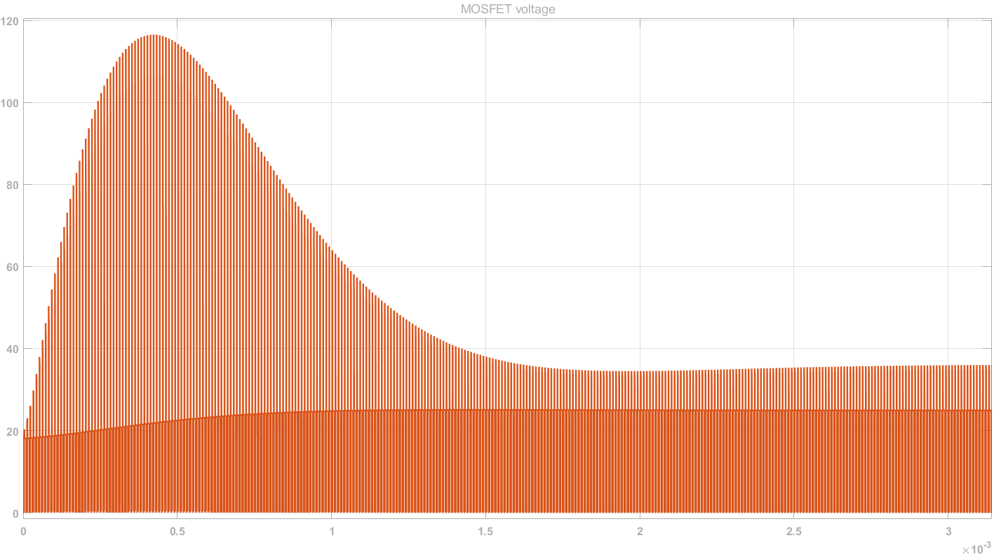
Simulation Results

Slide 17
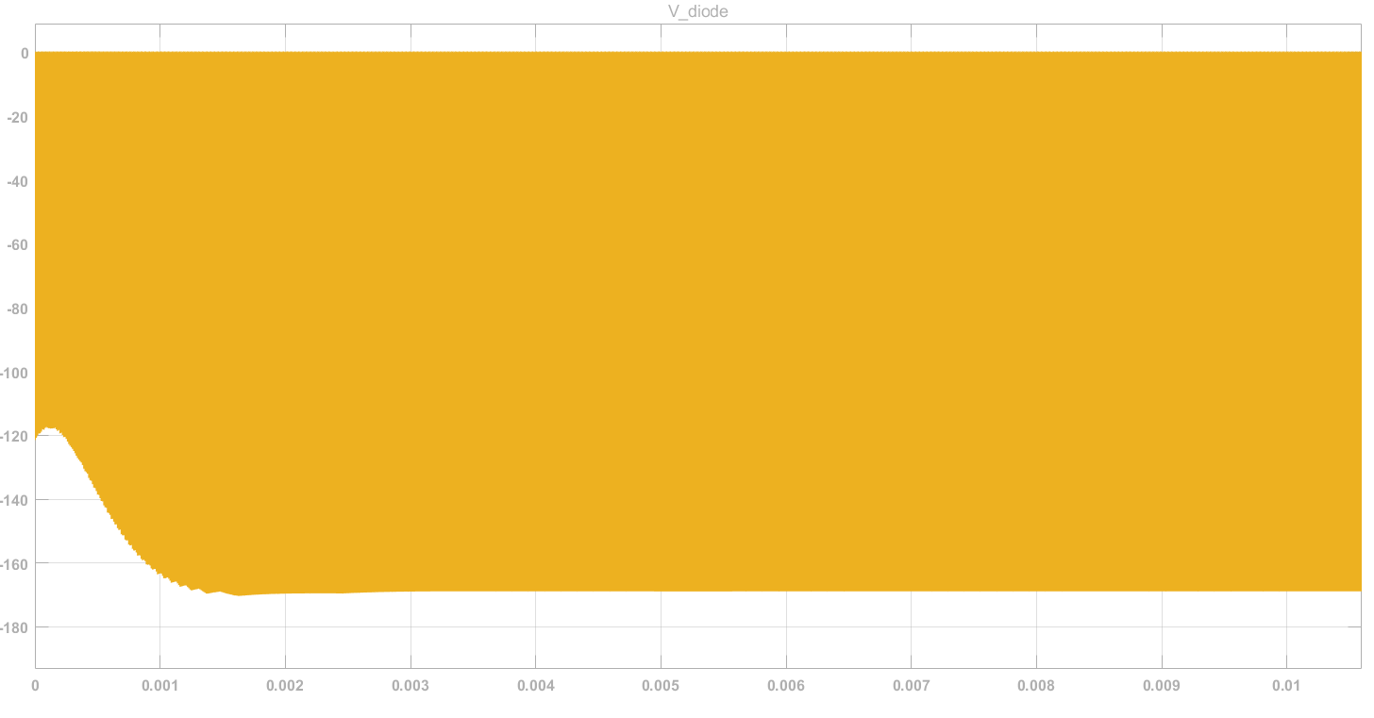
Simulation Results

Slide 18
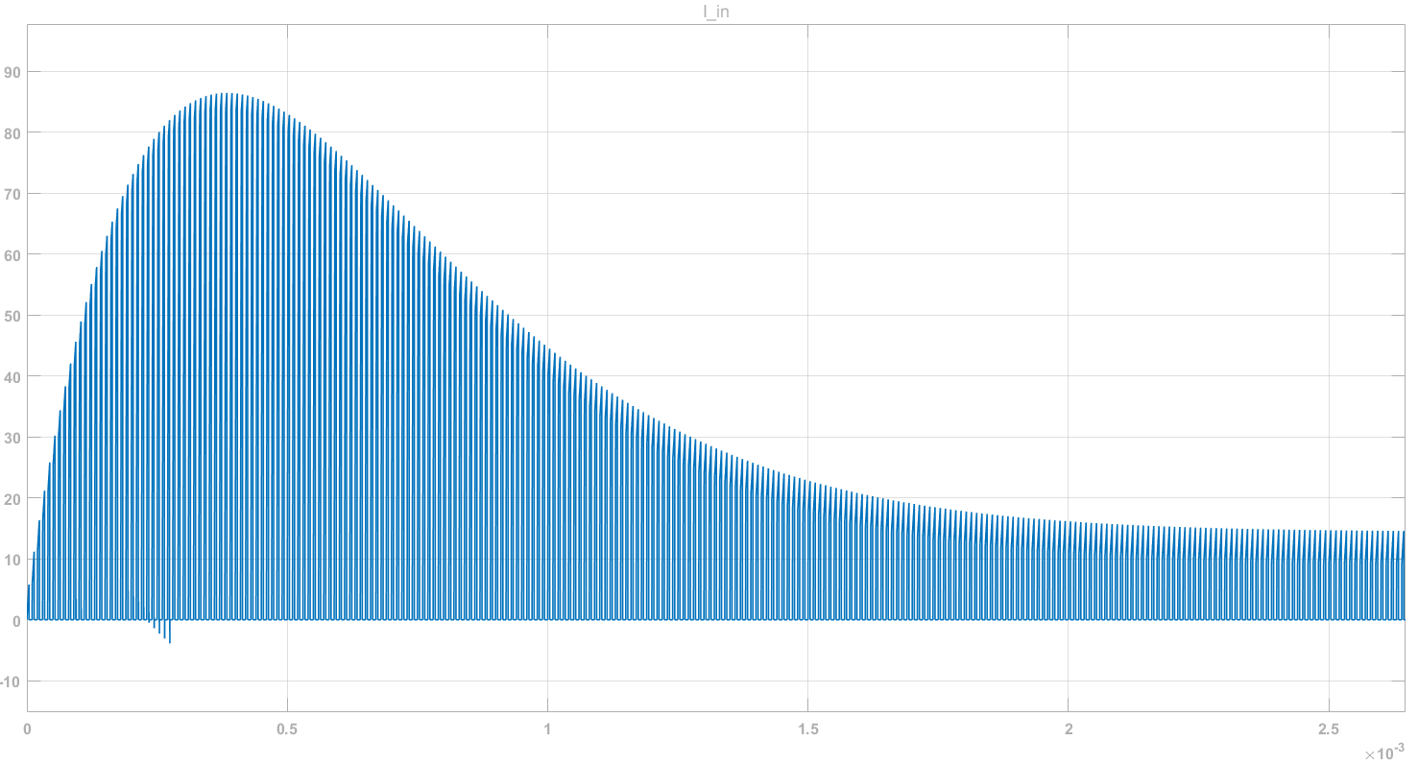
Simulation Results

Slide 19
Component Selection
MOSFET -> CSD19502Q5B
Vds = 80V, Ids = 100A, Rds = 3.8mΩ
DIODE -> SE10DTLJ
Vrrm = 600V, If = 10 A, Vf = 0.83 V
Output Capacitor
C = 47μF, V_rated = 100 V, ESR = 330mΩ

Slide 20
Conclusion
First implementations on perforated prototype board
Continue improving transformer design to reduce leakage inductance
Test and calibrate feedback and compensation of the controller IC

