Slide 1
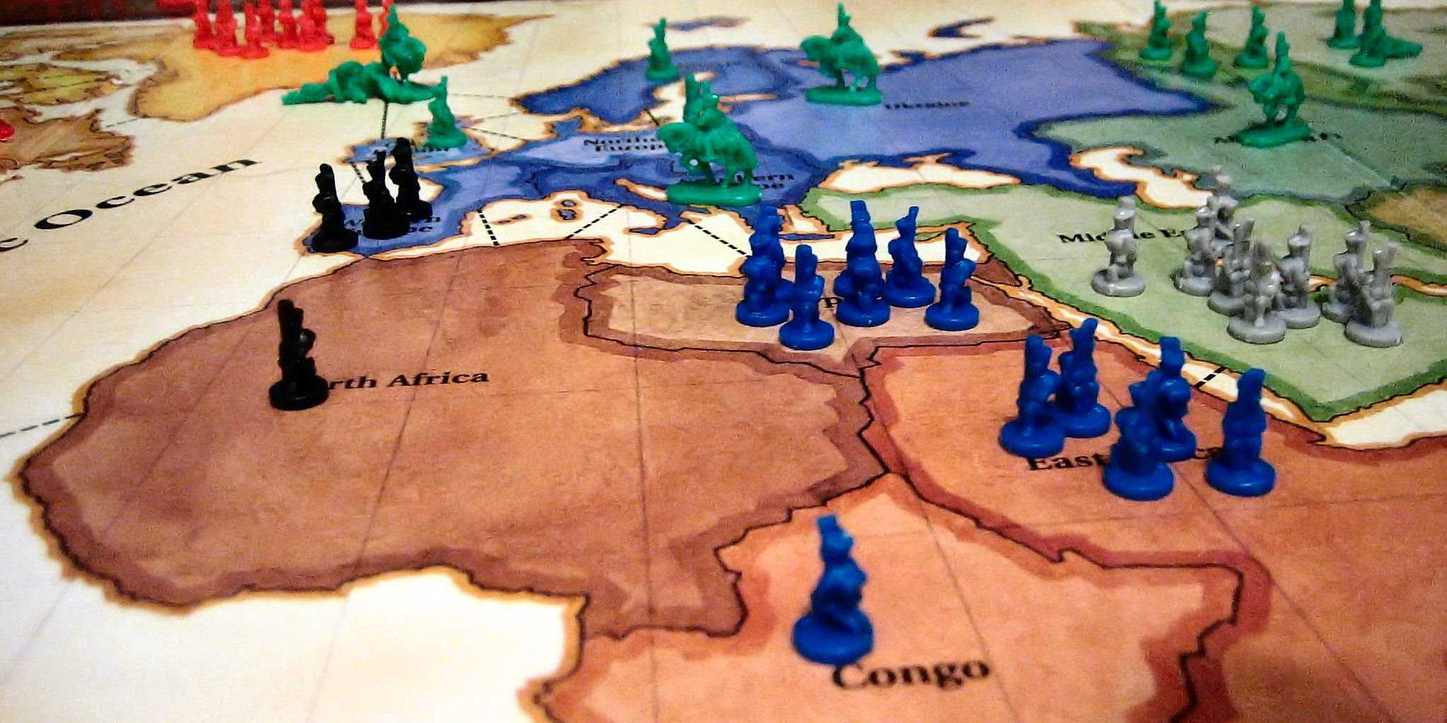
Risk Game Implementation
Mehmet Ceylan

Slide 2
Risk
Turn based game
2-6 Player
42 territory
If one player takes every territory, game over

Slide 3
Player turn
Getting and placing new armies
At the game start each player select territories one by one and than deploy given armies
Each player takes armies at the start of their turn according to the number of their territory number.
Each player takes armies at the start of game according to the number of player.

Slide 4
Player Turn
Attacking
Adjacent territories
Rolling Dice
Attacker rolling up to three dice
Defender rolling up to two dice
Each player's highest die is compared

Slide 5
Player turn
Fortifying
Player has the option to maneuver any number of armies

Slide 6
Implementation
Java
JavaFx
Fxml

Slide 7
Design
State Pattern
Each player have a state and traverse on that states at their turns according to game
SelectingTerritoryState
DeployingState
AttackingState
TransferState
EndGameState
UI Fxml (MVC)
Every UI Page have a contoller

Slide 8
