Slide 1
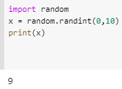
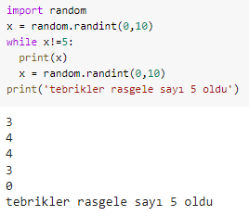
Adresi ile devam et
https://colab.research.google.com/drive/1r0WVGzu_7nNzEW_XdOGYT0jdB3HkBNJS#scrollTo=6pWihHcNlR1h

Slide 2
