Slide 1
Fruit Juice Dispenser
Berkan Alsancak Fatih Kıran
Mehmet Öztop Berk Şardan
Onur Üstün Cahit Kayın

Slide 2
Aim
Is to create a fruit juice dispenser that uses powdered fruit juice and a water supply. The process of mixing the powder with the water is going to be automated with a mixer division and the finalized fruit juice will be automatically poured into a cup with a simple activation. Therefore, the aim is to end up with fruit juice without manually stirring the mixture and without manually pumping the juice.

Slide 3
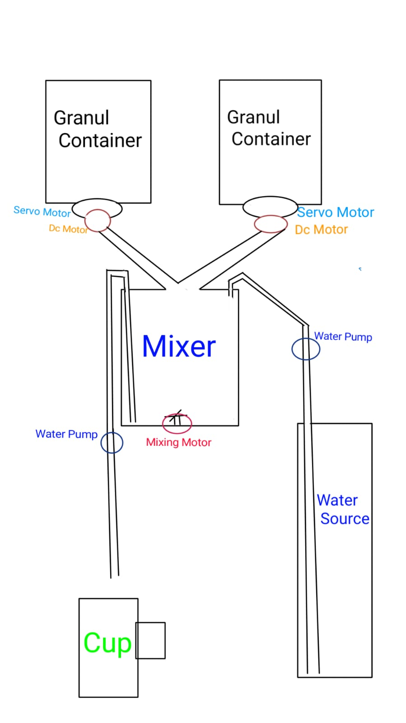
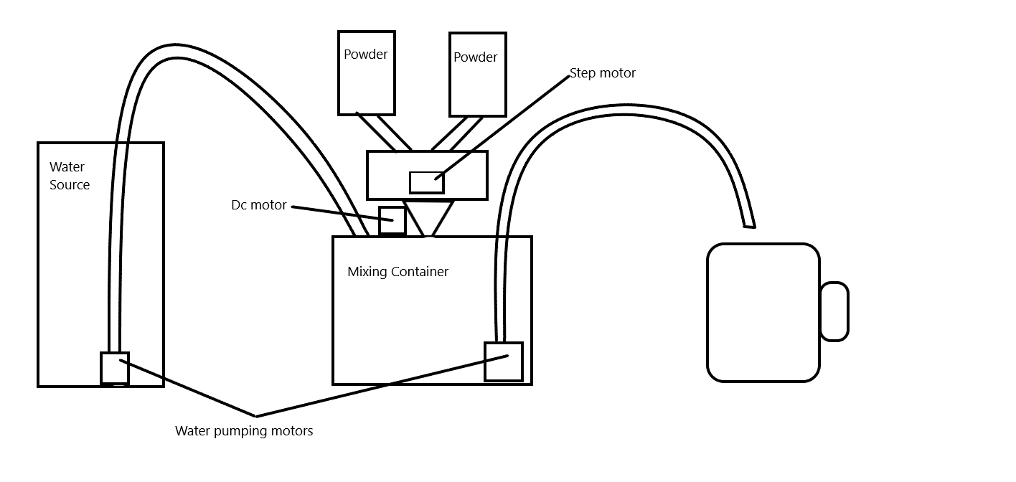
Design

Slide 4
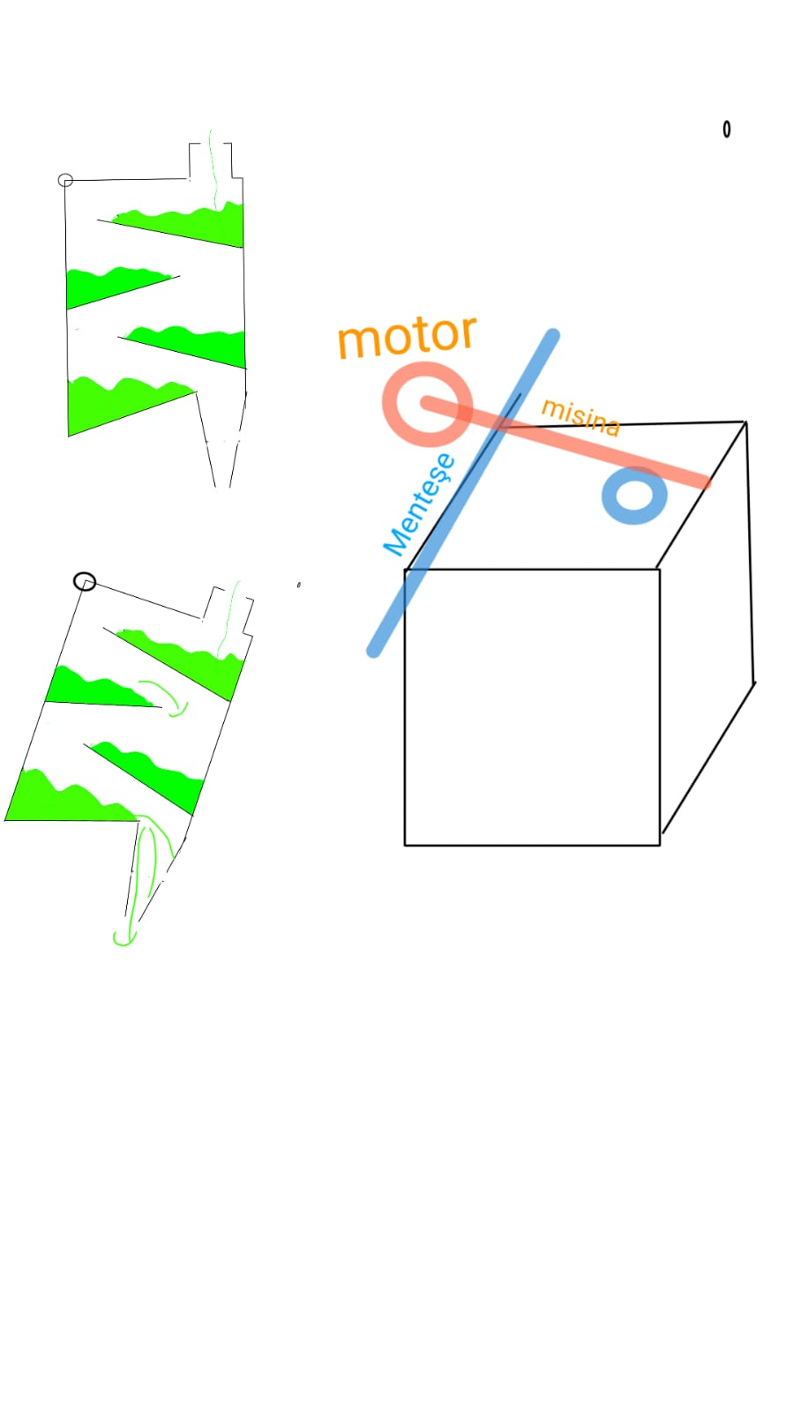
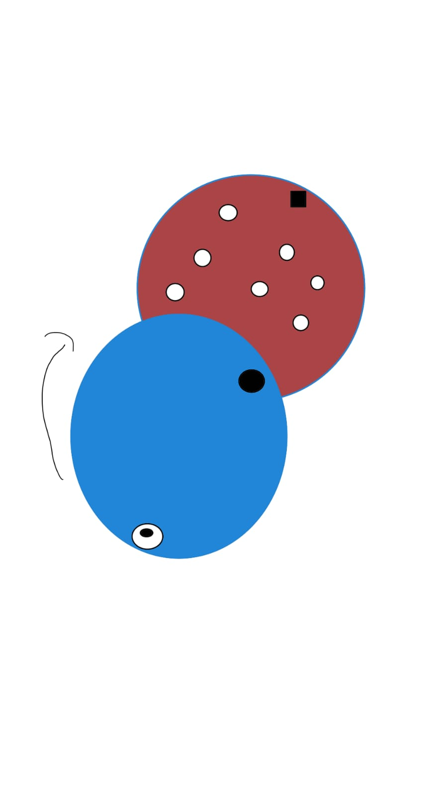
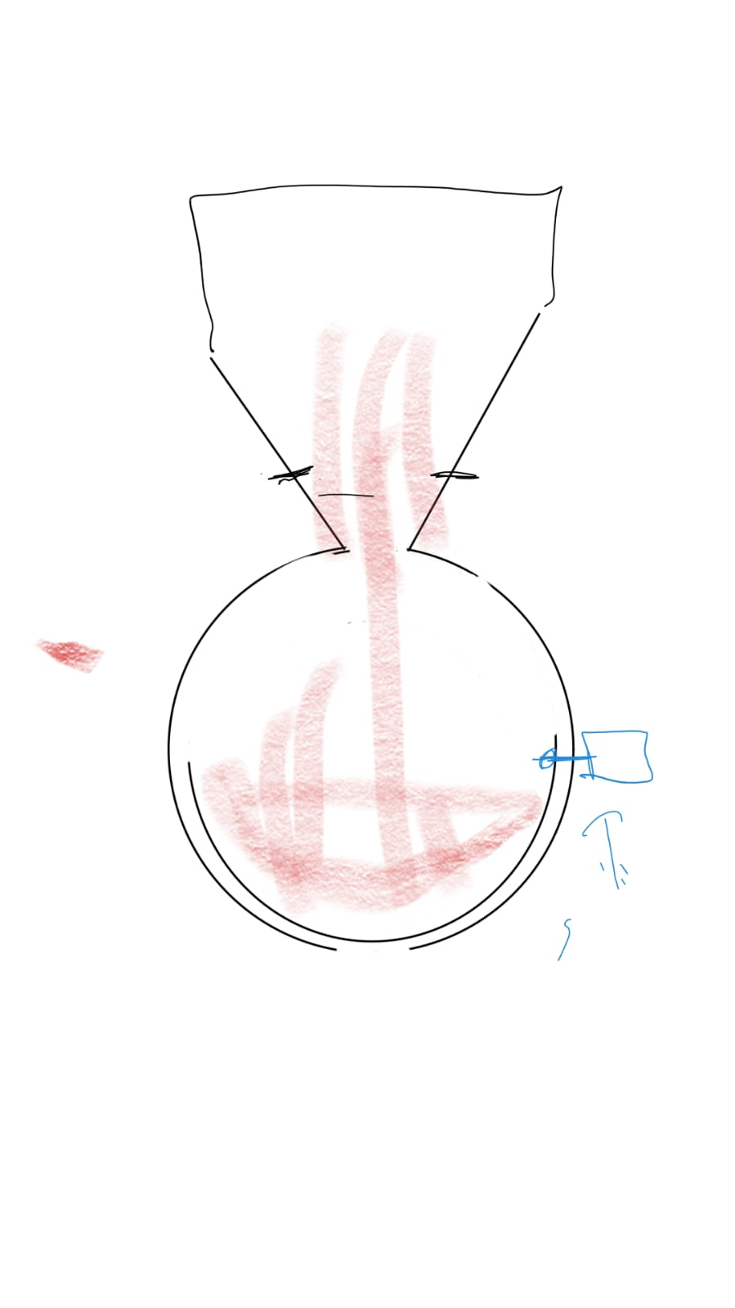
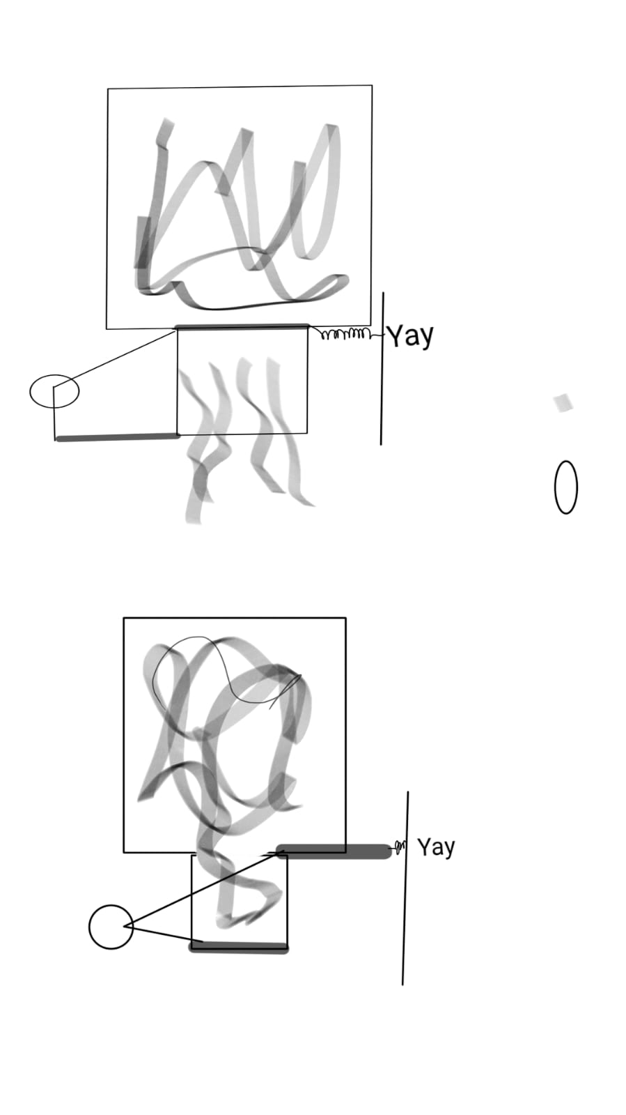
Powder box designs

Slide 5
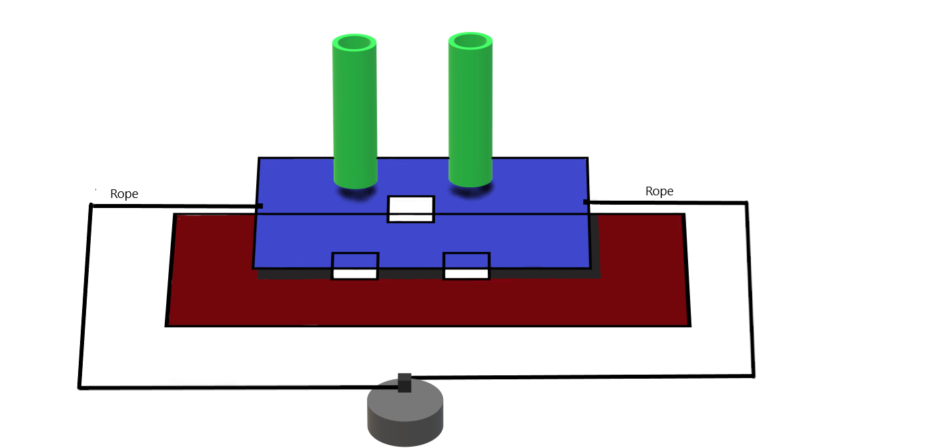
Powder box final design

Slide 6
MATERIALS
1x Arduino Mega,
1x 5V Step motor,
2x 6v DC motor, 1x DC motor driver
1x 5v DC motor,
1x LED light,
2x Push button,
1x Switch ,
1x Breadboard,
Jumper and copper cables,
2x 9V Battery.
1x 1.5V Battery

Slide 7
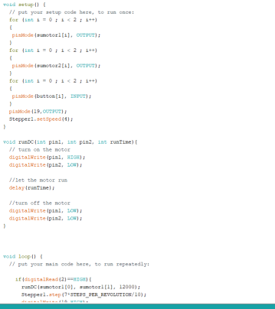
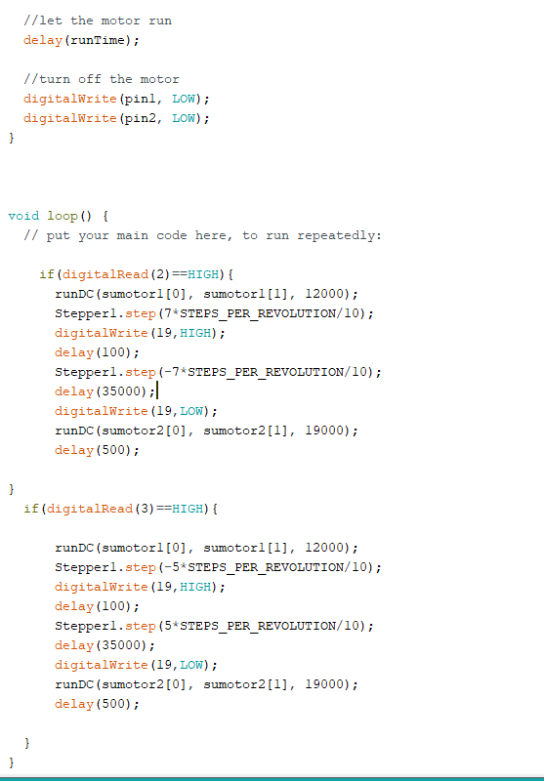
Codes

Slide 8
The Major Problems
Water leaking into the handmade water pump
Power supply problem
Running our software on the Arduino board
Incompatibility between the motors and the Arduino board
Loose connection on the cables leading to outages
Water leaking from the pipe junctions

