Slide 1
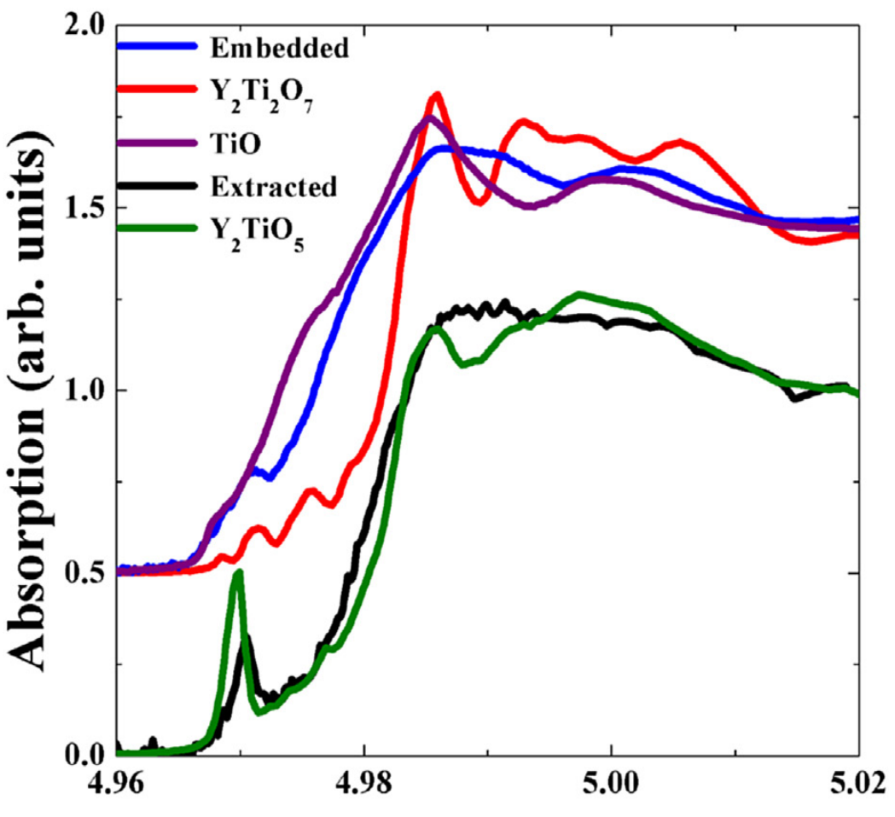
QUESTION-1:
Why is pre-edge peak in Y₂TiO₅
sharper compared to Y₂Ti₂O₇ ??

Slide 2
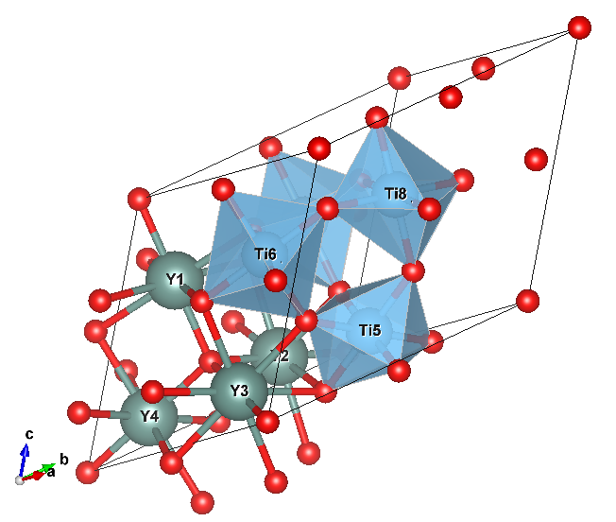
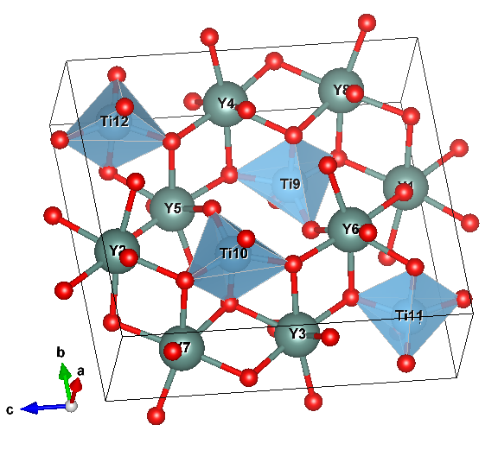
Y₂Ti₂O₇
6-coordinated
5-coordinated
Y₂TiO₅
QUESTION-1:
Why is pre-edge peak in Y₂TiO₅
sharper compared to Y₂Ti₂O₇ ??
ANSWER:
Because, all Ti ions of Y₂TiO₅ are 5-coordinated. On the other hand, Ti ions of Y₂Ti₂O₇ are 6-coordinated in octahedral environment. Broken inversion symmetry in 5-coordinated environment give rise to sharp pre-edge peaks.

Slide 3
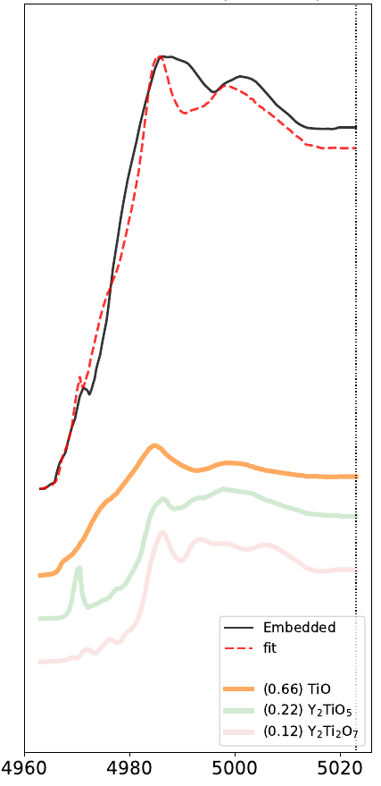
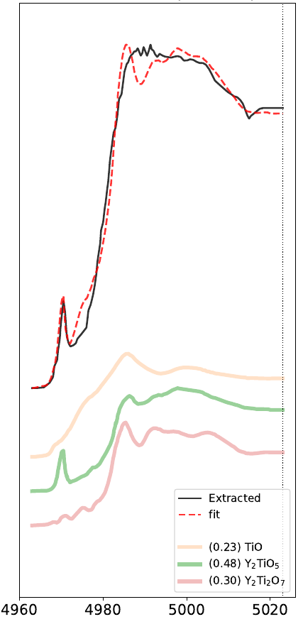
ANSWER: Yes !!
QUESTION-2:
Can we represent Embedded and Extracted spectra as a linear combination of TiO, Y₂Ti₂O₇, and Y₂TiO₅ spectra ?

Slide 4
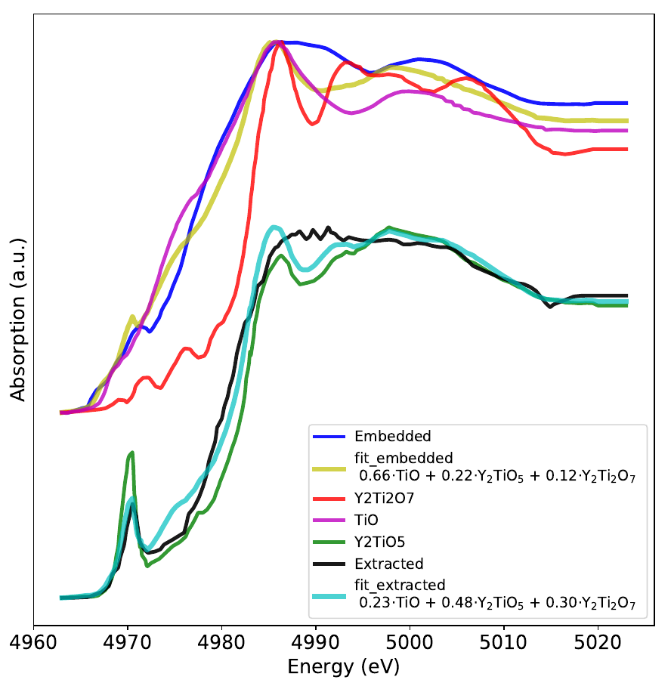
new
Conclusion-1: The decrease from 0.66 to 0.23 suggest that TiO nanoparticles are filtered.
Conclusion-2: 0.48 suggest that Y₂TiO₅ contribution is dominant in extracted spectrum.
Conclusion-3: Non-zero component from Y₇Ti,2O₇ suggests that Y₂TiO₅ co-exists withY₂TiO₅

