Slide 1
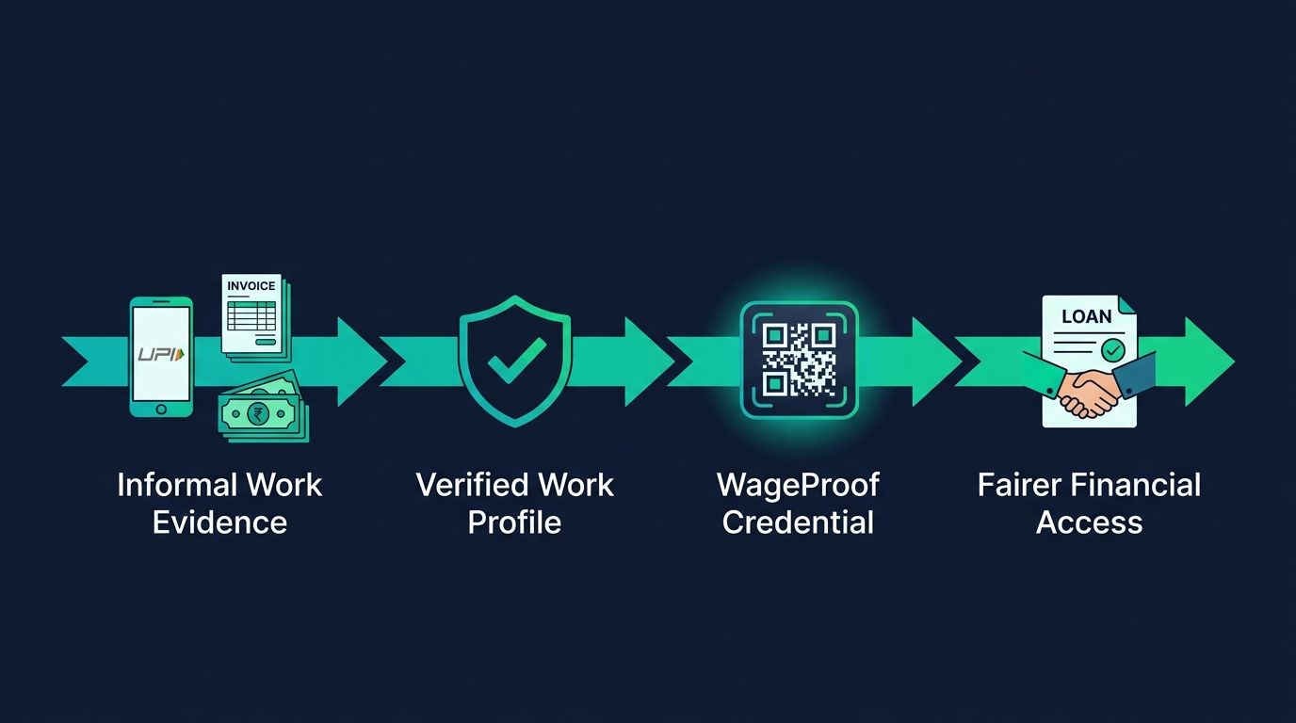
Track: Open Innovation | Inspired by Track 1 — Trust Scoring for the Credit-Invisible
WageProof
Turning informal work into trusted financial proof
A privacy-first financial readiness passport for India's informal workforce
Team Name: [Your Team Name] · Team Members: [Name 1] · [Name 2] · [Name 3] · Event: YEL Build Bank
"No salary slip should not mean no financial opportunity."

Slide 2
Problem Statement
02
Informal work is real — but often financially invisible
THE GAP
REAL-LIFE EXAMPLE
Formal lenders need salary slips, bank statements, and credit scores
Sana is a home-based tailor in Delhi. She has worked for over two years, receives UPI payments from repeat customers, and pays fabric suppliers regularly. When she needs a Rs.20,000 sewing-machine loan, she cannot show a salary slip or conventional credit history - her actual work remains invisible.
Informal workers receive income via UPI, cash, platform payouts & supplier transactions
A reliable worker may appear 'unscorable' or 'high risk' due to fragmented evidence
Sharing full bank statements exposes unrelated private expenses
Alternative credit models can be opaque and hard to challenge
Sana's Real Financial Life
Traditional Lending Requirement
UPI payments + cash Supplier bills & repeat customers Years of consistent work -> Financially RELIABLE
Salary slip + credit score Formal employer proof Bank statement -> Financially INVISIBLE
PROBLEM STATEMENT
How might we help informal workers convert fragmented work evidence into a consent-based, verifiable, privacy-preserving financial credential that lenders can understand and trust?

Slide 3
Proposed Solution & Key Features
03
WageProof: A portable work-and-income credential
1
2
3
4
5
6
Worker Gives Consent
->
Connects / Uploads Work Evidence
->
WageProof Verifies & Analyses
->
Generates Explainable Readiness Profile
->
Worker Shares QR Credential
->
Lender Sees Verified Claims
Feature
What WageProof Does
Value Created
Consent-first evidence vault
User selects only the records they want to share
Privacy & control
Work-evidence verification
Checks invoices, payout statements & attestations for consistency
Better evidence quality
Financial readiness profile
Measures work continuity, income consistency & payment discipline
Trust beyond a credit score
Explainable results
Shows what increased or limited the readiness result
No black-box decisions
QR-based shareable credential
Time-limited proof for lender, insurer, landlord, or merchant
Portable proof of economic activity
Revoke & delete controls
Allows the user to revoke a credential or withdraw consent
User data ownership
Proof-building guidance
Tells new workers what verified evidence strengthens their profile
Inclusion instead of rejection
EXAMPLE OUTPUT | Financial Readiness: 71/100 | Evidence Confidence: Moderate-High
Verified work continuity: 27 months | Estimated monthly income band: Rs.14,000-22,000 | Income-active weeks: 44 of 52 | Supplier-payment consistency: Good Recommended action: Manual review for a small flexible working-capital loan

Slide 4
Technology Stack
04
Secure, explainable, and scalable architecture
ARCHITECTURE
Layer
Technology
Purpose
Worker App / Web Portal
Frontend
Next.js / React + Tailwind CSS
Worker dashboard & lender portal
|
Backend
Python FastAPI
Secure REST APIs & orchestration
API Gateway
Database
PostgreSQL / Supabase
Profiles, consent logs, audit logs
|
Consent Svc | Evidence Vault | Feature Engine
File Storage
Supabase / Firebase Storage
Encrypted evidence-document storage
OCR Pipeline | Verification | Readiness Scoring
OCR
PaddleOCR / Tesseract
Extract dates, amounts, invoice IDs
Explanation API | Credential API | QR Verification
AI / ML
Python + Pandas + scikit-learn
Income-pattern & readiness model
|
Doc Checks
OpenCV + Image hashing + Rule checks
Detect duplicate / altered evidence
PostgreSQL / Supabase Storage
|
Credential
Signed JWT + QR code
Time-limited, verifiable credential
Lender / Verifier Portal
Visualisation
Recharts / Chart.js
Income trend & readiness breakdown
DATA PRIVACY DESIGN
Store only minimum evidence required for the selected purpose Share derived claims (income band, work-continuity duration) - not raw transactions Every credential is time-limited and revocable | Self-declared income clearly separated from verified evidence

Slide 5
Challenges
05
Designing trust without creating new risks
Challenge
Risk
WageProof Approach
Fragmented income
Income arrives through cash, UPI, platforms, and irregular jobs
Combine multiple optional signals; report ranges & confidence, not false precision
Fake documents
Invoices, payout screenshots, or letters may be altered
OCR + duplicate detection + metadata checks + consistency rules + verification status
Privacy concerns
Raw statements may expose personal spending & customer identities
Consent-based data sharing; disclose aggregates, not raw records
Algorithmic bias
A thin-file worker may be unfairly labelled risky
Separate 'insufficient evidence' from 'negative evidence'; route uncertain cases to human review
Low digital literacy
Users may not understand consent or technical scores
Hindi/Hinglish mode, visual summaries, and simple explanations
No lender integration
A hackathon prototype cannot operate lending services
Use synthetic data; present the product as an evidence layer for manual review
Regulatory boundaries
A model should not be treated as a credit bureau or automatic authority
Clearly state WageProof is decision support, not a final lending decision
ETHICAL PRINCIPLE
"A lack of formal evidence is not evidence of financial unreliability."

Slide 6
Future Scope
06
From prototype to an inclusive financial infrastructure
Phase 1
Phase 2
Phase 3
Strengthen the Prototype
Expand Financial Use Cases
Build an Ecosystem
✓ Hindi, Hinglish & voice-guided onboarding
✓ Small-ticket working-capital loans for vendors
✓ Partner with gig platforms, worker collectives & NGOs
✓ More evidence types: platform payouts, GST invoices, UPI summaries
✓ Flexible repayment for variable-income workers
✓ Digitally signed attestation flows for repeat clients
✓ Stronger tamper & fraud detection pipeline
✓ Insurance eligibility & affordable premium plans
✓ Privacy-preserving verification for institutions
✓ Transparent 'Build My Proof' checklist
✓ Rental / EMI eligibility via consented credential
✓ Fairness dashboards auditing performance across cohorts
✓ Usability testing with workers, lenders & NGOs
✓ Merchant & supplier trust profiles for B2B credit
✓ Reusable portable Financial Readiness Passport
Metric
What It Measures
Credential completion rate
Whether workers can successfully build proof
Verified-evidence coverage
Share of claims supported by strong evidence
Time to create a credential
Ease of onboarding and usability
Manual-review acceptance rate
Whether credentials help lenders assess applicants
Fairness gap across groups
Whether the model treats diverse workers equitably

Slide 7
Thank You
WageProof
Proof of work. Path to opportunity.
"A person should not be financially invisible simply because their work is informal."
Informal Work -> Verified Proof -> Fairer Opportunity
Team: [Your Team Name]
Members: [Names]
Contact: [Email / LinkedIn / GitHub]

