Slide 1
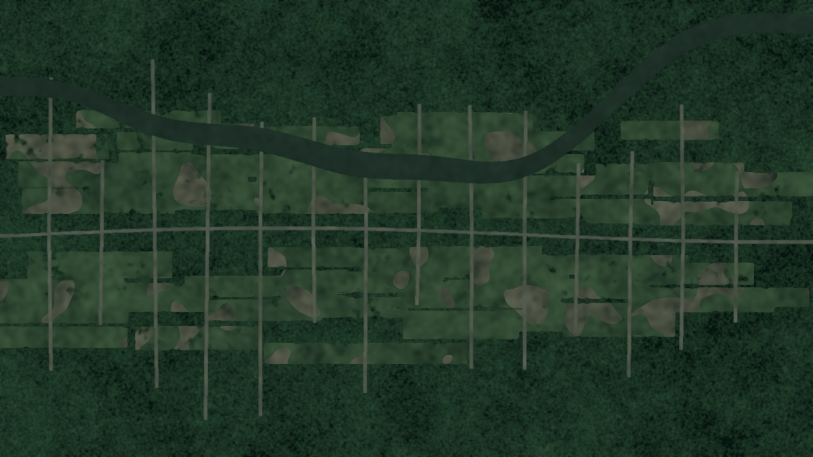
DATA SCIENCE II | PROJECT
Monitoring Deforestation and Land-Use Change in the Amazon
Using Deep Learning on Satellite Imagery
Oluwa Koretimi Adebowale
Josselin Jimenez
Mehrab U Azan
Data and preprocessing
Modelling
Evaluation and interpretability
40,479 tiles · 17 labels · 5 matched experiments · best macro F2 0.696 · per-tile F2 up to 0.911
Background: illustrative synthetic imagery, not real satellite data.
Notes:
PRESENTER: Oluwa Koretimi Adebowale
DO: Stand together. Koretimi steps forward and starts. Make eye contact before speaking.
SAY:
Good morning, everyone. I'm Koretimi Adebowale, and with me are Josselin Jimenez and Mehrab Azan. Our question is simple: can a neural network look at a satellite photo of the Amazon and tell us what's happening on the ground?
I'll set up the problem and the data. Josselin covers the models and results, and Mehrab the limits and the evidence.

Slide 2
KORETIMI
Progress is real, but the forest is still shrinking
5,796 km²
PRODES deforestation in 2025, down 11.08% from 2024
2,874 km²
DETER alerts, Aug 2025 to Jul 2026: lowest in the DETER series (36% below prior year)
Every year
Enforcement still depends on spotting new clearing early
Sources: INPE PRODES / DETER via O Liberal (2025) and Mongabay (Aug 2026); 2004, 2012, 2021 from INPE PRODES.
Monitoring Deforestation in the Amazon | Data Science II
Notes:
PRESENTER: Oluwa Koretimi Adebowale
DO: Point to the three stat cards, then sweep your hand across the bar chart from left to right.
SAY:
Recent news is encouraging. Brazil's PRODES program measured five thousand seven hundred ninety-six square kilometers of deforestation in 2025, down eleven percent, and DETER alerts for August 2025 to July 2026 are thirty-six percent lower, the lowest in the DETER series.
But look at the chart: twenty-seven thousand in 2004, a low of forty-five hundred in 2012, then back above thirteen thousand in 2021. Progress only holds if clearing gets spotted early.

Slide 3
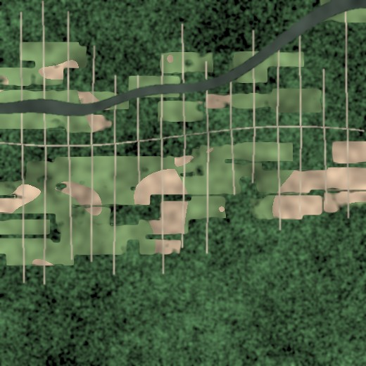



KORETIMI
Why we need machines to watch the forest
Scale
The basin is far too large for analysts to review tile by tile.
Speed
Automated tagging could surface new clearing faster: a potential application, not measured here.
Consistency
One model applies the same rules to every tile, every pass.
Illustrative synthetic tile: clearings branching off a road and river
Monitoring Deforestation in the Amazon | Data Science II
Notes:
PRESENTER: Oluwa Koretimi Adebowale
DO: Tick off the three words on your fingers: scale, speed, consistency.
SAY:
So why machines? Scale: the Amazon is too big to review tile by tile. Speed: if clearing could be flagged quickly, a patrol could still reach it. Consistency: one model applies the same rules everywhere. We give people a tireless first pass.

Slide 4
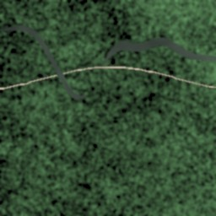
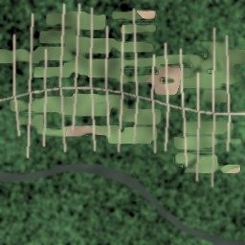
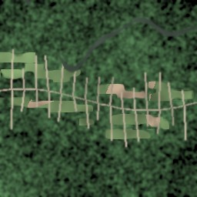
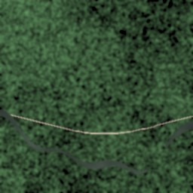
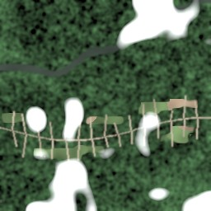
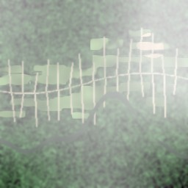
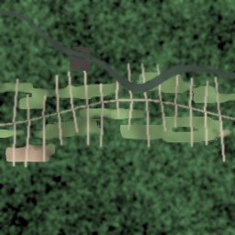
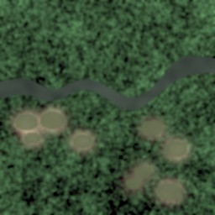
KORETIMI
The data: Planet's Amazon-from-space image chips
40,479
17 labels
labeled image chips, all used (no subsampling)
weather + land cover + land use
primary forest
agriculture
road
water
3 to 5
128 × 128
input channels from the 4-band TIF: RGB (3), + NIR (4), + NIR + NDVI (5)
model input size, resized from 256 × 256 chips
partly cloudy
haze
slash & burn
artisanal mine
Each tile can carry several labels at once, e.g. clear + primary + agriculture + road.
Tiles shown are illustrative synthetic renderings, not dataset images.
Monitoring Deforestation in the Amazon | Data Science II
Notes:
PRESENTER: Oluwa Koretimi Adebowale
DO: Gesture to the four number cards on the left, then to the eight example tiles on the right.
SAY:
Our data is the Kaggle competition Understanding the Amazon from Space, built on Planet imagery. We use all forty thousand four hundred seventy-nine labeled chips, each with seventeen labels.
Worth knowing: every model reads the same four-band TIF files. RGB models use three channels, model E adds near-infrared for four, and B and D add a derived NDVI for five. Tiles are resized to one hundred twenty-eight pixels.

Slide 5


KORETIMI
A multi-label problem, and three things that make it hard
Single-label
Multi-label (ours)
Softmax output
Classes compete: probabilities sum to 1
Forces a choice: forest OR farm
17 independent sigmoid outputs
Binary cross-entropy per label
Forest AND road AND haze can all be true
clear
primary
agriculture
road
Severe class imbalance
Clouds and haze
Mixed land use
Blow-down and artisanal mining appear in under 1% of tiles.
Weather hides the ground and can mimic bare soil.
One chip often holds forest, road and farmland together.
Monitoring Deforestation in the Amazon | Data Science II
Notes:
PRESENTER: Oluwa Koretimi Adebowale
DO: Left hand = single label, right hand = multi-label. Then hold up three fingers for the challenges.
SAY:
This isn't ordinary classification. One tile can be clear, primary forest, agriculture, and have a road, all at once. A softmax would force one choice, so we give the network seventeen independent sigmoid outputs, a separate yes or no for every label.
Three things make it hard: imbalance, with blow-down in under one percent of tiles; haze that hides the ground; and mixed land use in one tile.

Slide 6
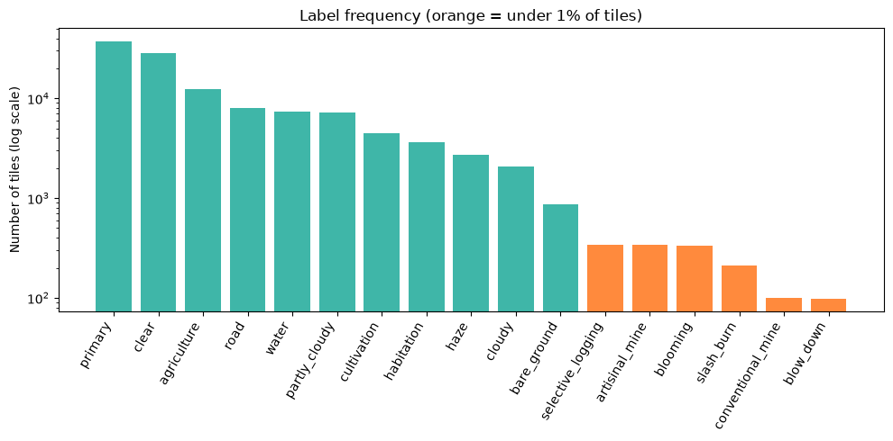
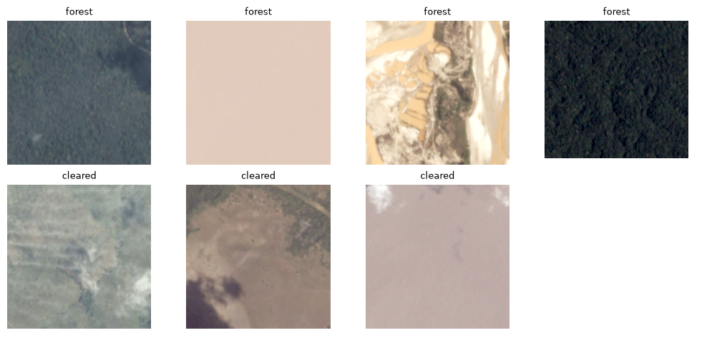
KORETIMI
What the data really looks like
70 / 15 / 15
~100 tiles
train / val / test split: 28,335 · 6,072 · 6,072 tiles, stratified on each tile's rarest label
blow_down and conventional_mine: the rarest labels, about 0.25% of the data
15 tiles
9 in 10
blow_down tiles in the test set. Rare-class scores carry real uncertainty
tiles contain primary forest, so accuracy alone would be misleading
Left: real label counts (orange = under 1%) and real chips.
Monitoring Deforestation in the Amazon | Data Science II
Notes:
PRESENTER: Oluwa Koretimi Adebowale
DO: Point to the orange bars on the chart; they are the rare labels. Then point to the real forest-versus-cleared chips.
SAY:
Now the real data. On this log scale, primary forest appears in over nine of ten tiles, while the orange bars, the rare labels, sit under one percent. Blow-down and conventional mining have only about a hundred tiles each.
We split seventy, fifteen, fifteen, stratified on each tile's rarest label: twenty-eight thousand training tiles, about six thousand each for validation and test. The test set has just fifteen blow-down tiles, so rare-class results are uncertain.

Slide 7






KORETIMI
Our approach: from raw chips to explained predictions
Satellite chips
›
Preprocess
›
Augment + rebalance
›
CNN classifier
›
Tune thresholds
›
Evaluate + explain
40,479 TIF tiles, 3 to 5 input channels, 128×128
Clip bands at 1st–99th percentile; standardise
8 orientations, oversample rare labels
17 sigmoid outputs, weighted BCE loss
Per-label cutoffs optimised for F2
F2, recall, Hamming loss, Grad-CAM
All five experiments share one TIF cache, split, seed and training framework, so the input comparisons are matched.
28,335 training tiles
6,072 validation tiles
6,072 test tiles
Monitoring Deforestation in the Amazon | Data Science II
Notes:
PRESENTER: Oluwa Koretimi Adebowale
DO: Walk your hand along the six boxes from left to right as you name each stage.
SAY:
Our pipeline has six steps: chips in, preprocessing that clips each band by percentile, augmentation and rebalancing, a CNN with seventeen outputs, a tuned threshold for each label, then evaluation and explanation. All five experiments share one TIF cache, split, seed, and training framework, so the input comparisons are matched.

Slide 8
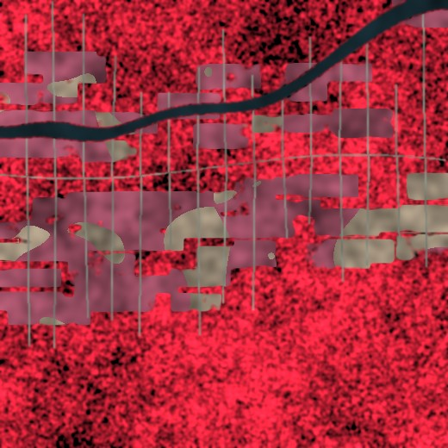
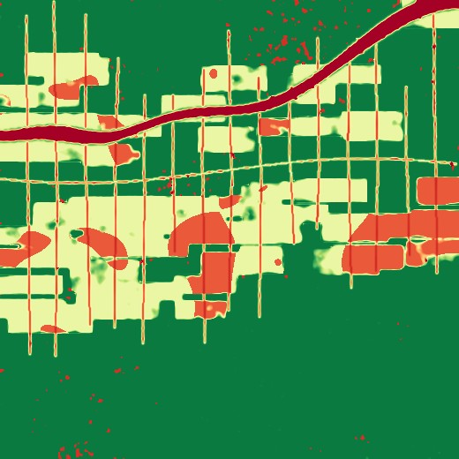


KORETIMI
NDVI, and fighting class imbalance
Rotations and flips
Top-down imagery has no fixed 'up': 8 orientations in training, averaged at test time.
Oversample rare labels
Tiles with rare labels are drawn more often each epoch.
Visible (RGB)
Near-infrared
NDVI channel
NDVI = (NIR − Red) / (NIR + Red)
dense green vegetation: high positive (often 0.6 to 0.9); bare soil: near 0; water: low or negative
Class-weighted loss
Weight = √((1−f)/f), clipped 1 to 10, so a missed rare label costs more.
Matched: all five models use the 4-band TIFs
Per-label thresholds
Tile-averaged NDVI check: mean NDVI over tiles carrying each label (mixed pixels, so values are lower than pure canopy): primary 0.38, agriculture 0.34, water 0.25. Panels above are illustrative.
Cutoffs tuned on validation data, grid 0.02 to 0.80, for best F2.
Monitoring Deforestation in the Amazon | Data Science II
Notes:
PRESENTER: Oluwa Koretimi Adebowale
DO: Left half first (NDVI), then the four techniques on the right. Finish by turning toward Josselin.
SAY:
Quick word on NDVI. It's near-infrared minus red, over their sum. Dense green vegetation is typically high, often point six to point nine; bare soil is near zero; water is low or negative. Our check passed: forest tiles averaged highest, water lowest.
For imbalance: rotations and flips, since a satellite has no real 'up'; oversampling; a weighted loss; and per-label thresholds. Josselin will show you the models.
[HAND-OFF to Josselin]

Slide 9
JOSSELIN
Models and the experiment grid
Baseline: CNN from scratch
Five experiments, one TIF dataset
4 blocks of 2 × (3×3 conv + BatchNorm + ReLU) + max-pool, 32 → 256 channels, global pooling, dropout 0.3, 17-way head. Shows what the data alone can teach.
RGB only
RGB + NIR + NDVI
A
B
Scratch CNN
1,177,585 trainable parameters (RGB input)
F2 0.688
F2 0.673
C
D
Transfer learning: ResNet-34
Pretrained
ImageNet-pretrained ResNet-34 with a new 17-way head. For NDVI models the first convolution is widened: RGB weights copied, NIR and NDVI initialised from their mean.
F2 0.696 (best)
F2 0.686
E ResNet-34, RGB + NIR: F2 0.690. Separates NIR (E − C) from NDVI (D − E).
21,293,393 parameters, 18× the scratch CNN
Monitoring Deforestation in the Amazon | Data Science II
Notes:
PRESENTER: Josselin Jimenez
DO: Point to the left cards, then read the 2-by-2 grid (A and C, then B and D), then the yellow E card below.
SAY:
Thanks, Koretimi. Two models: a CNN from scratch, four blocks with about 1.2 million parameters, and a ResNet-34 pretrained on ImageNet, with twenty-one million.
Crossing model and input gives the grid: A and C use RGB, B and D add infrared and NDVI. Model E, a ResNet on RGB plus infrared, lets us separate the infrared effect from NDVI.

Slide 10
JOSSELIN
Training recipe: one setup, a fair comparison
14
AdamW
√((1−f)/f)
epochs, batch size 128
+ OneCycle schedule, peak lr 3e-3 (scratch) / 1e-3 (ResNet)
per-label loss weight (f = training frequency), clipped to 1–10
Oversample
8 views
Seed 42
rare-label tiles are drawn more often each epoch
rotations + flips averaged at test time
mixed precision on GPU, thresholds tuned on validation only
Monitoring Deforestation in the Amazon | Data Science II
Notes:
PRESENTER: Josselin Jimenez
DO: Read the six big numbers quickly, like a scoreboard. Do not read the small text.
SAY:
A shared framework: fourteen epochs, batch one hundred twenty-eight, AdamW with a one-cycle schedule, seed forty-two, model-specific peak learning rate. Rare tiles are drawn more often. Each label's loss weight is the square root of one minus f over f, f being its training frequency, clipped between one and ten. We average eight views at test time.

Slide 11



JOSSELIN
Why F2? Missing deforestation costs more
F₂ = 5 · P · R / (4 · P + R)
Targets set before training
Recall is weighted more than precision, matching enforcement: a missed clearing is lost forest, a false alarm is a quick check.
≥ 0.85
macro F2 across all 17 labels
Worked example: precision 0.50, recall 0.80 gives F2 = 0.714 but F1 = 0.615, so catching more clearings is rewarded.
≥ 0.60
mean recall across the 4 rare labels: both mines, selective logging, slash-and-burn
Macro F2 gives rare labels the same weight as common ones
Accuracy alone would hide the imbalance
NDVI > RGB
a measurable gain over the RGB-only baseline
Per-label thresholds tuned on validation data only
Rare-class recall reported separately: the real mission
Monitoring Deforestation in the Amazon | Data Science II
Notes:
PRESENTER: Josselin Jimenez
DO: Point to the formula, then to the three targets on the right. Say 'targets' clearly.
SAY:
We score with F2, which weights recall above precision: a missed clearing is lost forest, a false alarm is a quick check. We use macro F2 so rare labels count equally.
Before training we set three targets: macro F2 of at least point eight five; mean recall of at least point six across the four rare classes; and the NDVI configuration beating RGB.

Slide 12
JOSSELIN
Where published models land on this dataset
Takeaways
Our RGB models reach per-tile F2 of 0.902 and 0.911: a different metric from our 0.85 macro target.
ResNet-34 sits about 0.02 below a published ensemble.
Our focus is rare-class recall and honest evaluation, not leaderboard chasing.
0.911 vs 0.931
ResNet-34 vs a published CS231n ensemble: a gap of 0.020, with no ensembling or soft-F2 loss.
Sources: see slide 25. Splits differ between sources, so the comparison is indicative only.
Monitoring Deforestation in the Amazon | Data Science II
Notes:
PRESENTER: Josselin Jimenez
DO: Point to the two orange bars labeled 'Ours'.
SAY:
For context, using the Kaggle metric: random forest point seven five, VGG16 point eight three, a simple CNN about point nine, and a published ensemble point nine three. Ours: point nine zero two for scratch and point nine one one for ResNet-34. That's per-tile F2, not our macro target, and splits differ.

Slide 13


JOSSELIN
Experiment scorecard: five matched runs
Experiment | Macro F2 | Per-tile F2 | Mean rare recall | Hamming loss
A Scratch CNN, RGB | 0.688 | 0.9023 | 0.684 | 0.0678
B Scratch CNN, RGB+NIR+NDVI | 0.673 | 0.9028 | 0.656 | 0.0665
C ResNet-34, RGB | 0.696 | 0.9106 | 0.5998 | 0.0614
D ResNet-34, RGB+NIR+NDVI | 0.686 | 0.9111 | 0.628 | 0.0589
E ResNet-34, RGB+NIR | 0.690 | 0.9100 | 0.633 | 0.0622
None of our six bootstrap comparisons reached significance (mean diff. in macro F2, 95% CI)
ResNet vs scratch (C − A)
NIR added (E − C)
NDVI on top of NIR (D − E)
+0.008 [−0.012, +0.029]
−0.006 [−0.022, +0.010]
−0.004 [−0.019, +0.013]
ResNet vs scratch, +NDVI (D − B)
NIR + NDVI, ResNet (D − C)
NIR + NDVI, scratch (B − A)
+0.013 [−0.004, +0.029]
−0.010 [−0.028, +0.009]
−0.014 [−0.033, +0.004]
Macro F2 ≥ 0.85
Mean rare recall ≥ 0.60
NDVI > RGB
best 0.696 (C): missed
4 of 5 met; C just below (0.5998)
not supported: no significant gain
Monitoring Deforestation in the Amazon | Data Science II
Notes:
PRESENTER: Josselin Jimenez
DO: Point to the table, then the six comparisons, then the chart. For the three pills say 'missed', 'met', and 'not supported' with a steady tone.
SAY:
The scorecard: five runs on matched data. Macro F2 sits between point six seven three and point six nine six, with the RGB ResNet, model C, on top.
The bootstrap tells the real story: none of our six comparisons reached significance. ResNet versus scratch, plus point zero zero eight; adding infrared, minus point zero zero six; adding NDVI on top, minus point zero zero four.
Against targets: macro F2 of point eight five, missed. Mean rare recall of point six, met by four models; model C just misses at point five nine nine eight. NDVI beating RGB, not supported.

Slide 14
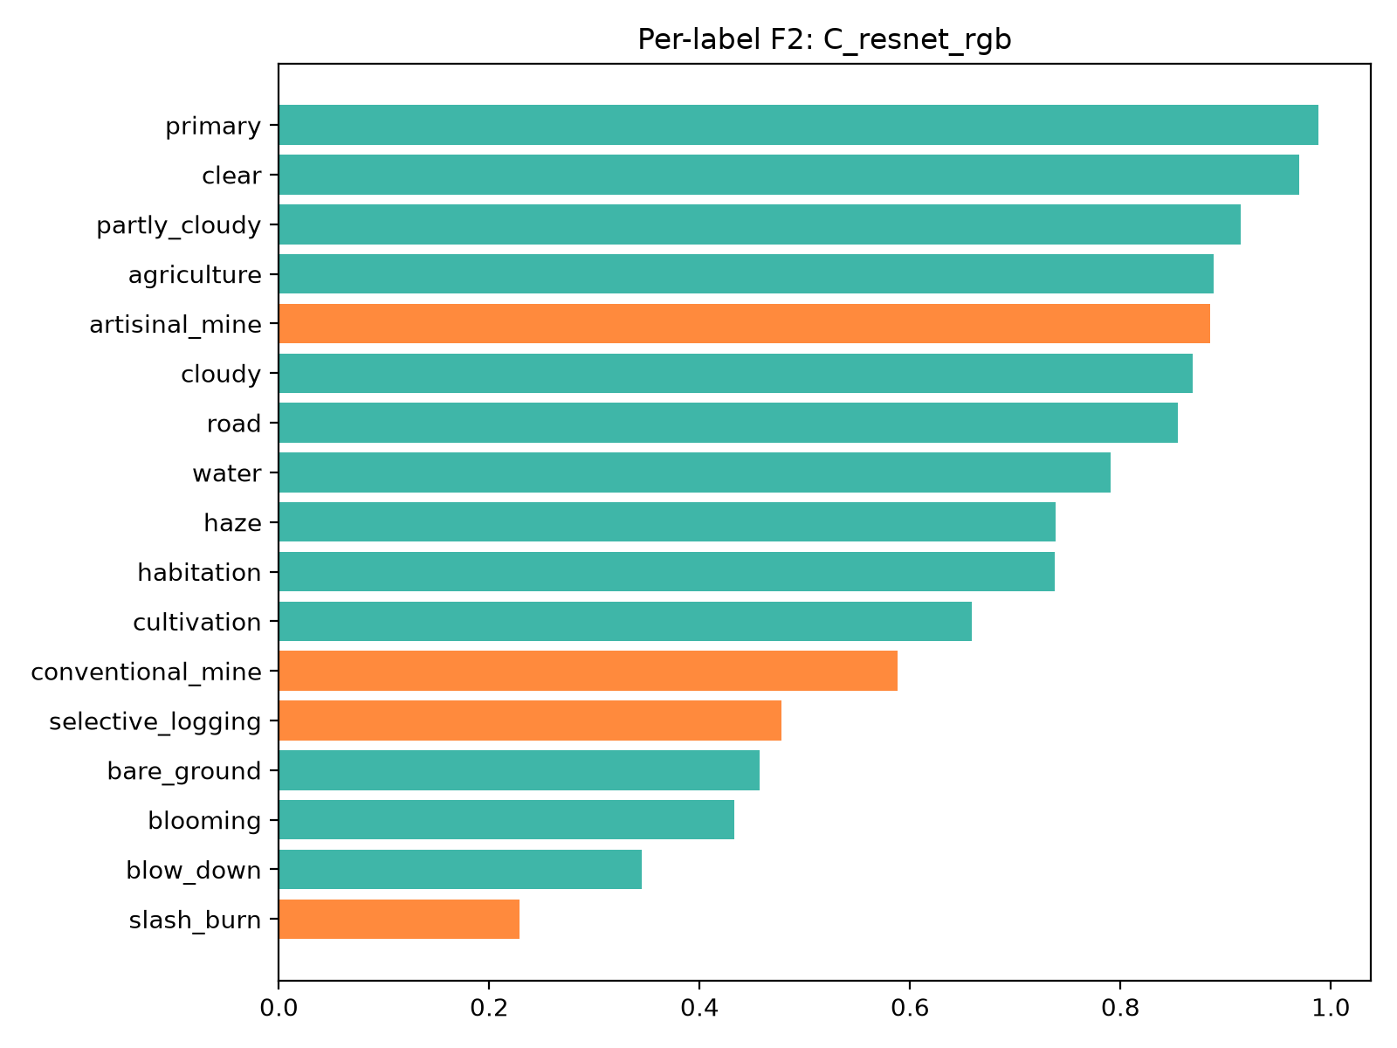
JOSSELIN
Per-label results: where the model wins and struggles
Strong
primary 0.99 and clear 0.97; artisanal mine F2 0.89, recall 0.94
Struggling
slash-and-burn F2 0.23, blow-down 0.35, selective logging 0.48; NIR and NDVI did not fix them
Model C (best macro F2), test set. Orange = the four rare labels with recall targets; blow-down and blooming are also rare. All five models: slide 23.
Monitoring Deforestation in the Amazon | Data Science II
Notes:
PRESENTER: Josselin Jimenez
DO: Point to the top of the per-label chart, then the orange bars, then the recall chart on the right.
SAY:
Macro F2 sits below per-tile F2 because every label counts equally. Primary and clear score above point nine six. The struggles are slash-and-burn, blow-down, and selective logging.
On the right, rare-class recall for all five models. The ResNets find more artisanal mining; the scratch CNN finds more selective logging and slash-and-burn.

Slide 15
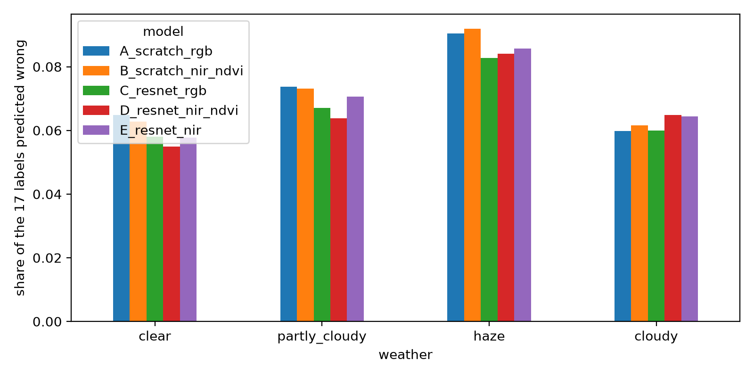
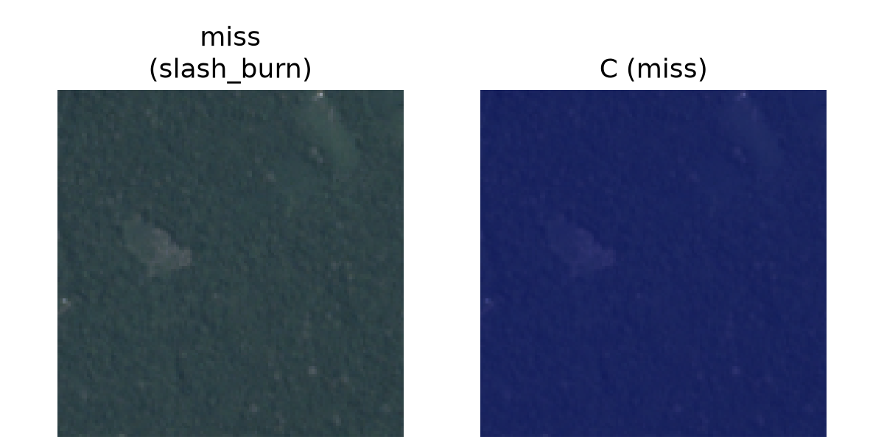
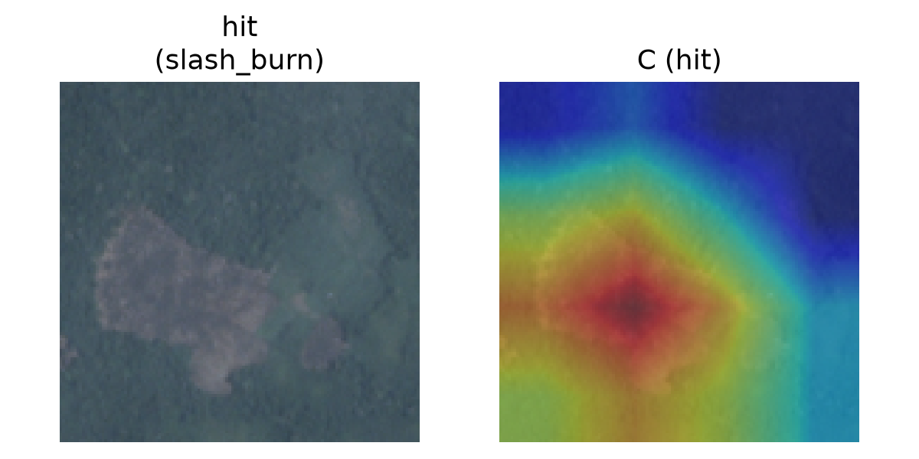
JOSSELIN
Opening the black box with Grad-CAM
Model C (matched run), slash-and-burn, real test tiles
≈ 8%
of labels wrong on hazy tiles vs ≈ 6% on clear (model C). NIR and NDVI models are no better on haze.
Miss: faint heat
When it hits
Heat sits on the cleared patch.
When it misses
Heat is faint. These misses contain small or subtle features. Grad-CAM shows influence, not the cause.
Hit: heat on the cleared patch. Red = most influential region.
Monitoring Deforestation in the Amazon | Data Science II
Notes:
PRESENTER: Josselin Jimenez
DO: Point to a 'hit' row where the heat is red, then a 'miss' row where it is dark blue.
SAY:
Grad-CAM shows where the model looks. On real test tiles, when model C gets slash-and-burn right, the heat sits on the cleared patch. When it misses, the heat is faint, and those examples contain small or subtle features. Grad-CAM shows influence, not cause.
By weather, about six percent of labels are wrong on clear tiles and about eight on hazy ones, and the infrared models are no better on haze.

Slide 16
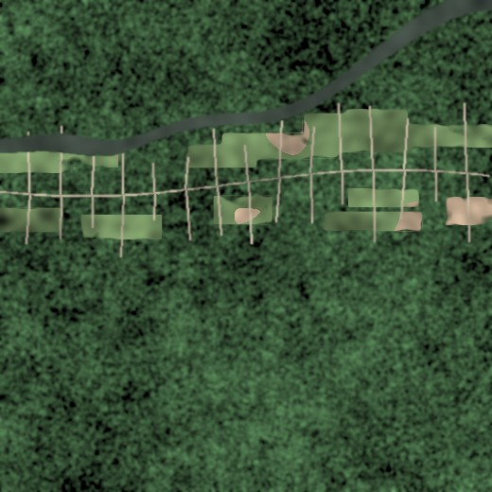
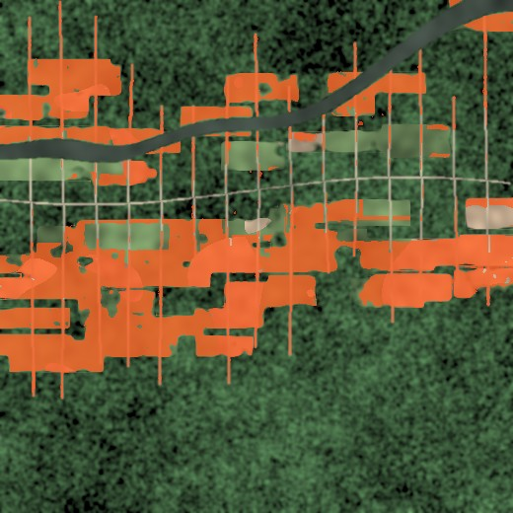


JOSSELIN
From tile tags to land-use change maps
Proposed application, not evaluated here: comparing predicted labels across two dates could flag where forest became road, pasture or bare soil. Illustrative synthetic scenes.
Earlier pass
Later pass
Flagged change
Detect
›
Prioritise
›
Verify with a human
›
Act
Enforcement agencies
Carbon accounting
Policy and NGOs
Rank tiles by risk so patrols go where clearing is likely.
Track forest loss and degradation more consistently.
Fast, repeatable, explainable evidence.
Monitoring Deforestation in the Amazon | Data Science II
Notes:
PRESENTER: Josselin Jimenez
DO: Left to right across the three images, then the four-step flow. Finish by turning toward Mehrab.
SAY:
A proposed application we did not evaluate: compare predictions for the same place at two times to flag where forest became road, pasture, or bare soil. These scenes are illustrative. Agencies could rank tiles by risk. But the model only Detects and Prioritizes; a human Verifies before anyone Acts. Mehrab will cover our limits.
[HAND-OFF to Mehrab]

Slide 17
MEHRAB
Limits we are upfront about, and what comes next
Limit | What we saw | Next step
Rare classes under-learned | slash-and-burn recall 0.26 (C) to 0.45 (A); blow-down F2 0.20 to 0.40 | Soft-F2 loss, ensembles, more rare-class data
Haze hides the ground | ≈ 8% of labels wrong on haze vs ≈ 6% on clear (model C) | Cloud-aware augmentation; multi-date compositing
No significant differences | None of our six bootstrap comparisons reached significance; that does not show the models are equivalent | Cross-validation to assess stability; more independent test data for precision; non-pretrained ResNet
Small rare-class samples | Only 15 test tiles for blow-down and conventional mine: one tile moves recall ≈ 7 points | More labelled rare-class tiles
Generalisation untested | All tiles come from one dataset; other regions and years were not tested | Spatial and temporal hold-out regions and years
Predictions are leads for human review, never automatic accusations.
Monitoring Deforestation in the Amazon | Data Science II
Notes:
PRESENTER: Mehrab U Azan
DO: Read down the first column of the table, then say the next steps with energy.
SAY:
Thank you, Josselin. Our limits. Rare classes are under-learned: slash-and-burn recall is under fifty percent for every model. Haze raises error. None of our six comparisons reached significance. Fifteen test tiles for some labels make rare-class estimates uncertain, and other regions and years were never tested.
Next: cross-validation to check stability, more independent test data, a non-pretrained ResNet, and held-out regions and years.

Slide 18

Takeaways
1
Five matched experiments on one TIF dataset tag 17 labels per tile: best macro F2 0.696 (ResNet-34, RGB); per-tile F2 up to 0.911.
2
None of our six bootstrap comparisons reached significance, e.g. ResNet vs scratch +0.008, 95% CI [−0.012, 0.029]. That does not show the models are equivalent.
3
We missed the macro F2 target (0.696 vs 0.85), and neither NIR nor NDVI gave a significant gain (D − E = −0.004, n.s.).
Koretimi Adebowale · Josselin Jimenez · Mehrab Azan
Notes:
PRESENTER: Mehrab U Azan
DO: All three step forward together. Read the three takeaways, then move to the supporting evidence.
SAY:
Three takeaways. One: across five matched experiments, the best macro F2 is point six nine six, and per-tile F2 reaches point nine one one. Two: none of our six bootstrap comparisons reached significance, including ResNet versus scratch. Three: we missed the macro F2 target, and neither infrared nor NDVI gave a significant gain.
The next slides provide supporting evidence.

Slide 19
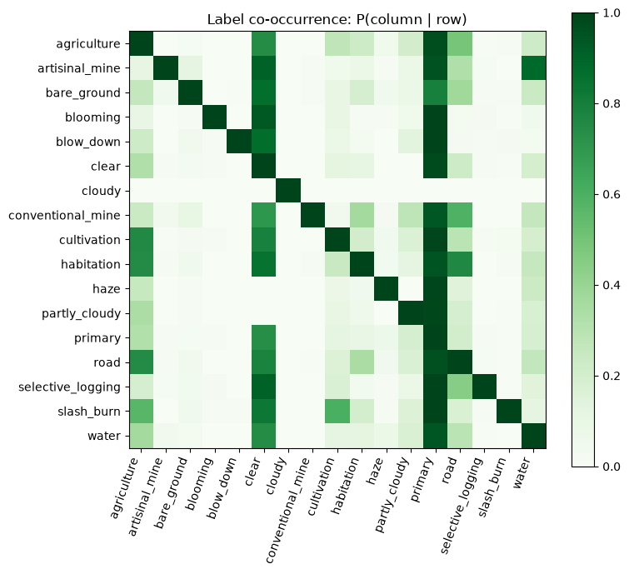
MEHRAB
Evidence: how the 17 labels occur together
Rare labels live in forest
slash_burn, blow_down, selective_logging and artisanal_mine almost always also carry primary (≈ 1).
Mines and water co-occur
About 85% of artisanal-mine tiles also carry a water label (co-occurrence, not location).
Slash-and-burn co-occurs with farming
slash_burn tiles also carry agriculture and cultivation labels about half the time (≈ 0.55 each).
Cloudy tiles stand alone
A tile labelled cloudy has almost no other labels, because the ground is hidden.
Monitoring Deforestation in the Amazon | Data Science II
Notes:
PRESENTER: Mehrab U Azan
DO: Point to the primary column, then the cloudy row.
SAY:
This heatmap shows how often labels occur together. Rare labels almost always sit in forest, about eighty-five percent of artisanal-mine tiles also carry a water label, and slash-and-burn often co-occurs with agriculture labels. Cloudy tiles stand alone because the ground is hidden.

Slide 20
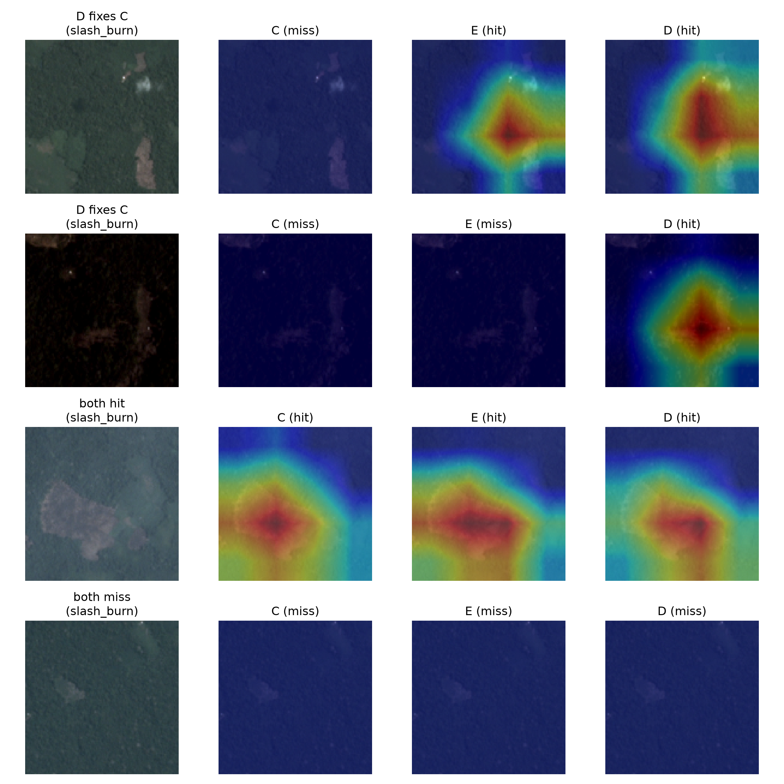
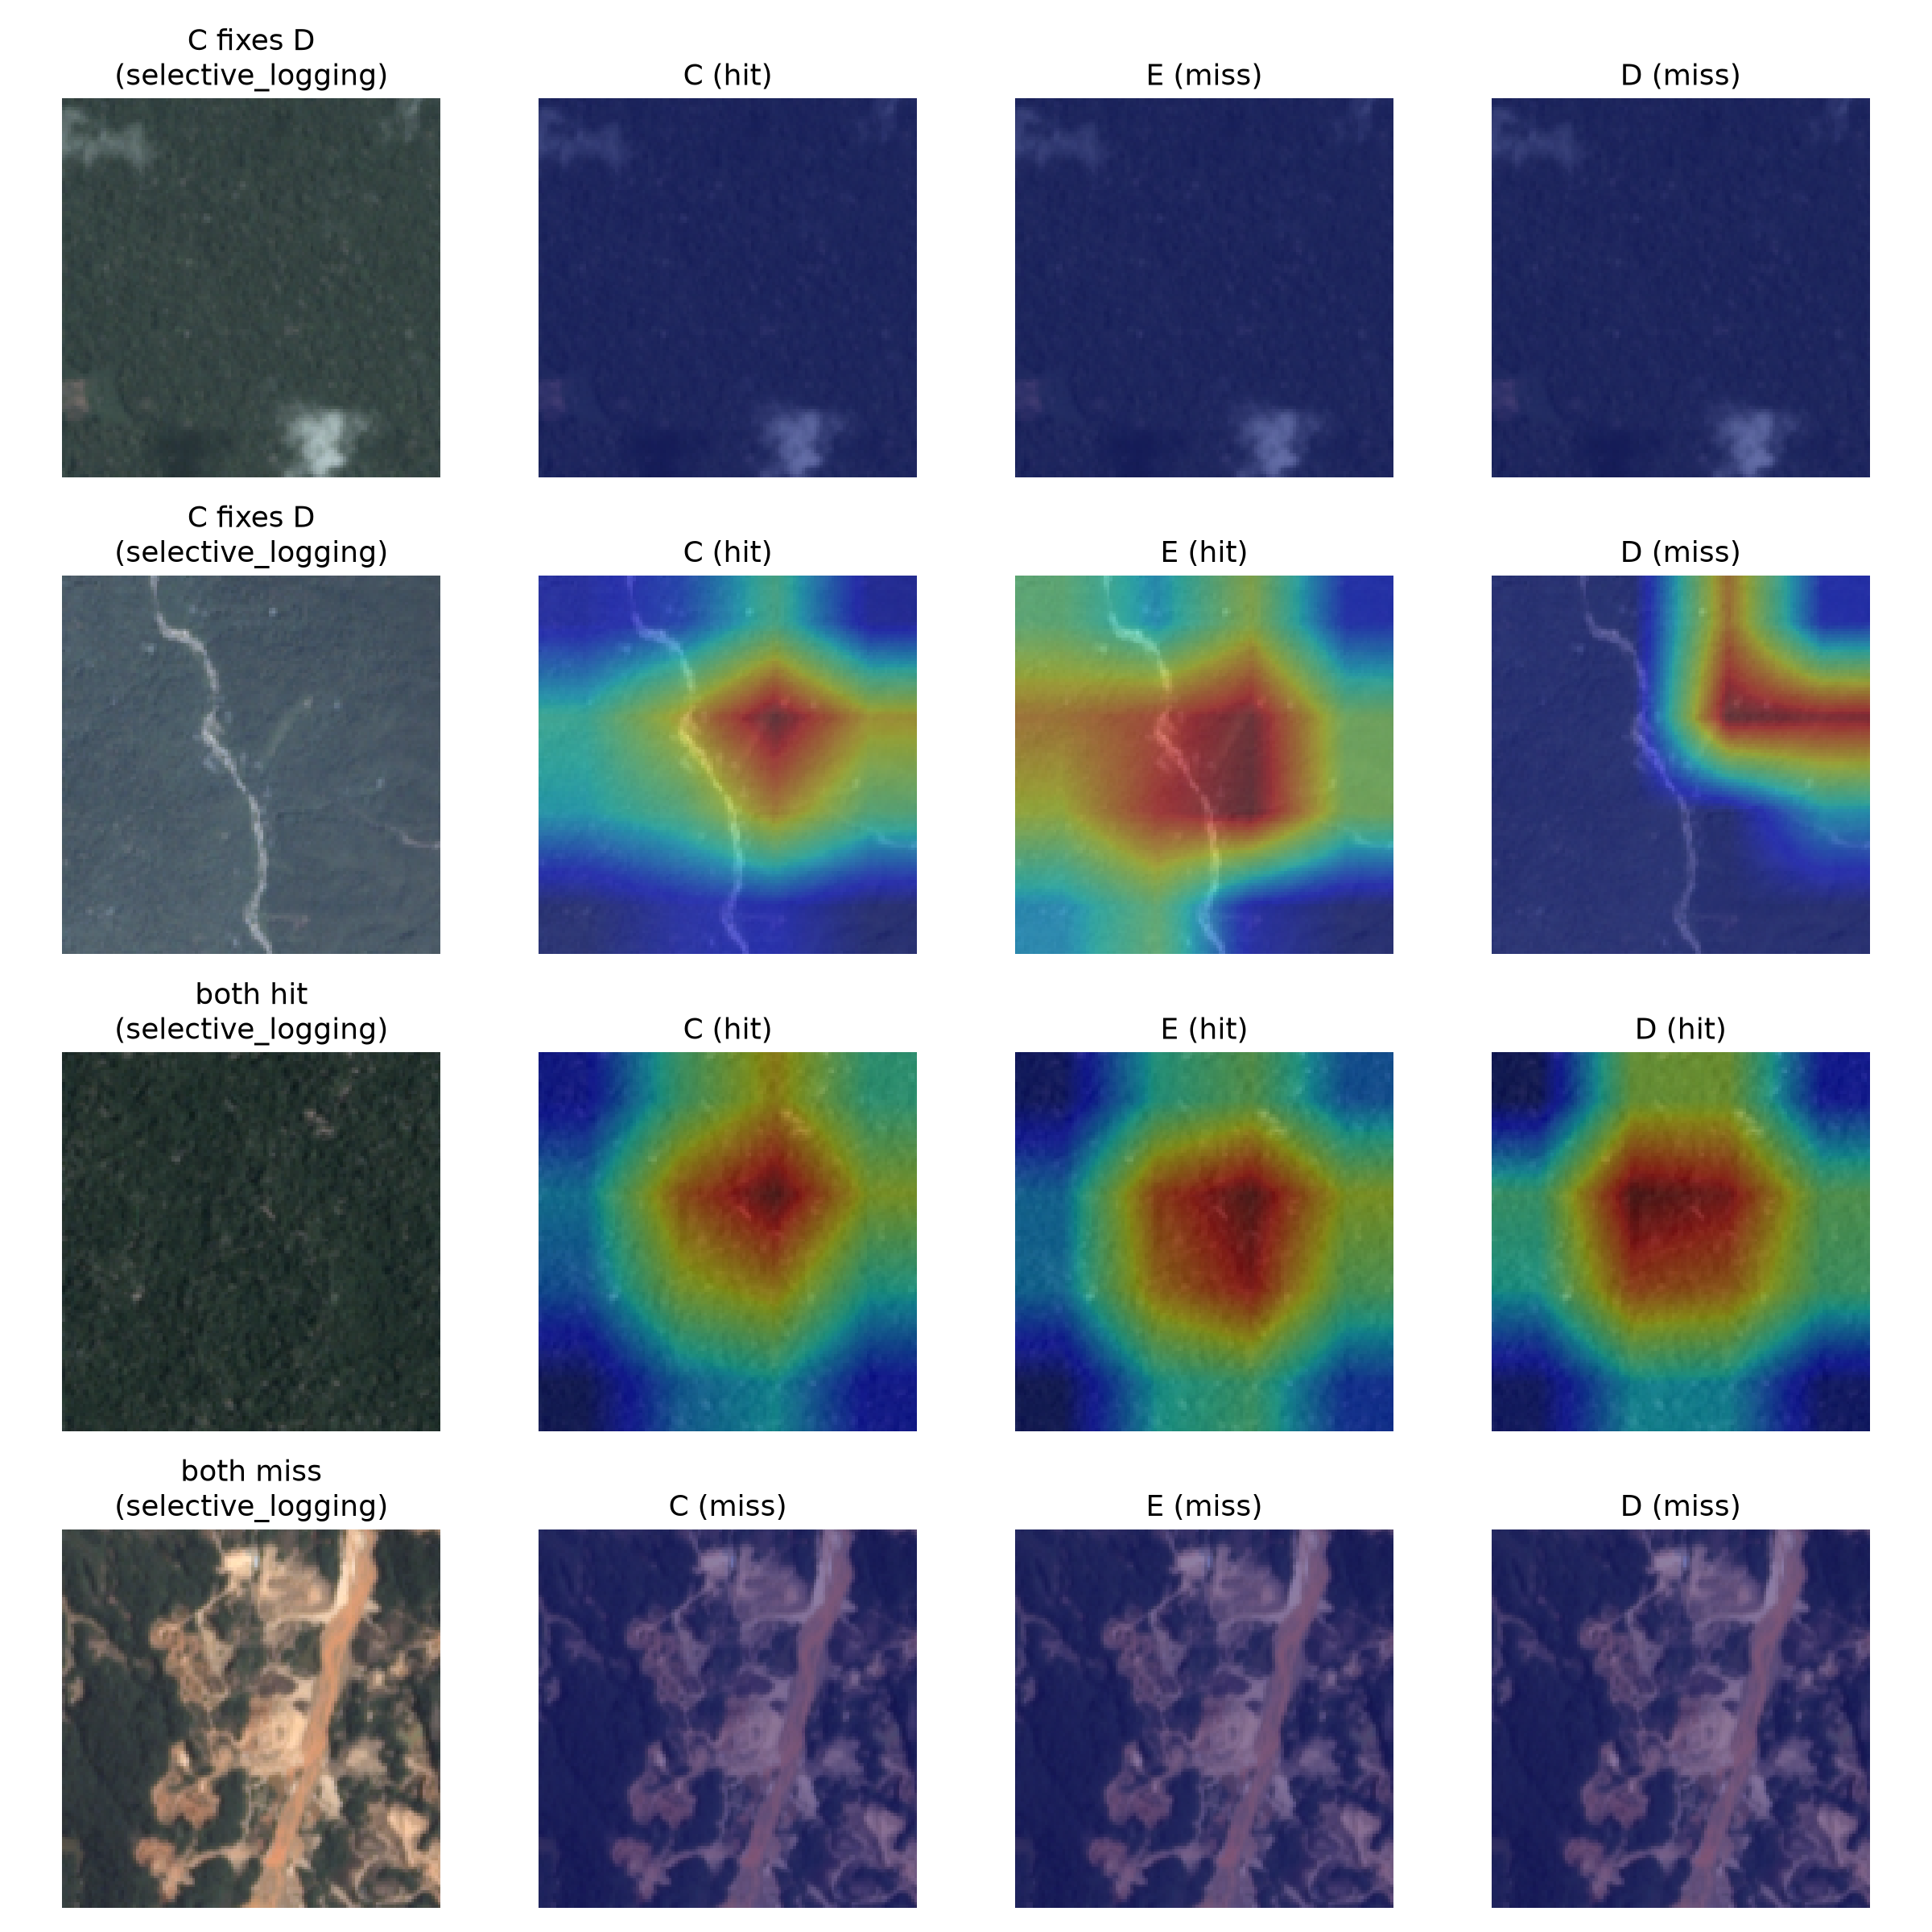
MEHRAB
Evidence: Grad-CAM, RGB vs NIR vs NDVI models
Slash-and-burn: D fixes C, both hit, both miss
Selective logging: C fixes D, both hit, both miss
What to look for
Columns: tile, then C (RGB), E (+ NIR), D (+ NIR + NDVI), each marked hit or miss.
Final matched checkpoints: every model sees the input it was trained on.
Different configurations correctly identify some tiles that others miss; some subtle clearings are missed by all three.
These show changed activation patterns; aggregate performance is on slides 13 and 23.
Monitoring Deforestation in the Amazon | Data Science II
Notes:
PRESENTER: Mehrab U Azan
DO: Read one row left to right: tile, then C (RGB), E (RGB + NIR), D (RGB + NIR + NDVI).
SAY:
Grad-CAM from the final matched checkpoints. Columns are the tile, then model C on RGB, E with infrared, and D with infrared and NDVI. Different configurations correctly identify some tiles that others miss, and some subtle clearings are missed by all three. These show changed activation patterns; aggregate performance is on the scorecard.

Slide 21
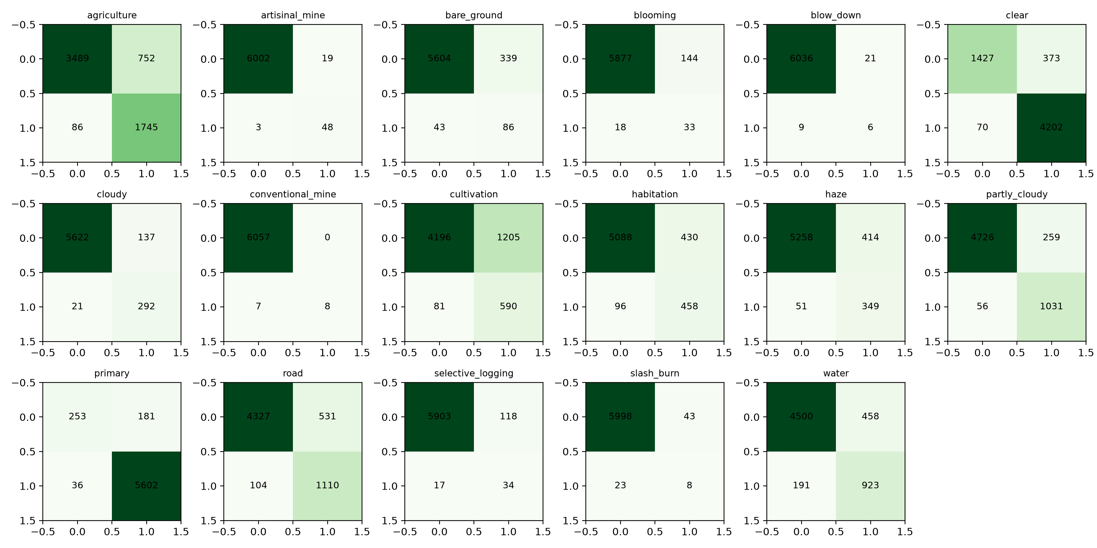
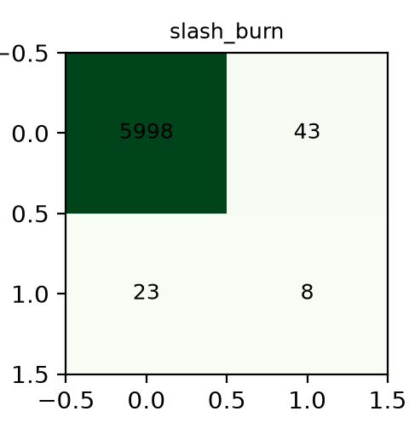
MEHRAB
Evidence: confusion matrices, ResNet-34 (model C)
Slash-and-burn: 8 found, 23 missed, 43 false alarms. Even with recall-tuned thresholds, most clearings are missed.
Each grid is one label on the 6,072-tile test set: top-left true negatives, top-right false positives, bottom-left false negatives, bottom-right true positives. Complete grid shown for reference.
Monitoring Deforestation in the Amazon | Data Science II
Notes:
PRESENTER: Mehrab U Azan
DO: Point to slash-and-burn, bottom row.
SAY:
Seventeen confusion matrices for model C on the test set. Slash-and-burn shows eight found, twenty-three missed, and forty-three false alarms. Even with recall-tuned thresholds, most clearings are missed. That's why rare classes are our first limit.

Slide 22
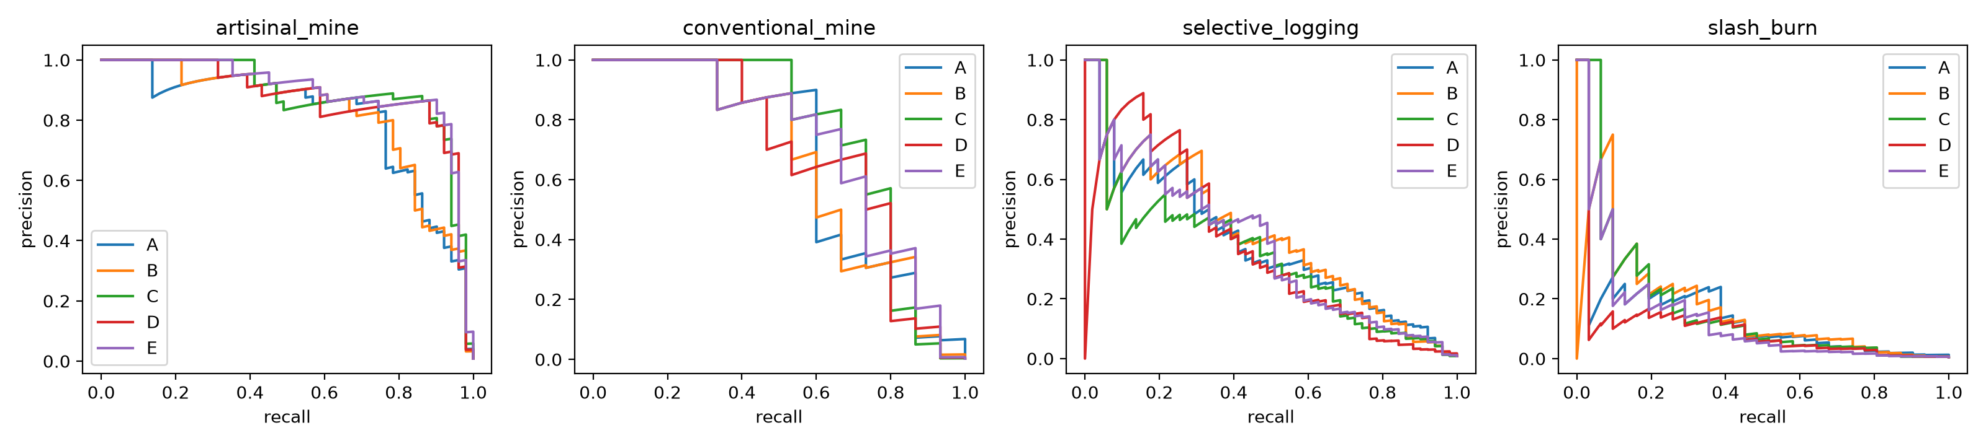
MEHRAB
Evidence: precision–recall curves, all five models
Reading the curves (blue A, orange B, green C, red D, purple E): artisanal mine holds high precision up to high recall, while slash-and-burn precision falls quickly as recall rises for every model. No curve clearly dominates, which is why we tune a separate threshold per label.
Monitoring Deforestation in the Amazon | Data Science II
Notes:
PRESENTER: Mehrab U Azan
DO: Point to the artisanal mine panel, then slash-and-burn.
SAY:
Precision against recall for all five models on the rare labels. Artisanal mine stays precise up to high recall, while slash-and-burn collapses as recall rises. No curve clearly dominates, which is why each label gets its own threshold rather than one global cutoff.

Slide 23
MEHRAB
Evidence: every metric we measured
Test-set metric | A | B | C | D | E
Macro F2 | 0.6877 | 0.6733 | 0.6955 | 0.6862 | 0.6898
Per-tile F2 (Kaggle) | 0.9023 | 0.9028 | 0.9106 | 0.9111 | 0.9100
Micro F2 | 0.8902 | 0.8922 | 0.9011 | 0.9010 | 0.9003
Hamming loss (lower better) | 0.0678 | 0.0665 | 0.0614 | 0.0589 | 0.0622
Mean rare recall (4) | 0.6835 | 0.6556 | 0.5998 | 0.6281 | 0.6328
Recall: artisanal mine | 0.7843 | 0.8431 | 0.9412 | 0.9216 | 0.9412
Recall: conventional mine | 0.7333 | 0.6667 | 0.5333 | 0.7333 | 0.6667
Recall: selective logging | 0.7647 | 0.7255 | 0.6667 | 0.4706 | 0.5686
Recall: slash-and-burn | 0.4516 | 0.3871 | 0.2581 | 0.3871 | 0.3548
Rare label | Test tiles
artisanal mine | 51
blooming | 51
selective logging | 51
slash-and-burn | 31
blow-down | 15
conventional mine | 15
Bootstrap, macro F2 (all n.s.)
C − A: +0.0083 [−0.0122, 0.0285]
D − B: +0.0131 [−0.0040, 0.0294]
E − C: −0.0059 [−0.0221, 0.0104]
D − E: −0.0035 [−0.0187, 0.0125]
D − C: −0.0098 [−0.0283, 0.0092]
B − A: −0.0144 [−0.0328, 0.0041]
A scratch RGB · B scratch +NIR+NDVI · C ResNet RGB · D ResNet +NIR+NDVI · E ResNet +NIR. All five from one TIF run (same cache, split, seed). Green = best per row (ties shown). Thresholds tuned on validation.
Monitoring Deforestation in the Amazon | Data Science II
Notes:
PRESENTER: Mehrab U Azan
DO: Run a finger down the C column, then to the bootstrap box.
SAY:
Every test metric for all five experiments, all from the same TIF run. Model C leads macro F2, model D leads per-tile F2 and Hamming loss, and model A leads mean rare recall. The bootstrap box shows all six comparisons; none reached significance.

Slide 24
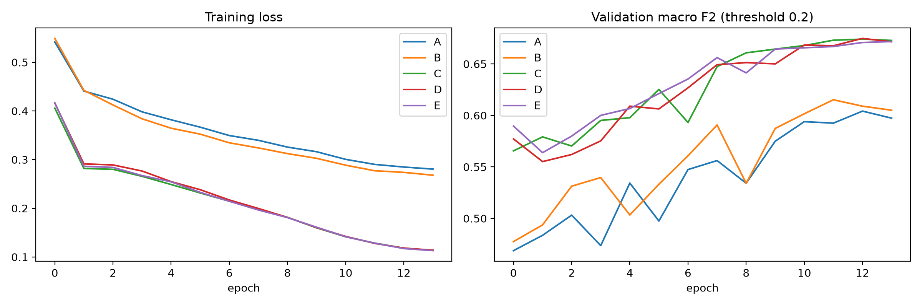
MEHRAB
Evidence: training curves, all five models
All five runs learned steadily over 14 epochs. The pretrained ResNets (C, D, E) reach about 0.67 validation macro F2, the scratch CNNs (A, B) about 0.60 to 0.62. The curves show no obvious divergence; they do not explain test differences.
Monitoring Deforestation in the Amazon | Data Science II
Notes:
PRESENTER: Mehrab U Azan
DO: Point to the falling loss, then the rising validation curve.
SAY:
All five training curves. Loss falls steadily with no obvious divergence. The pretrained ResNets reach about point six seven validation macro F2, the scratch CNNs about point six one. The curves don't explain test differences, and we did not test why.

Slide 25
MEHRAB
References and image credits
Kaggle. Planet: Understanding the Amazon from Space. kaggle.com/competitions/planet-understanding-the-amazon-from-space
INPE. PRODES and DETER deforestation monitoring (TerraBrasilis)
O Liberal (2025). Desmatamento na Amazônia em 2025 caiu 11,08% em relação a 2024, afirma Prodes/Inpe
Butler, R. A. (Aug 2026). Amazon deforestation alerts fall to lowest level since 2013. Mongabay (counts the predecessor DETER system; the current series began 2015/16)
Agência Brasil (Aug 2026). Amazon deforestation falls 36.87% over past year: lowest figure since 2016, when the historical series began
Sinha, S. (2017). Labeling Satellite Imagery with Atmospheric Conditions and Land Cover. Stanford CS231n report. cs231n.stanford.edu/reports/2017/pdfs/9.pdf
Chandak, S., Chitters, V., Honnungar, S. (2017). Understanding the Amazon Rainforest from Space using CNNs. Stanford CS231n report (ensemble F2 0.931)
mikeskaug (GitHub). amazon-classifier: classifying satellite images of the Amazon. github.com/mikeskaug/amazon-classifier (random forest ≈0.75, VGG16 ≈0.83)
Real chips, Grad-CAM panels and all result figures come from our own notebook run. All other satellite-style images in this deck are synthetic illustrations generated by the team.
Monitoring Deforestation in the Amazon | Data Science II
Notes:
PRESENTER: Mehrab U Azan
DO: All three step forward for the last line. Mehrab delivers the closing.
SAY:
Sources: Kaggle's Planet competition, INPE's PRODES and DETER, the Agência Brasil, Mongabay and O Liberal reports, and two Stanford CS231n reports. Real chips and all results come from our notebook; other satellite-style images are labeled illustrations.
Forest protection runs on early detection, and deep learning can help, with people in the loop. Thank you. We would be glad to take your questions.

