Slide 1
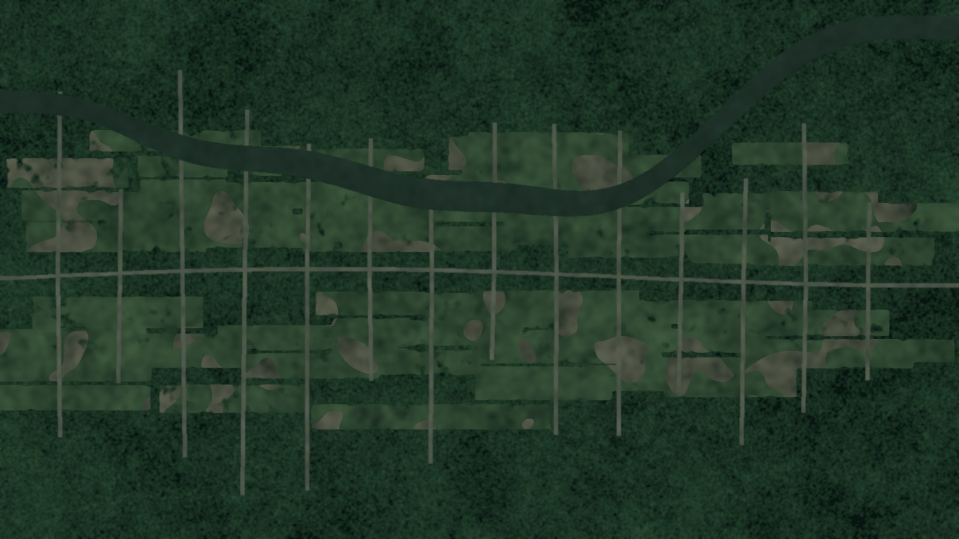
DATA SCIENCE II | PROJECT
Monitoring Deforestation and Land-Use Change in the Amazon
Using Deep Learning on Satellite Imagery
Oluwa Koretimi Adebowale
Josselin Jimenez
Mehrab U Azan
Data and preprocessing
Modelling
Evaluation and interpretability
40,479 tiles · 17 labels · 5 matched experiments · best macro F2 0.696 · per-tile F2 0.911
Background: illustrative synthetic imagery, not real satellite data.
Notes:
PRESENTER: Oluwa Koretimi Adebowale
DO: Stand together. Koretimi steps forward and starts. Make eye contact before speaking.
SAY:
Good morning, everyone. We are Koretimi Adebowale, Josselin Jimenez, and Mehrab Azan, and our project is Monitoring Deforestation and Land-Use Change in the Amazon, using deep learning on satellite imagery.
In ten minutes, we will show you how a neural network can tag a satellite tile with seventeen labels at once, and how honest we were about where it works and where it does not.
I will cover the problem and the data. Josselin presents the models and results, and Mehrab closes with our limits and takeaways.

Slide 2
Progress is real, but the forest is still shrinking
5,796 km²
PRODES deforestation in 2025, down 11.08% from 2024
2,874 km²
DETER alerts, Aug 2025 to Jul 2026: lowest since 2013 (36% below prior year)
Every year
Enforcement still depends on spotting new clearing early
Sources: INPE PRODES / DETER via O Liberal (2025) and Mongabay (Aug 2026); 2004, 2012, 2021 from INPE PRODES.
Monitoring Deforestation in the Amazon | Data Science II
Notes:
PRESENTER: Oluwa Koretimi Adebowale
DO: Point to the three stat cards, then sweep your hand across the bar chart from left to right.
SAY:
Why does this matter? The news is genuinely good. Brazil's PRODES program measured five thousand seven hundred ninety-six square kilometers of deforestation in 2025, down eleven percent. And DETER early-warning alerts for August 2025 to July 2026 total twenty-eight hundred seventy-four square kilometers, thirty-six percent lower and the lowest since 2013.
But look at the chart: twenty-seven thousand in 2004, a low of forty-five hundred in 2012, then back above thirteen thousand in 2021. Progress can reverse, and enforcement still depends on spotting clearing early.

Slide 3
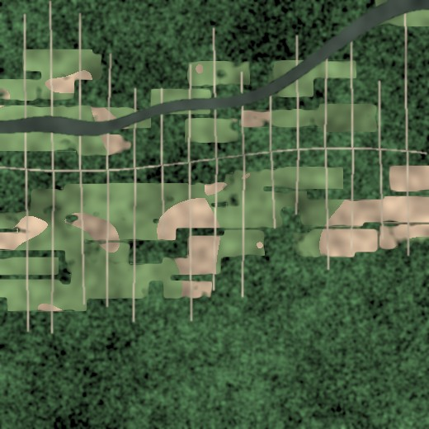



Why we need machines to watch the forest
Scale
The basin is far too large for analysts to review tile by tile.
Speed
Automated tagging can surface new clearing in near real time.
Consistency
One model applies the same rules to every tile, every pass.
Illustrative synthetic tile: clearings branching off a road and river
Monitoring Deforestation in the Amazon | Data Science II
Notes:
PRESENTER: Oluwa Koretimi Adebowale
DO: Tick off the three words on your fingers: scale, speed, consistency.
SAY:
So why machines? Three reasons. Scale: the Amazon is far too large for analysts to review tile by tile. Speed: automated tagging can surface new clearing while patrols can still reach it. Consistency: one model applies the same rules to every tile, every pass.
That was the job we gave our model: be the tireless first pair of eyes, and hand its findings to people.

Slide 4
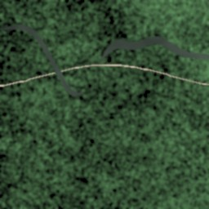
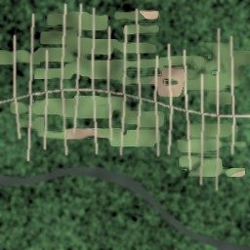
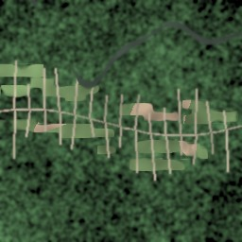
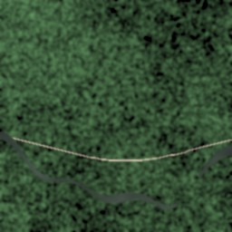
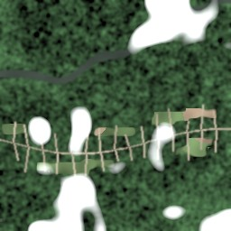
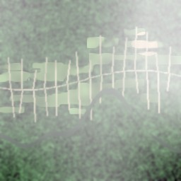
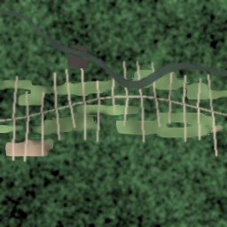
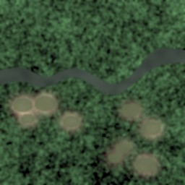
The data: Planet's Amazon-from-space image chips
40,479
17 labels
labeled image chips, all used (no subsampling)
weather + land cover + land use
primary forest
agriculture
road
water
4 bands
128 × 128
R, G, B and near-infrared from the TIF release; every model reads the same TIF tiles
model input size, resized from 256 × 256 chips
partly cloudy
haze
slash & burn
artisanal mine
Each tile can carry several labels at once, e.g. clear + primary + agriculture + road.
Tiles shown are illustrative synthetic renderings, not dataset images.
Monitoring Deforestation in the Amazon | Data Science II
Notes:
PRESENTER: Oluwa Koretimi Adebowale
DO: Gesture to the four number cards on the left, then to the eight example tiles on the right.
SAY:
Our data is the Kaggle competition Understanding the Amazon from Space, built from Planet imagery. We used all forty thousand four hundred seventy-nine labeled chips, each with seventeen labels covering weather, land cover, and land use.
Every model reads the four-band TIF files, which add a near-infrared band to red, green and blue. Models B, D and E use that extra band. Every tile is resized to one hundred twenty-eight pixels square.
The tiles on the right are illustrative drawings, not dataset images.

Slide 5


A multi-label problem, and three things that make it hard
Single-label
Multi-label (ours)
Softmax output
Classes compete: probabilities sum to 1
Forces a choice: forest OR farm
17 independent sigmoid outputs
Binary cross-entropy per label
Forest AND road AND haze can all be true
clear
primary
agriculture
road
Severe class imbalance
Clouds and haze
Mixed land use
Blow-down and artisanal mining appear in under 1% of tiles.
Weather hides the ground and can mimic bare soil.
One chip often holds forest, road and farmland together.
Monitoring Deforestation in the Amazon | Data Science II
Notes:
PRESENTER: Oluwa Koretimi Adebowale
DO: Left hand = single label, right hand = multi-label. Then hold up three fingers for the challenges.
SAY:
This is not ordinary classification. One tile can be clear, primary forest, agriculture, and have a road. Softmax forces one choice. We use seventeen independent sigmoid outputs, so forest, road, and haze can all be true together.
Three things make it hard. Severe imbalance: labels like blow-down and artisanal mining appear in under one percent of tiles. Clouds and haze hiding the ground. And mixed land use inside a single tile.

Slide 6
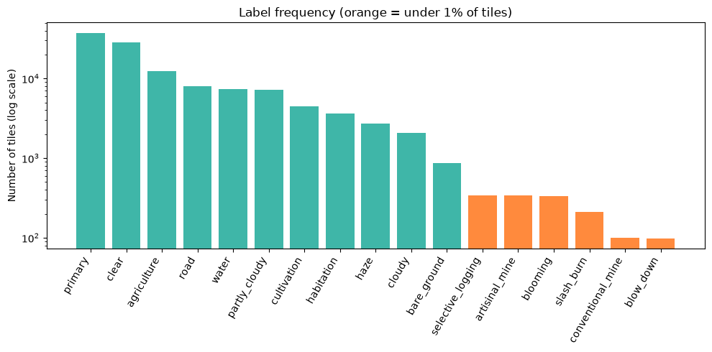
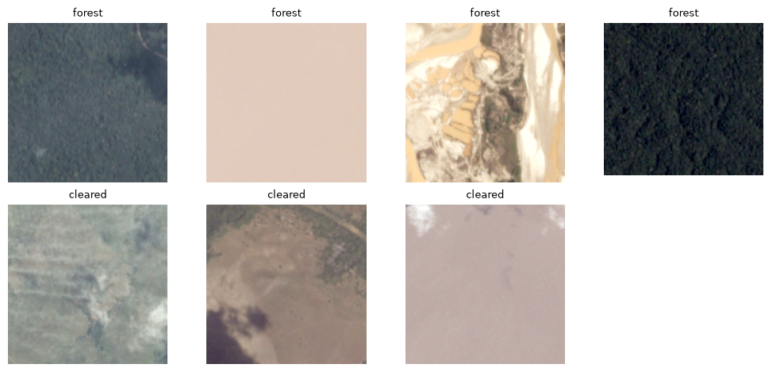
What the data really looks like
70 / 15 / 15
~100 tiles
train / val / test split: 28,335 · 6,072 · 6,072 tiles, stratified on each tile's rarest label
blow_down and conventional_mine: the rarest labels, about 0.25% of the data
15 tiles
9 in 10
blow_down tiles in the test set. Rare-class scores carry real uncertainty
tiles contain primary forest, so accuracy alone would be misleading
Left: real label counts (orange = under 1%) and real chips.
Monitoring Deforestation in the Amazon | Data Science II
Notes:
PRESENTER: Oluwa Koretimi Adebowale
DO: Point to the orange bars on the chart; they are the rare labels. Then point to the real forest-versus-cleared chips. Then move on to slide 7.
SAY:
Now the real data. This log-scale chart shows primary forest in over nine of ten tiles, while the orange bars, under one percent, include blow-down and conventional mining with only about a hundred tiles each. The real chips show forest versus cleared land from orbit.
We split the data seventy, fifteen, fifteen, stratified on each tile's rarest label, giving twenty-eight thousand training tiles and six thousand each for validation and test. Even so, the test set has only fifteen blow-down tiles, so rare-class results carry real uncertainty.

Slide 7






Our approach: from raw chips to explained predictions
Satellite chips
›
Preprocess
›
Augment + rebalance
›
CNN classifier
›
Tune thresholds
›
Evaluate + explain
40,479 TIF tiles, RGB (+ NIR for B, D, E), resized to 128×128
Clip bands at 1st–99th percentile; standardise
8 orientations, oversample rare labels
17 sigmoid outputs, weighted BCE loss
Per-label cutoffs optimised for F2
F2, recall, Hamming loss, Grad-CAM
Every experiment uses the same split and the same seed, so any improvement can be traced to one change at a time.
28,335 training tiles
6,072 validation tiles
6,072 test tiles
Monitoring Deforestation in the Amazon | Data Science II
Notes:
PRESENTER: Oluwa Koretimi Adebowale
DO: Walk your hand along the six boxes from left to right as you name each stage.
SAY:
Here's our pipeline from data to prediction. We start with the satellite chips, shrunk to 128 pixels to cut training time about four times. We clip extreme values like sun glare, then standardize every channel. We rotate and flip tiles for variety, and show rare tiles more often. A neural network gives each tag a probability, and we decide, tag by tag, how confident it must be to say yes. Finally, we score the results and check where the model looked.
Every model gets the same split, seed and recipe, so if a score moves, we know what moved it.

Slide 8
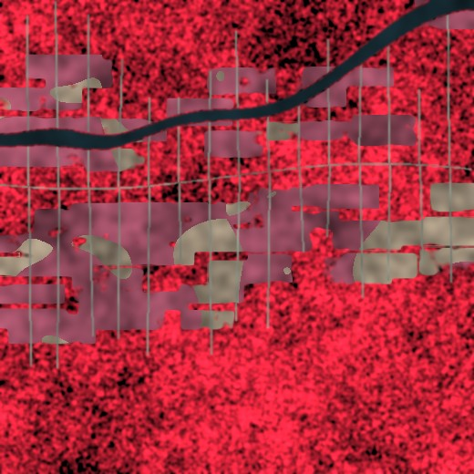
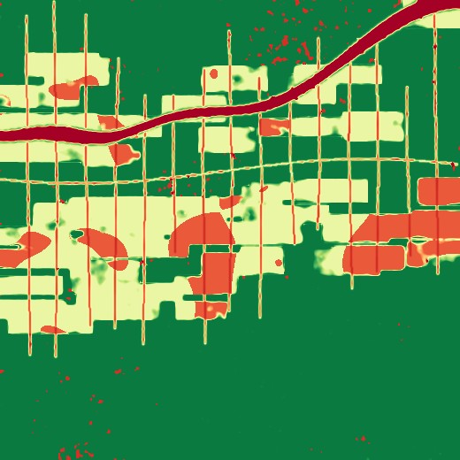


NDVI, and fighting class imbalance
Rotations and flips
Top-down imagery has no fixed 'up': 8 orientations in training, averaged at test time.
Oversample rare labels
Tiles with rare labels are drawn more often each epoch.
Visible (RGB)
Near-infrared
NDVI channel
NDVI = (NIR − Red) / (NIR + Red)
dense canopy ≈ +1, pasture and soil ≈ 0, water < 0
Class-weighted loss
Weight = √((1−f)/f), clipped 1 to 10, so a missed rare label costs more.
All models use the 4-band TIFs
Per-label thresholds
Sanity check on the NIR band: mean NDVI is highest for primary forest (0.38), then agriculture (0.34), lowest for water (0.25). Panels above are illustrative.
Cutoffs tuned on validation data, grid 0.02 to 0.80, for best F2.
Monitoring Deforestation in the Amazon | Data Science II
Notes:
PRESENTER: Oluwa Koretimi Adebowale
DO: Left half of the slide first (NDVI), then turn to the four boxes on the right. Turn to Josselin on the final line.
SAY:
On the left is NDVI. Healthy leaves reflect a lot of near-infrared light, which our eyes can't see, so NDVI is high over forest and near zero over bare soil. [We hoped that would make clearings jump out.] That band only comes in the four-band TIF files, so every model reads the TIFs, and we checked we were reading the band correctly: forest scored highest, water lowest.
On the right is how we handle imbalance. Some labels show up in a quarter of one percent of tiles, so a lazy model could just never predict them. We push back four ways: random rotations and flips, since a satellite image has no "up"; showing rare tiles more often; making a missed rare label cost more; and giving every label its own cutoff.
Josselin will walk you through the models.
[HAND-OFF to Josselin]

Slide 9
Models and the experiment grid
Baseline: CNN from scratch
Four experiments isolate each idea
4 blocks of 2 × (3×3 conv + BatchNorm + ReLU) + max-pool, 32 → 256 channels, global pooling, dropout 0.3, 17-way head. Shows what the data alone can teach.
RGB only
RGB + NIR + NDVI
A
B
Scratch CNN
1,177,585 trainable parameters (RGB input)
F2 0.688
F2 0.673
C
D
Transfer learning: ResNet-34
Pretrained
ImageNet-pretrained ResNet-34 with a new 17-way head. For NIR/NDVI models the first convolution is widened: RGB weights copied, the new channels initialised from their mean.
F2 0.696 (best)
F2 0.686
Macro F2 on the test set: same recipe and same 4-band TIF tiles for all. Extra run E (ResNet, RGB + NIR, no NDVI): 0.690.
21,293,393 parameters, 18× the scratch CNN
Monitoring Deforestation in the Amazon | Data Science II
Notes:
PRESENTER: Josselin Jimenez
DO: You pick up from Koretimi. Point to the two model cards, then the 2×2 grid. Read down the columns, then across the rows.
SAY:
Thanks, Koretimi. Now the models. Our baseline is a small CNN trained from scratch, about 1.2 million parameters. It shows what our data alone can teach.
The second is ResNet-34: eighteen times larger, and already trained on more than a million everyday photos. [The edges and textures it learned there carry over to satellite images, which matters when a label has only a few hundred examples.] For the infrared models, we widened its first layer from three input channels to five.
With two different models and two different inputs, we have a total of four experiments. Down each column, the pretrained model scores slightly higher. Across each row, adding infrared scores slightly lower. All four use exactly the same TIF images. [We also ran a fifth model, E: the ResNet with near-infrared but no NDVI.] In a few slides, I'll show whether any of these gaps are real.

Slide 10
Training recipe: one setup, a fair comparison
14
AdamW
√((1−f)/f)
epochs, batch size 128
+ OneCycle schedule, peak lr 3e-3 (scratch) / 1e-3 (ResNet)
per-label loss weight, clipped to 1–10
Oversample
8 views
Seed 42
rare-label tiles are drawn more often each epoch
rotations + flips averaged at test time
mixed precision on GPU, thresholds tuned on validation only
Monitoring Deforestation in the Amazon | Data Science II
Notes:
PRESENTER: Josselin Jimenez
DO: Point at the big numbers as you say them; don't read the small text.
SAY:
All four models share one recipe: fourteen passes through the training data, batches of 128, the AdamW optimizer, and a learning rate that warms up and then cools down. [The ResNet gets a lower peak rate, so we don't overwrite what it already knows.]
The rarest tiles are drawn about twenty times more often than common ones, and the loss gives rare labels up to ten times the weight. At test time, each tile is scored in eight orientations and the answers are averaged. And thresholds are tuned on validation data only: the test set is used once, at the very end.

Slide 11



Why F2? Missing deforestation costs more
F₂ = 5 · P · R / (4 · P + R)
Targets set before training
Recall is weighted more than precision, matching enforcement: a missed clearing is lost forest, a false alarm is a quick check.
≥ 0.85
macro F2 across all 17 labels
Worked example: precision 0.50, recall 0.80 gives F2 = 0.714 but F1 = 0.615, so catching more clearings is rewarded.
≥ 0.60
recall on mining, selective logging and slash-and-burn
Macro F2 gives rare labels the same weight as common ones
Accuracy alone would hide the imbalance
NDVI > RGB
a measurable gain over the RGB-only baseline
Per-label thresholds tuned on validation data only
Rare-class recall reported separately: the real mission
Monitoring Deforestation in the Amazon | Data Science II
Notes:
PRESENTER: Josselin Jimenez
DO: Point to the formula, then the worked example, then the three targets.
SAY:
How do we score it? With F2. It's like the F1 score, but it weights recall, catching what's really there, above precision. We chose it because in forest monitoring, missing a clearing is worse than a false alarm: a missed clearing is forest that's gone, while a false alarm just costs someone a quick look. [In the example on the slide, the same predictions score 0.71 on F2 but only 0.62 on F1.]
We average F2 per label, so mining counts as much as forest. Plain accuracy would hide the problem: a model that always says "forest" is right nine times out of ten.
Before training, we set three targets. In two slides, we'll see how we did.

Slide 12
Where published models land on this dataset
Takeaways
All four of our models clear the 0.85 bar on the per-tile metric.
ResNet-34 sits about 0.02 below the Kaggle winners.
Our focus is rare-class recall and honest evaluation, not leaderboard chasing.
0.911 vs 0.930
ResNet-34 vs the best Kaggle ensemble: a gap of 0.019, with no ensembling or soft-F2 loss.
Sources: GitHub mikeskaug/amazon-classifier; Stanford CS231n 2017 report; Kaggle winners' write-ups; our test set. Indicative only.
Monitoring Deforestation in the Amazon | Data Science II
Notes:
PRESENTER: Josselin Jimenez
DO: Point to each bar as you name it, the orange "Ours" bars last.
SAY:
For context, here are published results on this dataset using Kaggle's own metric, F2 averaged per tile: a random forest around 0.75, VGG16 0.83, a simple CNN 0.90, and the winning Kaggle ensembles 0.93.
Our ResNet reaches 0.911, about two hundredths behind the winners, with one model and no ensemble. [All four of our models land above 0.90.] This is an estimate since we tested on our own split, not Kaggle's hidden test set.
Now let's look at the full results.

Slide 13

Experiment scorecard: all five runs
Experiment | Macro F2 | Per-tile F2 | Rare recall | Hamming loss
A Scratch CNN, RGB | 0.688 | 0.902 | 0.684 | 0.0678
B Scratch CNN, RGB+NIR+NDVI | 0.673 | 0.903 | 0.656 | 0.0665
C ResNet-34, RGB | 0.696 | 0.911 | 0.600* | 0.0614
D ResNet-34, RGB+NIR+NDVI | 0.686 | 0.911 | 0.628 | 0.0589
E ResNet-34, RGB+NIR | 0.690 | 0.910 | 0.633 | 0.0622
Transfer learning (C − A)
NIR + NDVI on ResNet (D − C)
+0.008 [−0.012, +0.029] not significant
−0.010 [−0.028, +0.009] not significant
NIR alone on ResNet (E − C)
NDVI on top of NIR (D − E)
−0.006 [−0.022, +0.010] not significant
−0.004 [−0.019, +0.013] not significant
Macro F2 ≥ 0.85
Rare recall ≥ 0.60
NDVI > RGB
best 0.696: missed
4 of 5 met (*C: 0.5998, just short)
not supported: no significant gain
Monitoring Deforestation in the Amazon | Data Science II
Notes:
PRESENTER: Josselin Jimenez
DO: Point to the table, then the four comparison rows, then the three result pills at the bottom. Say "missed" and "met" in the same steady tone.
SAY:
In the macro F2 column, the scratch CNN scores 0.688, and 0.673 with infrared. The ResNet scores 0.696, our best, and 0.686 with infrared. Our fifth run, E, is the ResNet with near-infrared but no NDVI: 0.690.
To check whether those gaps are real or just luck, we resampled the test set a thousand times and recomputed each difference. If 95 percent of the results land on one side of zero, the gap is real. None of our gaps pass. Transfer learning is plus 0.008, near-infrared alone minus 0.006, and NDVI on top of it minus 0.004: all within noise.
Against our targets: macro F2 of 0.85, missed. Rare-class recall of 0.6, met by four of the five models, with the ResNet just short at 0.5998. And infrared did not beat RGB.

Slide 14
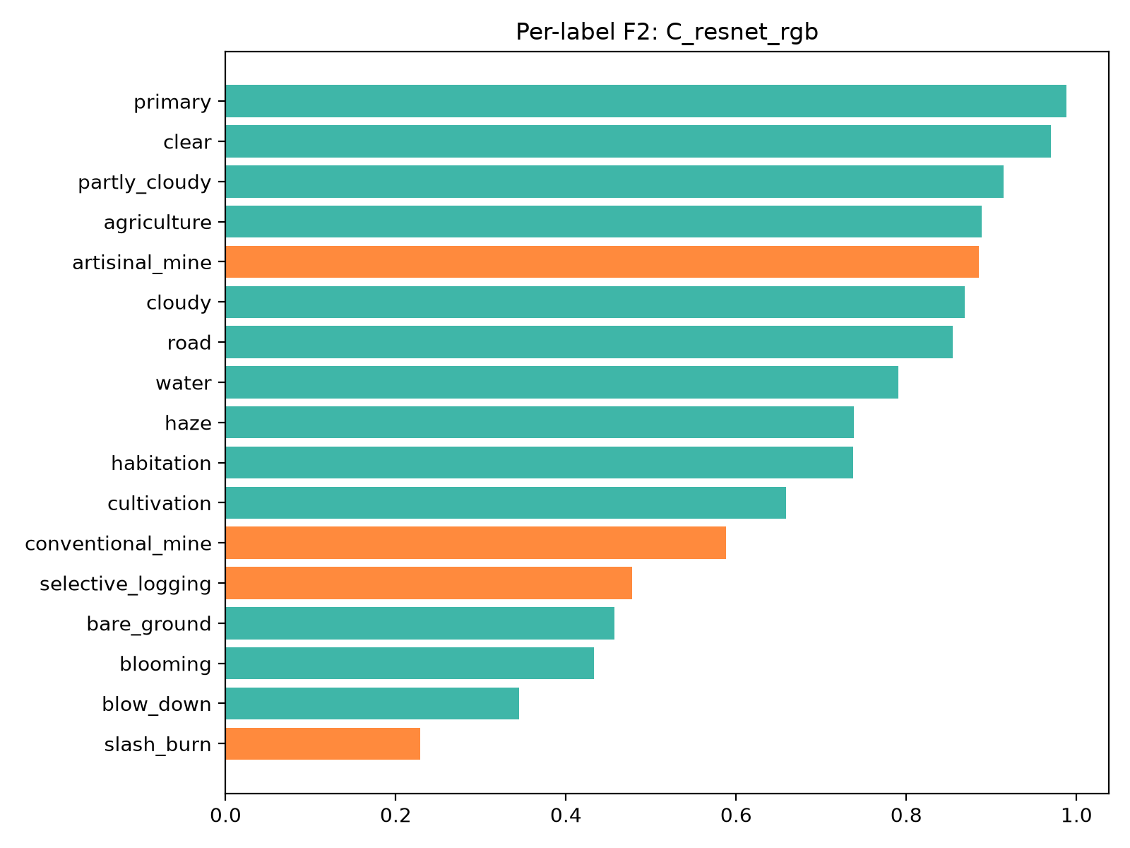
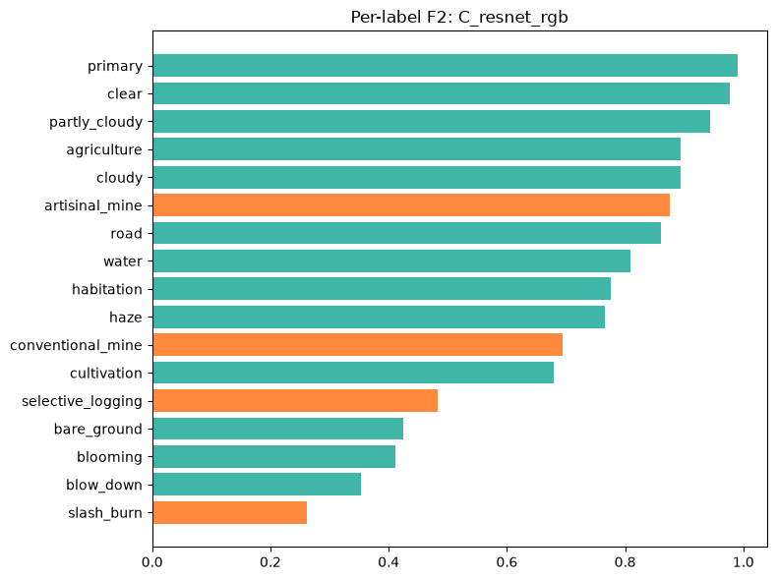
Per-label results: where the model wins and struggles
Strong
primary 0.99 and clear 0.97; artisanal mine F2 0.89, recall 0.94
Struggling
slash-and-burn F2 0.23, blow-down 0.35, selective logging 0.48; NIR and NDVI did not fix them
Model C (ResNet-34), best by macro F2: per-label F2 on the test set. Orange = the four rare labels we set recall targets on. All four models are in the appendix table.
Monitoring Deforestation in the Amazon | Data Science II
Notes:
PRESENTER: Josselin Jimenez
DO: Point to the top of the left chart, then the orange bars, then the recall chart on the right.
SAY:
Why is macro F2 so much lower than the per-tile score? Macro gives every label an equal vote, so a few hard labels drag it down. On the left is our best model, the ResNet. Primary forest and clear weather are near perfect, at 0.99 and 0.97. Artisanal mining is a bright spot: it catches 94 percent of mines. [That's likely because mines sit along rivers and leave bright, bare ground.]
The struggles are slash-and-burn at 0.23, blow-down at 0.35 and selective logging at 0.48, which are small, subtle marks inside forest. Infrared didn't fix any of them.
On the right is rare-class recall for all five models, and no model wins everywhere. [The scratch CNN actually finds more of every rare label except mines: for example, 76 percent of selective logging versus 67 for the ResNet.]

Slide 15
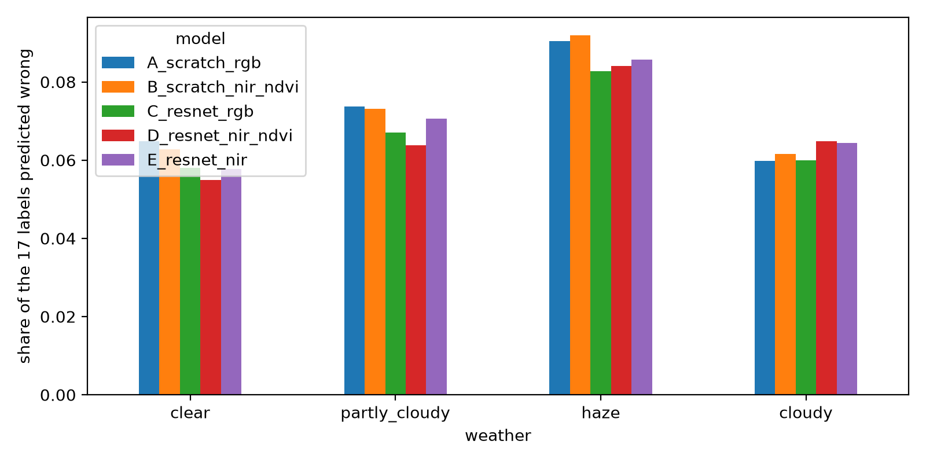
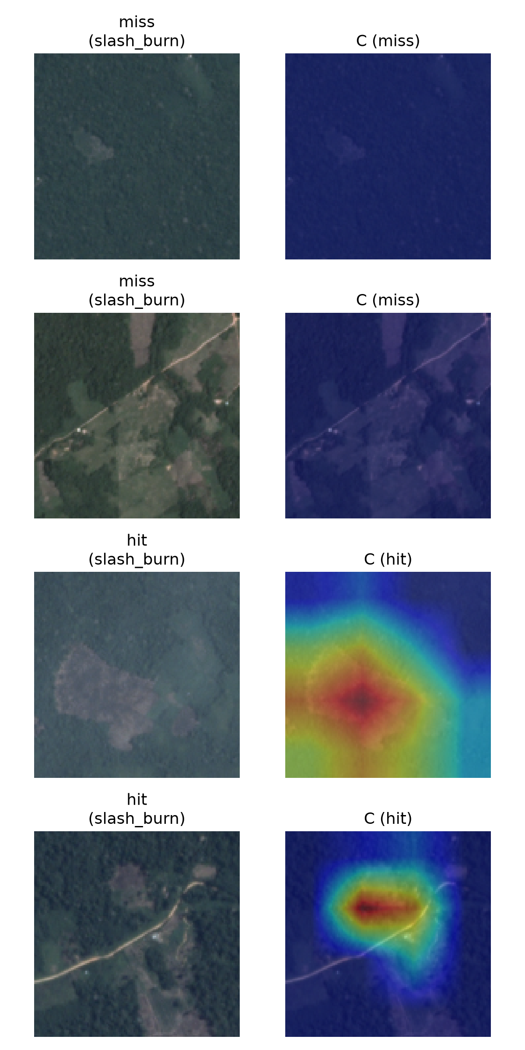
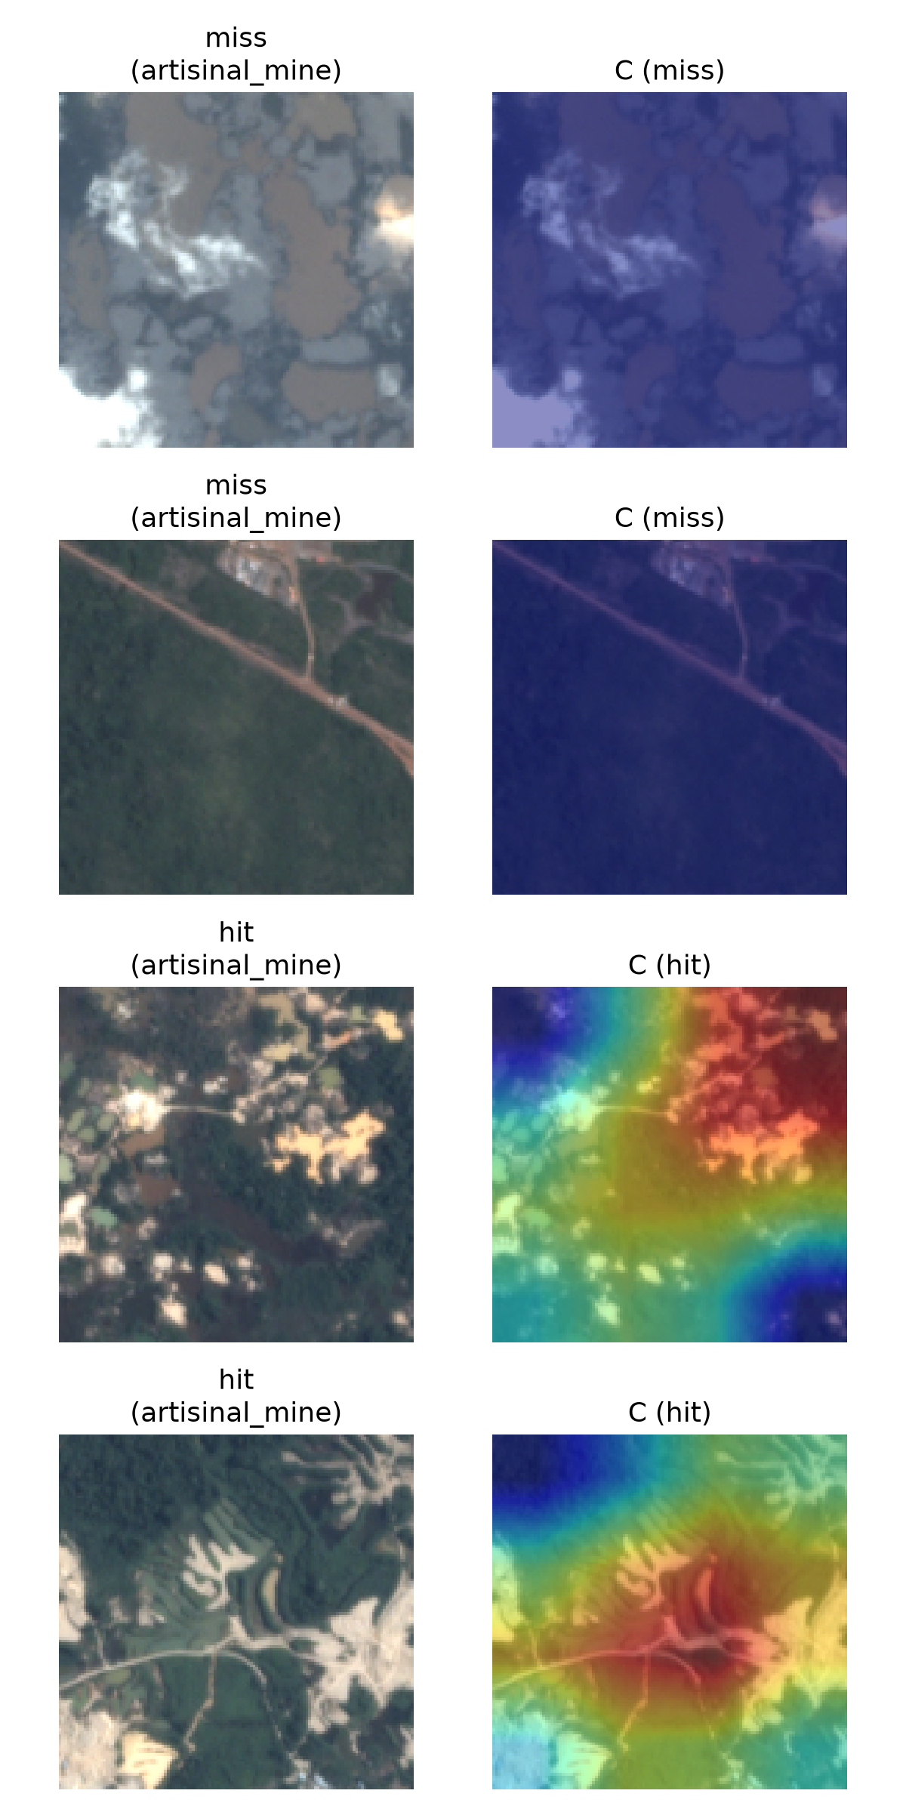
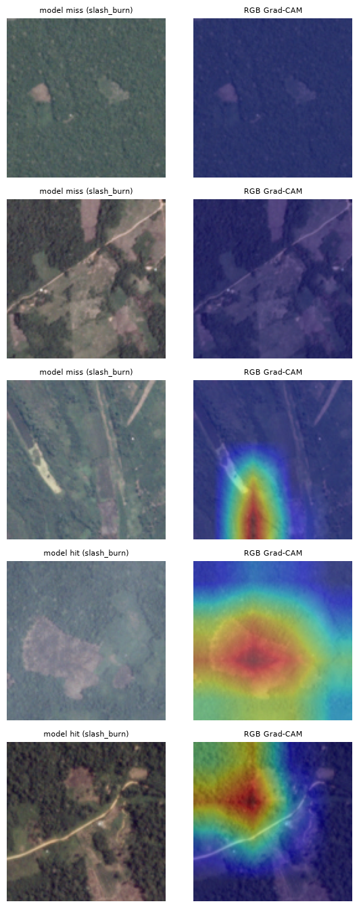
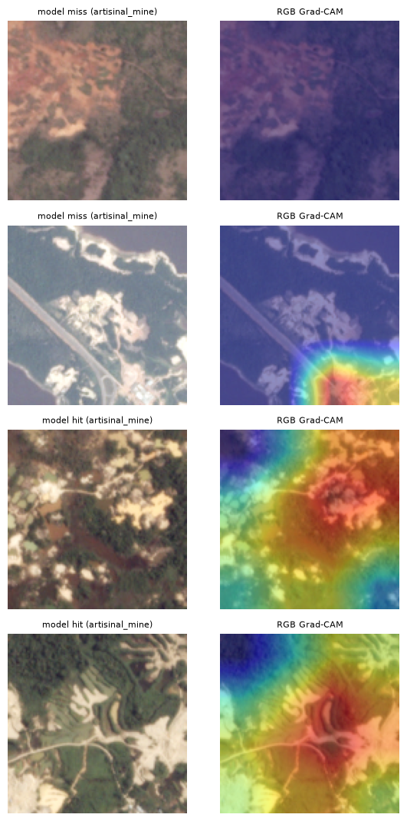
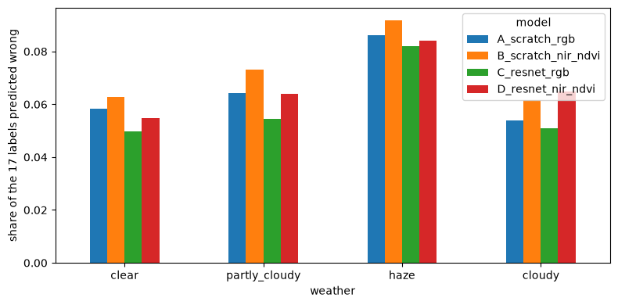
Opening the black box with Grad-CAM
≈ 8%
of labels wrong on hazy tiles vs ≈ 6% on clear (ResNet-34). NIR and NDVI models are no better on haze.
When it hits
Heat locks onto the cleared patch or the mine itself.
When it misses
Heat is faint: the clearing is tiny, subtle or hidden by haze.
Real test tiles. Left pair: slash-and-burn. Right pair: artisanal mine. Red = strongest influence; top rows are misses, bottom rows are hits.
Monitoring Deforestation in the Amazon | Data Science II
Notes:
PRESENTER: Josselin Jimenez
DO: Point to a "hit" row where the heat is red, then a "miss" row where it is faint or blue.
SAY:
To see why the model misses, we used Grad-CAM. It traces a prediction back through the network and highlights the parts of the tile that pushed that label's score up. Red means strong influence.
When the model gets slash-and-burn or a mine right, the heat sits right on the cleared patch or the mine. When it misses, the heat is faint and scattered: the clearing is tiny, subtle, or hidden by haze.
That matches the weather numbers. On clear tiles, the ResNet gets about 6 percent of labels wrong. [That's about one of the seventeen answers per tile.] On hazy tiles, that rises to about 8 percent. [And the infrared models were no better on haze.]

Slide 16
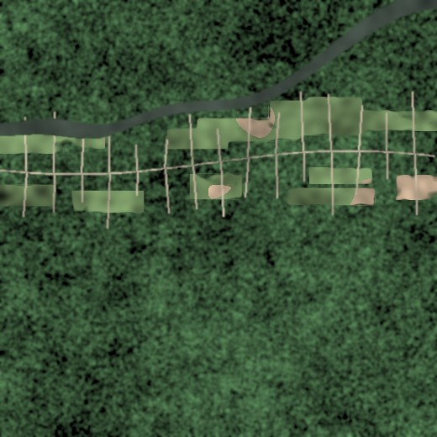
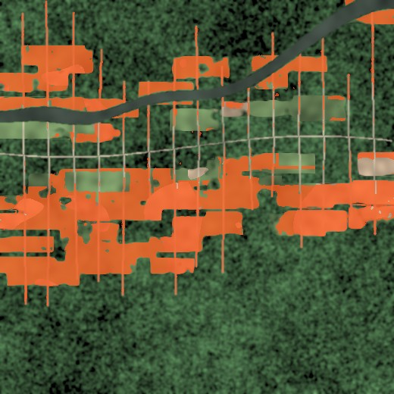


From tile tags to land-use change maps
Comparing NDVI and predicted labels across two acquisitions highlights where primary forest became road, pasture or bare soil. Illustrative synthetic scenes.
Earlier pass
Later pass
Flagged change
Detect
›
Prioritise
›
Verify with a human
›
Act
Enforcement agencies
Carbon accounting
Policy and NGOs
Rank tiles by risk so patrols go where clearing is likely.
Track forest loss and degradation more consistently.
Fast, repeatable, explainable evidence.
Monitoring Deforestation in the Amazon | Data Science II
Notes:
PRESENTER: Josselin Jimenez
DO: Move left to right across the three images: earlier, later, flagged change. Then gesture along the four-step flow. Turn to Mehrab on the final line.
SAY:
So how would this actually be used? We run the model on the same place at two different times and compare the tags. Wherever "primary forest" turns into "road", "agriculture" or "bare ground", that spot gets flagged. // These scenes are illustrative. [But that's how tile tags become change maps.]
The model handles the first two steps, detect and prioritize, so patrols go where clearing is most likely. A person verifies before anyone acts. [It also gives carbon accounting teams and NGOs fast, repeatable evidence.] Predictions are leads for review, never automatic accusations.
Mehrab will close with our limits and what comes next.
[HAND-OFF to Mehrab]

Slide 17
Limits we are upfront about, and what comes next
Limit | What we saw | Next step
Rare classes under-learned | slash-and-burn recall 0.26 to 0.45; blow-down F2 0.20 to 0.40 | Soft-F2 loss, ensembles, more rare-class data
Haze hides the ground | ≈ 8% of labels wrong on haze vs ≈ 6% on clear | Cloud-aware augmentation; multi-date compositing
NIR and NDVI did not help | No significant effect: D − C −0.010, NIR alone −0.006, NDVI on top −0.004 | Learned NIR fusion; several seeds per model to size run-to-run noise
May not transfer | Only 15 test tiles for blow-down and conventional mine | Temporal and spatial hold-out regions and years
Predictions are leads for human review, never automatic accusations.
Monitoring Deforestation in the Amazon | Data Science II
Notes:
PRESENTER: Mehrab U Azan
DO: Read down the first column of the table, then say the next steps with energy.
SAY:
Thank you, Josselin. Our limits. Rare classes are still under-learned: slash-and-burn recall is under fifty percent. Haze raises error. Near-infrared and NDVI did not help. And with fifteen test tiles for some labels, results may not transfer to new regions or years.
Next: try learned fusion of the infrared band, and train each model with several seeds to measure run-to-run noise; test on held-out regions and years; and try a soft-F2 loss and ensembles, which got Kaggle winners to point nine three.

Slide 18

Takeaways
1
A multi-label CNN tags Amazon tiles with 17 labels in one pass: best per-tile F2 0.911 and best macro F2 0.696 (ResNet-34, RGB).
2
On matched data, no single change was a clear win: transfer learning +0.008, NIR −0.006, NDVI −0.004 macro F2, all within noise.
3
We missed the macro F2 target (0.696 vs 0.85); rare-class recall reached 0.60 in four of five runs, and infrared did not beat RGB.
Koretimi Adebowale · Josselin Jimenez · Mehrab Azan
Notes:
PRESENTER: Mehrab U Azan
DO: All three step forward together for the last line. Mehrab delivers the closing, then invites questions.
SAY:
Three takeaways. One: a multi-label CNN tags Amazon tiles with seventeen labels in one pass, with a best per-tile F2 of point nine one one. Two: once every model used the same images, no single change was a clear win: not transfer learning, not near-infrared, not NDVI. Three: we missed the macro F2 target, rare-class recall reached point six in four of five runs, and infrared did not beat RGB. We tested it, and we report that result.
Forest protection runs on early detection, and deep learning can help, with people in the loop. Thank you. We would be glad to take your questions.

Slide 19
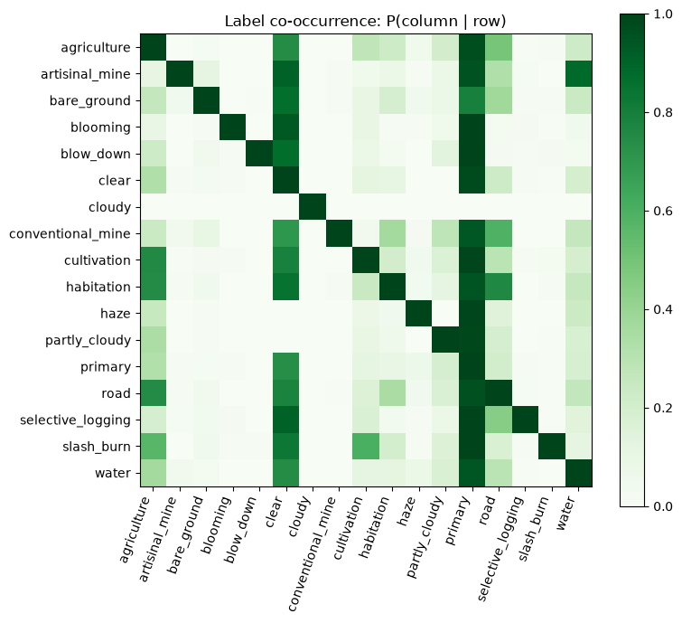
Appendix: how the 17 labels occur together
Rare labels live in forest
slash_burn, blow_down, selective_logging and artisanal_mine almost always also carry primary (≈ 1).
Mines sit beside water
P(water | artisanal_mine) is high (≈ 0.85): rivers are where informal mining happens.
Slash-and-burn borders farms
slash_burn tiles also carry agriculture and cultivation about half the time (≈ 0.55 each).
Cloudy tiles stand alone
A tile labelled cloudy has almost no other labels, because the ground is hidden: the hardest case for the model.
Monitoring Deforestation in the Amazon | Data Science II
Notes:
APPENDIX: use if asked how labels relate. Heatmap shows P(column label | row label) over all 40,479 tiles.

Slide 20
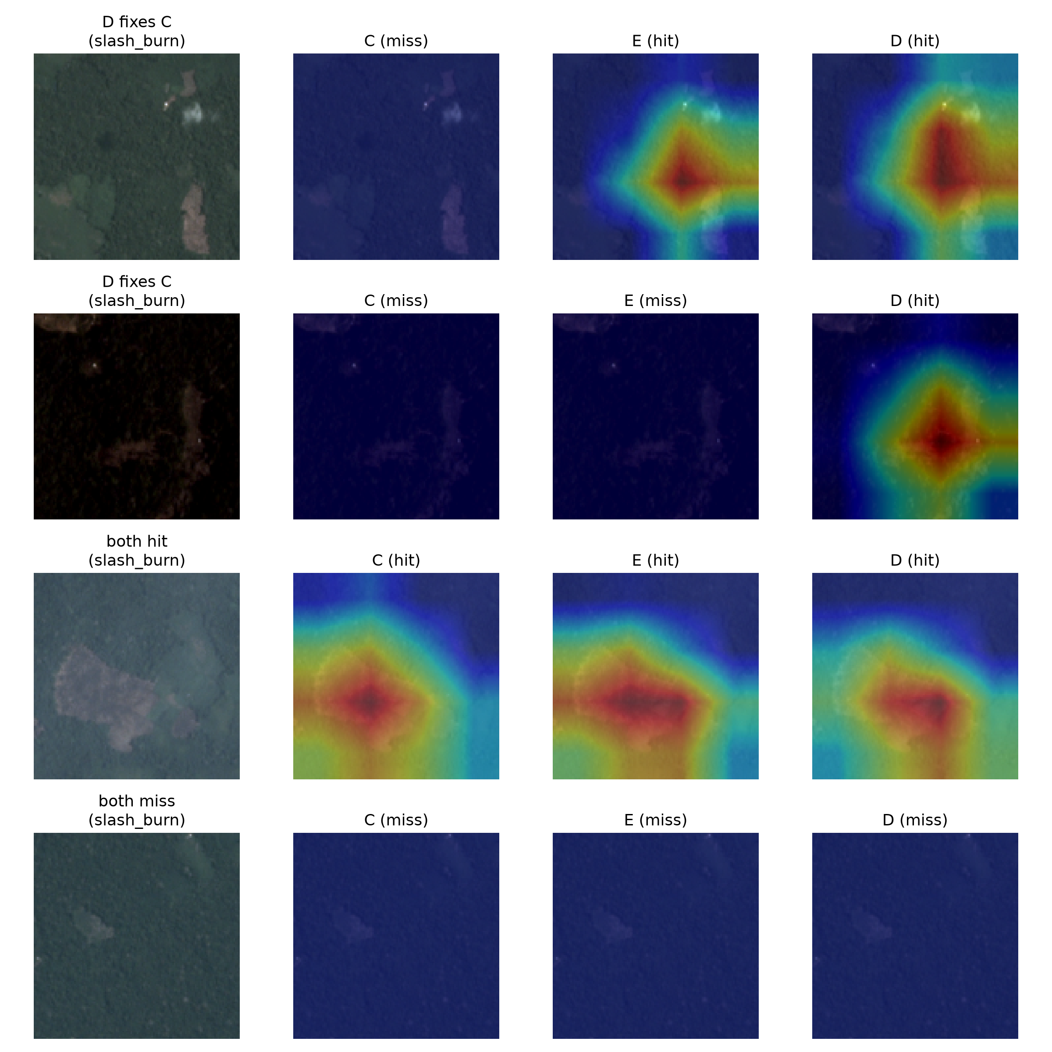
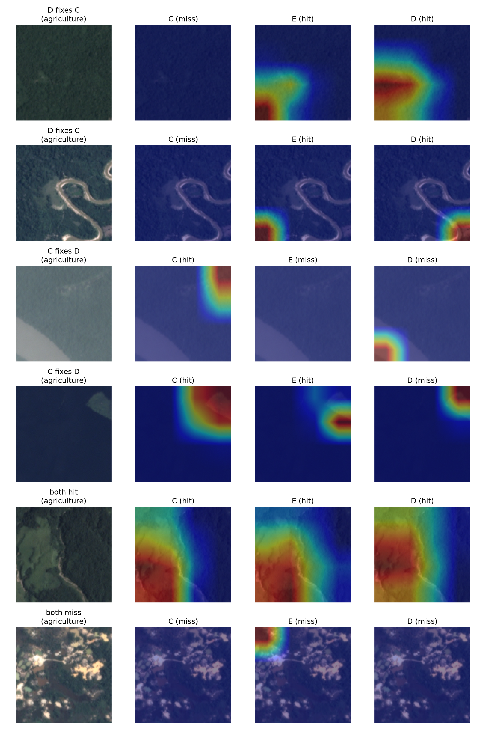
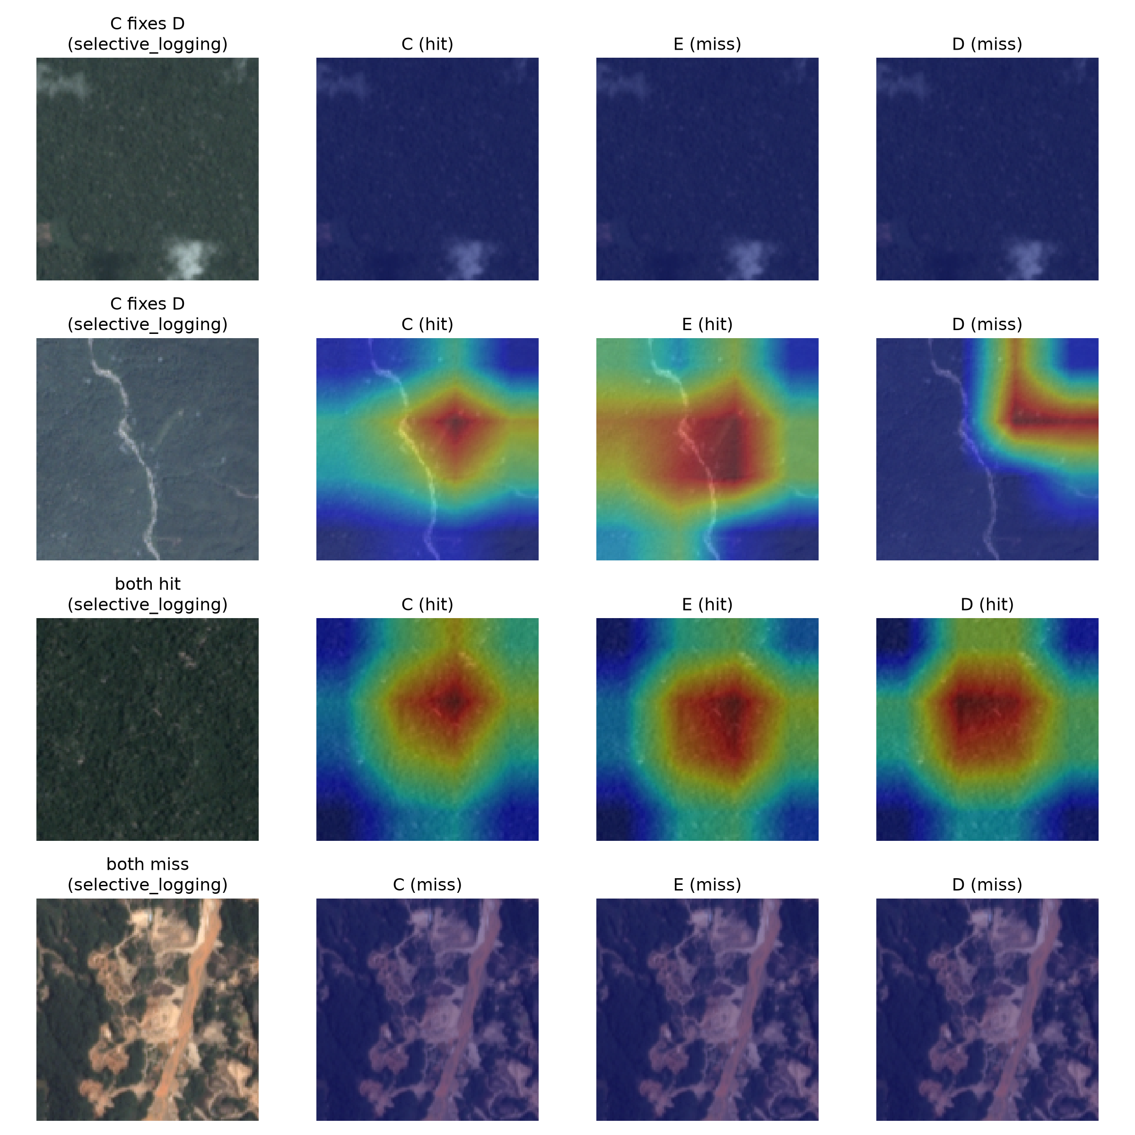
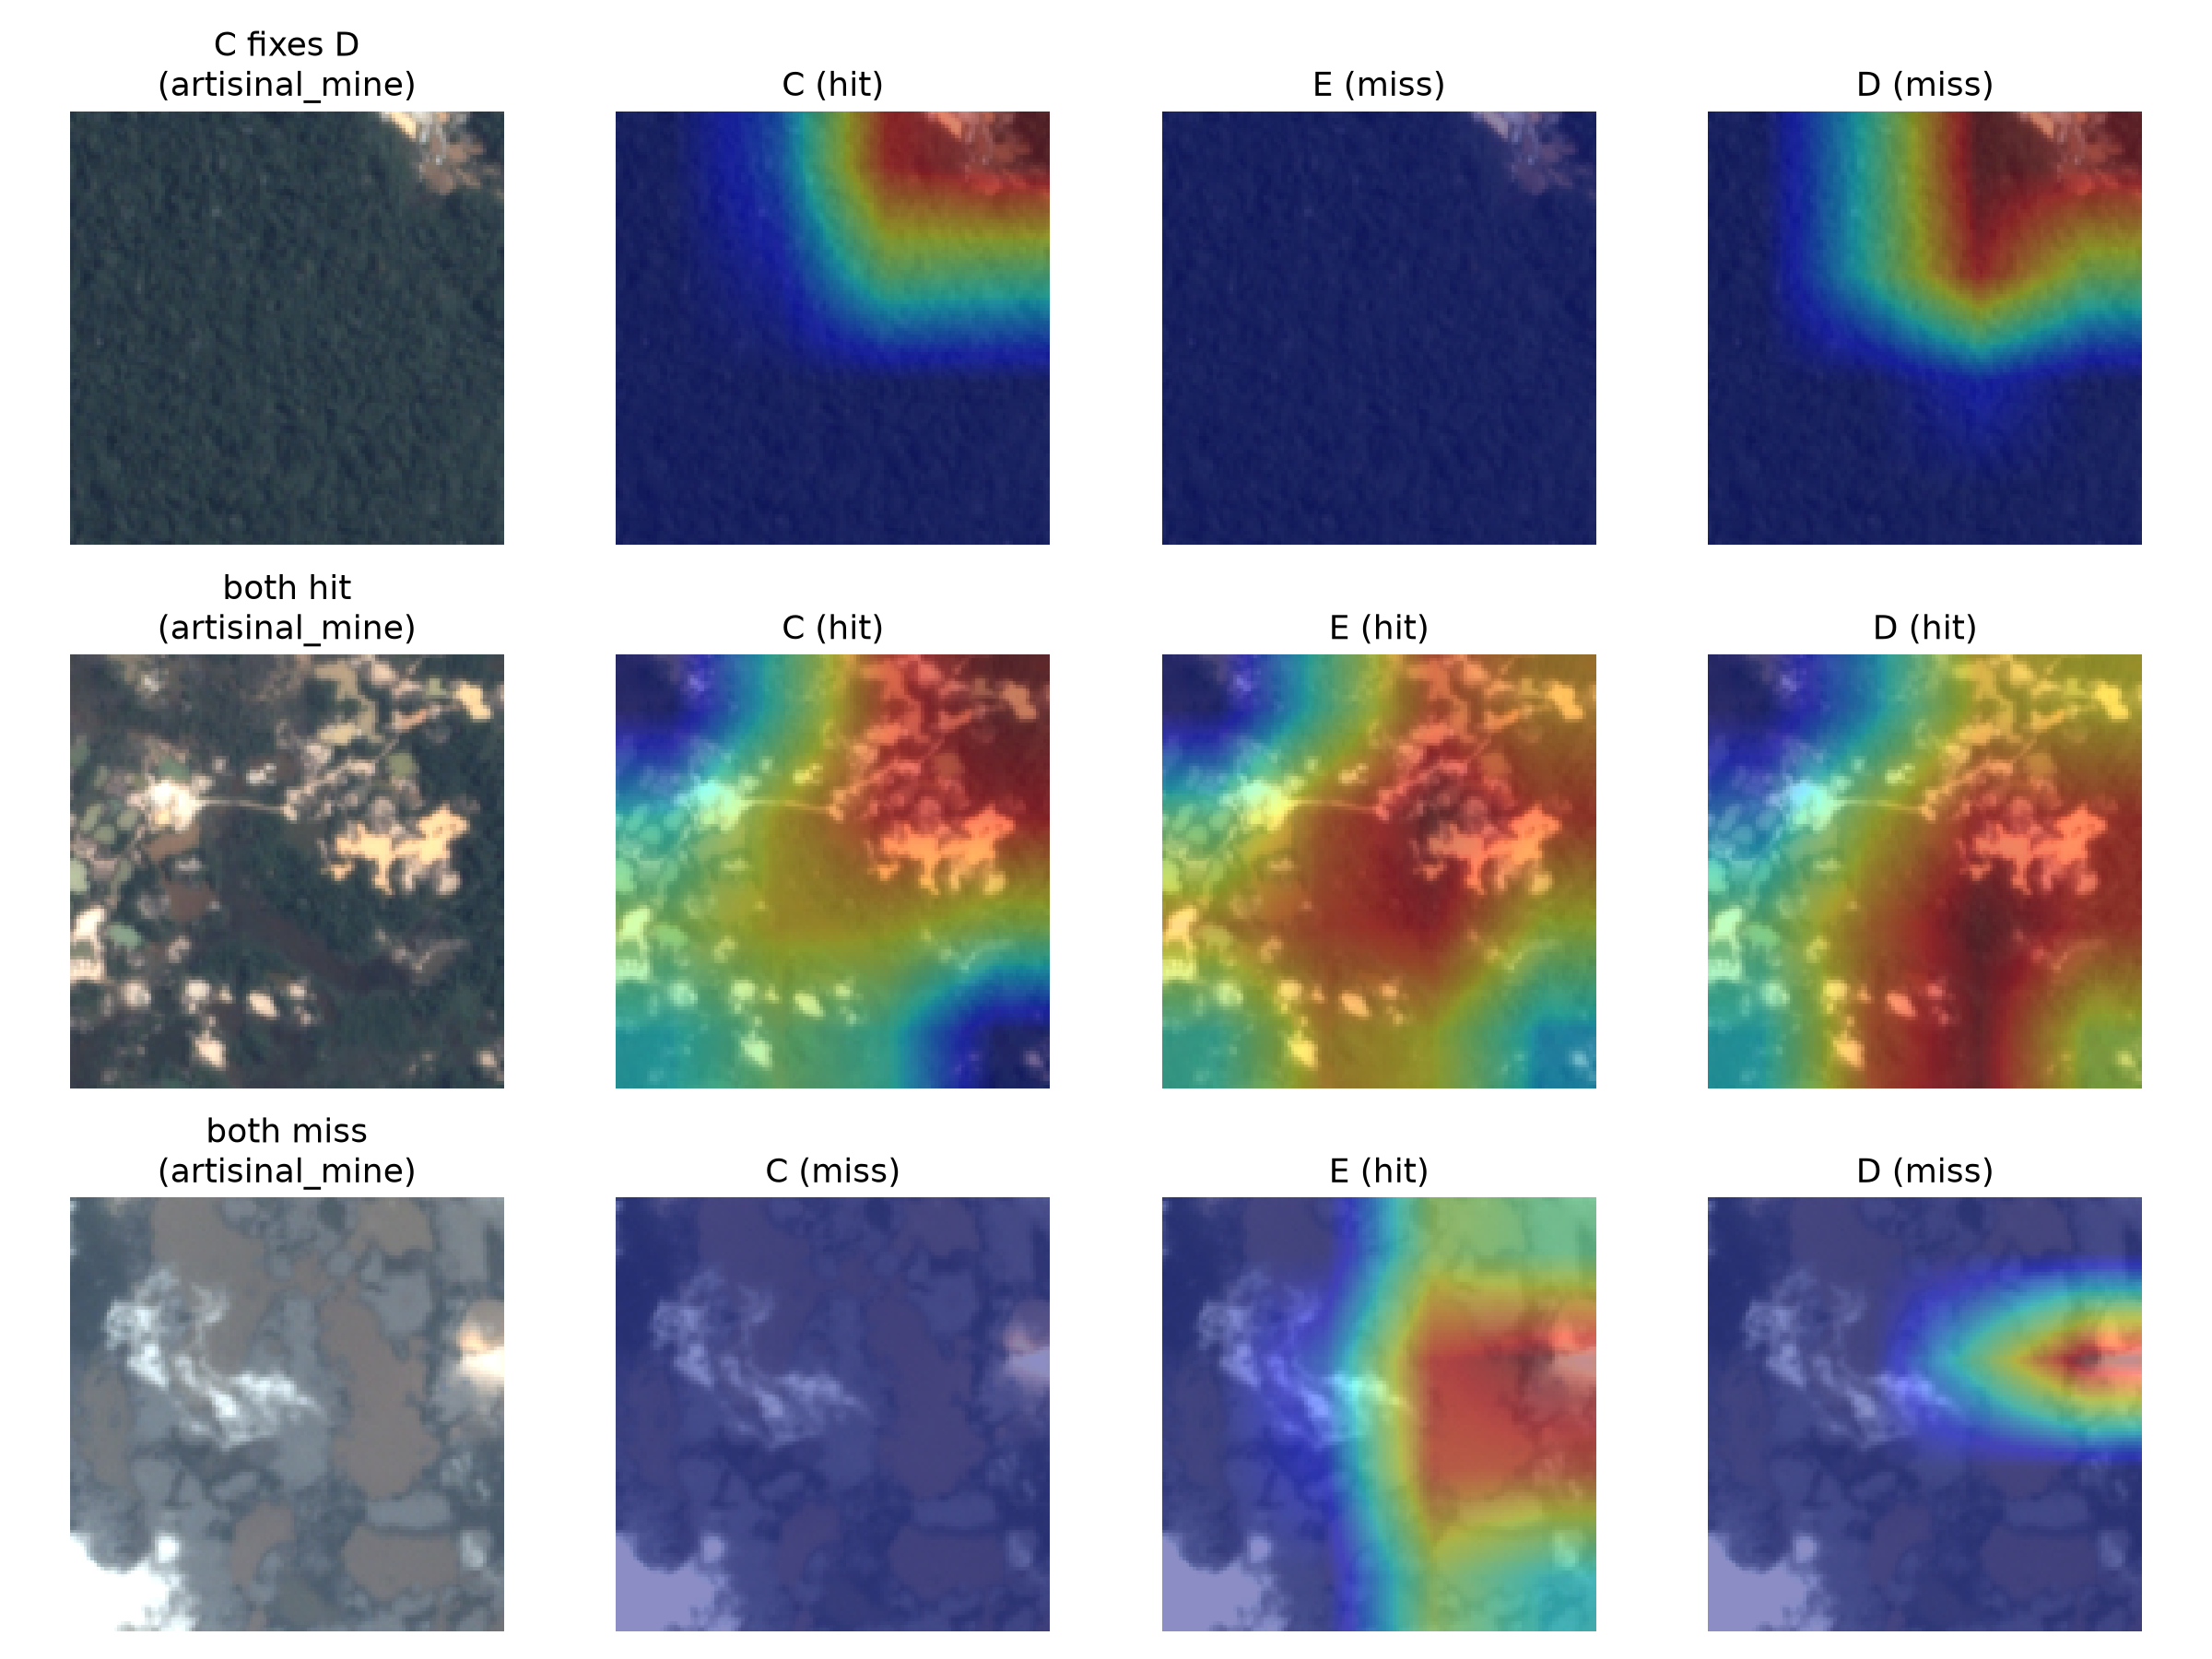
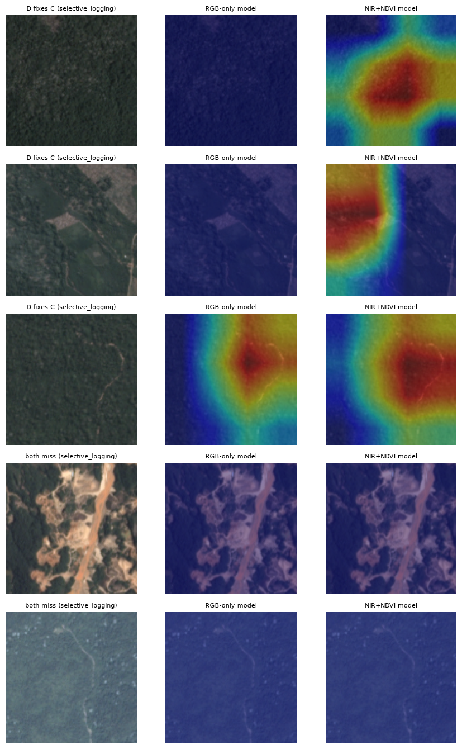
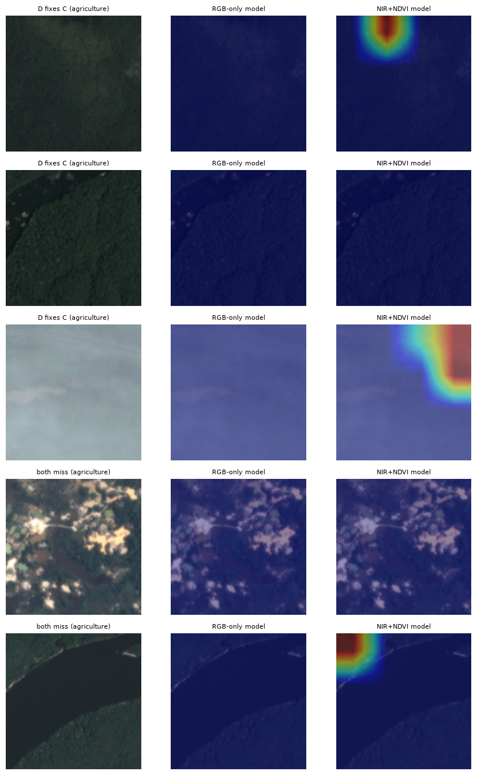
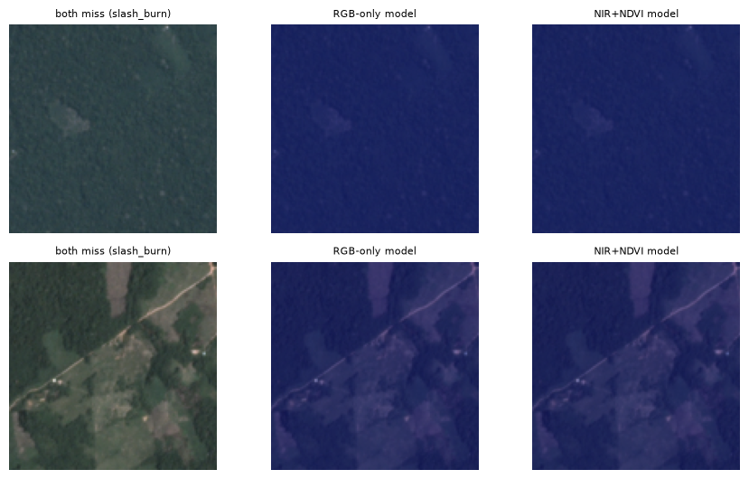
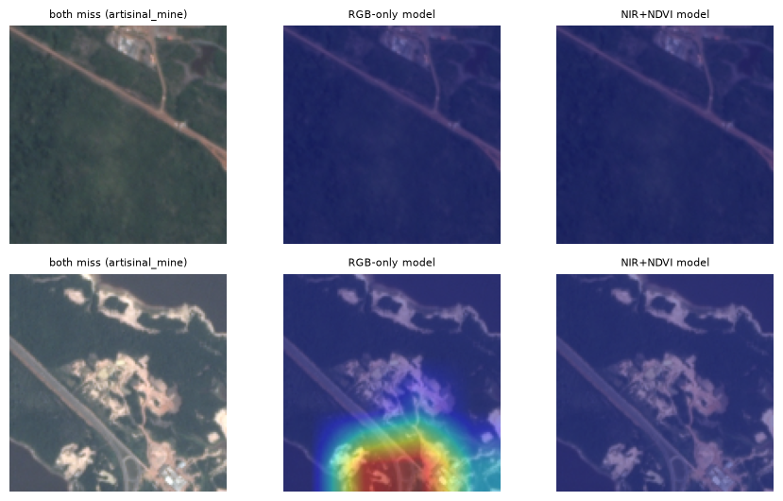
Appendix: Grad-CAM, RGB versus NIR and NDVI models
Agriculture
Selective logging
Slash-and-burn
What to look for
Columns: tile, then ResNets C (RGB), E (+NIR) and D (+NIR+NDVI).
Rows: D fixes C, C fixes D, both hit, both miss.
Each input catches some tiles the others miss, so none wins outright.
'Both miss': subtle clearings stay invisible to all three, matching the low slash-and-burn recall.
NIR changes where the model looks more than how often it is right.
Artisanal mine
Monitoring Deforestation in the Amazon | Data Science II
Notes:
APPENDIX: use if asked for more Grad-CAM examples. Columns: the tile, then the RGB ResNet (C), the RGB+NIR ResNet (E) and the RGB+NIR+NDVI ResNet (D). Red = strongest influence. Rows are labelled 'D fixes C', 'C fixes D', 'both hit' or 'both miss'. All panels come from the final matched checkpoints, every model trained on the same TIF tiles.

Slide 21
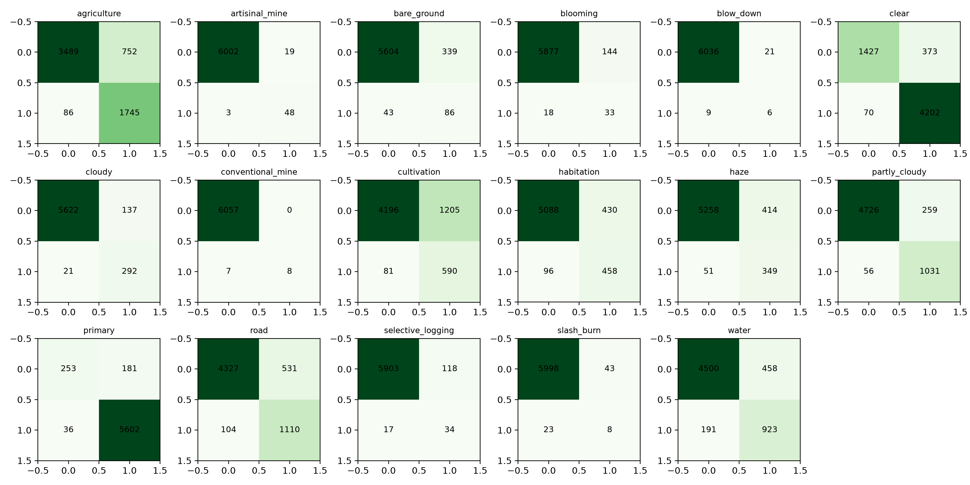
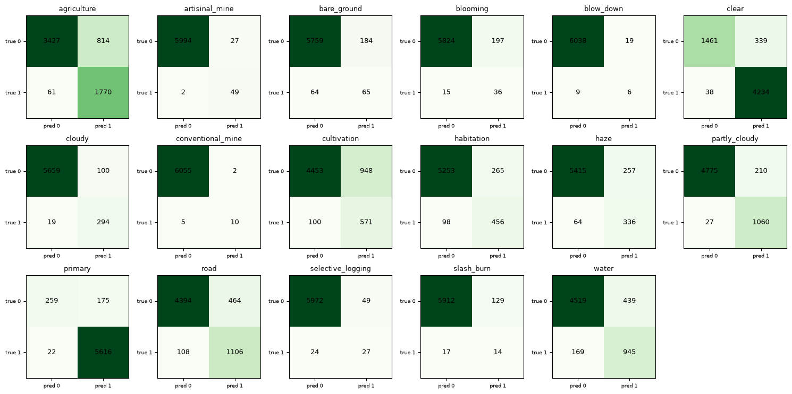
Appendix: confusion matrices, ResNet-34 (model C)
Monitoring Deforestation in the Amazon | Data Science II
Notes:
APPENDIX: use only if asked about per-label errors. Each 2×2 grid shows true negatives, false positives, false negatives, true positives for one label on the 6,072-tile test set.

Slide 22
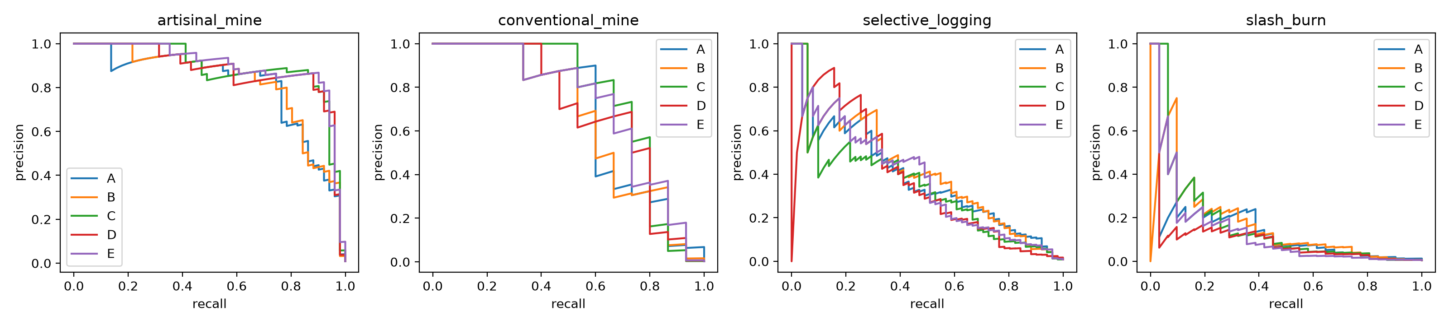
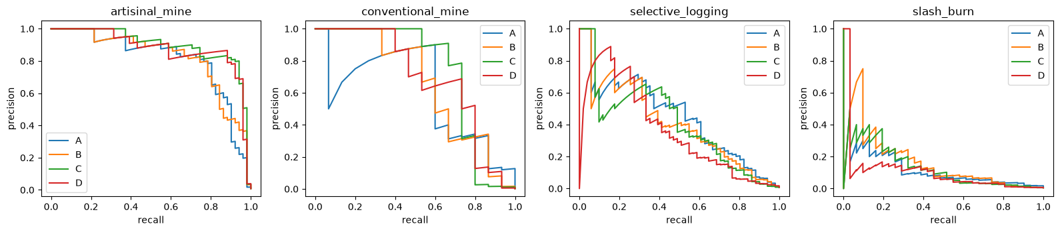
Appendix: precision–recall curves, all five models
Reading the curves (blue A, orange B, green C, red D, purple E): artisanal mine holds high precision up to high recall, while slash-and-burn precision falls quickly as recall rises for every model. No curve clearly dominates, which is why we tune a separate threshold per label.
Monitoring Deforestation in the Amazon | Data Science II
Notes:
APPENDIX: use only if asked about threshold choice. Blue = A, orange = B, green = C, red = D, purple = E.

Slide 23
Appendix: every metric we measured
Test-set metric | A scratch RGB | B scratch +NDVI | C ResNet RGB | D ResNet +NDVI | E ResNet +NIR
Macro F2 | 0.6877 | 0.6733 | 0.6955 | 0.6862 | 0.6898
Per-tile F2 (Kaggle metric) | 0.9023 | 0.9028 | 0.9106 | 0.9111 | 0.9100
Micro F2 | 0.8902 | 0.8922 | 0.9011 | 0.9010 | 0.9003
Hamming loss (lower is better) | 0.0678 | 0.0665 | 0.0614 | 0.0589 | 0.0622
Rare-class recall (mean of 4) | 0.6835 | 0.6556 | 0.5998 | 0.6281 | 0.6328
Recall: artisanal mine | 0.7843 | 0.8431 | 0.9412 | 0.9216 | 0.9412
Recall: conventional mine | 0.7333 | 0.6667 | 0.5333 | 0.7333 | 0.6667
Recall: selective logging | 0.7647 | 0.7255 | 0.6667 | 0.4706 | 0.5686
Recall: slash-and-burn | 0.4516 | 0.3871 | 0.2581 | 0.3871 | 0.3548
Rare label | Test tiles
artisanal mine | 51
blooming | 51
selective logging | 51
slash-and-burn | 31
blow-down | 15
conventional mine | 15
Bootstrap, 1,000 resamples
C − A: +0.0083 [−0.0122, 0.0285] not significant
D − C: −0.0098 [−0.0283, 0.0092] not significant
E − C: −0.0059 [−0.0221, 0.0104] not significant
D − E: −0.0035 [−0.0187, 0.0125] not significant
B − A: −0.0144 [−0.0328, 0.0041] not significant
D − B: +0.0131 [−0.0040, 0.0294] not significant
Rare labels: artisanal mine, conventional mine, selective logging, slash-and-burn. Thresholds tuned per label on validation data. All five models trained on the same TIF tiles, split and seed. Green = best in row.
Monitoring Deforestation in the Amazon | Data Science II
Notes:
APPENDIX: use if asked for any number not on the main slides. All values are test-set results from the matched run (every model on the same TIF tiles, split and seed); thresholds were tuned per label on validation data only.

Slide 24
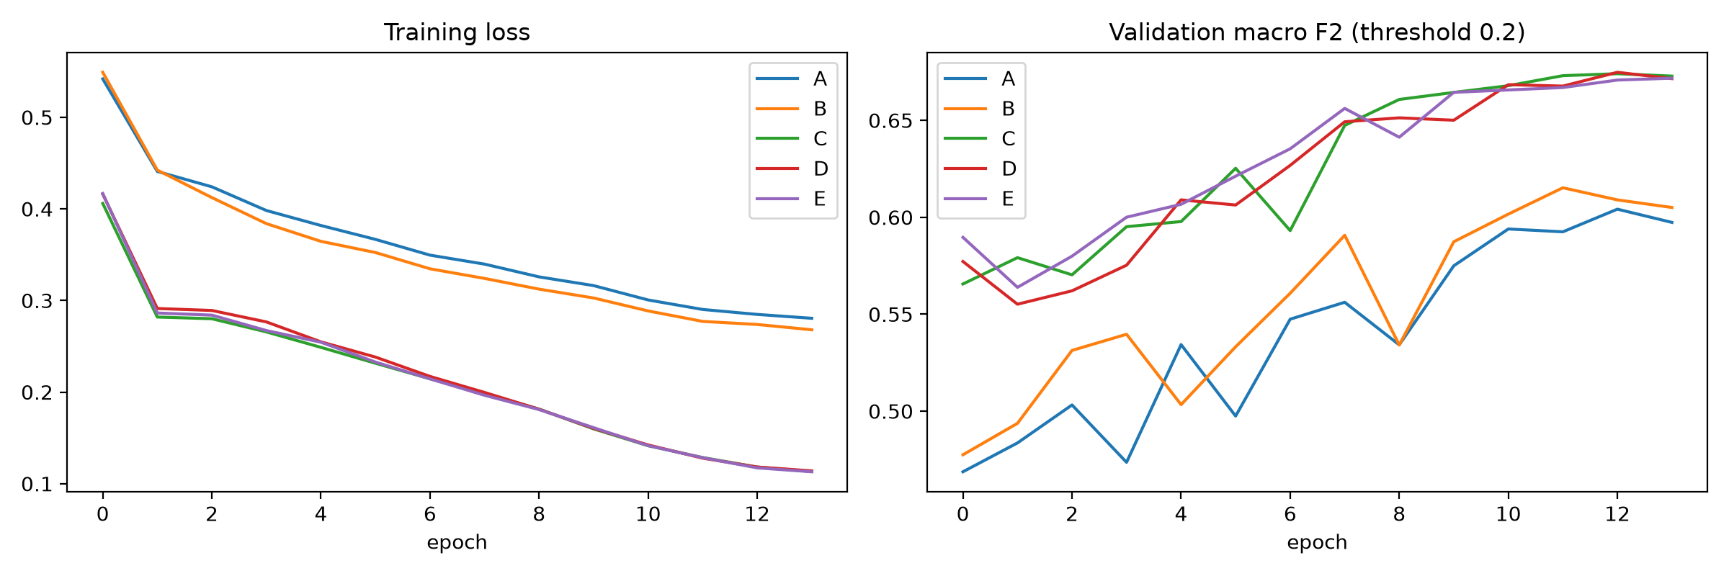
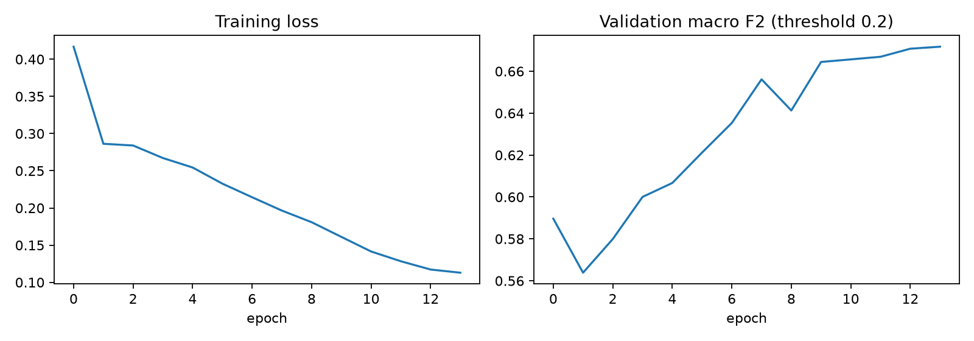
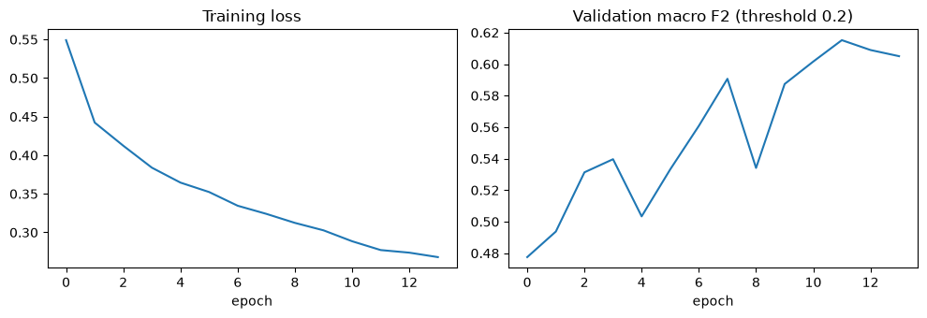
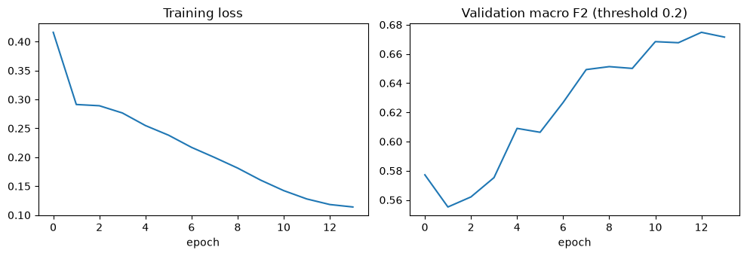
Appendix: training curves for all five models
All five runs (A–E)
E: ResNet-34, RGB + NIR
Scratch CNNs (A, B) end near loss 0.27–0.28 and validation macro F2 ≈ 0.60–0.62; ResNets (C, D, E) end near 0.11 and ≈ 0.67.
Loss falls from 0.42 to 0.11; validation macro F2 climbs from 0.59 to about 0.67, almost identical to C and D.
All five runs trained cleanly for 14 epochs. The three ResNets converge to nearly the same validation score whatever the input, consistent with near-infrared and NDVI adding little beyond RGB here.
Monitoring Deforestation in the Amazon | Data Science II
Notes:
APPENDIX: use if asked whether the models trained properly. Left: all five runs (training loss and validation macro F2 at a fixed 0.2 threshold, before per-label tuning). Right: run E alone.

Slide 25
References and image credits
Kaggle. Planet: Understanding the Amazon from Space. kaggle.com/competitions/planet-understanding-the-amazon-from-space
Selvaraj, A., et al. Deep Learning Approaches for Land Cover and Land Use Classification Using Remote Sensing Imagery. Remote Sensing Applications, 2019 to 2023
INPE. PRODES and DETER deforestation monitoring (TerraBrasilis)
O Liberal (2025). Desmatamento na Amazônia em 2025 caiu 11,08% em relação a 2024, afirma Prodes/Inpe
Butler, R. A. (Aug 2026). Amazon deforestation alerts fall to lowest level since 2013. Mongabay
Stanford CS231n (2017). Project report on Planet Amazon classification (F2 benchmarks)
Skaug, M. amazon-classifier (GitHub), random forest and VGG16 baselines
Real chips, Grad-CAM panels and all result figures come from our own notebook run. All other satellite-style images in this deck are synthetic illustrations generated by the team.
Monitoring Deforestation in the Amazon | Data Science II

