Slide 1

“Higher Education in Bangladesh”
Mehrab Hossain Mashrur
Batch-39(01-039-10)

Slide 2

History and Development
Brief History: Discuss the origins of higher education in Bangladesh, focusing on the establishment of key universities such as Dhaka University (founded in 1921) and its role in shaping the academic landscape.
Notable Milestones: Highlight significant events like the establishment of the University Grants Commission (UGC) in 1973, which oversees and coordinates the activities of higher education institutions.
Key Developments: Include major reforms, expansion of higher education institutions, and the impact of international collaborations on the educational framework.

Slide 3

Current Status
Current Landscape: Describe the overall structure of higher education, including the types of institutions such as public universities, private universities, and technical institutes.
Number of Institutions: Provide statistics on the total number of universities and higher education institutions in Bangladesh.
Types of Institutions: Detail the distinctions between public universities, private universities, and technical institutes, emphasizing their roles and contributions.
Enrollment Statistics: Include data on the number of students enrolled in higher education, gender distribution, and fields of study.

Slide 4


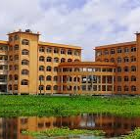
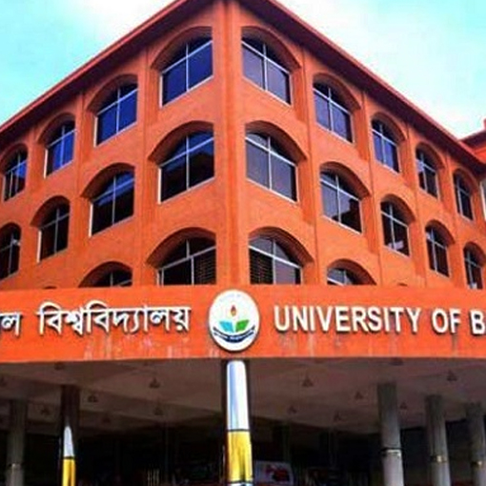


Challenges and Opportunities
Opportunities for Improvement:
Government Initiatives
International Collaborations
Increased Investment
Technological Advancements
1
2
Common Challenges
Quality of Education
Infrastructure
Faculty Shortage
Funding
3
4
5
6

Slide 5
Future Directions
Future Plans & Policies
Expansion Project
Quality Assurance
Policy Framework
Strategic Goals
Initiatives to Improve Higher Education
Research and Development
Teacher Training Programs
Student Support Services

Slide 6


Thank You
Mehrab Mashrur
jrmehrab@gmail.com

