Slide 1


Data Cleaning Boris Kerkez
Mehrad Tavanamehr
202201051

Slide 2

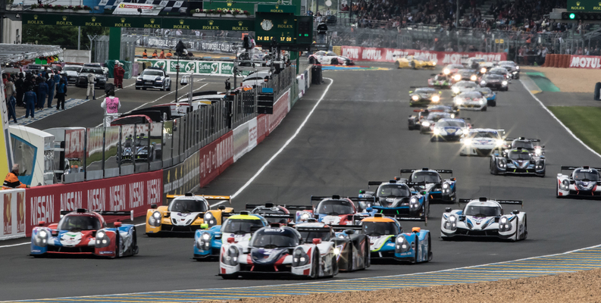
FIA World Endurance Championship Lap Data 2012-22
This dataset contains the lap time information for the FIA World Endurance Championship (WEC) for the 2012 to 2022 seasons.
Data was scraped from the FIA WEC timing, hosted at http://fiawec.alkamelsystems.com/index.php.

Slide 3
Content
number: The car number that completed the lap driver_number: The driver of the car number that completed the lap lap_number: The lap number of the race the lap was completed at lap_time: The lap time recorded as they crossed the timing beam lap_improvement: Haven't looked into this, but my guess would a variable showing if the driver made improvement vs previous lap_times. Likely 0 is no improvement, 1 is green (personal best), 2 is purple (race best), and 3 is a WR? 99% of the laps have 0 improvement, so further research probably needed. crossing_finish_line_in_pit: boolean for if they crossed the finish line, B if they did, nan else s1, s2, s3 The sector times recorded as they crossed the timing beam (recorded in ss.mss) s1/s2/s3_improvement similar to lap_improvement s1/s2/s3_large: how they crossed the timing beams similar to lap_time t6, t7, porsche, ford: only applicable to LE_MANS, the timing recorded similar to s1, s2, s3_large kph: the average kph of the lap top_speed: the fastest recorded time of the lap driver_name: the driver that recorded the lap pit_time: the recorded time that was spent in the pitlane (typically followed by "B" in crossing_finish_line_in_pit) class: the class of the car that set the lap time group: the group of the car that set the lap time, only applicable to LMP1s and LMP2 Pro/Am (2021 season?) team: the team of the car that set the lap manufacturer: the manufacturer of the car that set the lap season: the WEC season the lap was set at circuit: the circuit the lap was set at round: the round (race number in the championship) the lap was set at vehicle: the car the lap was set with flag_at_fl: the flag status at the timing beam (only for 2022) lap_time_ms: The lap time recorded in milliseconds (seconds*1000) lap_time_s: the lap time recorded in seconds team_no: A combination of team and the team's number e.g Toyota Gazoo Racing #7 engine: The engine of the car the lap was set with. driver_stint_no: Labeling the driver stint. A stint changes when the driver pits and either a. stays in the car, or b. swaps into the car. driver_stint: A combination of driver_name and the driver_stint_no, e.g. Mike CONWAY Stint #1 team_stint_no: Labeling the team stint. A stint changes when the driver pits. team_stint: A combination of team_no and the team_stint_no, e.g. Toyota Gazoo Racing #7 Stint #1 position: The position of the car at the time of the lap. class_position: The position of the car in class at the time of the lap. interval_ms: The interval (gap to the car in front for position) in ms interval: The interval (gap to the car in front for position) in s gap: The total time to the leader (time to 1st position overall) in s class_interval: The interval (gap to the car in front for position in class) in s class_gap The total time to the leader (time to 1st position in class) in s
Dataset.shape
(483178, 50)

Slide 4
Steps in brief
General loading dataset with pd.read_csv()
Initial analyze
Loading dataset, based on initial analyze
Check and change data types of fields
Separate dataset to meaningful parts based on content of data
Check and fill null value with proper values
fixing values of categorical data
Reducing duplicate features
Continue with numeric values and find outliers
Checking some method for categorical data

Slide 5
The most difficulties
The most difficulties I faced,
Changing datatype from string to specific time format
def convertstrTotime(item):
if str(item).count(':') == 0:
hr, minu = '00','00'
if str(item).count('.') == 0:
misec = str(item)
sec = '00'
else:
sec, misec = map(str, item.split('.'))
elif str(item).count(':') == 1:
hr = '00'
minu, secmic = map(str, item.split(':'))
if str(secmic).count('.') == 0:
sec = str(secmic)
misec = '00'
else:
sec, misec = map(str, secmic.split('.'))
elif str(item).count(':') == 2:
hr, minu, secmic = map(str, item.split(':'))
if str(secmic).count('.') == 0:
sec = str(secmic)
misec = '00'
else:
sec, misec = map(str, secmic.split('.'))
return hr.zfill(2)+':'+minu.zfill(2)+':'+sec.zfill(2)+'.'+misec

Slide 6
The most difficulties
The most difficulties I faced,
Selecting correct method for finding outliers
Checking distribution of each feature and deciding use between below methods
IQR
Zscore
KNN

