Slide 1
AZƏRBAYCAN HAVA YOLLARI “QSC” MİLLİ AVİASİYA AKADEMİYASI
Course Work
Faculty: Aerospace
Specialty: Computer Engineering
Group:1459i
Subject: Memory Handling In Assembly Language
Student: Babayev Mehrali

Slide 2
Assembler language
In 1952, Grace Hopper, an American woman, created Assembler, the world's first mnemonic programming language. Its name is derived from the English word "assemble", which means "to assemble". It included a system of mnemonic commands (command lists), a library of procedures, and a special program to convert program texts into machine code.
Assembler is unlike any other programming language and is a completely different language. The fact that the Assembler language is a 2nd generation language and the development of 3rd generation languages ​​on the assembler does not mean that the Assembler language is outdated and is no longer used.

Slide 3
Advantages of Assembly Language 1. It requires less memory and execution time; 2. It allows hardware-specific complex jobs in an easier way; 3. It is suitable for time-critical jobs; 4. It is most suitable for writing interrupt service routines and other 5. memory resident programs. The Disadvantages of Assembly Language 1. Machine-dependent. 2. lengthy code. 3. error-prone (likely to generate errors). 4. On small-sized computers, such programs cannot be executed. 5. Coding or writing the program takes a lot of time, as it is more complex. 6.The syntax is difficult to remember.

Slide 4
What Is Memory Management? Memory management is regulating and coordinating computer memory by allocating parts of memory known as blocks to various operating applications to improve the system’s overall performance. The management of primary memory is the most critical function of an operating system. It facilitates the movement of processes between the main memory and the execution disc. It assists the operating system in keeping track of all memory locations, whether they are allocated to a processor stay unallocated.

Slide 5
Why Memory Management Is Needed? There are several reasons to use memory management: 1. It enables you to determine how much memory should be assigned to processes that 2. determine which processors should receive memory at what moment. 3. Keeps track of when inventory is released or unallocated. It will, according to it, update the status. 4. It gives application routines the space they need. 5. It also ensures that these programs do not conflict with one another. 6. Assists in the protection of several processes from one another. 7. It loads the applications into memory to make the most of the available memory.

Slide 6
HoW Memory Management Work? The sys_brk() system call is provided by the kernel, to allocate memory without the need of moving it later. This call allocates memory right behind the application image in the memory. This system function allows you to set the highest available address in the data section. This system call takes one parameter, which is the highest memory address needed to be set. This value is stored in the EBX register. In case of any error, sys_brk() returns -1 or returns the negative error code itself. The following example demonstrates dynamic memory allocation.

Slide 7
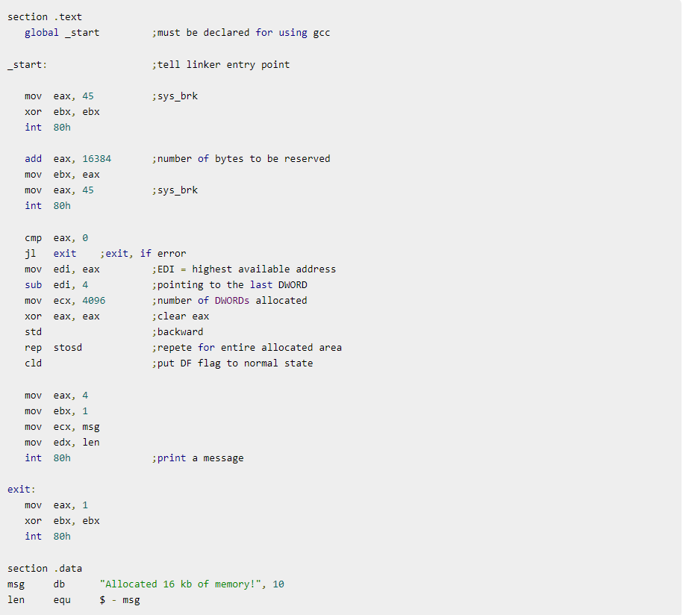

Example The following program allocates 16kb of memory using the sys_brk() system call −
When the above code is compiled and executed, it produces the following result −

Slide 8
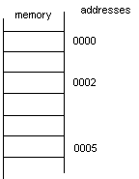
Memory Structure
The computer's memory can be thought of as small memory slots arranged sequentially and numbered starting at 0.
The index number (k) of the last memory slot is determined by the size of the memory. The size of each memory slot is 1 byte, and in these memory slots can be placed only integers from 0 to 255. Each byte, in turn, consists of 8 bits. Each of these bits corresponds to any number from 0 to 255.
To access the information stored in the computer's memory, you need to know its address.

Slide 9
Address
The index number of each memory slot is called its "address". Since index numbers are numbered starting from 0, the address of the first byte of memory is 0, the address of the next byte is 1, and so on. they are. As we can see, memory addresses, in turn, are expressed in numbers. Each piece of information and instruction is stored in memory at a specific address. To get the address of a variable, you need to add a dollar sign to the beginning of its name.

Slide 10
How to access the memory of the processor
The processor must know its address in order to access the information in memory. We can use various features provided by the processor to specify the address. The simplest way to transfer data to a processor is to place the information in a single instruction.
Movl $45 %ebx
In the above code, 45 is transferred to the %ebx register. In this case, the price of 45 is placed directly in the movl $ 45 %ebx instruction, the processor does not get it in any memory address. For example, we declare a long variable y in memory and assign 3 values ​​to it.
.data
y:
.long 3
In this case, if we want to copy that information to the variable %ebx, we write:
movl y, %ebx
As a result, the "value" of the variable y - 3 will be written to the% ebx register. This time the data is already transferred from memory to the processor.

Slide 11
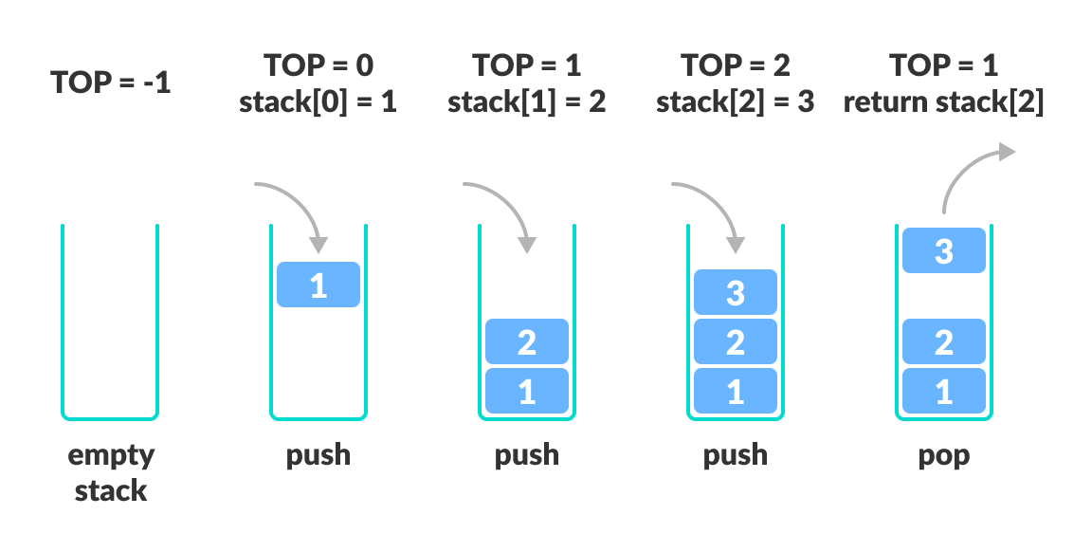
POP and push
The push instruction is used to place information from the stack.
A pop-up instruction is used to retrieve information from the stack.

Slide 12
Addressing methods
1) Direct application method. This method is only used using the ADDRESS_AND_SLINE limit.
For example: movl ADDRESS, %eax movl 0x453ac00, %ebx
This instruction copies the information stored in the ADDRESS memory to the %eax register.
2) Indexed addressing mode. In this case, the %INDEX limits with ADDRESS_OR_SLIMT are present.
movl string_start(,%ecx,1), %eax

Slide 13
Addressing methods
3) Indirect addressing mode. In the indirect reference method, the address of the memory byte to be referenced is placed in any register. For example, if the address is %eax If it is written (movl $ ADDRESS, %eax), then we perform the following operation to write the value at that address to %ebx.
movl (%eax), %ebx
4) Base pointer addressing mode. The initial indicator reference method is close to the indirect reference method. The difference is that in this case, a fixed quantity is added to the address given in the register.
movl 4(%eax), %ebx

Slide 14
Addressing methods
5) Immediate mode. This method is very simple. This goes beyond the general formula we have adopted. A quick way is to write values ​​directly to registers or memory. For example, if you want to write the number 12 in %eax
movl $12, %eax
you have to write.
6) Register application method. This method simply writes any information to the register or reads it from the register. In addition to these methods, there are other instructions for transferring data from one place to another. For example, the movl instruction is 4 bytes each time transmits information in size. In most cases, you will only need to copy one byte from the given address. To do this, use the movb instruction are. However, since the registers we are looking at are 4 bytes, they cannot be used in these instructions. Instead you register you must use parts.

Slide 15


