Slide 1
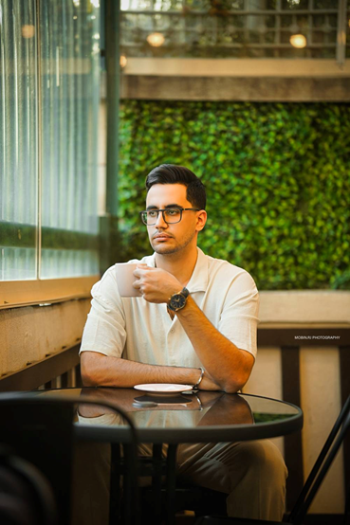


👤Personal Information
Date of birth : 2005/1/18
Marital Status : Single
👁️ Summary
Sixth-semester Computer Engineering student with an excellent academic record and experience in game development. Skilled in contributing to both commercial and academic projects across software, hardware, and programming domains. Passionate about web development and software engineering, with strong problem-solving abilities, teamwork skills, and a proven capacity for rapid learning. Seeking professional opportunities to apply technical knowledge, gain hands-on experience, and further develop a career in software development.
Mehrdad Varmazyar
Software developer
👨‍🎓 Education
📱09223848714
📧mehrdadmrs10@gmail.com
🏠 Hamedan Mehrdad_383 Mehrdad386
Mehrdad386
Bachelor of Computer Engineering
Major: Software Engineering
University: Bu-Ali Sina University
Location: Hamedan, Iran
Start Date: October 2023
Expected Graduation: Currently Enrolled
GPA: 17.36 / 20
Skills
Software programming
C++ 🟩🟩🟩🟩🟩
Python 🟩🟩🟩⬜⬜
👨‍💻Work experience
Hardware programming
VHDL 🟩🟩🟩⬜⬜
Game Development Trainee
Noavaran khalagh pendar Co. – Hamedan, Iran
Jul 2023 – Jun 2024
• Learned game development using the Construct 3 game engine.
• Designed and developed 2D web-based games.
• Gained hands-on experience with game development logic and systems.
• Participated in game development projects and team collaboration.
Web Programming
HTML , CSS 🟩🟩🟩⬜⬜
Word press ⬜⬜⬜⬜⬜
Computer stuffs
ICDL 🟩🟩🟩🟩🟩
Game development
Construct3 🟩🟩🟩🟩⬜
Foreign Languages
English 🟩🟩🟩🟩⬜
Database Design
Postgresql 🟩🟩🟩🟩⬜

Slide 2
🗃️ Projects
Traffic Escape
Employer : Noavaran khalagh pendar
Date : March 2025
Explanation : 2D web-based game implemented with Construct3 game engine
Link :
see project
WOOD NUTS AND BOLT PUZZLE
Employer : Noavaran khalagh pendar
Date : March 2024
Explanation : 2D web-based game implemented with Construct3 game engine
Link :
see project
Final Fight
Employer : Academic Project
Date : December 2023
Explanation : a terminal game as final project of “basic programming” course , implemented with CPP
Link :
see project
Rakab
Employer : Academic Project
Date : July 2024
Explanation : A terminal boardgame as final project of “advance Programming” course , implemented with CPP
Link :
see project
Vending Machine
Employer : Academic Project
Date : December 2024
Explanation : a hardware VHDL program to handle a vending machine ; final project of “Digital Circuits Design” course
Link :
see project
Uni Shop
Employer : Academic Project
Date : December 2025
Explanation : Final project of “Database design” course consist of an EER , SQL code of schema , schema tables , python app to help user connect db
Link :
see project

Slide 3
Heap Allocator
Employer : Academic Project
Date : May 2025
Explanation : Final project of “Operating systems” course , implemented with C
Link :
see project
Data Structures
Employer : Academic Project
Date : December 2024
Explanation : important data structures implemented in CPP as exercises of “Data structures” course
Link :
see project
DBMS Storage manager
Employer : Academic Project
Date : April 2026
Explanation : storage manager system of a DBMS , implemented with CPP as a mini project for “implementation of Database systems” course
Link :
see project
10 Small Python Projects
Employer : self-employed
Date : March 2024
Explanation : 10 small project of python (to help me in my learning path)
Link :
see project

