Slide 1
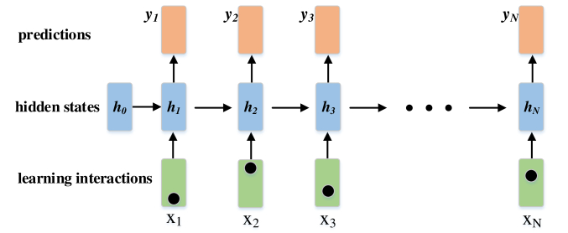

How models for knowledge tracing depend on data
Machine learning for behavioural data, CS-421, EPFL, Switzerland
Group
- Tikhon Parshikov
- Mehrdad Kiani

Slide 2
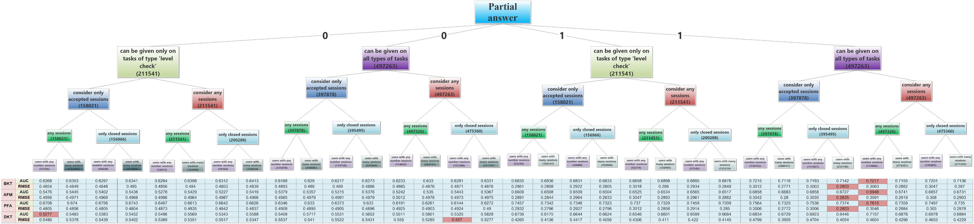
Decision tree
- 32 experiments on data frame subjects,
- Metrics to compare: AUC and RMSE.

Slide 3
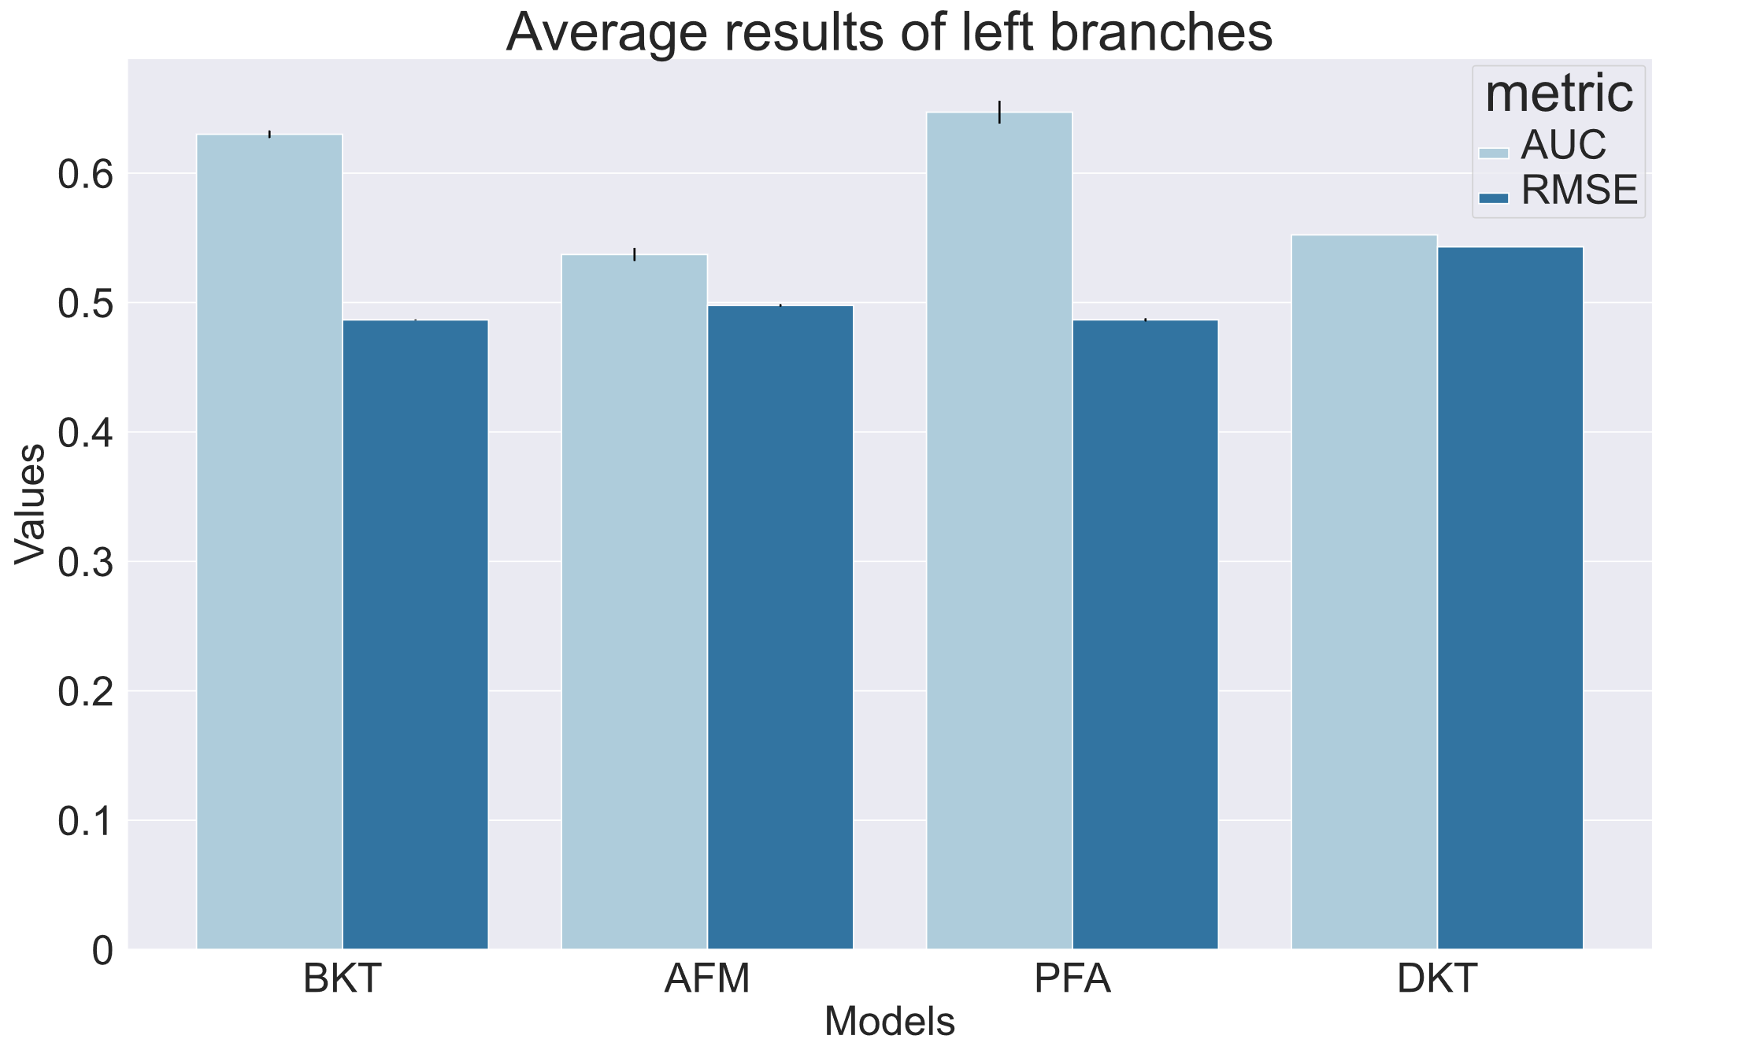
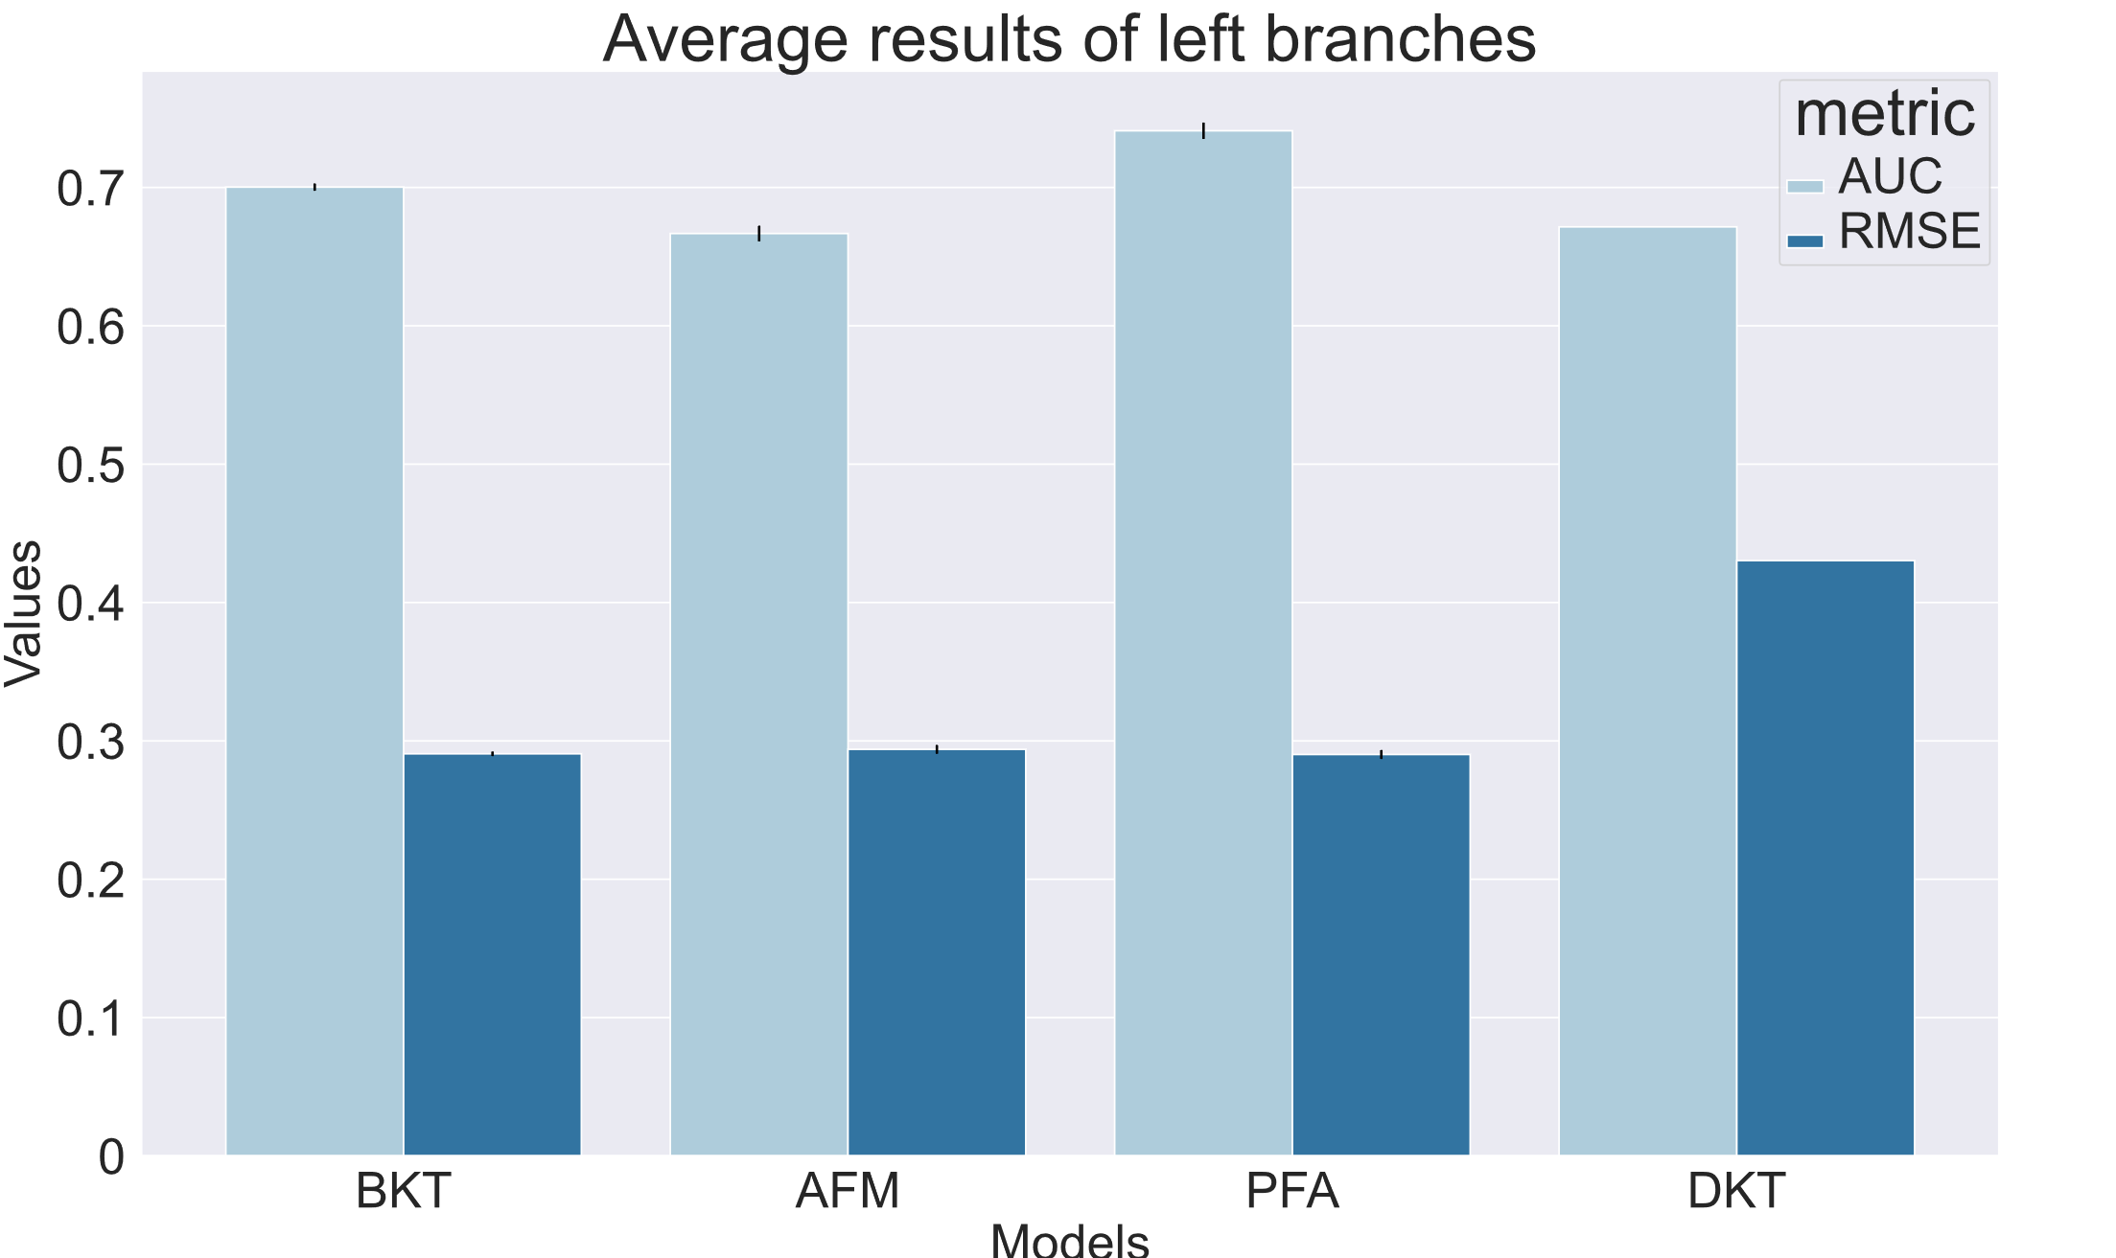
Performance of models

Slide 4
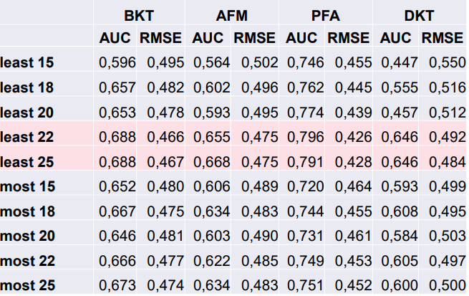
Knowledge models performance

Slide 5
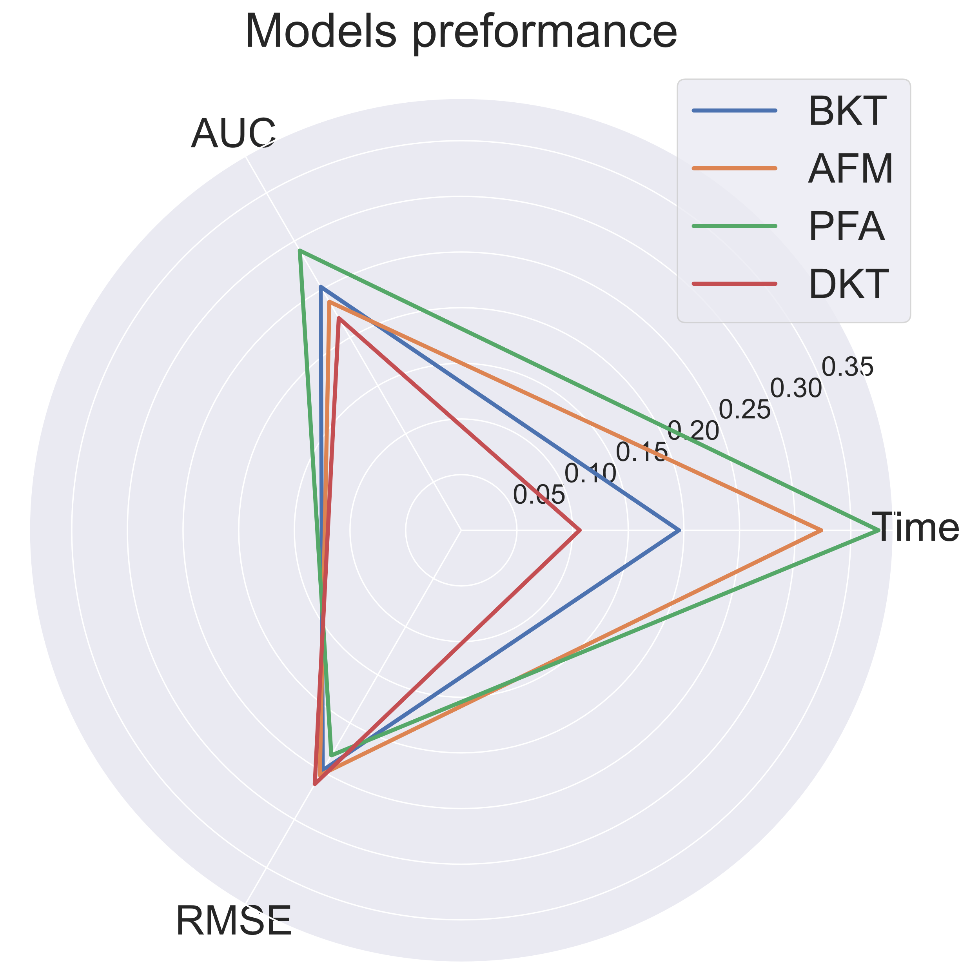
Performance-time execution
Experiments were done on topics,
PFA has the best performance,
BKT has the second rank of performance and low execution time,
Almost the same RMSE for all methods.

Slide 6
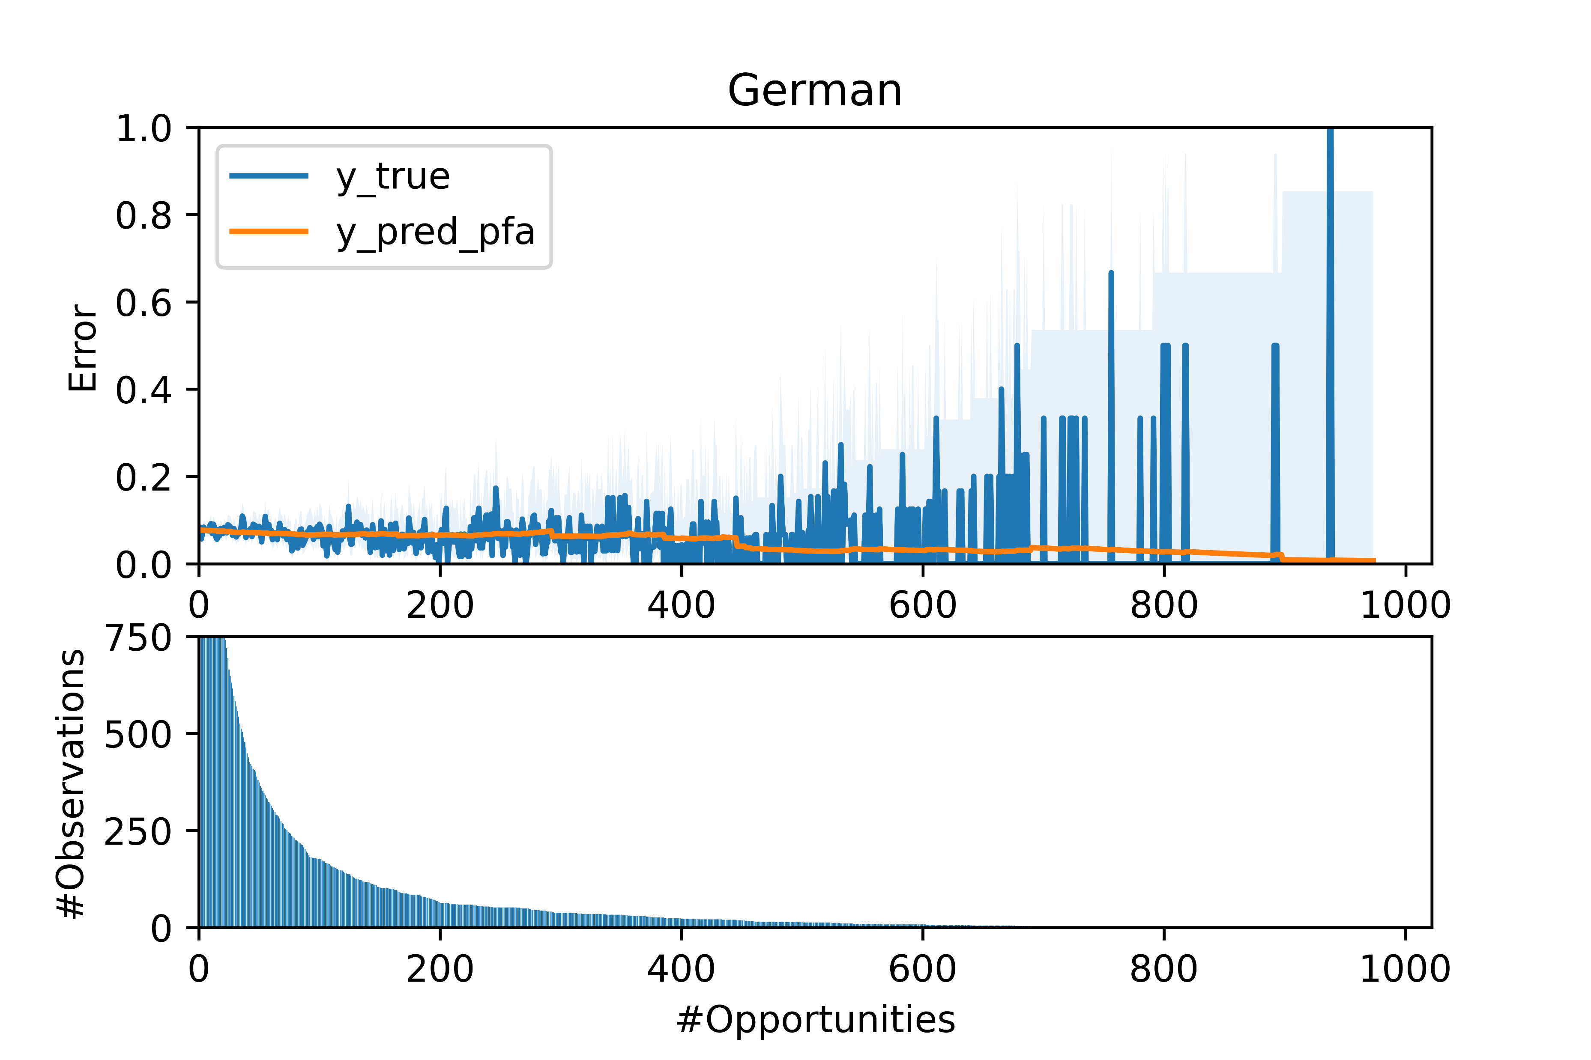
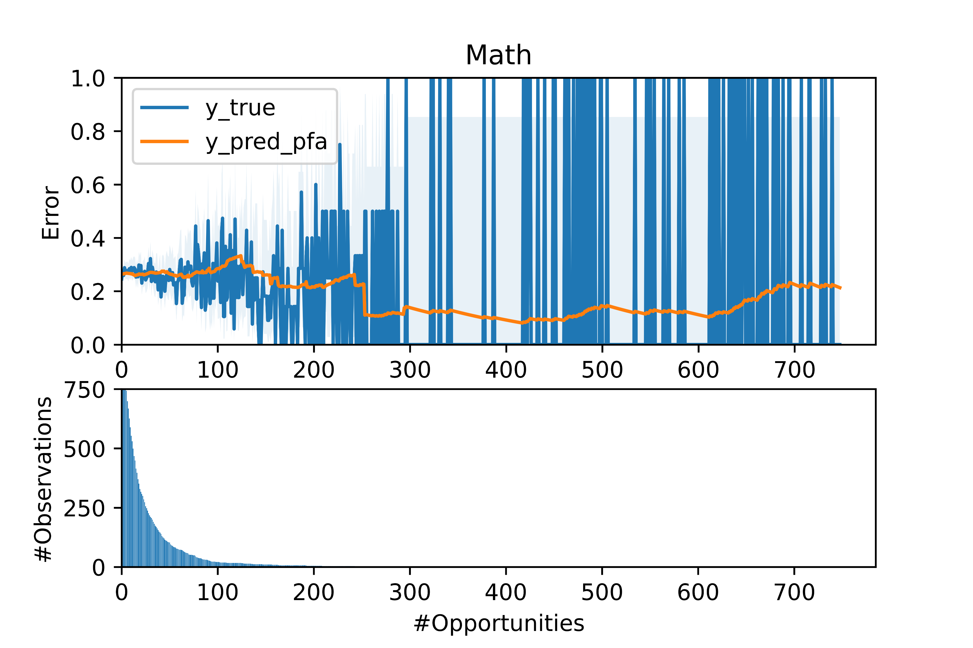
Learning curve

Slide 7
Conclusion
PFA model performed the best and BKT is on second place.
It can be seen that AFM and DKT are much less qualified for this data.
On datasets with more than 20000 rows AFM and PFA train for a much bigger amount of time than BKT and DKT.
There is always a tradeoff between time (BKT) and quality (PFA).
Working with this dataset and having enough amount of data we would advise to use BKT model, while for small datasets or when the quality of the model is crucially important PFA should be used.

