Slide 1





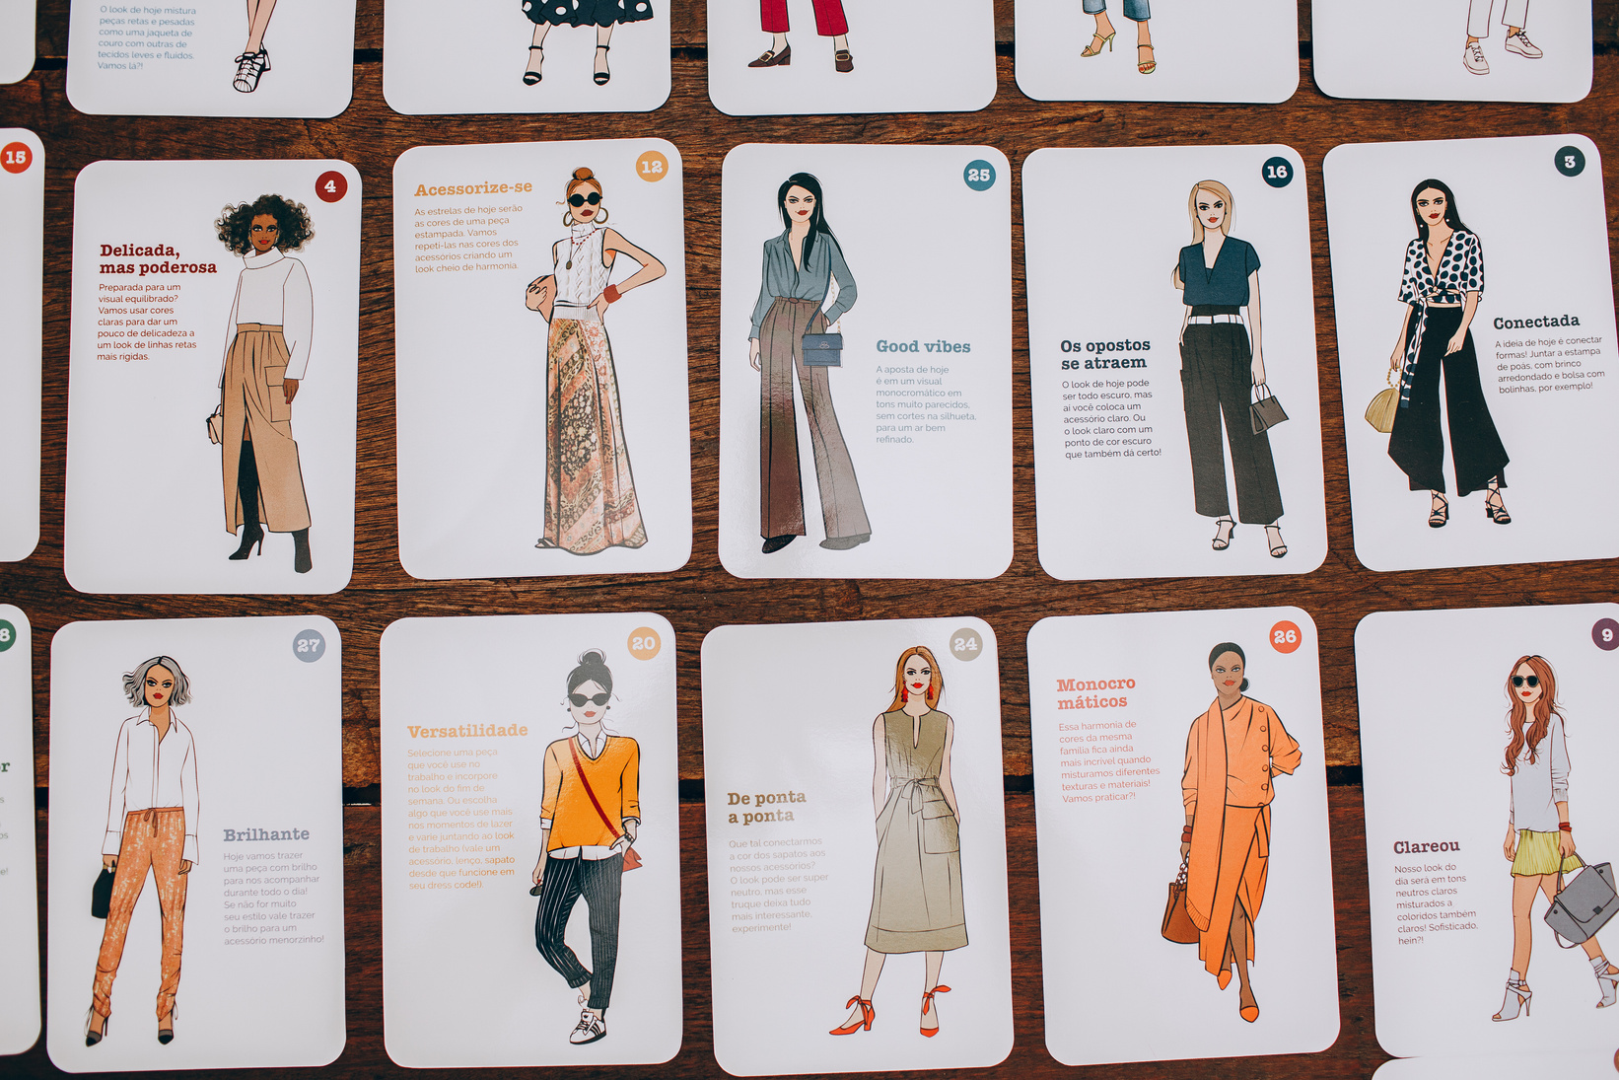
Fashion-MNIST Classification Project
Building a Convolutional Neural Network (CNN) for Image Classification
Mehrdad Naderi
University of Colorado Boulder
2024 - Fall 2

Slide 2



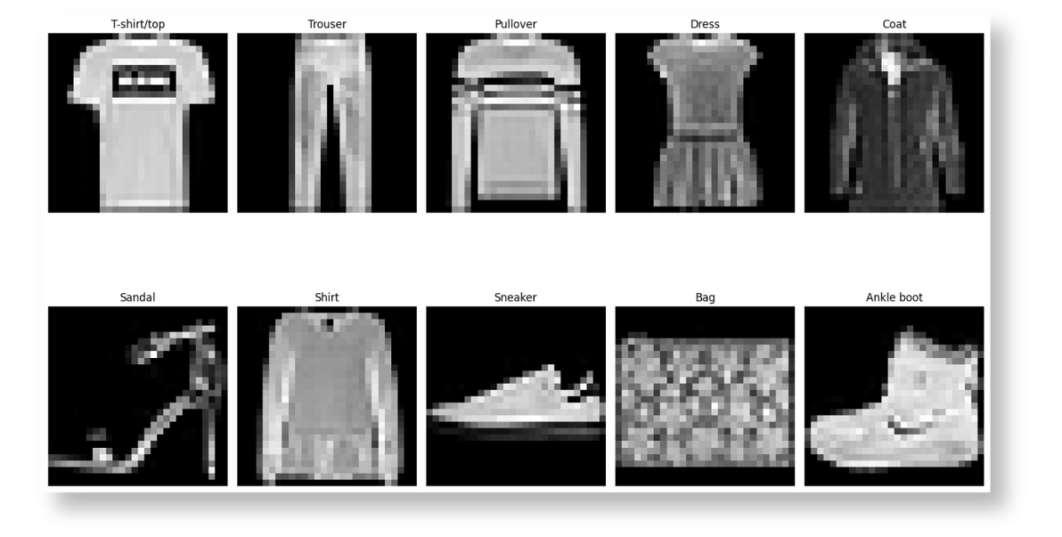




Problem:
Classifying grayscale images of clothing into 10 categories.
Objective:
Build and evaluate a CNN to achieve high classification accuracy.
Dataset Details:
60,000 training images and 10,000 test images.
Image size: 28x28 pixels, grayscale.
Categories: T-shirt/top, trouser, pullover, dress, coat, sandal, shirt, sneaker, bag, ankle boot.

Slide 3
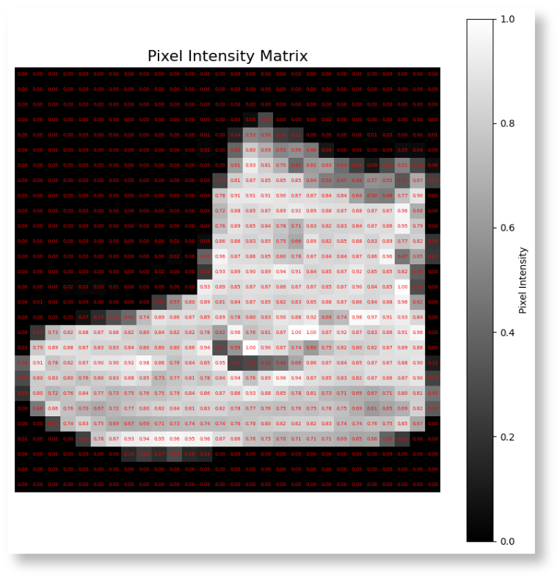


Steps Taken:
Normalized pixel values to the range [0, 1].
Split data into training, validation, and testing sets.
One-hot encoded labels for classification.
Reasoning:
Why no additional preprocessing was needed (clean, normalized, consistent dataset).

Slide 4
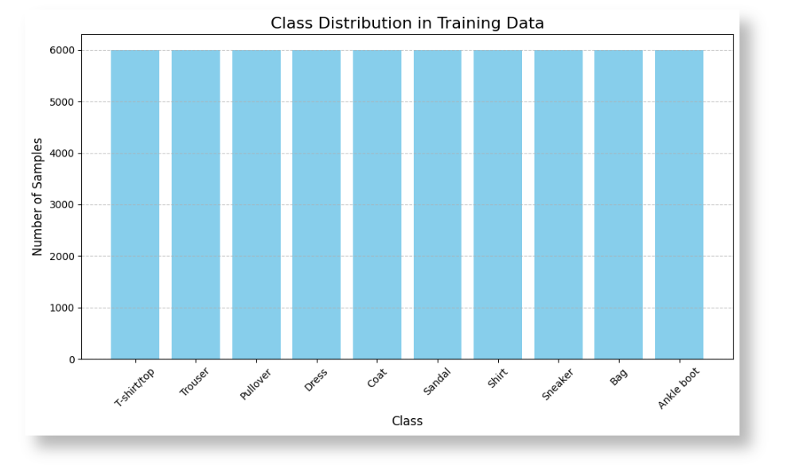
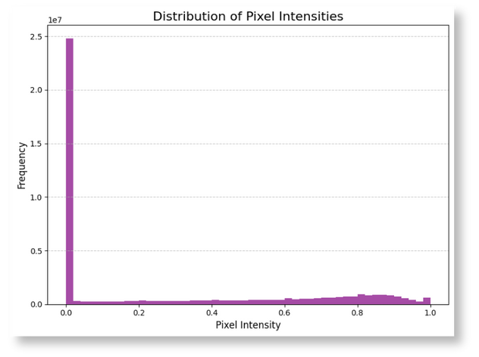
Insights from EDA:
Balanced class distribution.
Pixel intensity range [0, 1], confirming consistency.
No missing values or outliers.
Visualizations:
Class distribution plot.
Pixel intensity histogram.

Slide 5
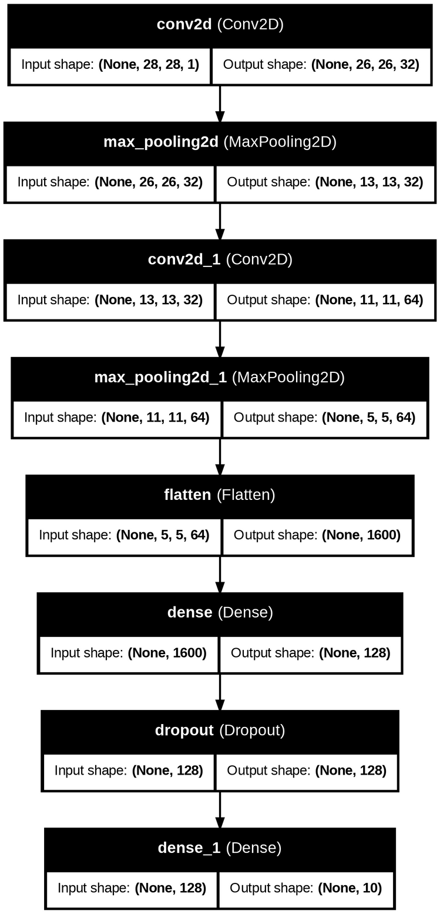

Model Overview:
Two convolutional layers with max pooling.
Flattening and dense layers with ReLU activation.
Dropout for regularization.
Output layer with softmax activation.
Compilation Details:
Optimizer: Adam.
Loss Function: Categorical Crossentropy.
Metric: Accuracy.

Slide 6
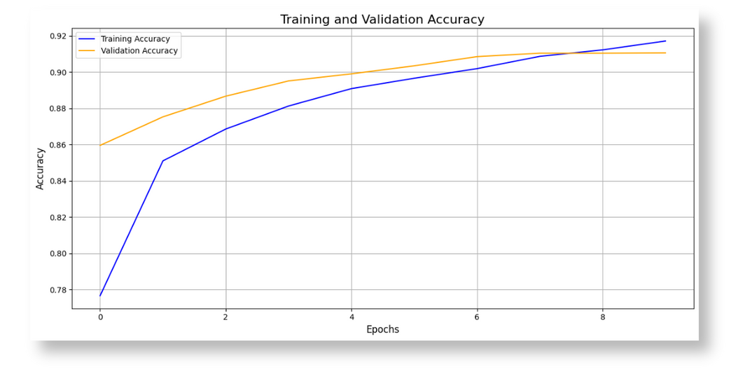


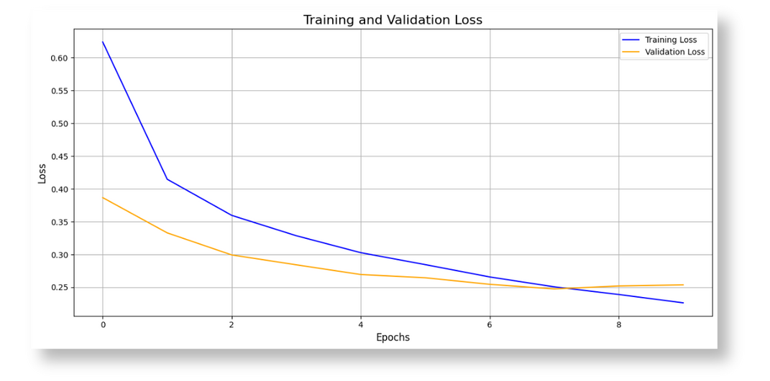
Training Details:
Batch size: 64.
Epochs: 10.
Results:
Training Accuracy: ~92%.
Validation Accuracy: ~90%.
Loss and Accuracy Trends:
Steady improvement without overfitting.

Slide 7


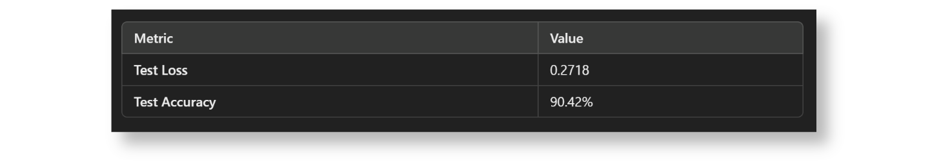
1
2
Test Set Performance:
Key Takeaways:
Test Accuracy: 90.42%.
Test Loss: 0.2718.
High accuracy demonstrates generalization.
Low loss reflects good predictions.

Slide 8
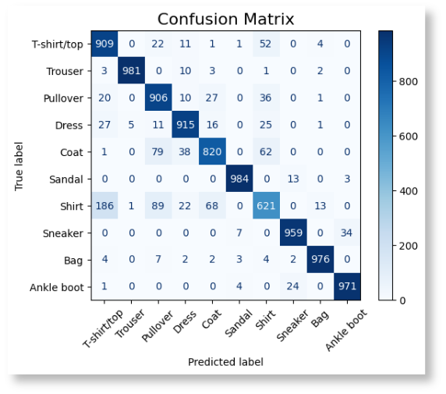
1
Purpose:
Shows performance for each class.
Key Observations:
High precision for most classes.
Minimal misclassifications.
2

Slide 9
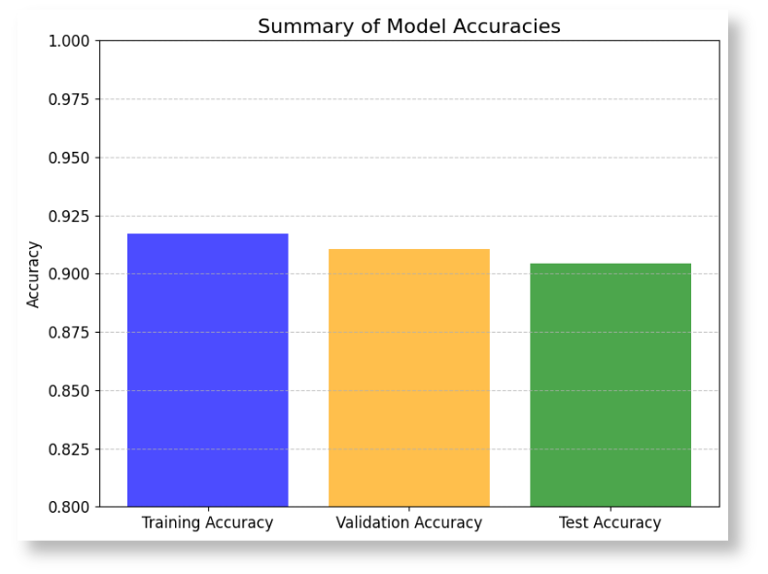
Successes:
Achieved high accuracy and generalization.
Balanced and clean dataset simplified the process.
CNN architecture was effective for this task.
Future Improvements:
Explore data augmentation.
Experiment with advanced architectures like ResNet.
Adapt the model for real-world applications like e-commerce.

Slide 10

Mehrdad Naderi
University of Colorado Boulder
2024 - Fall 2

