Slide 1

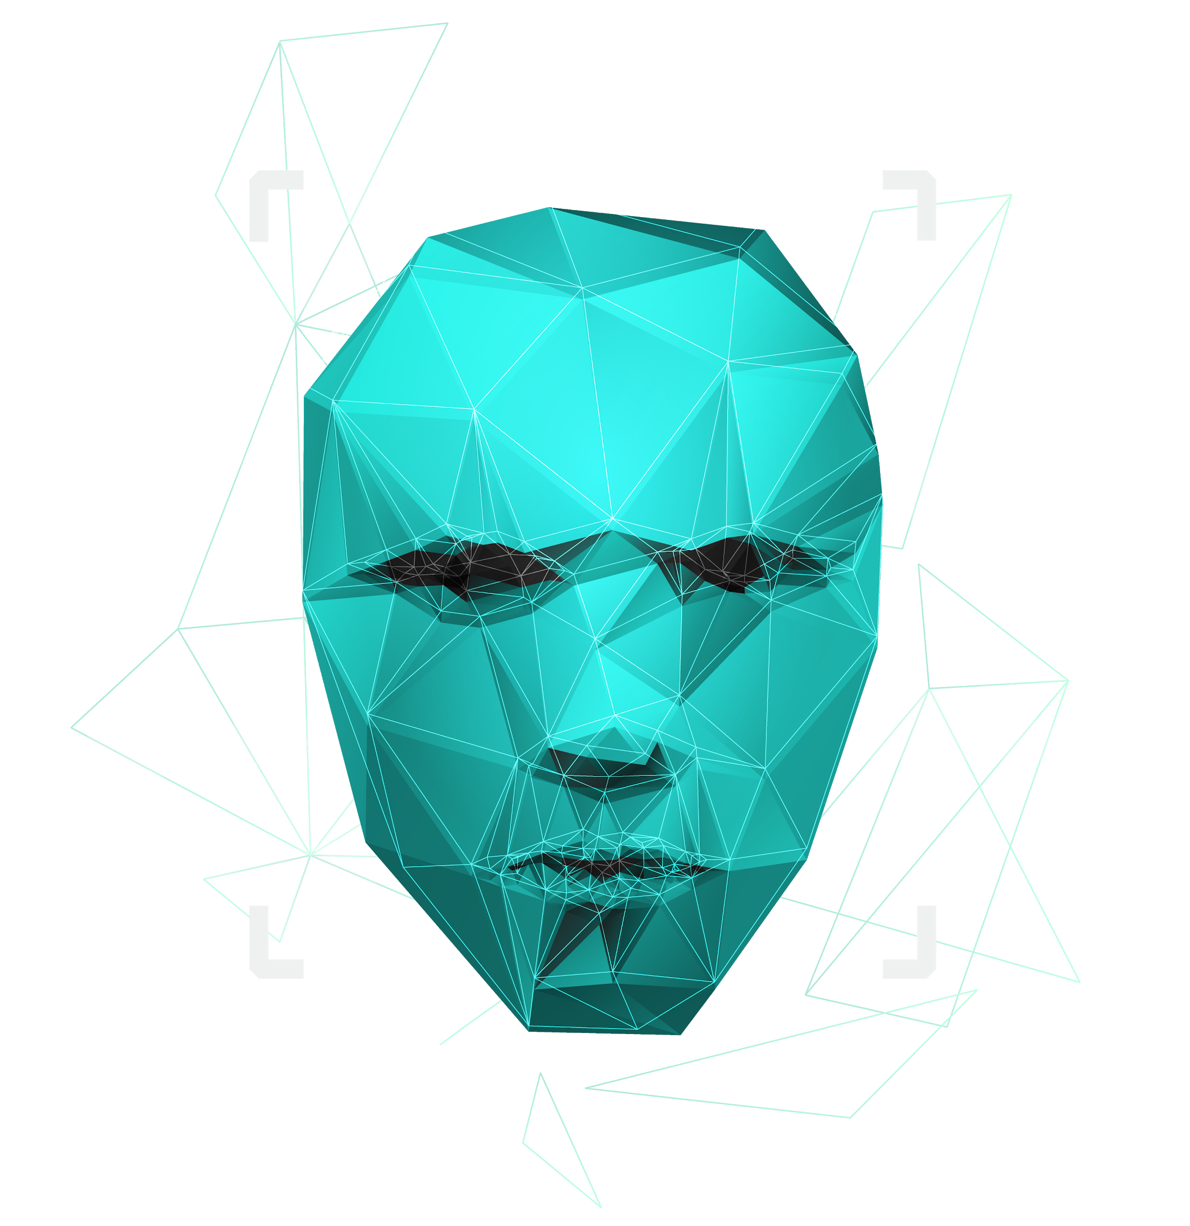
Voice assistant
phenom corporation

Slide 2
Phenom team
Mehrdad Ghasabi
Hadi Heidari Rad
Navid Shaghozaei
Naser Farajzadeh
Mohammad Ghorbanpoor
Erfan Khoob Shahmiri

Slide 3

Why this?
Scalability
01
03
Features
How we do it?
02
04
It’s the way of why we want develop this application
What is scalable if add features to this application
Features of our application
Explain about how we do this project and what tools use

Slide 4

Why this?
A lot of virtual assistant made in many area that you think and growing in every day.
The more interesting thing that they can be personalized and in this project we want to create another one that personalized for linux users.

Slide 5
Features
Text to speech and reverse
Learn and talk with you
Search in google and etc
Time based-reminder
Open and close your software
Send and receive emails
System report
Play music

Slide 6
scalability
You can easily add some features you want to use like turn up or down volume, take screen shot and etc.

Slide 7
How we do it?
Use python language for development
Use aiml to make artificial inteligent brain
Python
Aiml
Documentation
MySQL
For documentation we have a full featured site that explain about our product
For save data

Slide 8
THANKS!

