Slide 1

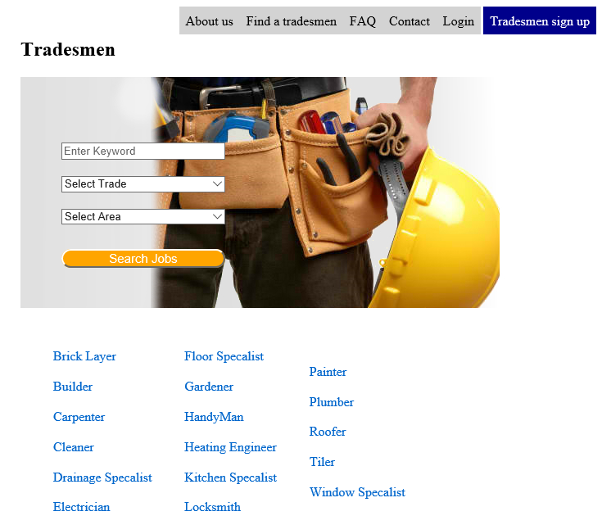
yourjobdone.ie
By
B00067565 Mehreen Malik
B00067382 Mirza Rizvanovic
B00074947 Seth Harbottle

Slide 2
Overview
TradesmenDirectory offers consumers a simple way to find reliable tradesmen in their local area.
It provides tradesmen a way to access more consumers then relying on word of mouth per say.
The website is free to use both from consumers and tradesmen.

Slide 3
Features
Consumer feedback
Current jobs being completed
Verified tradesmen / waiting period
Email verification
Security
Available Jobs by registered consumers

Slide 4
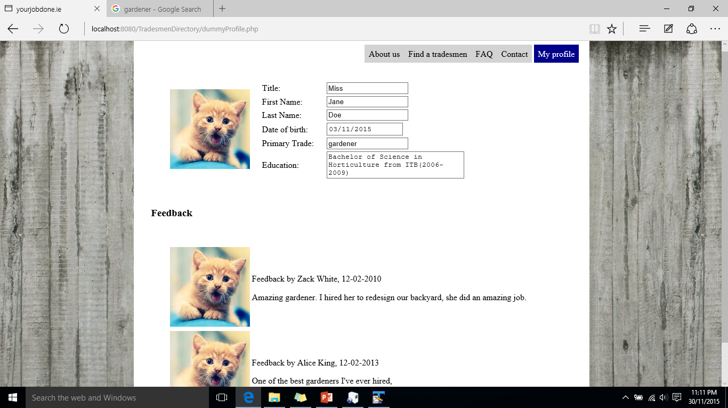
Custom user profile

Slide 5
Consumer Feedback
On each individual tradesmen profile is a section for feedback.
Consumers who have hired a tradesmen, can leave feedback once a job is completed.
When comparing some of the sites out there, we found this feature lacing in many of them.

Slide 6
Jobs Board
Verified consumers will have the ability to advertise jobs on the job board, where tradesmen can reply back to them.
The jobs board is created using a software called phpBB.
phpBB is a widely used open source bulletin board system in the world.
It supports private messaging. Which we can use to allow consumers and tradesmen to message each other on the site.

Slide 7
Email Verification
In order to have a full working account, consumers and tradesmen must provide a working email where they’ll be sent a verification link. The user won’t be able to login until the account has been verified.

Slide 8
Summary

