Slide 1

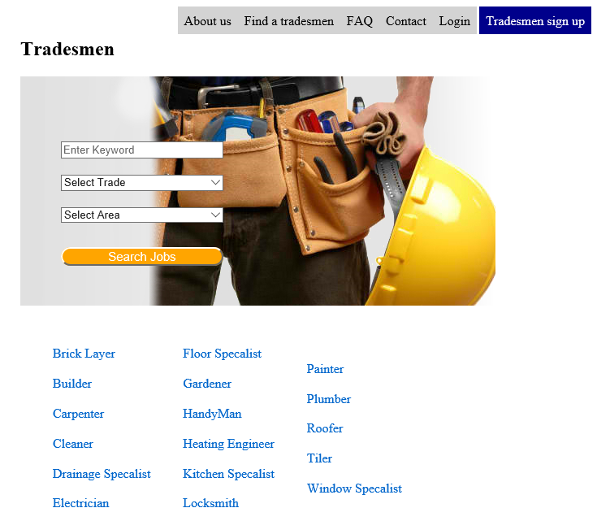
yourjobdone.ie
By
B00067565 Mehreen Malik
B00067382 Mirza Rizvanovic
B00074947 Seth Harbottle

Slide 2
Overview
TradesmenDirectory offers consumers a simple way to find reliable tradesmen in their local area.
It provides tradesmen a way to access more consumers then relying on word of mouth per say.
The website is free to use both from consumers and tradesmen.

Slide 3
Features
Consumer feedback
Current jobs being completed
Verified tradesmen / waiting period
Email verification
Security
Available Jobs by registered consumers

Slide 4
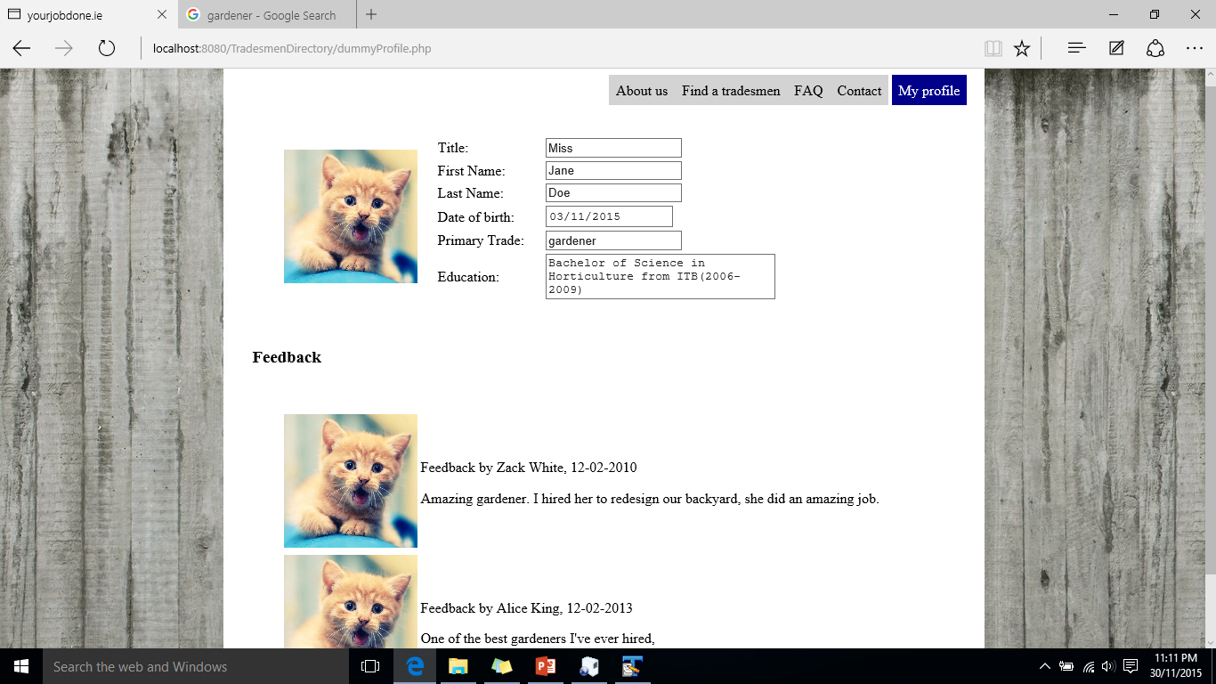
Custom user profile

Slide 5
Consumer Feedback
On each individual tradesmen profile is a section for feedback.
Consumers who have hired a tradesmen, can leave feedback once a job is completed.
When comparing some of the sites out there, we found this feature lacing in many of them.

Slide 6
Jobs Board
Verified consumers will have the ability to advertise jobs on the job board, where tradesmen can reply back to them.

Slide 7
Email Verification
In order to have a full working account, consumers and tradesmen must provide a working email where they’ll be sent a verification link. The user won’t be able to login until the account has been verified.

Slide 8
Summary

