Slide 1

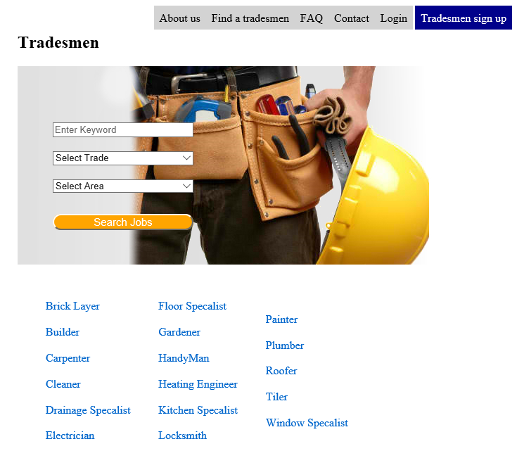
yourjobdone.ie
By
B00067565 Mehreen Malik
B00067382 Mirza Rizvanovic
B00074947 Seth Harbottle

Slide 2
Overview
TradesmenDirectory offers consumers a simple way to find reliable tradesmen in their local area.
It provides tradesmen a way to access more consumers then relying on word of mouth per say.
The website is free to use both from consumers and tradesmen.

Slide 3
Features
Consumer feedback
Current jobs being completed
Verified tradesmen / waiting period
Messaging between consumer/tradesmen
Email verification
Security
Available Jobs by registered consumers

Slide 4
Pricing
Detail the product models available and list specific prices for each model and additional options.

Slide 5
Availability
List availability dates.
Describe where product can be purchased, or where to direct orders.

Slide 6
Summary

