Slide 1
ENIAC A/B TESTING
CTA performance analysis across four website variants
SHOP NOW vs. SEE DEALS • CTR • Chi-square • Post-hoc analysis
Based on the Eniac A/B Testing notebook • WBS Coding School • Data Science & AI

Slide 2
Executive summary
Recommendation: keep Version A (white SHOP NOW)
HIGHEST OBSERVED CTR
CONTROL CTR
OVERALL TEST
C VS A
2.12%
2.02%
p < 0.001
p = 0.465
Version C
Version A
χ² = 224.02
Not significant
The four versions do not have equal click-through rates.
Version C has the highest observed CTR, but its advantage over A is not statistically significant.
Both red-button variants (B and D) perform materially below the white-button variants.
Version A keeps the lowest drop-off rate (~62% vs ~71% for C), so it is the recommended winner.
2

Slide 3
Experiment setup
Four website variants and one primary CTA metric
VERSION A
VERSION B
VERSION C
VERSION D
White • SHOP NOW
Red • SHOP NOW
White • SEE DEALS
Red • SEE DEALS
Primary metric
CTR = clicks / visits × 100
Statistical test
Chi-square test of independence
3

Slide 4
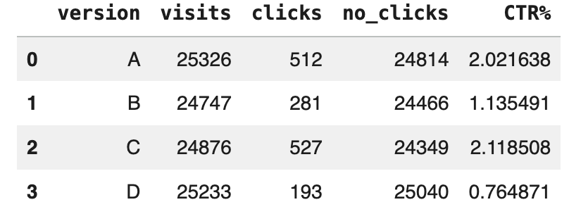
Data overview
Observed visits, clicks and non-clicks
Version | Button | Visits | Clicks | No-clicks | CTR
A | White • SHOP NOW | 25,326 | 512 | 24,814 | 2.02%
B | Red • SHOP NOW | 24,747 | 281 | 24,466 | 1.14%
C | White • SEE DEALS | 24,876 | 527 | 24,349 | 2.12%
D | Red • SEE DEALS | 25,233 | 193 | 25,040 | 0.76%
Every version received ~25,000 visits over 14 days, above the 19,784 per variant required by the power calculation (80% power, 20% MDE).
Visits were parsed from the ‘Snapshot information’ text; clicks come from the SHOP NOW / SEE DEALS row.
4

Slide 5
Statistical test
Overall chi-square test
H₀
The click rate is equal across versions A, B, C and D.
Hₐ
At least one version has a different click rate.
CHI-SQUARE
P-VALUE
DECISION
224.02
2.72 × 10⁻⁴⁸
Reject H₀
df = 3
α = 0.05
Overall CTRs differ
Interpretation: the observed differences among the four variants are unlikely to be explained by random variation alone.
5

Slide 6
Post-hoc pairwise comparisons
Bonferroni correction for six comparisons
Comparison | χ² | p-value | Adjusted p (×6) | Significant?
A vs B | 62.49 | 2.7 × 10⁻¹⁵ | 1.6 × 10⁻¹⁴ | Yes
A vs C | 0.53 | 0.465 | 1.00 | No
A vs D | 144.28 | 3.1 × 10⁻³³ | 1.8 × 10⁻³² | Yes
B vs C | 74.23 | 7.0 × 10⁻¹⁸ | 4.2 × 10⁻¹⁷ | Yes
B vs D | 17.88 | 2.4 × 10⁻⁵ | 1.4 × 10⁻⁴ | Yes
C vs D | 161.12 | 6.5 × 10⁻³⁷ | 3.9 × 10⁻³⁶ | Yes
Key finding
A vs C: not significant (adjusted p = 1.00).
White beats red: A and C are both significantly better than B and D.
B vs D: significant, D is the weakest version.
Bonferroni threshold: α = 0.05 / 6 = 0.00833.
No single CTR winner: A and C remain → decide with secondary metrics.
6

Slide 7
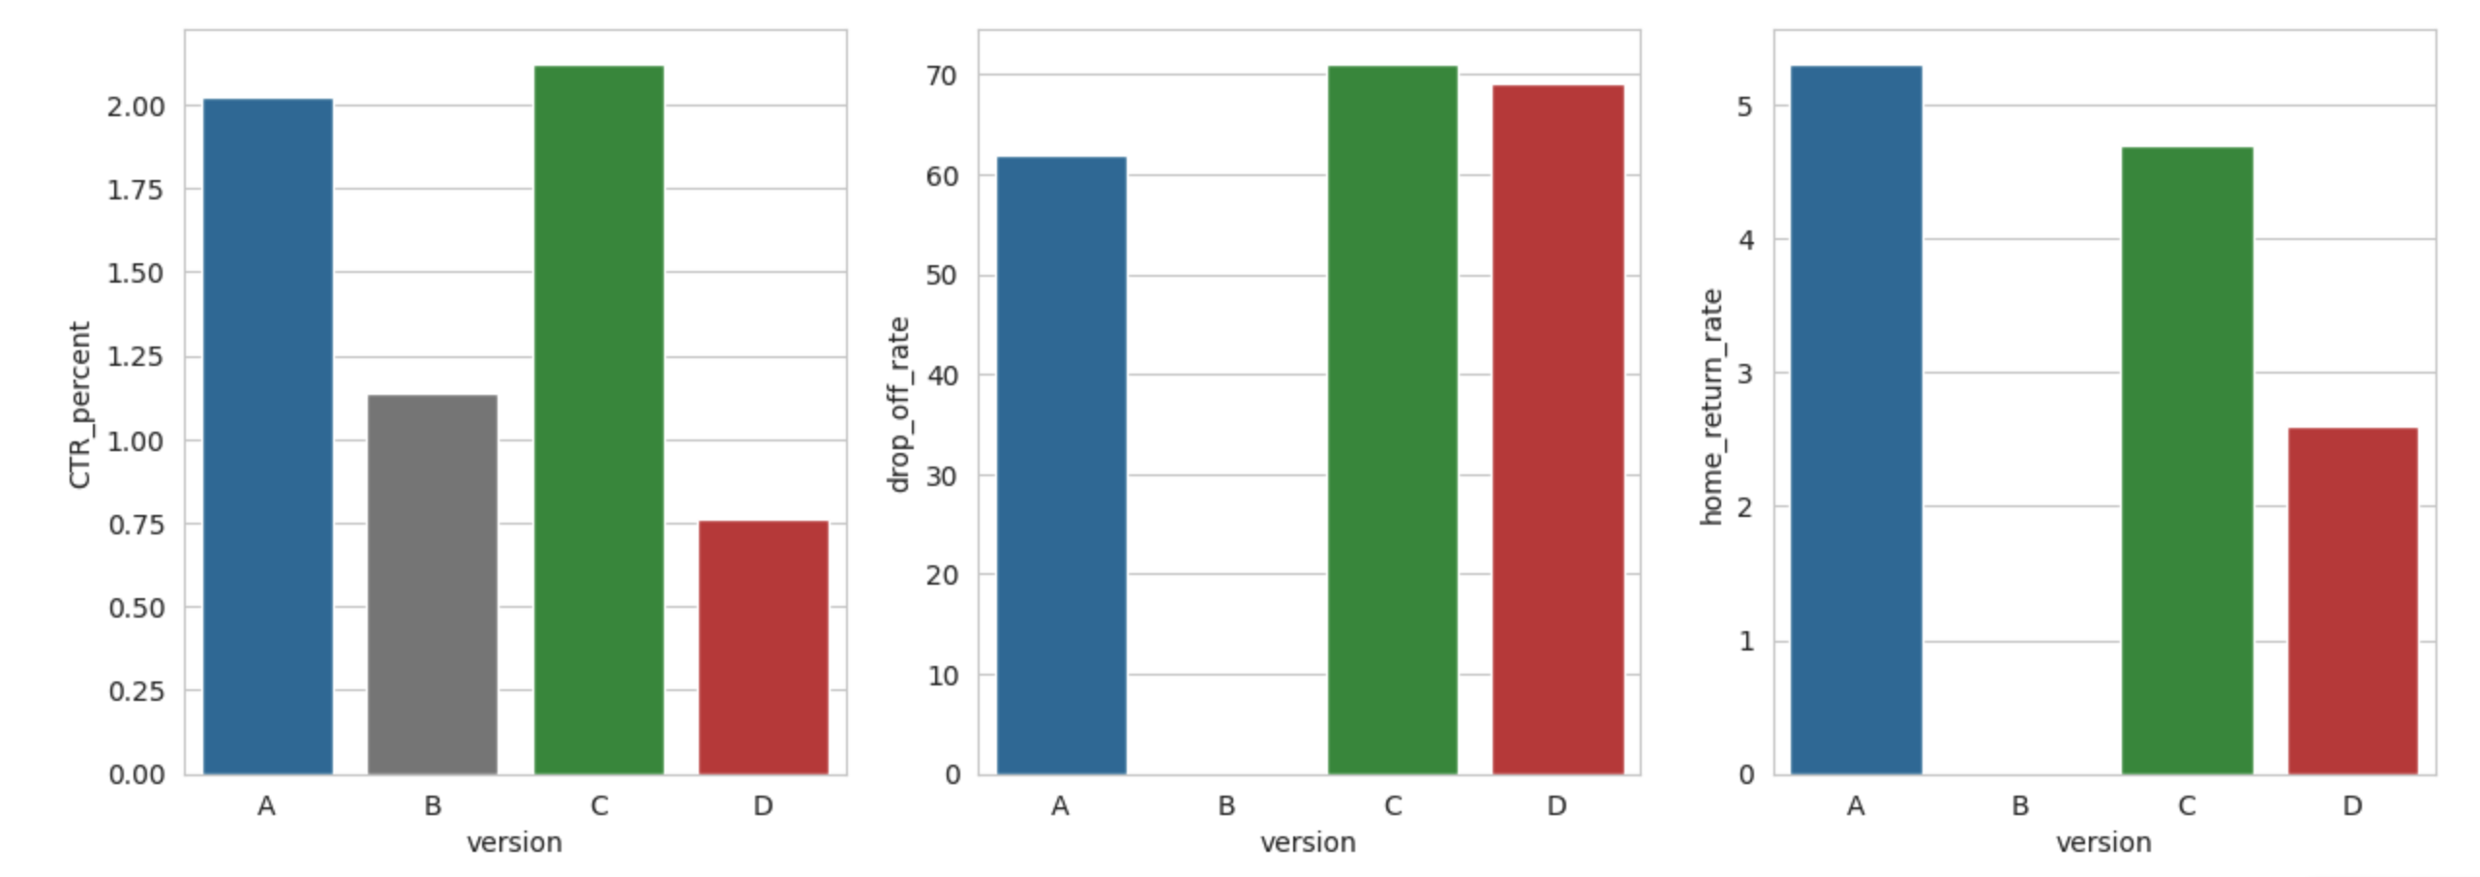
Secondary metrics & guardrails
CTR alone is not enough: what happens after the click?
Data note
Drop-off and homepage-return rates come from the website team's report in the LMS (values read from its charts). Version B is missing because of a tracking error. Blue = white button, red = red button.
A has the lowest drop-off by far (~62% vs ~71% for C). C returns slightly fewer users to the homepage (4.7% vs 5.3%).
7

Slide 8
Decision: combine click and completion
Completed conversions per 1,000 visits = CTR × (1 − drop-off) × 1,000
A VS C
+25%
more completed conversions per visit with Version A
A: 7.7 • C: 6.1 • D: 2.4 per 1,000 visits
C wins the click, but loses more users afterwards.
Caveat: secondary metrics are not significance-tested.
8

Slide 9
Business interpretation
What can—and cannot—be concluded
Supported by the analysis
Not statistically established
Red-button variants B and D have substantially lower CTR than A/C.
The overall experiment shows statistically different CTRs.
A and C are both among the higher-performing variants.
A has the lowest drop-off → about 25% more completed conversions than C.
C is not proven to outperform A on CTR.
The observed C-over-A uplift is ~5%, below the planned 20% MDE.
Drop-off and return rates are report values without a significance test.
Revenue per visit was not measured.
9

Slide 10
CONCLUSION
Keep Version A (white SHOP NOW): red loses clearly, “SEE DEALS” does not beat A on CTR, and A converts best after the click.
Final evidence snapshot
Overall χ² test: p ≈ 2.72 × 10⁻⁴⁸; A vs C not significant (adj. p = 1.00)
C-over-A CTR uplift ≈ 5% vs planned 20% MDE
A: lowest drop-off (~62%) → 7.7 vs 6.1 conversions per 1,000 visits
Next: drop red buttons; optional follow-up test A vs C on conversion rate
Source: Eniac AB Testing notebook; drop-off/return: LMS report

