Slide 1
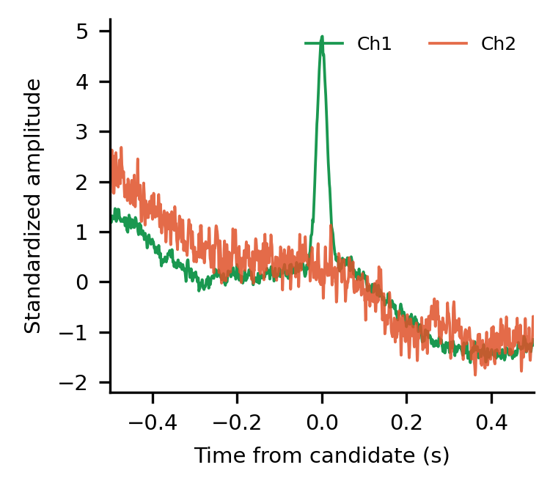
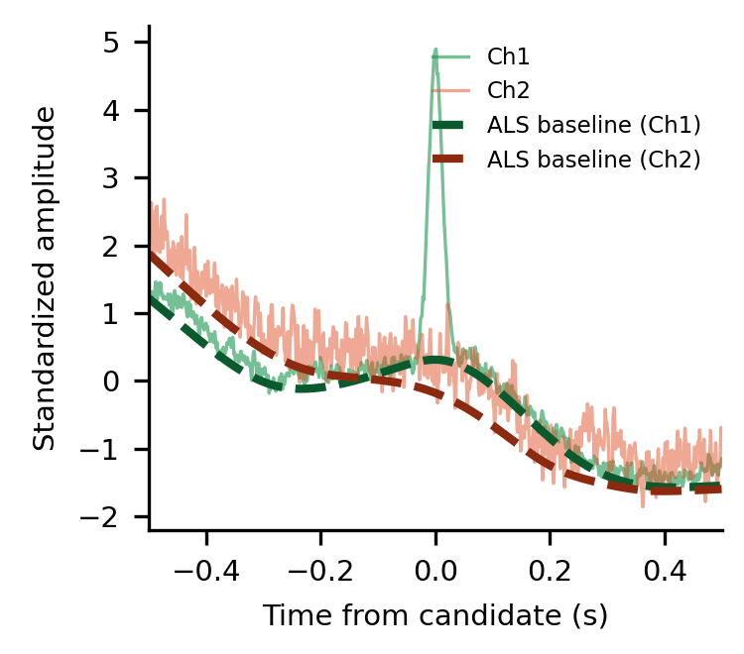
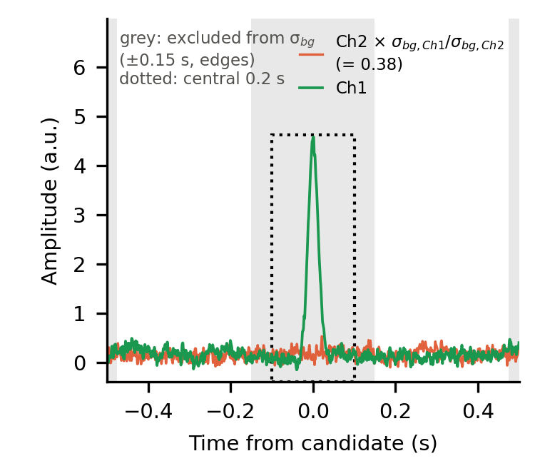
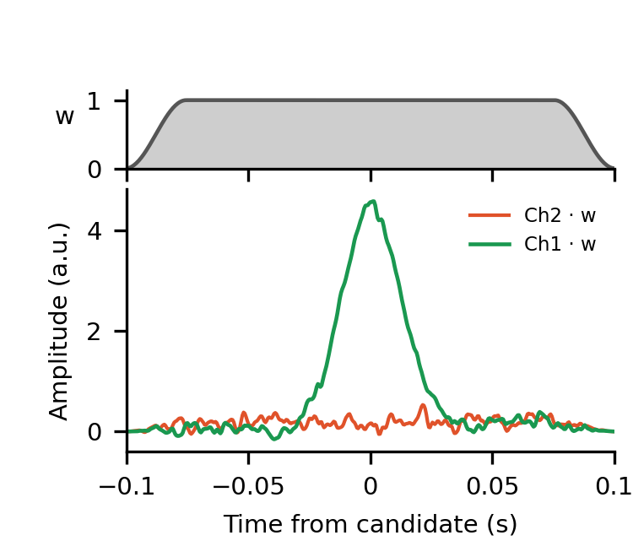
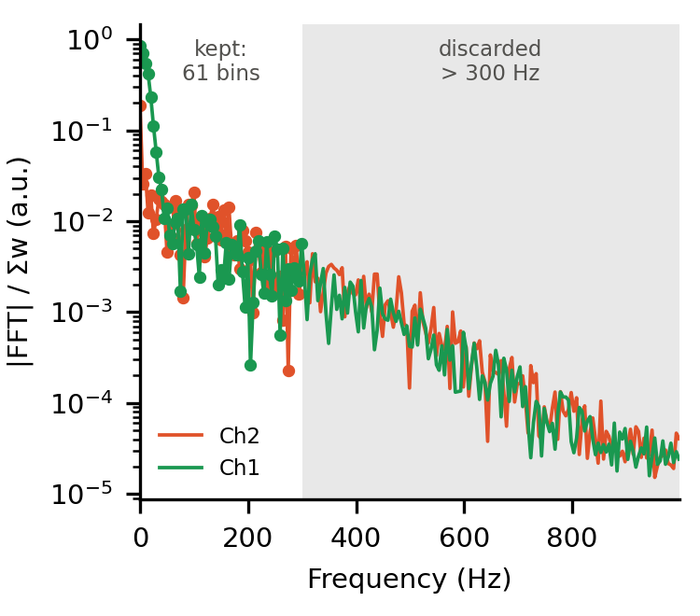
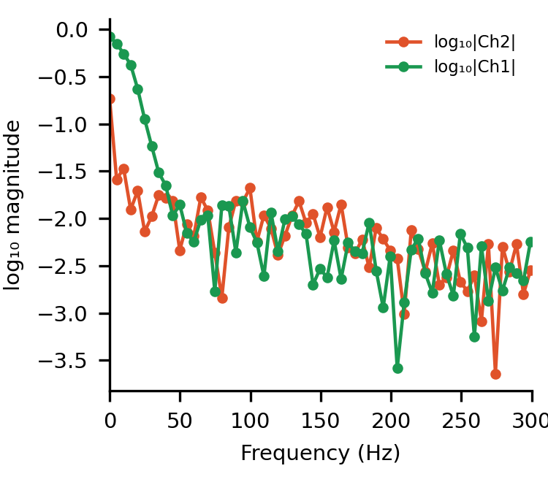
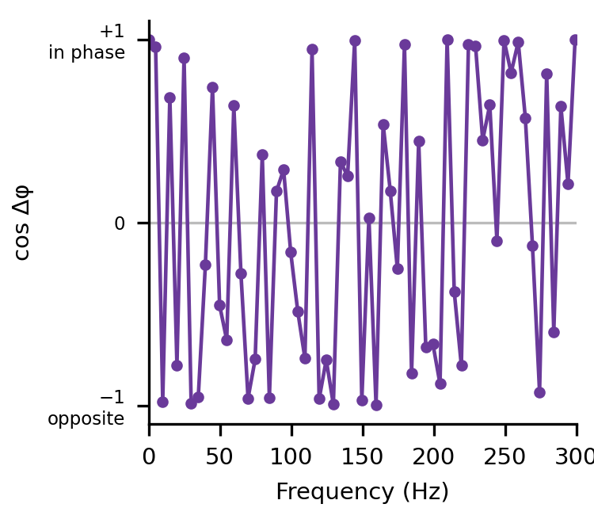
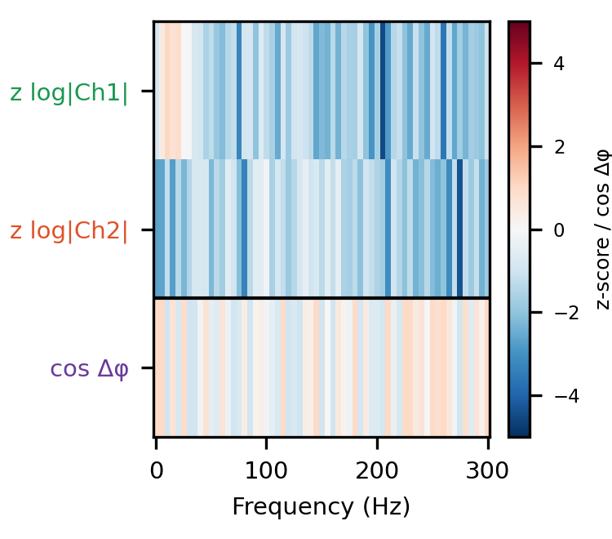
Standardized window
2 × 2001, joint Ch1/Ch2 z-score
ALS baseline estimation
λ = 10⁷, p = 0.01, per channel
Baseline removed, Ch2 scaled
Ch2 × σbg,Ch1 / σbg,Ch2
Central 0.2 s × cosine taper
2 × 401, 0.025 s ramps
FFT magnitude
|rFFT| / Σw, Δf = 5 Hz
Log magnitude, 0–300 Hz
61 bins, Δf = 5 Hz
Cross-channel phase
cos(φCh1 − φCh2)
Spectral-CNN input
61 × 3, z-scored per bin
Spectral
CNN
3 × [Conv1D
→ BN → ReLU]
Flatten → FC 64
→ z_{s}

