Slide 1

Assassin’s creed 2
Anvil Engine
Notes:
-Chose AC2 as it made many improvements to Assassin’s Creed 1 (AC1) and defined the AC series

Slide 2
Anvil Engine
Originally called Scimitar
Coded in C++ (though now can use C# now)
Notes:
-Engine created by Ubisoft in 2007.
-Was used for AC1, Prince of Persia (2008) & Shaun White Snowboarding
-Called Project Scimitar up until 2006
-Mainly uses C++ though Ubisoft is integrating C# into it

Slide 3
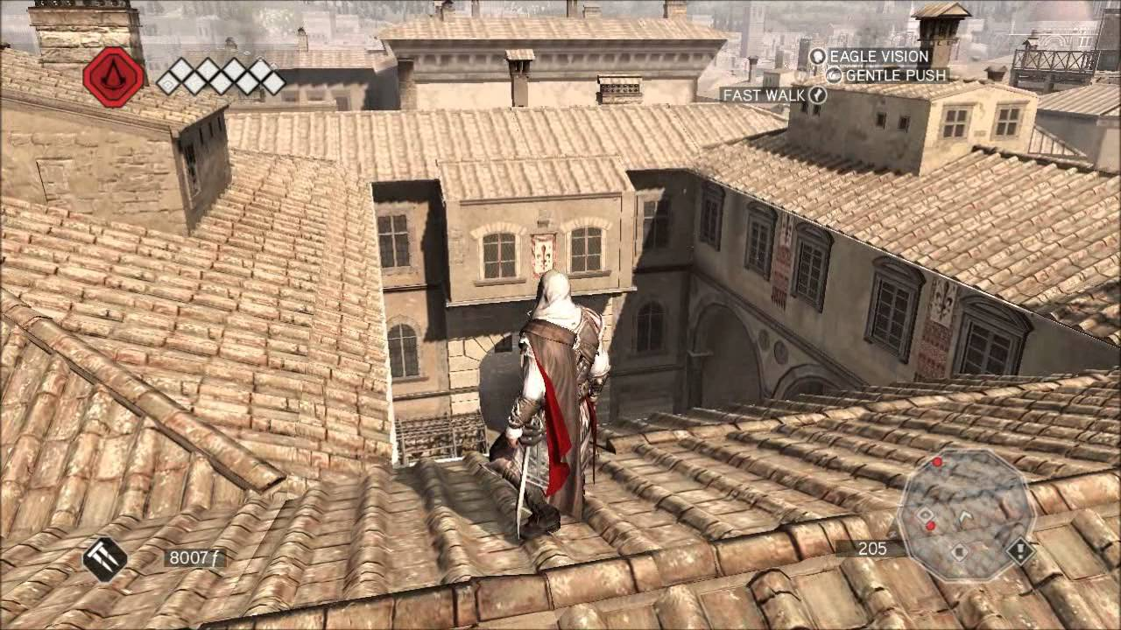
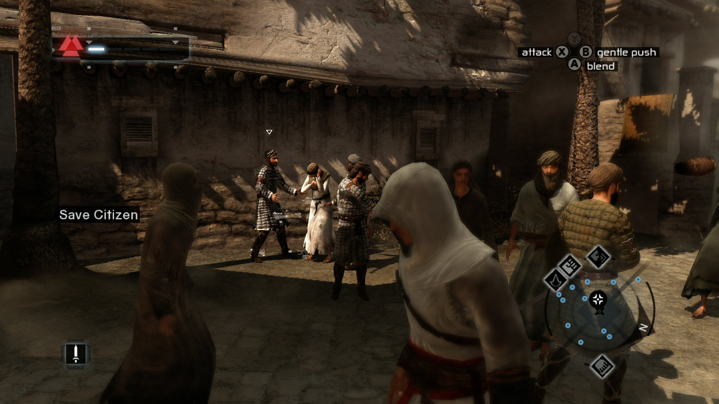
Improved Lighting!
Notes:
-Volumetric fog, reflection maps, global illumination
-As you can see the textures are much more detailed in AC2 vs AC1
-Artists went to visited all the cities in game to make it as detailed as possible

Slide 4
New Animations!
https://youtu.be/7HIED-aARfk (spear)
https://youtu.be/98FWeHKC26E (Fisticuffs& Hidden Blade)
Notes:
-Animations were refined and more fluid
-Each weapon has different animations allowing for hundreds of unique animations

Slide 5
New Cloth Rendering system
Longer load distance
https://youtu.be/G2mABKvnRSM
Notes:
-Climbing has become faster and more fluid.
-Ezio realistically grabs each ledge
-This is done with Autodesk’s HumanIK (used to position the characters’ hands and feet when fighting or climbing during gameplay
-Cloth moves more realistically
-Greater load distance, allowing for more detailed environments from far away

Slide 6
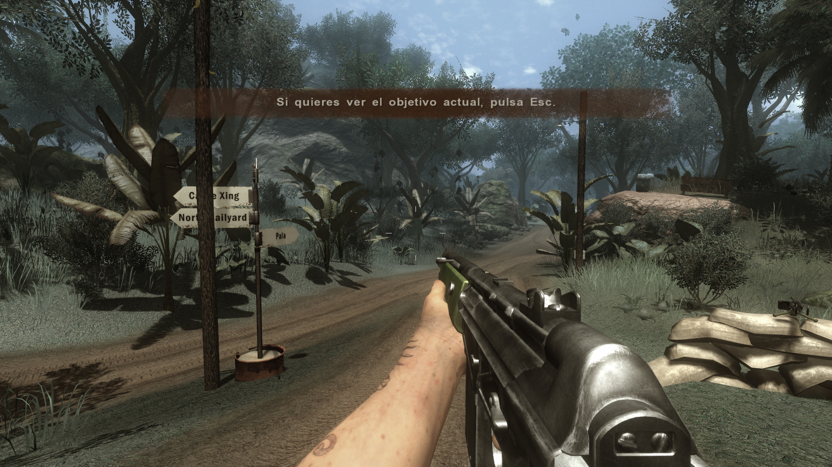
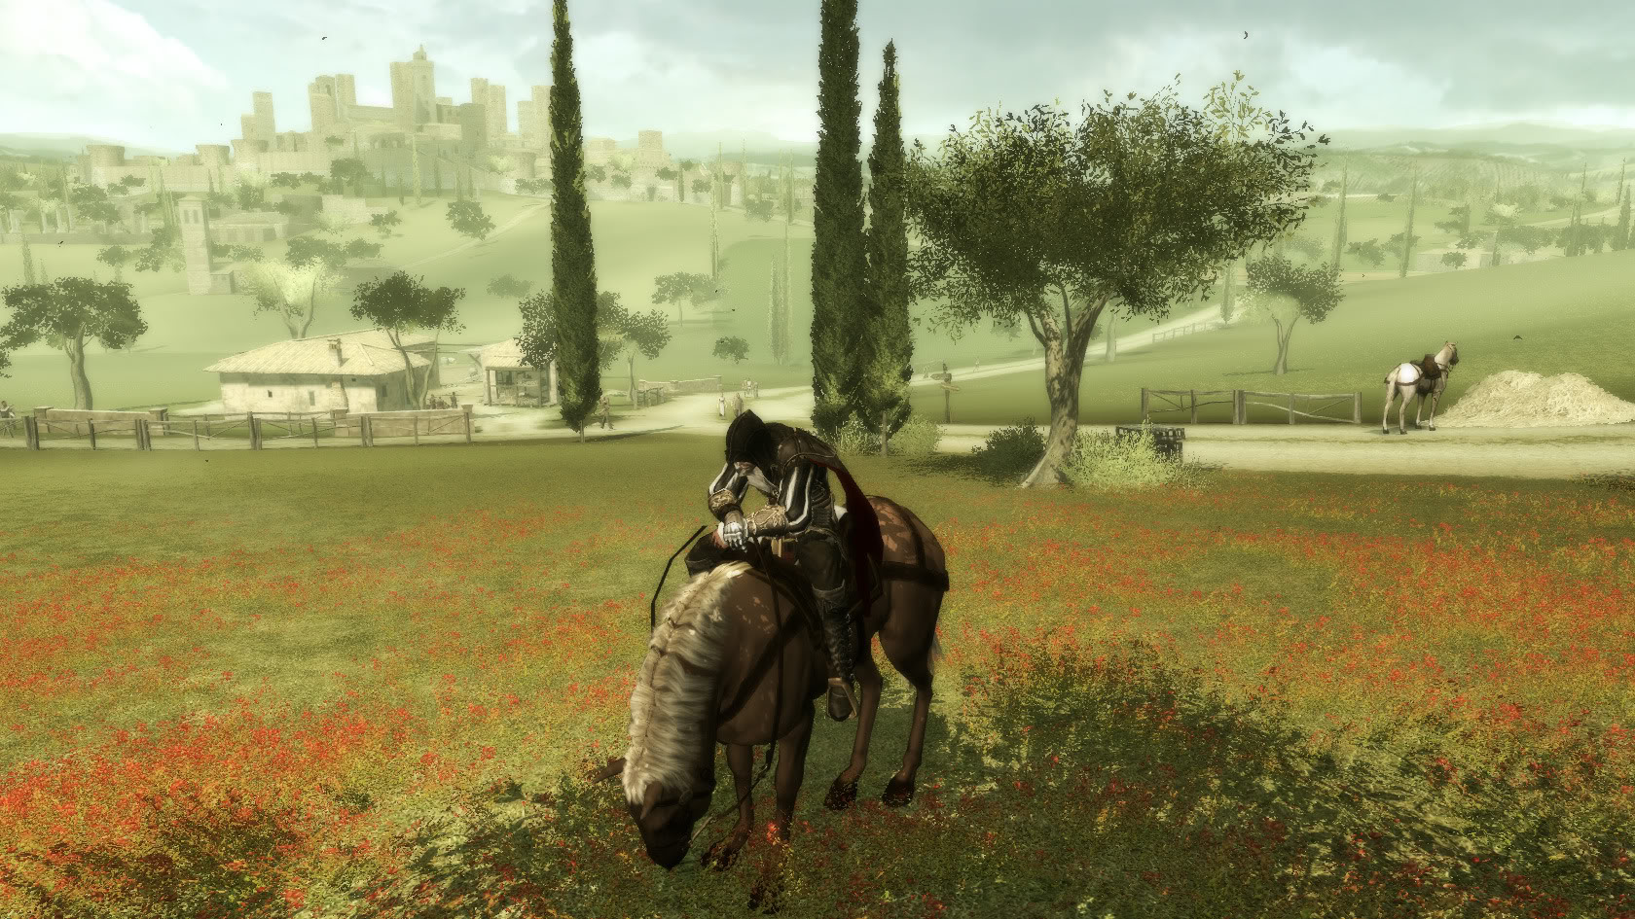
Miscellaneous
Day/Night Cycles
Realtree (Dunia Engine)
Notes:
-Day/Night cycles
-Uses Realtree for realistic dynamic foliage
-This was also used in Far Cry 2

Slide 7
References
http://www.pcgames.de/Assassins-Creed-2-Spiel-18272/Specials/Assassins-Creed-2-Interview-mit-Sebastien-Puel-684781/2/
http://uk.ign.com/articles/2010/03/12/assassins-creed-ii-review
http://www.impulsegamer.com/pcfarcry2.html
Notes:
Additional notes:
-Environment modelled in 3ds Max, Zbrush for character modelling

