Slide 1
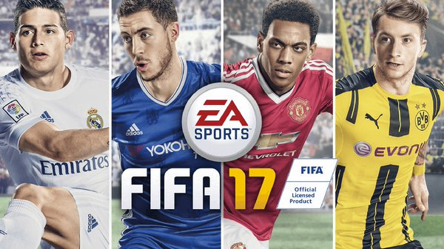
FIFA 17

Slide 2

Game Engine

Slide 3
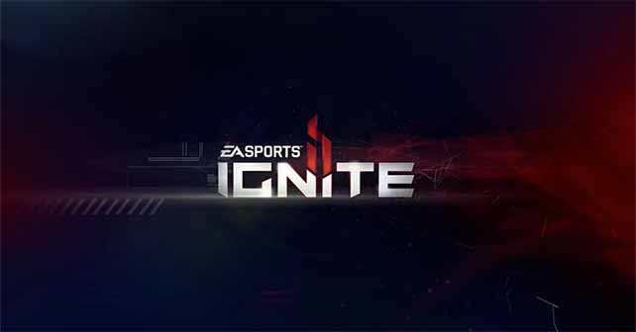
Previous Iterations
FIFA 14/15/16

Slide 4
Why the switch?
Under the same engine
Couldn’t handle new changes
Inclusion of Managers and the new Player Career mode

Slide 5
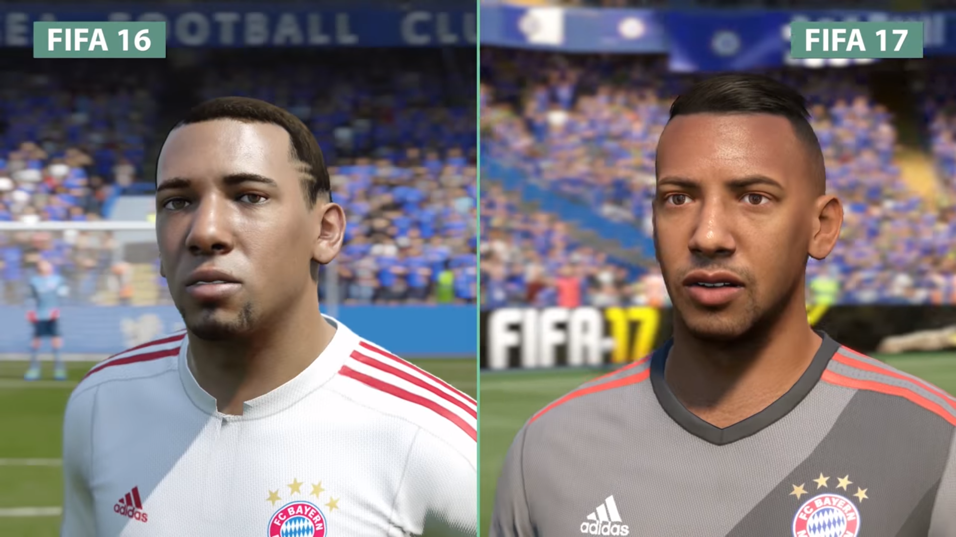
Comparison Video
https://youtu.be/jWusTxN5JWg?t=56s

