Slide 1
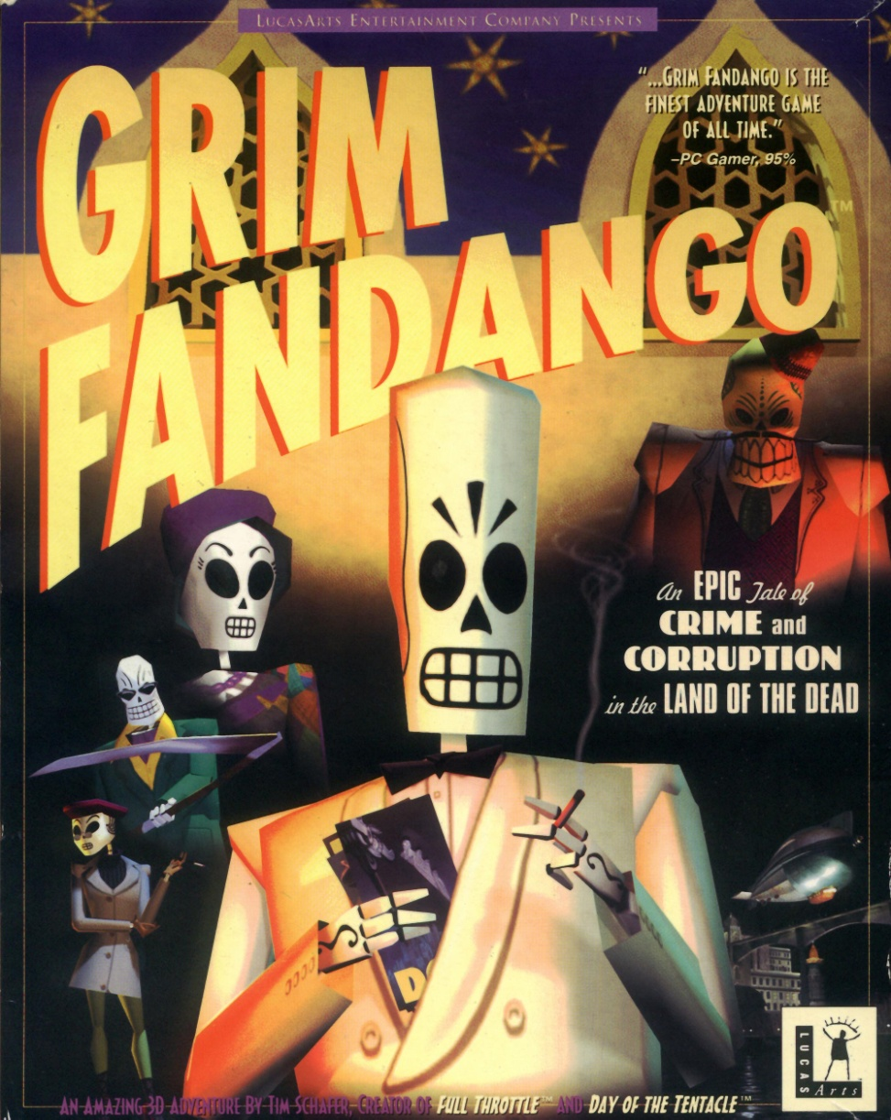
A presentation by Emelie Edholm, 1503396

Slide 2
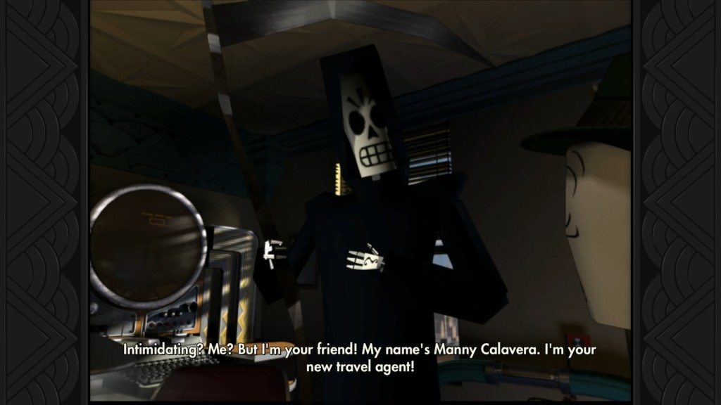
Fantastic Facts!
The first adventure game by Tim Schafer made in 3D.

Slide 3
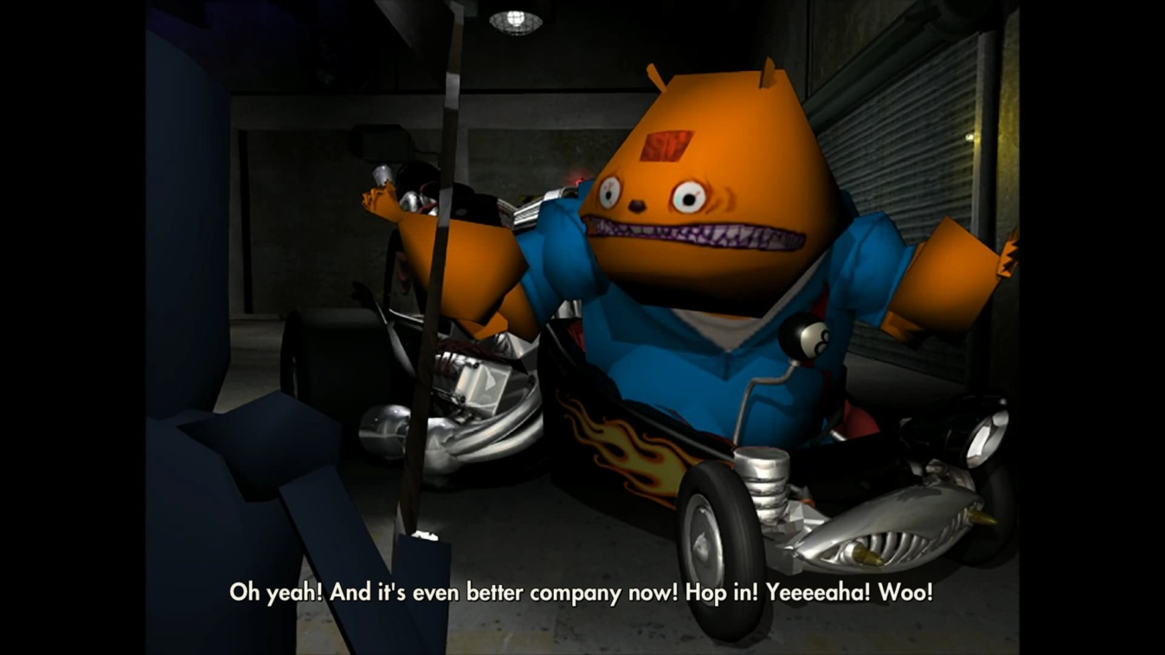
Fantastic Facts 2!
The game engine was called GrimE, which was developed out of Sith, the engine used to make Jedi Knight: Dark Forces II.

Slide 4
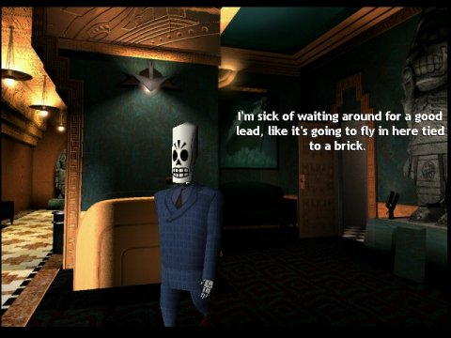
Fantastic Facts 3!
GrimE was written in Lua. Because the head programmer, Bret Mogilefsky, liked it.

Slide 5
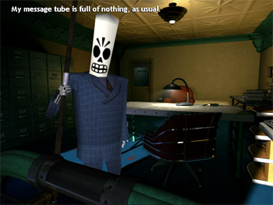
Fantastic Facts 4!
Just before release, none of the lip syncing for the over 8000 dialogue lines worked. The freeware Microsoft Agent Software Development Kit came to the rescue.

Slide 6

Gameplay

Slide 7
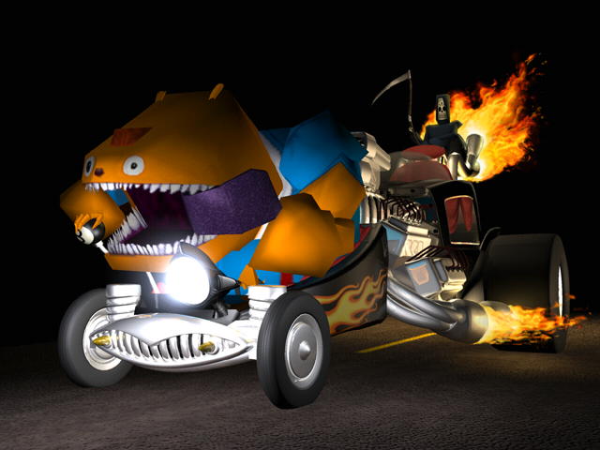
Questions?

