Slide 1

S K Y R I M
By Beth Hain
1501693

Slide 2
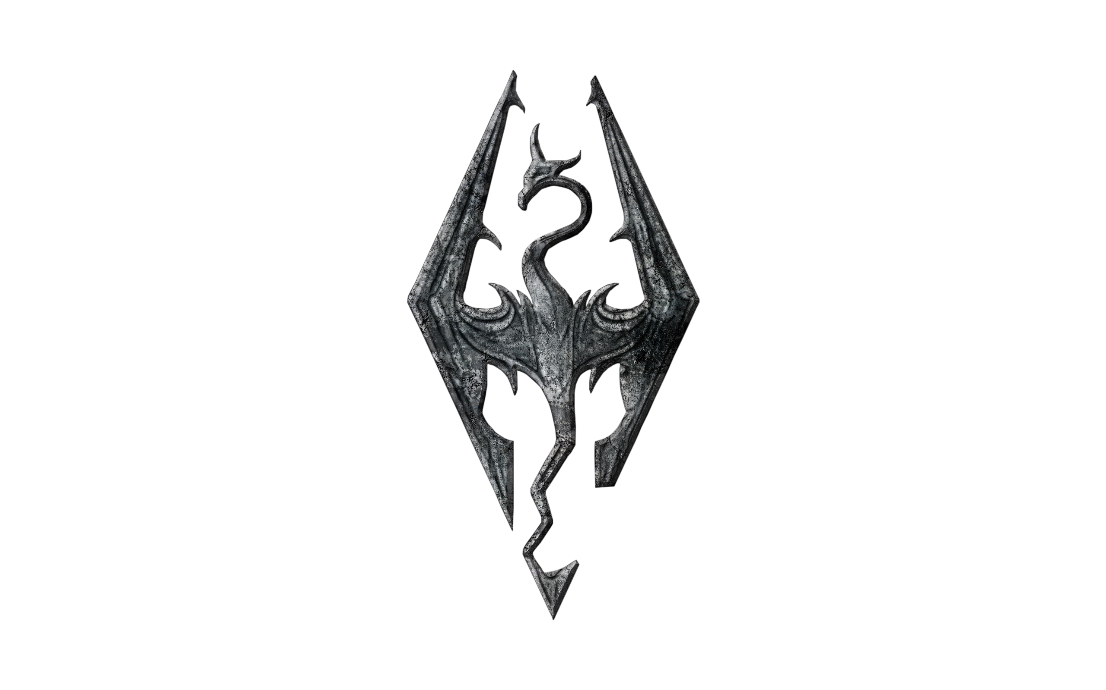
Game Facts
The Elder Scrolls V: Skyrim was released November 11th 2011 and is still a very popular game, hence its rerelease this year
It has one of the biggest active modding communities
However opinion is very divided – some players think it’s the best Elder Scrolls; some feel it is a step backwards for the series
It is inspired heavily from Norse culture and mythology
It received high critic scores including 94% PC Gamer UK, 10/10 Wired and 10/10 Eurogamer

Slide 3

The Game Engine
Bethesda developed Creation Engine
They have used it for Skyrim & Fallout 4
It is written in C++
Many PC users criticize this engine

Slide 4
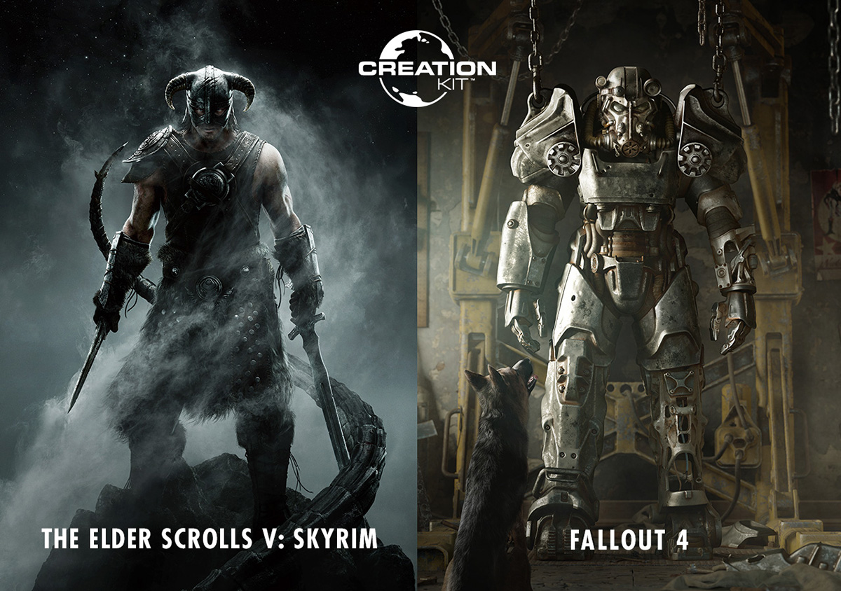
Creation Engine Features
It used basic real-time shadows and the draw distance renders farther then previous Elder Scrolls games
The updated version used for Fallout 4, offers physically-based rendering, dynamic volumetric lighting, and more advanced character generation
The Creation Kit is a modding tool for games made with Creation Engine

Slide 5
The Physics
The Creation Engine used a lot of Havok software
You can pick up items and move them around the world – which can cause some issues e.g. clipping
Some items will lag around in front of the player, fly into the air or continually move if it is colliding with another object
Some bugs cause objects to have no weight e.g. being able the shout dragon skeletons across the map or giants hitting you and sending your character into space
This makes physics mods very popular with PC users

