Slide 1
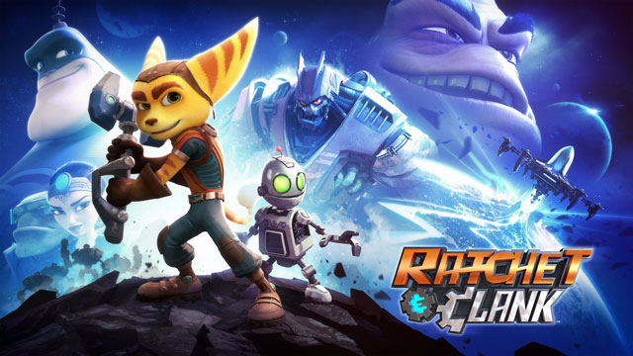
Ratchet and Clank (2016)
Steven Crighton 1500702

Slide 2

General Info
Console: PS4
Developer: Insomniac Games
Publisher: Sony Interactive Entertainment
It is a remake of the first game in the series released in 2002, which has been re-imagined and based on the movie adaption.
The game was in development at the same time as the film adaption and Insomniac would send 3D models or environment to Rainmaker Entertainment who would then send back slightly altered versions for use in-game.
This was so that there was consistency between the two medias, in some cases Insomniac tried to match cutscenes in game with their movie counterpart.

Slide 3
Game Engine
Ratchet and Clank uses Insomniac Games’ in-house engine which they tweak and adapt for each of their games.
Ratchet and Clank’s version is adapted from FUSE and Sunset Overdrive’s.
Ratchet and Clank was also listed as using the Havok Engine for it’s physics module.
https://youtu.be/i-f0PyD4PYI?t=50s

Slide 4
Comparison between PS4 and PS2
The PS2 title ran at 60 FPS, while the PS4 runs at 30.
This was due to the games on the PS2 having to be 60 FPS to run at full speed, as the FPS were FPS based.
While now, the FPS is based on time allowing games to run at full speed at lower FPS.
Interestingly, in 2009 Insomniac Games’ released a blog post talking about FPS and if it matters. They conducted research in whether or not fps impacted the sales of games and found that while people said high fps mattered, sales were unaffected.
As such Insomniac said that Ratchet & Clank Future: A Crack in Time will be their last 60 FPS game.
http://i.imgur.com/mvrfKRk.gifv
http://i.imgur.com/zTnyuGv.gifv
Gifs made by reddit.com/user/mushroomwig

Slide 5
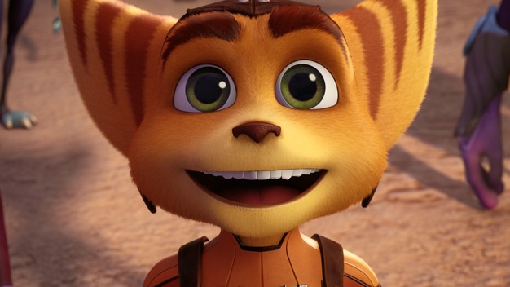
Questions?

Slide 6
References
https://en.wikipedia.org/wiki/Ratchet_%26_Clank_(2016_video_game)
http://www.insomniacgames.com/how-much-does-framerate-matter/
http://gearnuke.com/ratchet-clank-ps4-vs-ps2-comparison-shows-insomniac-made-true-next-gen-game/
https://en.wikipedia.org/wiki/List_of_games_using_Havok

