Slide 1
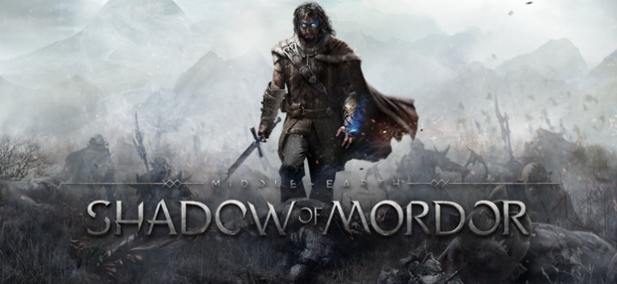
Andrew Howells

Slide 2
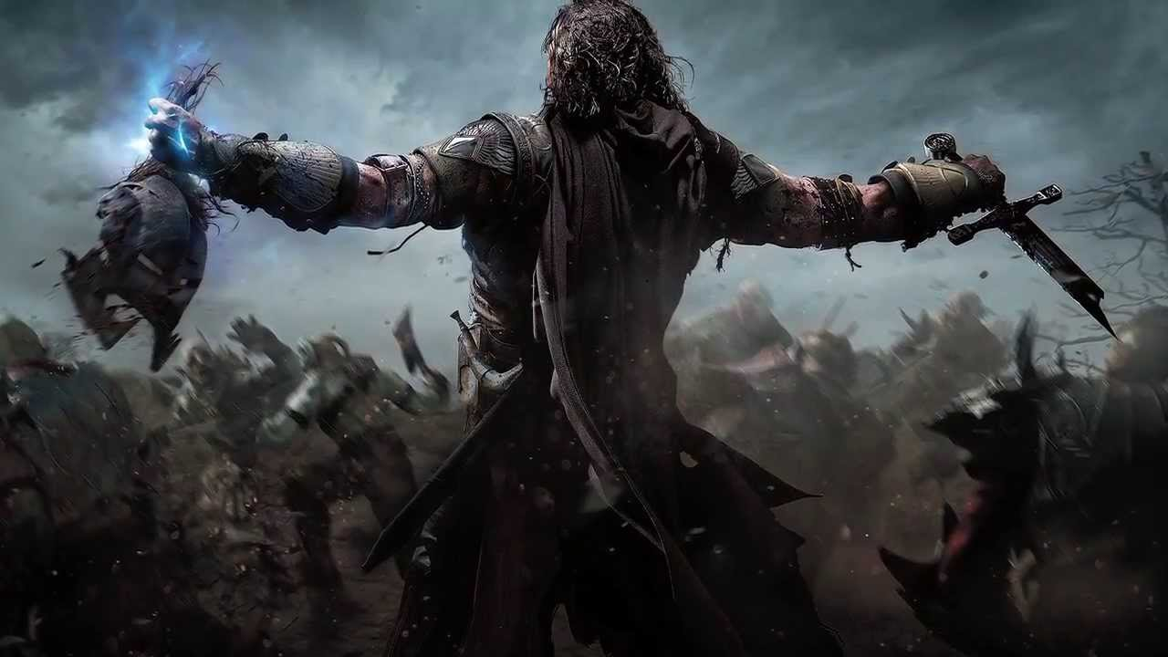
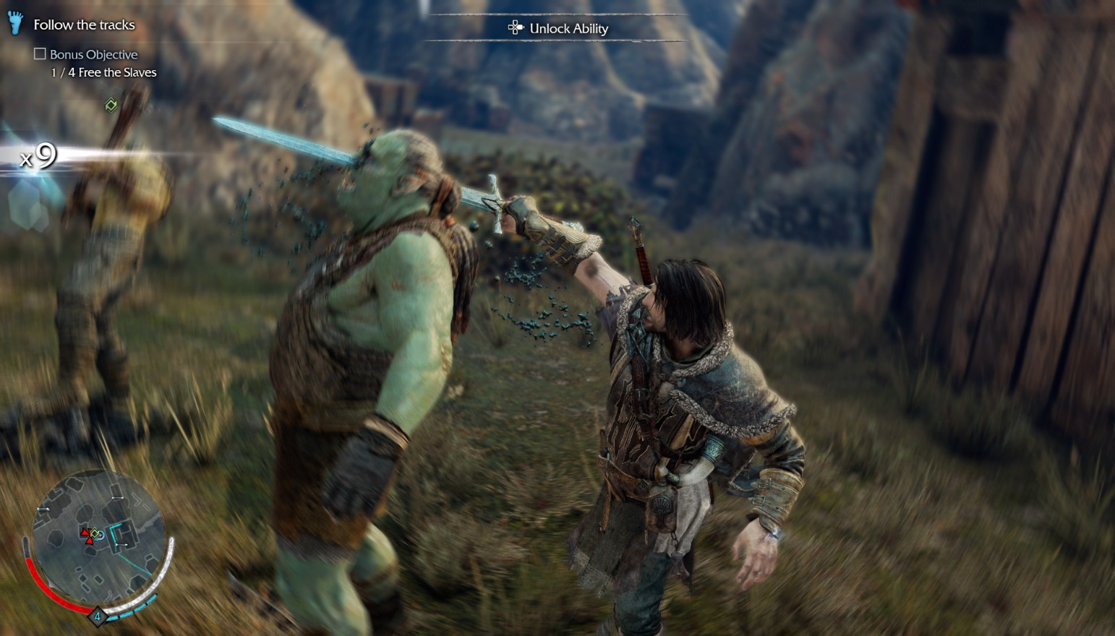
The Game
Third person open world action-adventure game
Set in Tolkeins fantasy world of Middle earth
Released on PC, xbox one and PS4 in September 2014
Combines open world gameplay with stealth, melee and ranged combat
https://www.youtube.com/watch?v=fpRXiyIvvX4

Slide 3
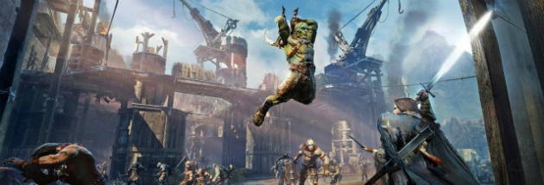


The Engine
Shadow of Mordor was made using the LithTech Engine
This engine was built by Monolith in collaboration with Microsoft
Lithtech is now known as Touchdown Entertainment
Known for its brilliant use of pixel shader water, level design and superior weather effects.
https://www.youtube.com/watch?v=-F8UCDGi4vk

Slide 4
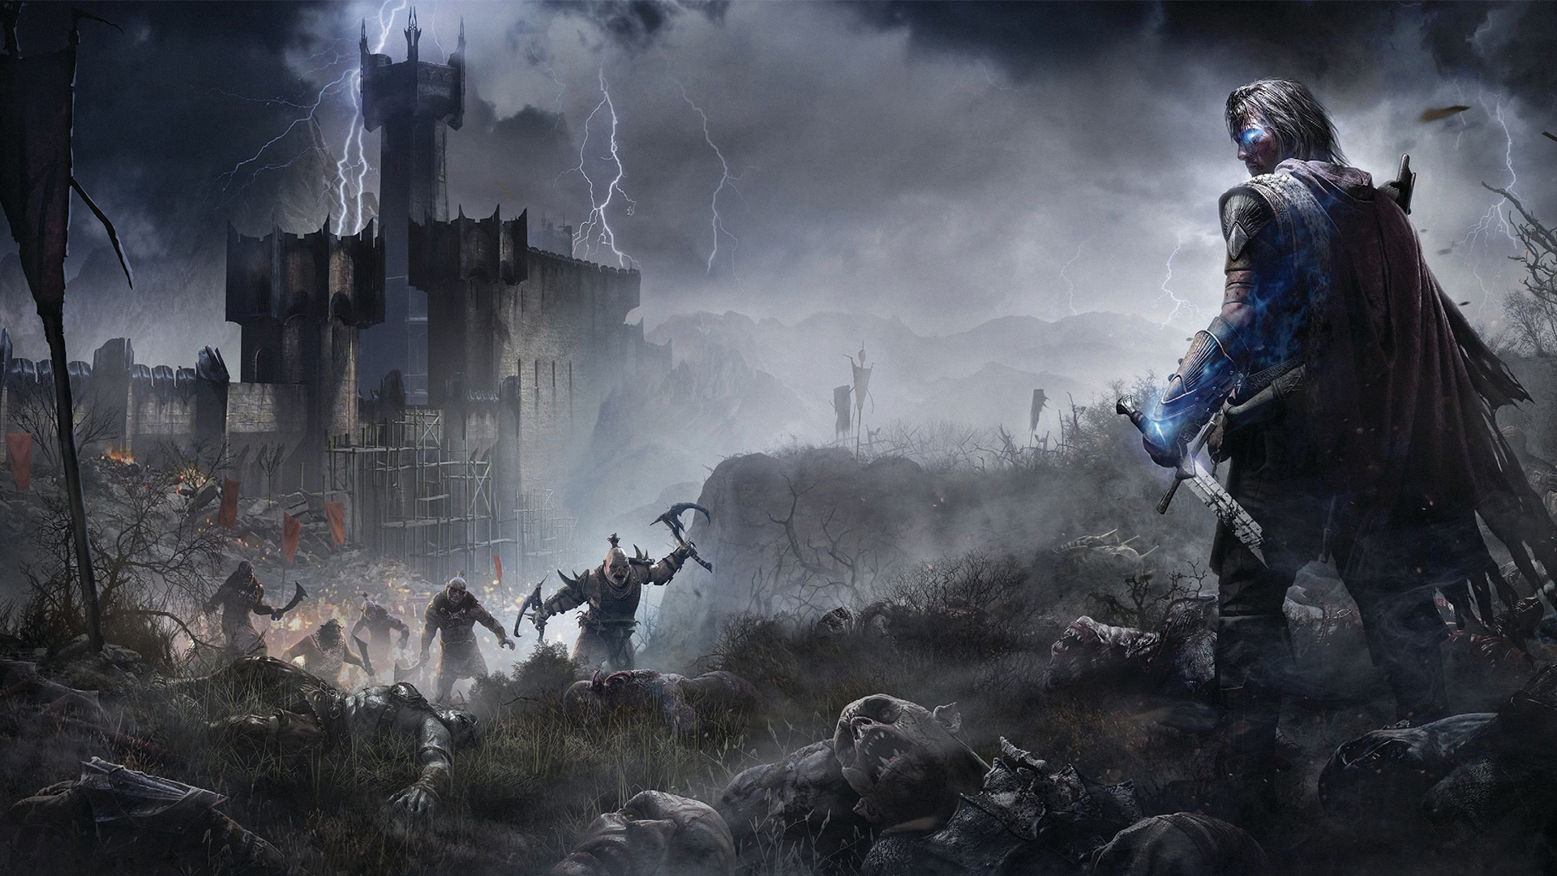

Weta Workshop
Monolith productions worked closely with Weta Workshop
Weta contributed many pieces of artwork including references to characters, weapons, creatures and environments
This made the game as close to the Lord of the Rings franchise as possible

Slide 5
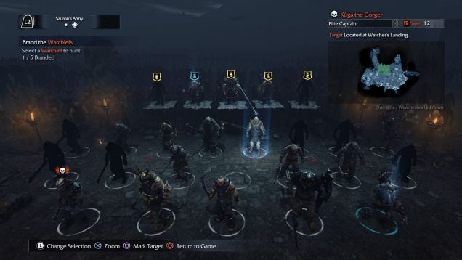
Nemesis system
Shadow of Mordor’s most praised feature is the nemesis system
Extremely smart AI that adapts to your strategy every time you face them
Changes it’s strategy based on your previous attempts and creates unique dilagoue
All built using the Lithtechs superb use of AI within its engine
https://www.youtube.com/watch?v=QNUib1YcgyY

Slide 6
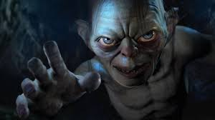
Thankyou
Any questions?

