Slide 1
Fox engine and MGSV
By Kojima productions

Slide 2
Quick background
Metal gear solid is well known for its cinematic cut scenes that are rendered real time in engine for continuity.

Slide 3
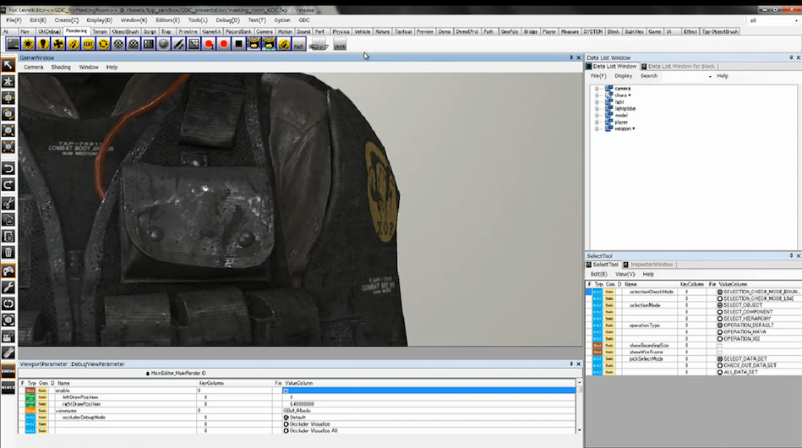
FOx engine capabilities
'Realism from the eyes of a fox'
A feature packed engine
focused on photorealism
Key aspects:
Level editor
Cut scene editor(real time rendering)
Effects(lighting)

Slide 4

Positives of fox
Lighting effects supplement models
Real time cut scenes
108060fps capable on PS4
Excellent optimization

Slide 5
Youtube!
https://youtu.be/36xm1LpBkB0?t=43m31s

