Slide 1
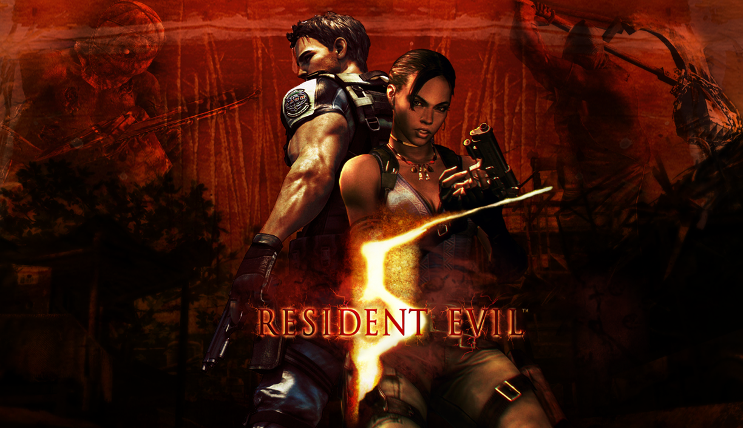
By Simon Wood

Slide 2

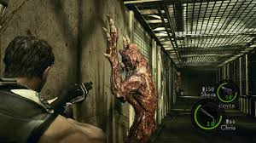
Resident Evil 5 is a survival
horror game made by Capcom
Was released in March 2009
It is technically the 7th major installment of the Resident Evil Franchise
2nd of the series to use over the shoulder camera rather than the fixed camera angles
Highest selling game from the series

Slide 3

The Engine
The engine used for RE5 is MT Frameworks
MT stands for "Multi-thread", "Meta Tools" and "Multi-Target"
Capcom has used this engine for every one of their games starting from Dead Rising in 2006 up till the release of Resident Evil 7 next year
Was created as Capcoms teams were using engines and tools of their own design and then bringing them together, so they created MT Framework so the company had an engine they were all able to use
4 Versions of the engine: MT Framework 1.x, 2.x, lite and mobile
The main features Capcom have highlighted about this engine are the use of 2.5D motion blur, light-space perspective shadow maps and percentage closer filtering - more realistic lighting and shadows
Set almost entirely during the day to show off lighting
Resident Evil 5 was the first game to be presented entirely in Stereoscopic 3D throughout the entire game

Slide 4
Sound Design
Because Resident Evil 5 is set almost entirely during the day, sound composer Kota Suzuki said the timing of sound effects had to be precise as there was high visibility to players
The sound track was composed by a 103 piece Hollywood studio symphony orchestra

Slide 5
Gameplay
https://www.youtube.com/watch?v=4An07jKIToI

Slide 6
Thanks for listening
Questions?

Slide 7
Sources
https://en.wikipedia.org/wiki/Resident_Evil_5#Development
https://en.wikipedia.org/wiki/MT_Framework
https://www.youtube.com/watch?v=Vb6X4M9X1XI

