Slide 1
Exploring the Impact of Digital Screen Time On Adolescent Well-being
A Data-Driven Approach to Understanding Screen Time and Its Effects
Name ID
Iftekhar Alam Ishti S383561
Mehruz Saif S383768
Syed Rubayet Hossain S383306
Md Abdur Rahman S382105

Slide 2
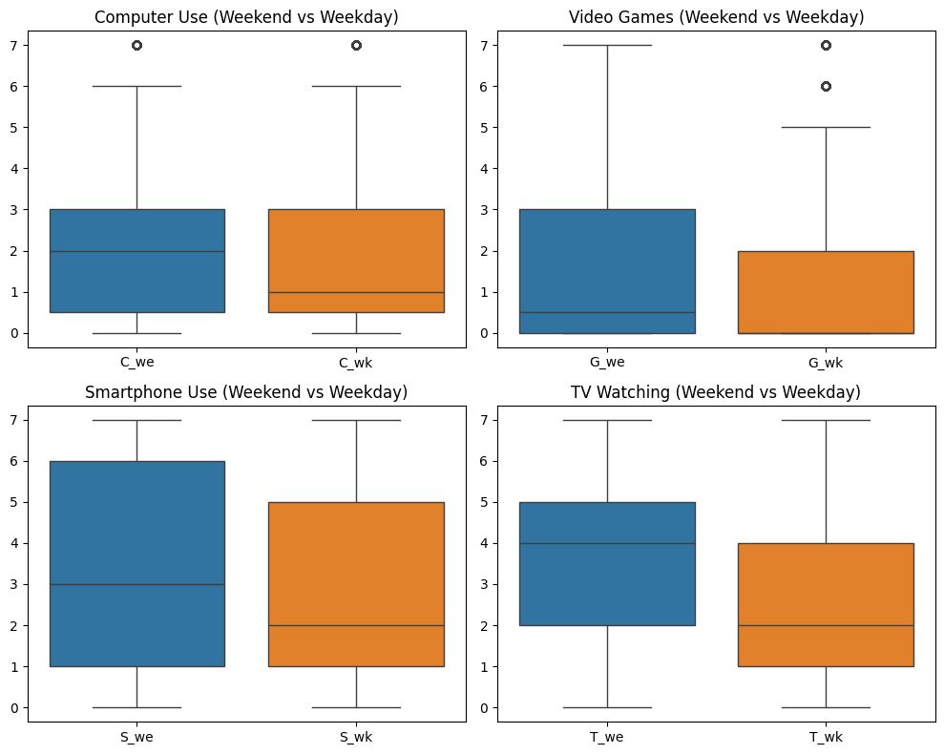
Descriptive Statistics
Dataset: Screen Time Activities
Mean & Median Screen Time:
Calculated for Computer (C), Gaming (G), Smartphone (S), TV (T) on Weekdays (wk) and Weekends (we)
Results:
Mean Screen Time: Displays average hours for each activity
Median Screen Time: Displays the middle value for each activity
Visualization:
Boxplots comparing Weekday vs Weekend screen time for:
Computer Use
Video Games
Smartphone Use
TV Watching

Slide 3
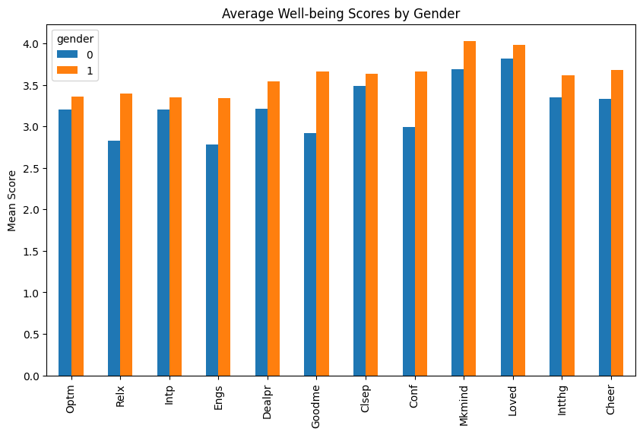
Gender Differences in Well-being
Data Sources: Merged Gender (dataset1) with Well-being Data (dataset3)
Well-being Measures:
Optimism (Optm), Relaxation (Relx), Interaction (Intp), etc.
Analysis:
Mean Well-being Scores calculated for each gender
Display of available well-being indicators
Visualization:
Barplot of Well-being Scores by Gender

Slide 4

Inferential Statistics - Minority Status and Screen Time
Objective: Compare Screen Time between Minority and Majority groups
Screen Time Calculation:
Total screen time for all activities combined
Independent T-Test:
Groups: Minority (1) vs Majority (0)
Result:
T-statistic and P-value calculated
Interpretation of significance

Slide 5
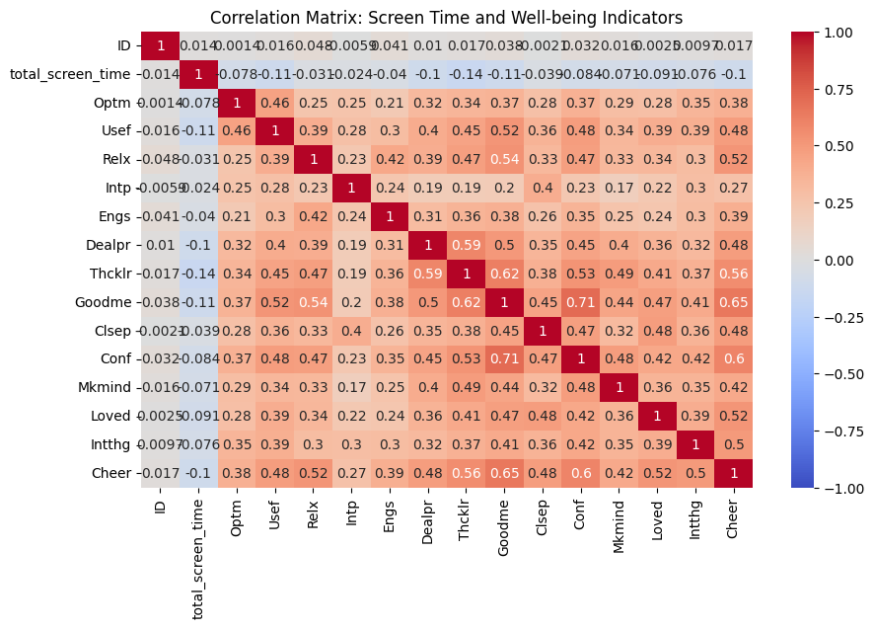
Screen Time and Well-being Correlation
Objective: Investigate the correlation between total screen time and well-being indicators
Data Merged: Screen time (dataset2) and well-being (dataset3)
Pearson Correlation Analysis:
Correlation matrix calculated between screen time and well-being indicators
Visualization:
Heatmap of correlations showing positive/negative relationships

Slide 6
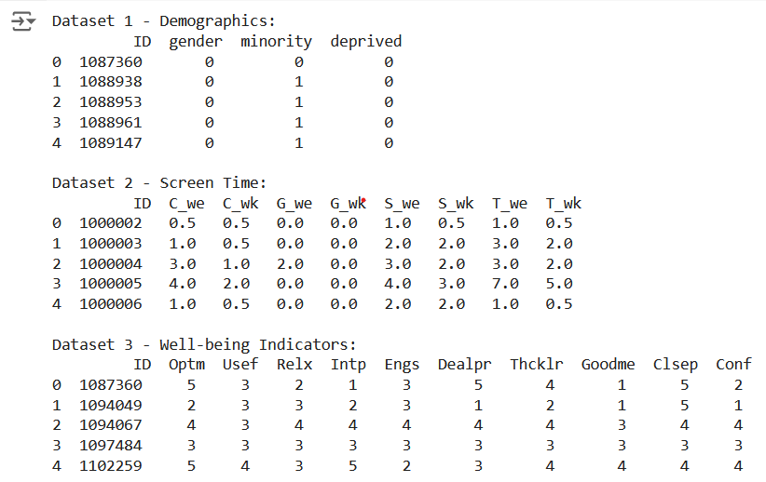
Data Exploration
Datasets Overview:
Demographics (dataset1), Screen Time (dataset2), Well-being (dataset3)
Key Steps:
Display first few rows of each dataset
Check for missing values
Summary statistics for each dataset

Slide 7
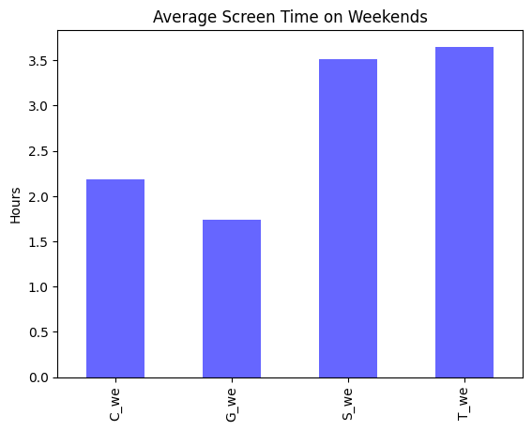
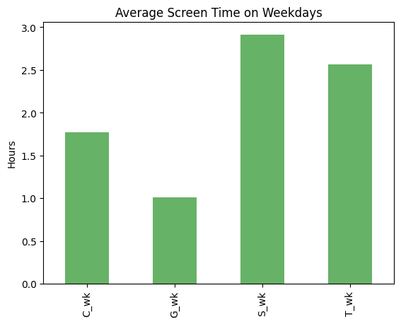
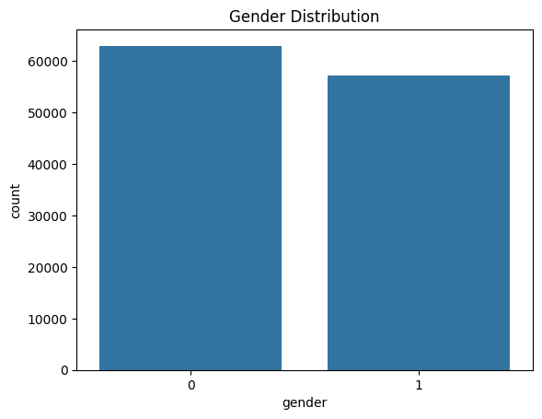
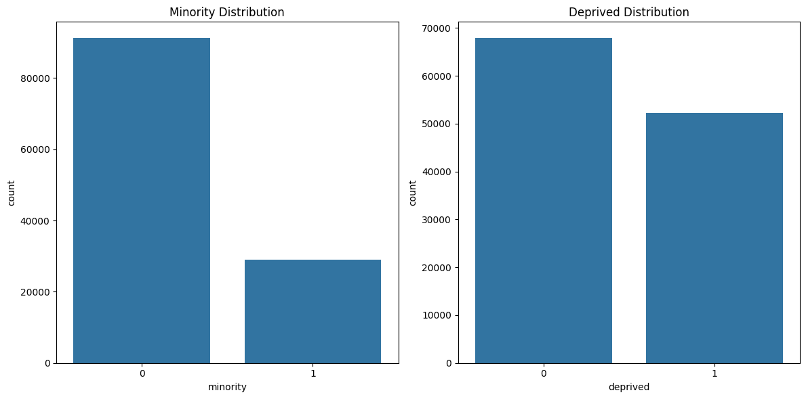
Data Visualization - Demographics and Screen Time
Demographics:
Gender Distribution: Count plot showing gender distribution
Minority & Deprived Status: Count plots for both categories
Screen Time (Weekdays vs Weekends):
Barplots comparing screen time on weekends and weekdays for:
Computer Use
Video Games
Smartphone Use
TV Watching

Slide 8
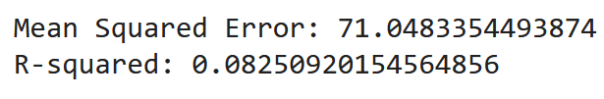
Linear Regression Model
Objective: Model Well-being using Screen Time and Demographics
Features (X): Total Screen Time (Weekdays & Weekends), Gender, Minority, Deprivation Status
Target (Y): Total Well-being Score
Process:
Split data into training and test sets
Train a linear regression model
Make predictions and evaluate performance
Results:
Mean Squared Error (MSE): Measures model error
R-squared: Explains variance in well-being due to features

Slide 9
Thank You

