Slide 1
Online based movie review and ratings platform
Submitted by
Md. Samiul Basher-16101090
Niloy Julious Rosario-16301162
Mehruz saif-19101665
Farshid Saad-16101314
Junaed Iqbal-17121014

Slide 2
Introduction
A platform for people to find reviews on different kinds of movie
Find details about the movies ,the casts and more .
Join a community of other users and read their opinion on movies
Submit your review and rating so other might find it useful

Slide 3
Motivation
Saving a lot of time when finding what movie to watch
A entirely spoiler free review will ensure you get the theme of the movie without ruining it for you
Community driven site to feel you more connected with the movie
Advanced recommendations based on the movies you watched
Viewing all the timing of the movies in different theaters

Slide 4
Methodology
Throwaway Prototype
Regular updates for new movies
Adding new features and updating existing one based on user recommendations

Slide 5
Softwares/Applications used
Laravel Framework
Xampp
Language on backend - Javascript and PHP
Database - Mysql server

Slide 6
Functional Requirements
User will have his/her own account in which they can log-in
The system will provide the user with information of the all current movies
The system must provide the user with opportunity to ratings and comments

Slide 7
Business Value
$60,000 a year from Premium accounts ( from 500 customers, charging $10 per month
$3000 a year from new accounts ( from 50customers, charging $5 as new account fee)
$25,000 a year from advertising revenues ( with average CPC of $0.25 , 100,000 clicks per year)

Slide 8
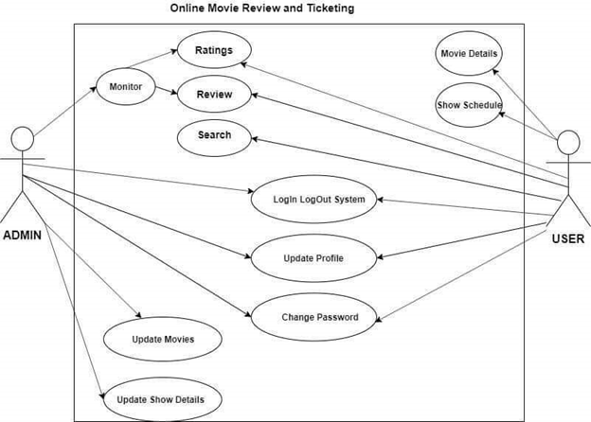
Use Case Diagram

Slide 9
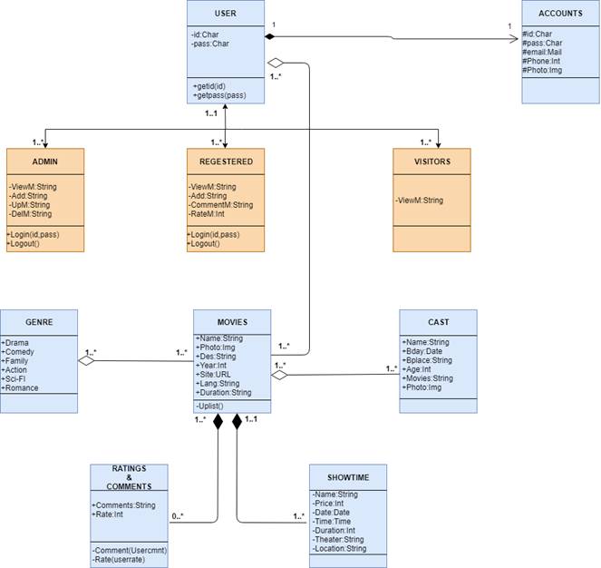
Class Diagram

Slide 10
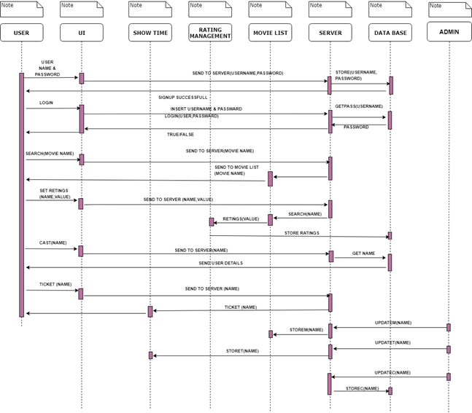
Sequence Diagram

Slide 11
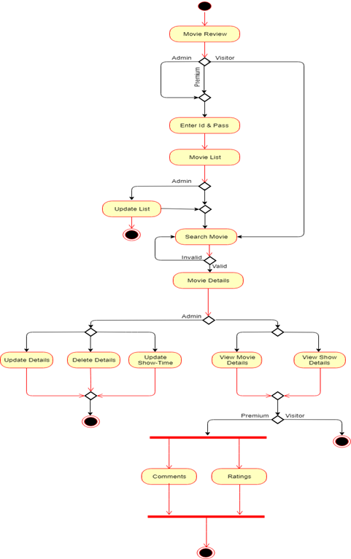
Activity Diagram

Slide 12
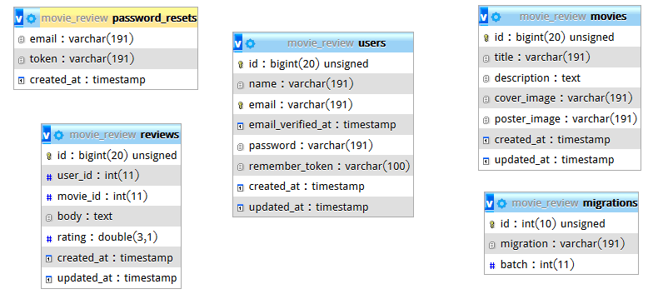
E-R Diagram

Slide 13
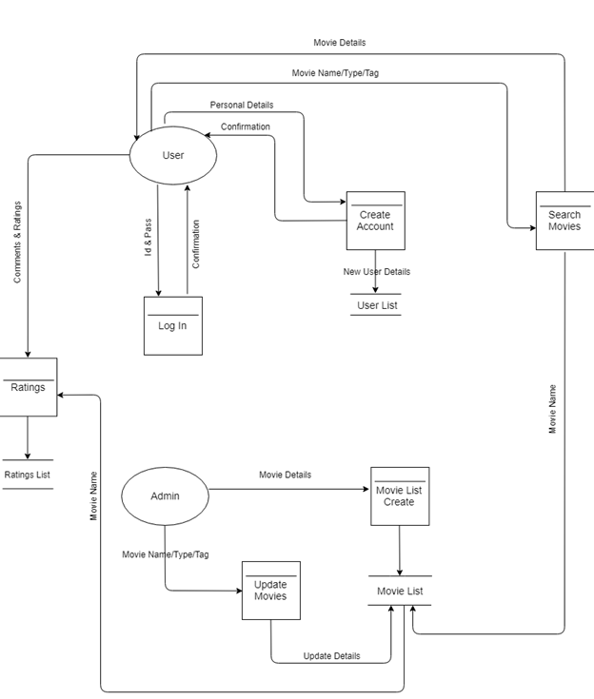
Data Flow Diagram

Slide 14
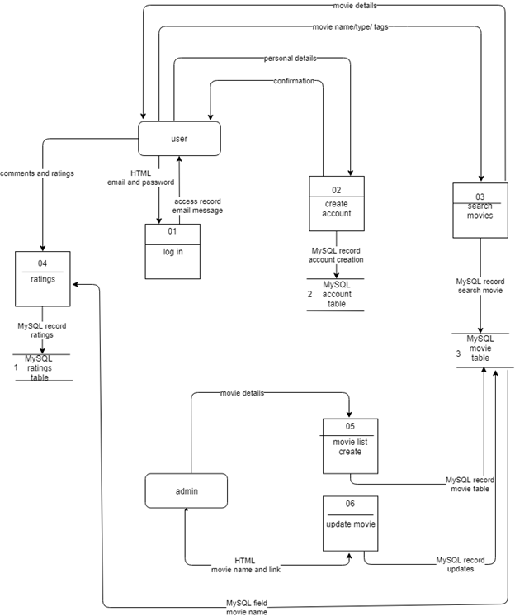
Physical DFD

Slide 15
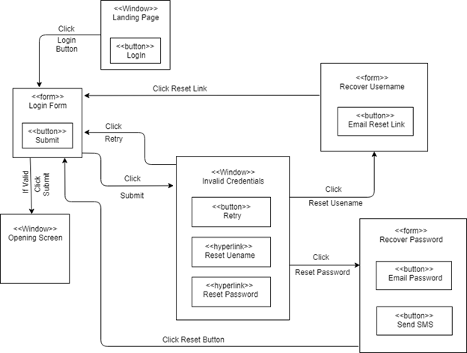
WND Diagram

Slide 16
Future Improvements
Buying tickets directly from the site
24/7 online customer service
Premium early access features for premium members
Advanced machine learning technology for better recommendations
Search by casts /director/movie theater option

Slide 17
THANKS

