Slide 1
Indian Retail Store Data Analysis
This dashboard provides a visual summary of sales and profit performance across categories, regions, and time periods for an Indian retail store.

Slide 2
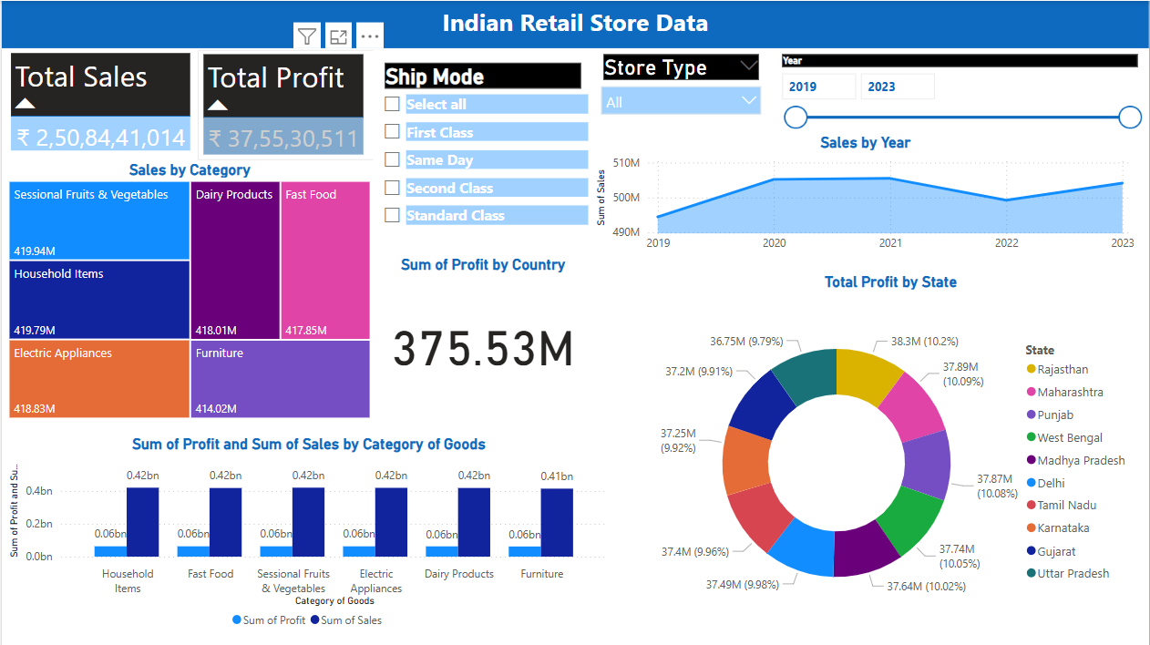

Slide 3

Total Sales: ₹2,50,84,41,014
Total Profit: ₹37,55,30,511

Slide 4
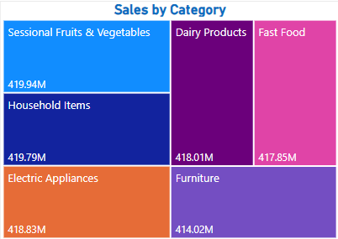
Sales by Category
A Tree Map.
Top-performing categories:
Sessional Fruits & Vegetables: ₹419.94M
Household Items: ₹419.79M
Other notable categories include Dairy Products, Fast Food, Furniture, etc.

Slide 5
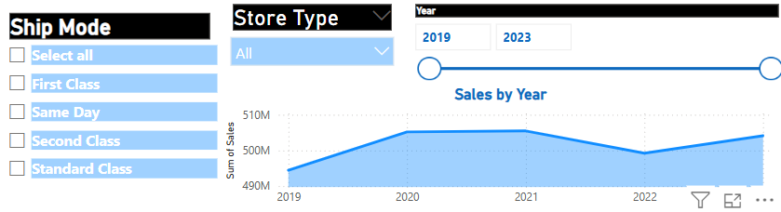
Filter Options
Ship Mode: First Class, Same Day, Second Class, etc.
Store Type: All / Specific store type
Year Range Selector: 2019 to 2023

Slide 6
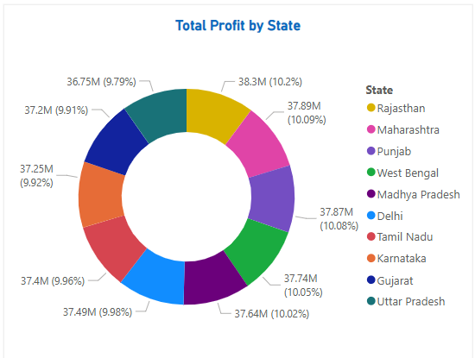
Profit by State
Donut Chart highlights contributions by different states.
Top contributors (around 10% each):
Rajasthan
Maharashtra
Punjab
Others including Tamil Nadu, Karnataka, etc.

Slide 7
CONCLUSION
Sum of Sales trended down, resulting in a 51.36% decrease between 1950 and 2018.﻿
Sum of Sales started trending down on 2014, falling by 52.38% (1,93,28,458.97) in 4 years.﻿
Sum of Sales dropped from 3,69,02,686.05 to 1,75,74,227.08 during its steepest decline between 2014 and 2018.﻿ ﻿

Slide 8


