Slide 1
DronePro
By Centurion Drone
Final Project
INFO 6215 Business Analysis and Information Engineering
08.15.17

Slide 2
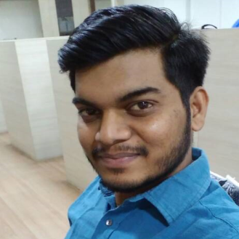
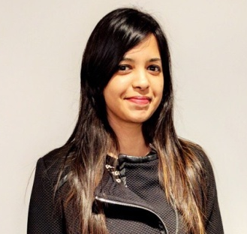
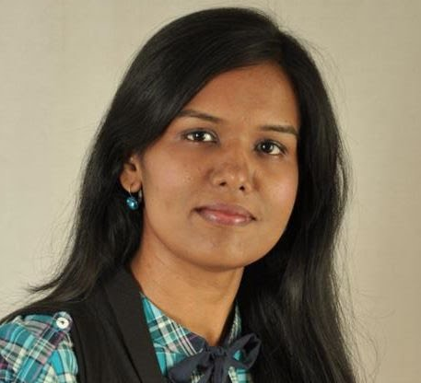
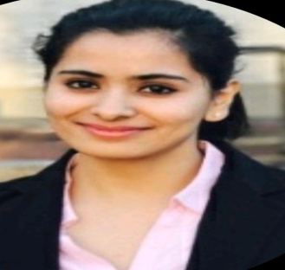
Meet The Team
Omkar Daphal
Project Manager
Soumiya Roy
IT Head
Vaishali Lambe
Strategy Analyst
Shruti Mehta
Solutions Engineer

Slide 3
Deliverables
Business Case
Requirements Document
Process Flow Diagrams
Use Case and Personas
Web Interface Screens
App Interface Screens
Minutes Of Meetings
Team Evaluation

Slide 4
Introduction
Drone Pro is a product aiming to provide the diversified consumer base with drones
which can be used for multiple security purpose.
Customers can customize their drones based on their need on our interactive web portal
and place an order. The company submits the order for assembly to its allocated vendor
and delivers it to the client. The also provide customer mobile app to track and control the drones.

Slide 5
Business Problem
In past couple of years, with the increase in online marketplace, the number of
warehouses has increased by 12%. There are valuable goods within the
warehouse that needs to be guarded well. In past 5 years, there was more than
20% increase in the theft cases. Moreover, influenced and wealthy people are
Always seeking for personal security because of rivalries and threats. Having
personnel hired for the safety of a person would add to the burden and expense
Of the company. Also, a lot of Construction sites have some difficult sections. And
When in problem, this needs lot of efforts for engineers to take a look and
understand.
This results in loss of time. CCTV footages are sometimes not clear and unable to record the 360 degrees view of the event where theft or crime is happening, there is a dire need of improved safety measures.

Slide 6
Solution
The solution to this problem has been found by replacing the security personnel
and CCTVs by Security Drones launched by Centurion Drones, focusing on
providing the security to the citizens of the country. By using this drone, at least 40% of the licensed users would get benefitted from the product. Moreover, this product gives them the opportunity to customize the drone with their needs and
requirements.

Slide 7
Assumptions and Constraints
Assumptions:
All staff and employees will be trained accordingly in their respective data entry, timesheet and reporting tasks on the new web-based system
All customizable parts are available to customize a drone as per customer demand
Delivery system is efficient
All requirements are in Max allowable size/weight/speed
Cost will be increased as per customizable part value and shown on web system immediately.
Funding is available for purchasing hardware/software for web-based system
All department heads will provide necessary support for successful project completion
Project has executive-level support and backing
Constraints:
There are limited IT resources available to support the Drone Pro Project and other ongoing IT initiatives.
There are a limited number parts available to produce a customizable drone
As implementation, will be done internally and not by the product developers or vendors, there will be limited support from the hardware/software providers.

Slide 8
Business Goals and Objectives
Business Goal/Objective
Reduce time for the Web based tool will allow real-time and accurate reporting of all payroll and administrative metrics by 30%
Decrease in the number of HR and payroll staff required for managing these activities which will improve efficiency by 40%
Improved efficiency in autonomy and flexibility will address employee concerns and allow managers to focus on billable tasks by double rate
Customization with web platform leads to an increased number of Sales with a profit margin of $100,000

Slide 9
Live Demo Web Portal Phone App

Slide 10
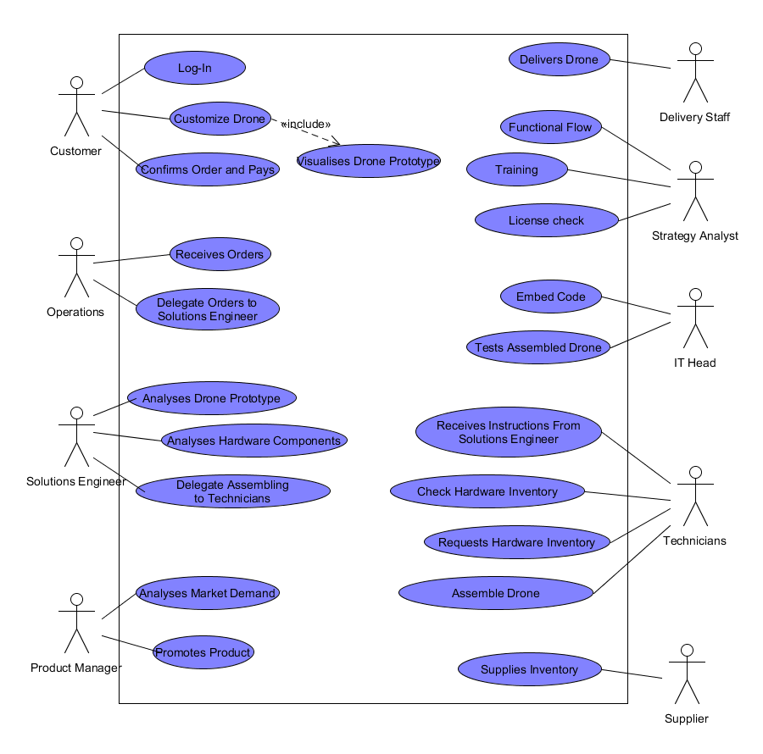
Use Case Diagram

Slide 11
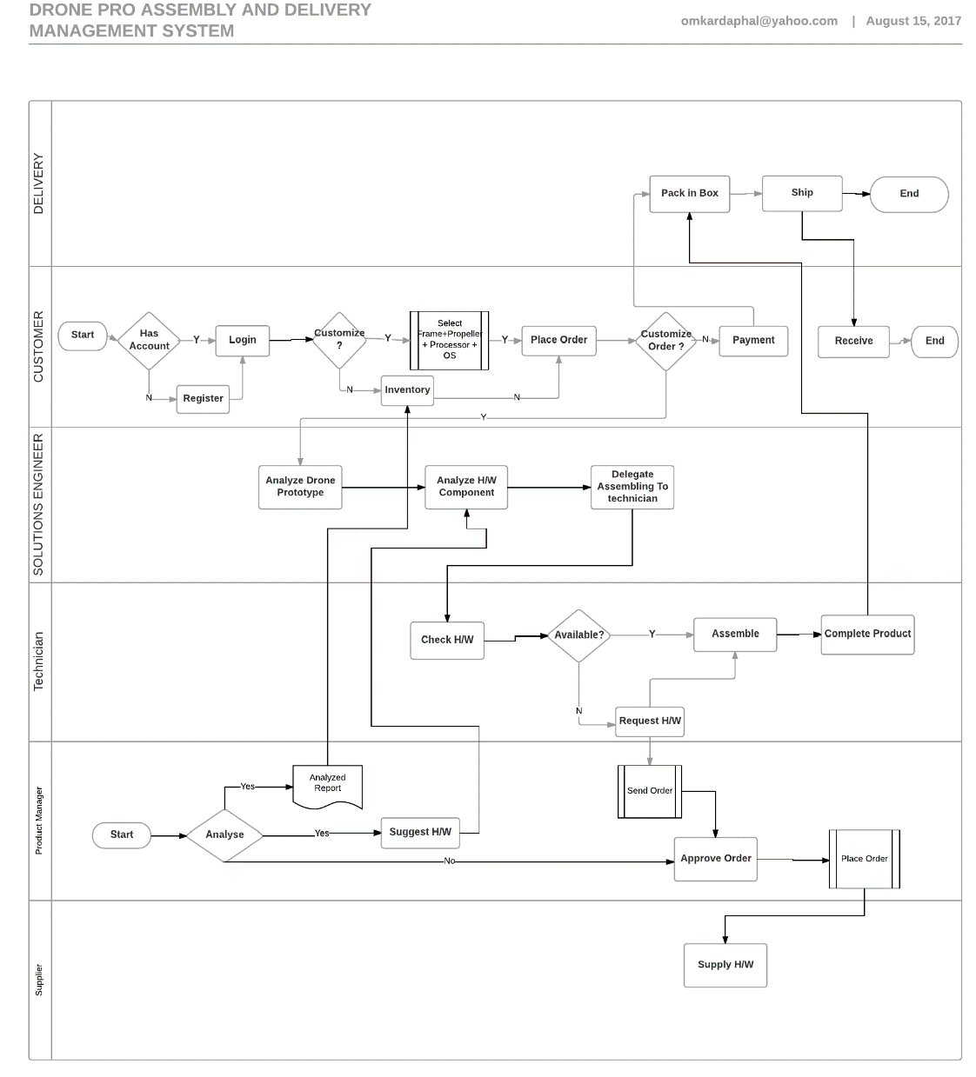
Process Flow Diagram

Slide 12
Business Requirements
ID | Business Requirement Statement
B1 | An authorized user (customer) should be able to login through web portal.
B2 | An authorized user (customer) should be able to login in app.
B3 | Customer should be able to customize drone on web portal.
B4 | All payment of the drone to be accepted and process by electronic way only. International payments to be converted into dollars.
B5 | Receipt of the successfully placed order to be sent by mail and cellular SMS.
B6 | Information regarding estimated delivery time of the product.
B7 | Integration and calibration of drone with app.
B8 | Navigation and maneuver of the drone.

Slide 13
User & Functional Requirements
ID | User and Functional Requirement Statements
Goal U1 | Customer Onboarding
U1.1 | Register and Login on web portal
U1.1F1 | Validation and verification of license
U1.2 | Login through App
U1.2F1 | Login through token (verified license number)
Goal U2 | Placing order
U2.1 | Customize drones
U2.1F1 | Select components, features and color
U2.2 | Payment
U2.2F1 | Integration with payment gateway (Citrus)
U2.3 | Order Confirmation
U2.3F1 | Mail and SMS integration
Goal U3 | Delivery of product
U3.1 | Delivery details sent to customer
U3.1F1 | Estimated delivery time sent on mail/SMS. By default, 5 days for standard delivery, if not in inventory: 10days
U3.2 | Return Policy
U3.2F1 | Within 10 days from delivery date, full refund upon inspection
Goal U4 | Control and Tracking
U4.1 | App integration
U4.1F1 | Integration with Drone device number/license
U4.2 | Controls and Settings
U4.2F1 | Control motion, speed, components (mic/camera)

Slide 14
Non-Functional Requirements
N-ACS1 | The system shall resist unauthorized, accidental or unintended usage by validating valid drone license information
N-AVL1 | The system shall be available for normal use 24 by 7 Monday to Sunday
N-AVL2 | The system shall be available for system maintenance purposes from 22:00 to 24:00 hours by weekly
N-EFC1 | The system shall allow several sales to be made at the same time without downgrading performance
N-EFC2 | The response time shall be 10 seconds maximum
N-INT1 | For the sales process, all currency conversion values will be calculated to 2 decimal places.
N-REL1 | The system shall be consistent for all involved processes starting user login, security check, placing order, payment, sales etc.
N-SRV1 | When an update failure is detected all updates performed during the failed session shall be rolled back to restore the data to pre-session condition.
N-USE1 | The system shall be easy to use by all employees including sales representatives and managers
N-FLX1 | The system shall be easy use in all kind of environments
N-MNT1 | The mean preventative maintenance time on applying routine plug-in updates to the Website shall be less than 30 minutes every 2 weeks.
N-SCL1 | The system shall accommodate unrestricted growth in customers to support business growth
N-VER1 | The system shall be accessed in different browsers and on different systems to see performance and analysis, how well it performs, quality of the system etc.
N-IOP1 | The system shall have clearly defined interface between Mobile App and Drone
N-POR1 | The system shall be available on operating systems specifically Windows, Mac OS, Android
N-REU1 | The system shall be easy to accommodate multiple drones in one mobile app

Slide 15
Summary
DronePro helped Centurion Drones to make world safer place thru tools of web portal and drone app
Implementing Web based platform enabled Centurion Drones a global reach.
Introduced customization of drones repercussion of more customer satisfaction.
Expected increase of 65% alone from sales revenue.
Cost Benefit Analysis for first year totalling to $342,738

Slide 16
Thank You

