Slide 1




HUMAN COMPUTER INTERACTION
PROF. MANISH KHARE
ZENSCAPE
GROUP 1

Slide 2
PROBLEMS
EXCESSIVE USE OF MOBILE DEVICES
NO MOTIVATION TO
GET RID OF PHONE
NOT ABLE TO KEEP TRACK
NEED STRICT RESTRICTIONS
NEED OF DIFFERENT MODES
PARENTAL
CONTROL

Slide 3
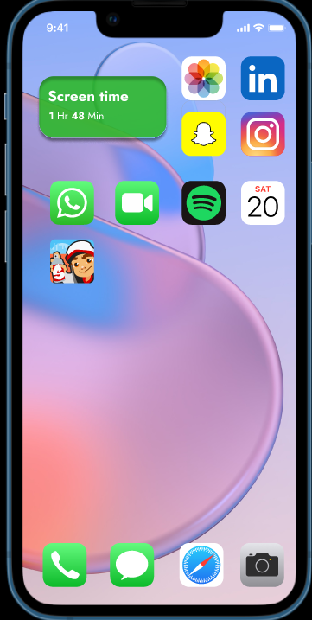
SHOWS SCREEN TIME

Slide 4
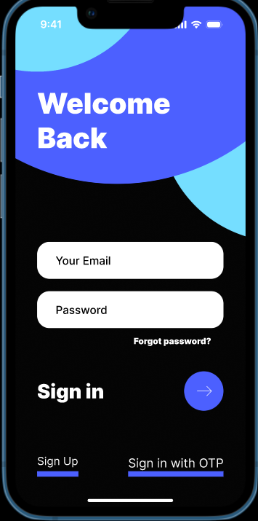
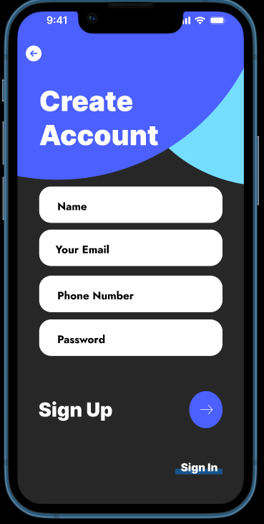
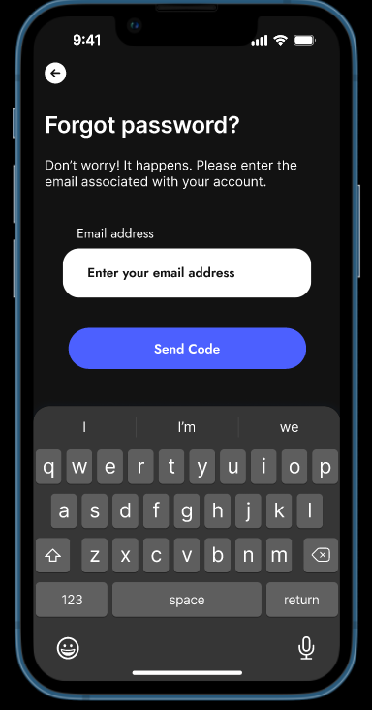
Notes:
Affordances

Slide 5
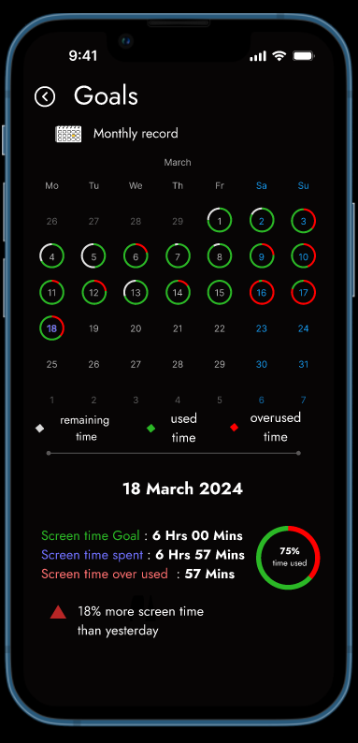
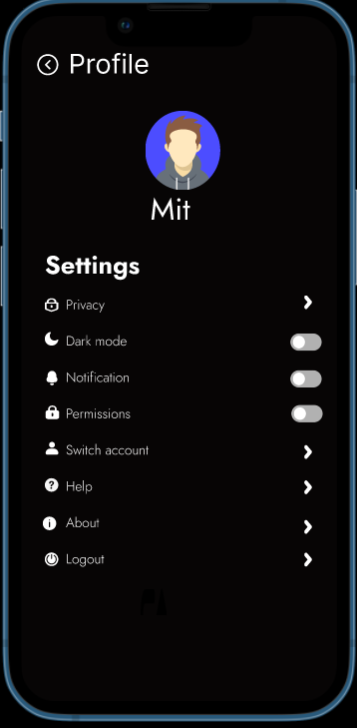
USER PROFILE

Slide 6
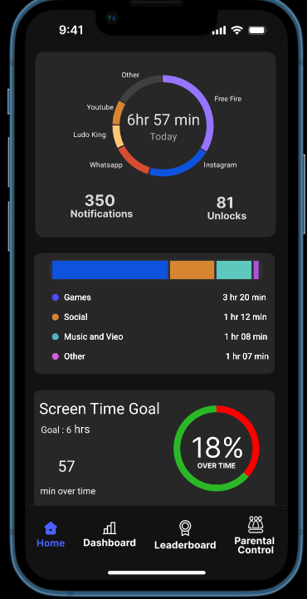
HOME PAGE

Slide 7
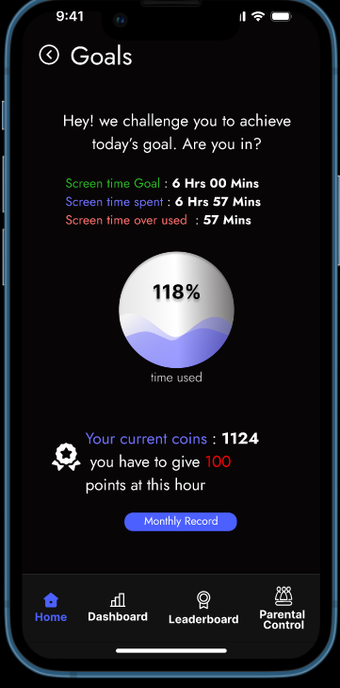
COIN SYSTEM
Notes:
affordances

Slide 8
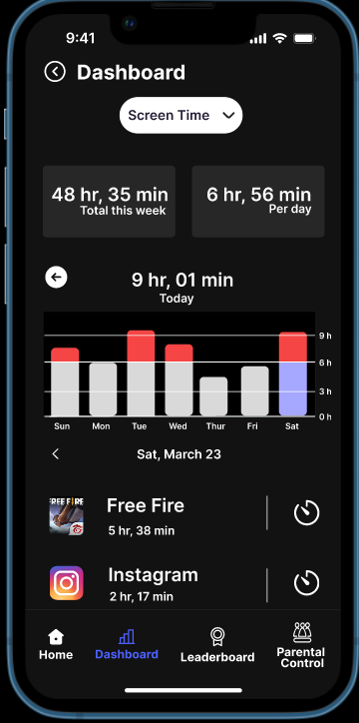
APPWISE WEEKLY DATA

Slide 9
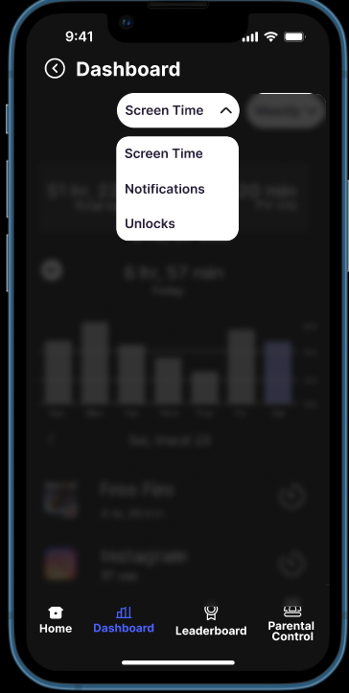
NOTIFICATIONS AND UNLOCKS

Slide 10
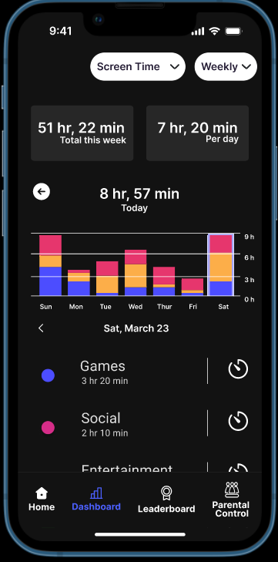
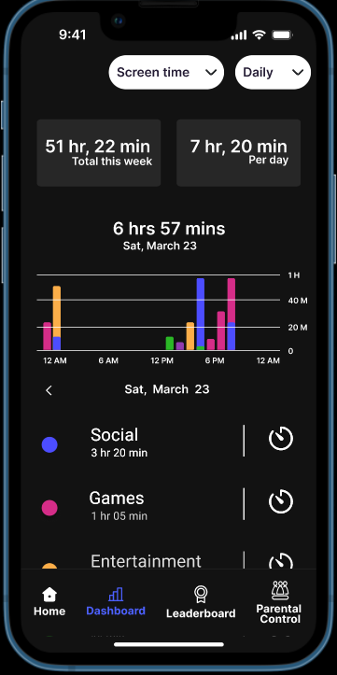
CATEGORYWISE DATA
Notes:
Mappings

Slide 11
SCREEN TIME GOAL
Notes:
Mappings

Slide 12
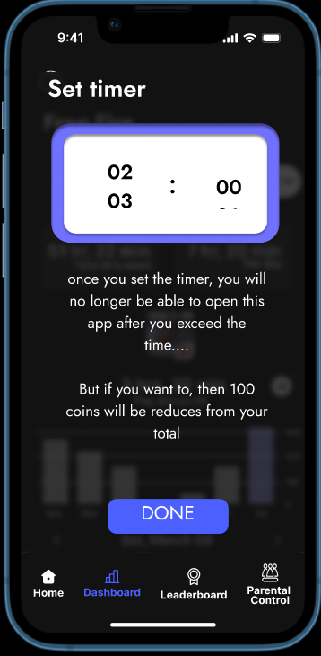
SETTING TIMER
Notes:
affordances

Slide 13
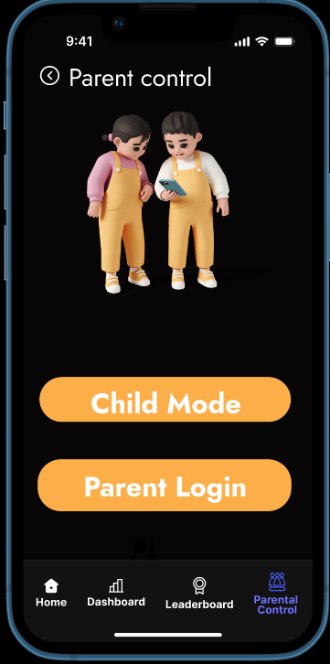
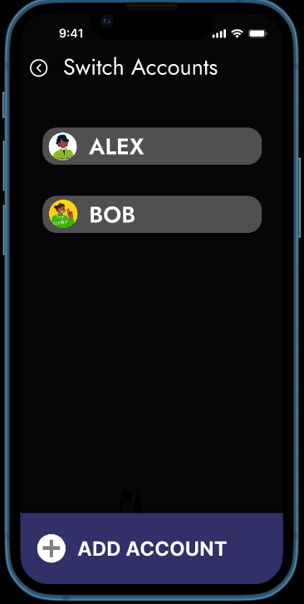
PARENT CONTROL

Slide 14
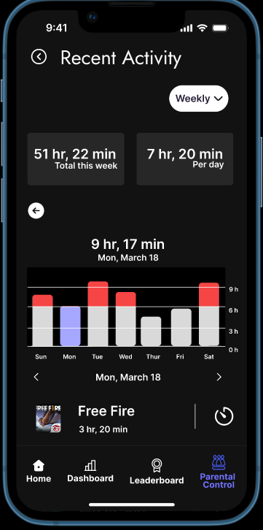
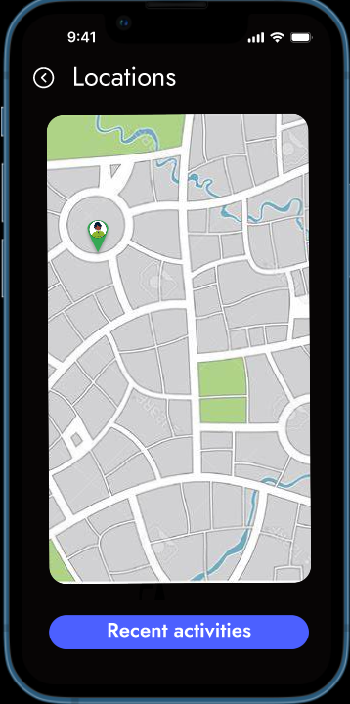
PARENT CONTROL

Slide 15
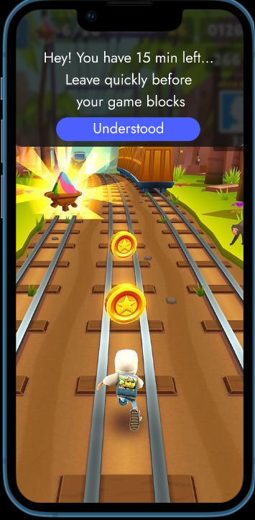
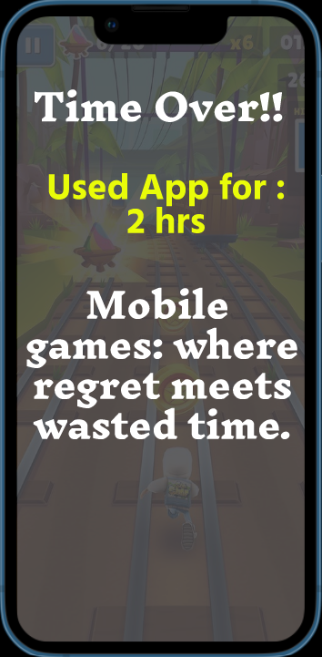
ALERTS AND POP-UPS
Notes:
Feedbacks

Slide 16
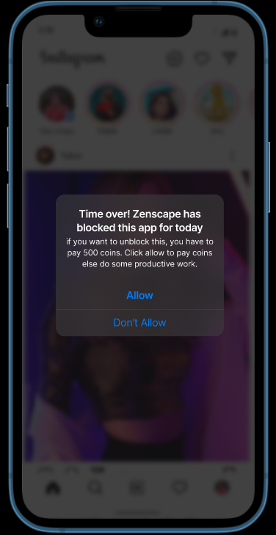
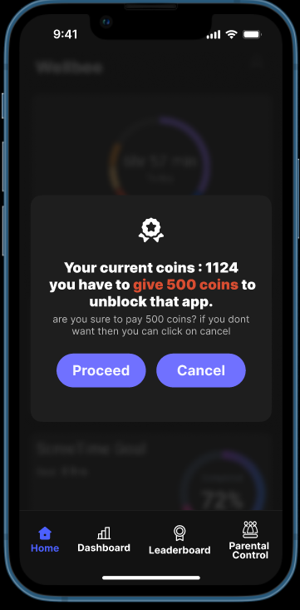
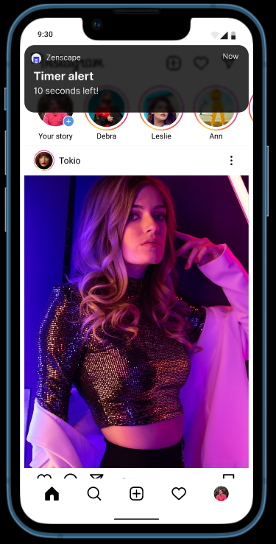
Notes:
constraints

Slide 17
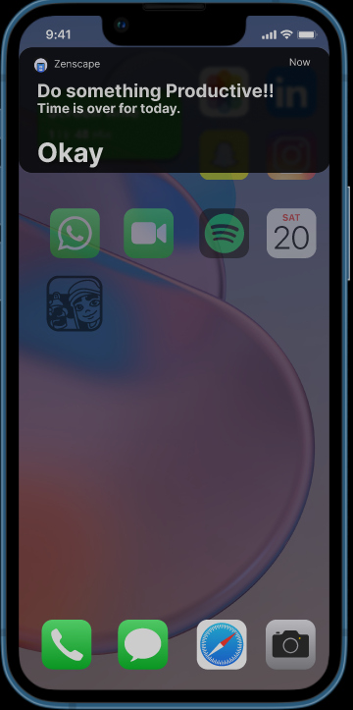
POP-UPS

Slide 18
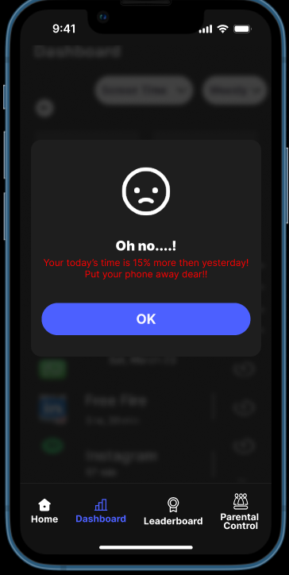
POP-UPS

Slide 19
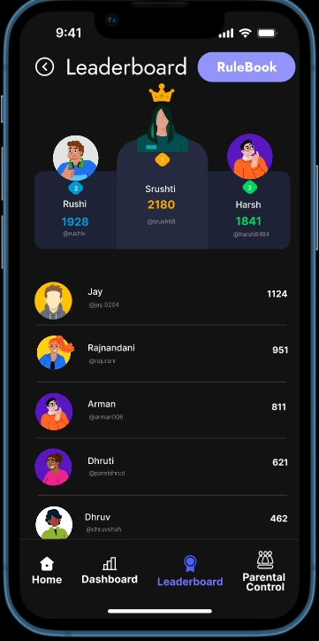
LEADERBOARD

Slide 20
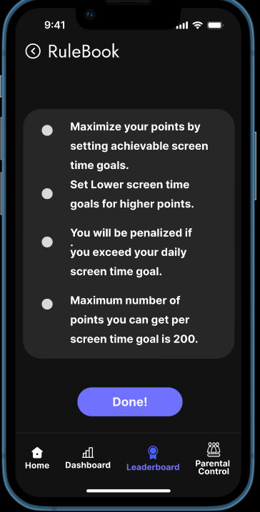
RULEBOOK

Slide 21
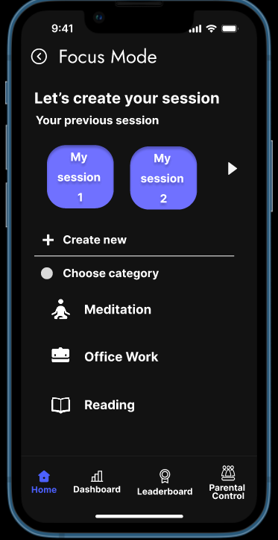
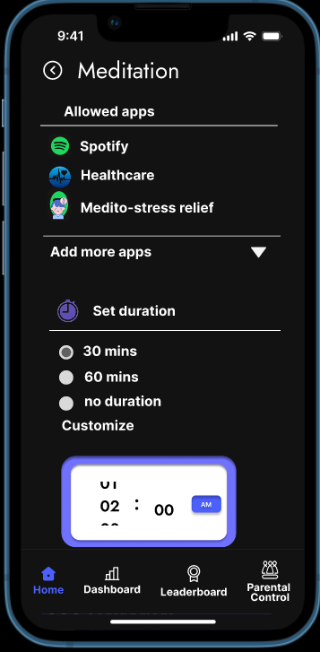
FOCUS MODE

Slide 22
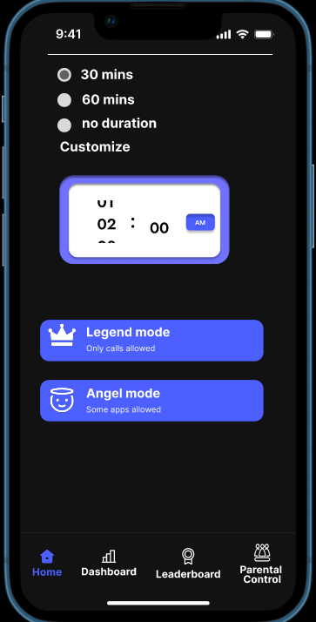
LEGEND AND ANGEL MODE

Slide 23
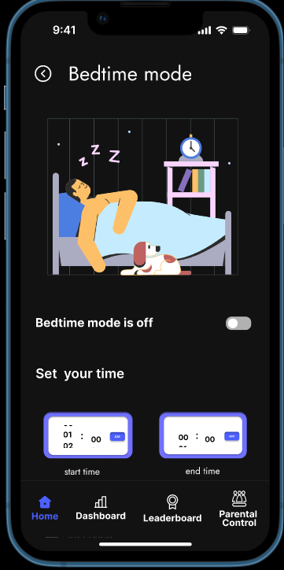
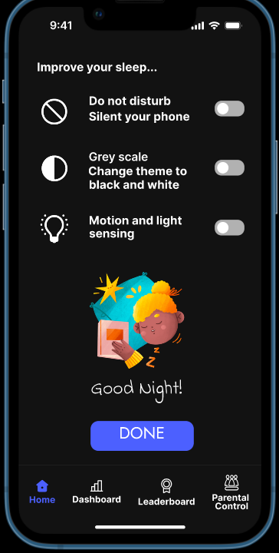
BEDTIME MODE

Slide 24
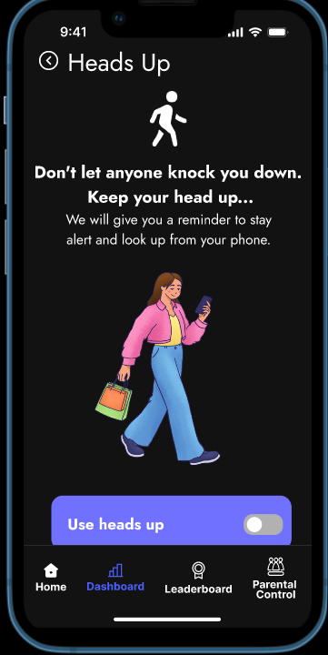
HEADS UP FEATURE

Slide 25
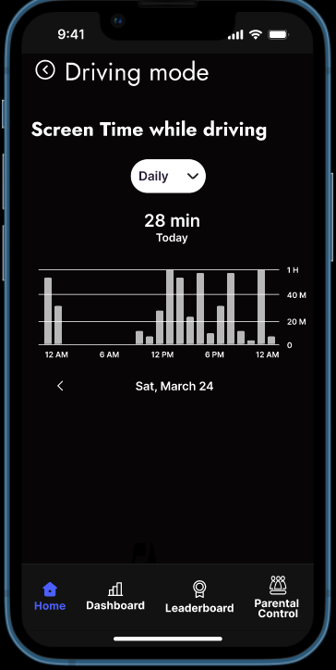
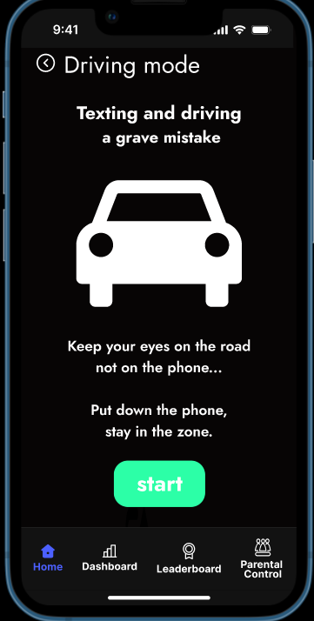
DRIVING MODE

Slide 26
HCI CONCEPTS
MENTIONED BEFORE
USEFUL AND USABLE
MATCH BETWEEN WORLDS
FITTS’ LAW
USER CONTROL/FREEDOM
PROTOTYPING

Slide 27
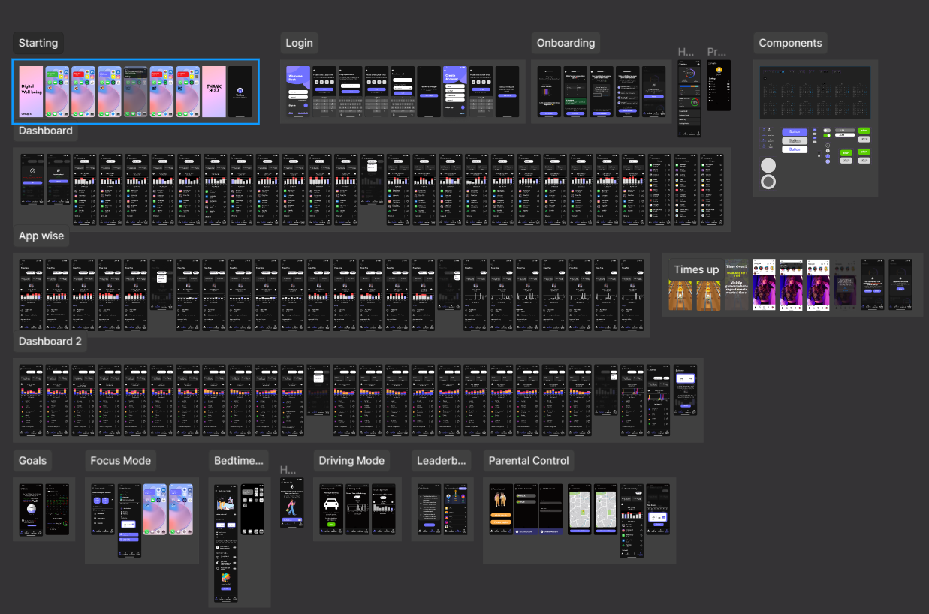
SOFTWARE PROTOTYPE

Slide 28
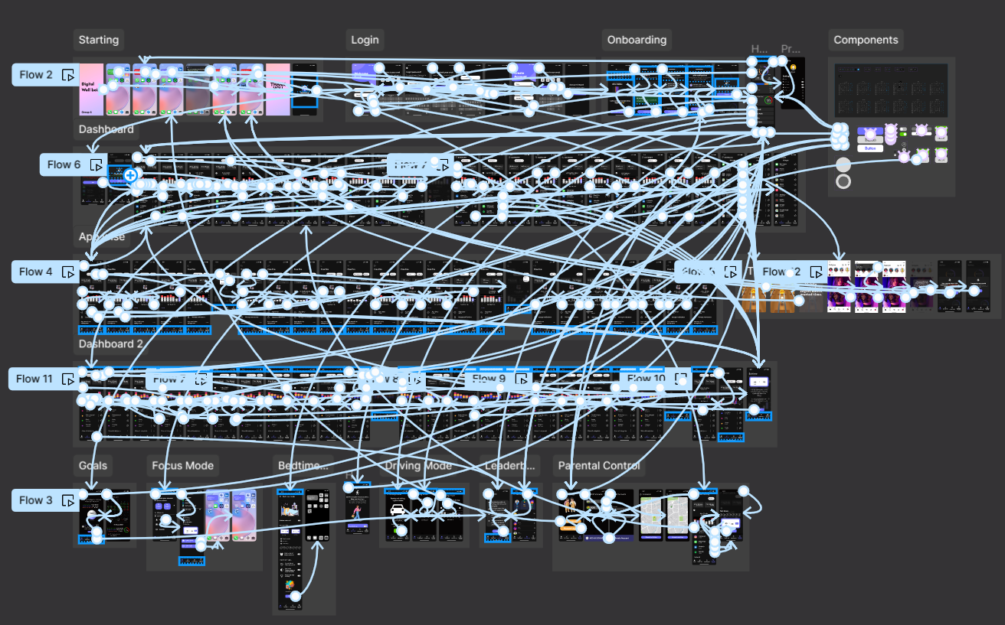
WIREFRAMES

Slide 29
THANK YOU
Group 1
202101006
YASH GARG
202103006
MAKHANI ARMAN BARKATBHAI
202201033
SAGAR SHAILESH SURATI
202203002
MEHTA MIT MITESH
202411005
CHANIYARA JEEL

