Slide 1














Technical Partner
Team Name: Padhlo Pappu
Team Leader Name: Mehul Bisht
Problem Statement: Intelligent Solar Feasibility and Planning System for Buildings.

Slide 2



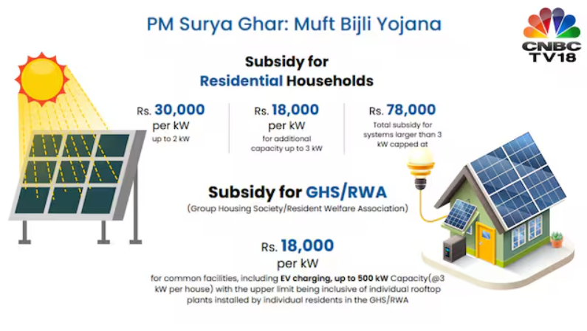
Problem Statement
Solar energy adoption processes are highly complex and fragmented, lacking an automatic, accessible way for property owners to assess their feasibility
Homeowners and building managers struggle to get accurate, personalized system sizing and realistic financial payback data without specialist consultations
Results in widespread consumer hesitation, prolonged decision-making, and a drastically slowed transition to renewable energy
Statistic
Studies indicate that manual feasibility quoting and customer acquisition can account for up to 50-60% of the total price of a residential solar installation, acting as a major artificial barrier to widespread adoption

Slide 3
Proposed Solution
An AI-powered solar feasibility platform that automatically analyzes a building’s historical electricity consumption data and generates a fully personalized solar installation plan — eliminating the need for expert consultation.
Ingests detailed electricity usage patterns across time-of-day and seasonal cycles to accurately determine the optimal solar capacity for partial or complete grid replacement.
Integrates solar irradiance, geographic, and weather datasets to predict real-world energy generation potential based on the building’s location, orientation, and environmental conditions.
Delivers a comprehensive financial blueprint, including panel requirements, rooftop space utilization, installation costs, maintenance estimates, and payback period — all computed automatically from real data.
Provides interactive dashboards showcasing energy consumption trends, projected solar output, CO₂ emission reductions, and financial returns, enabling users to make informed, data-driven decisions at a glance.

Slide 4
Technology Stack
Programming Languages
Python
JavaScript
TypeScript
Models / Logic
Meta Prophet
XGBoost
Custom Solar Sizing Algorithm
Frameworks and Libraries
React.js
Tailwind CSS
FastAPI
Recharts
React Leaflet
PVLIB (Solar Energy Simulation)
Database / Storage
MongoDB

Slide 5
Methodology
Steps:
Data Ingestion & Building Profile
Consumption Analysis & Forecasting
Solar Potential Estimation
Optimal System Sizing
Financial Viability Report
AI-Powered Advisory & Dashboard
Data ingestion
& building profile
Commercial Analysis & Forecasting
Solar Potential Estimation
System Sizing & Optimization
Financial Viability report
AI Advisory and Dashboard

Slide 6
Impact:
Who Benefits:
Home owners and building owners
Environment and local communities
Solar installer and policymakers
What Change It Brings:
Simplifies complex solar feasibility assessment
Promotes transition to renewable energy
Accelerates decision-making for solar investments
Reduces carbon footprints of buildings
Example
Provides property owners with instant, easy-to-understand system sizing and financial payback data without needing expert consultations
Drives the shift toward clean energy adoption, reducing the community's dependency on traditional power grids
Turns a lengthy planning process into a quick upload-and-view experience, making solar adoption accessible to everyone
Offers tangible metrics on CO₂ offsets (like equivalent trees planted), allowing users to see their direct environmental contribution

Slide 7
Feasibility & Innovation
Feasibility
Uses a lightweight web-based application accessible directly from standard desktop and mobile browsers
Requires only basic, easily accessible inputs, seamlessly processing standard electricity bill images or PDFs
Integrates reliably with established global datasets for precise solar irradiance
Built using highly scalable, industry-standard modern web technologies
Innovation
Combines AI-powered OCR bill parsing with dynamic, custom solar sizing algorithms
Uses interactive geospatial mapping to pinpoint exact building coordinates for localized solar data
Integrates immediate financial forecasting alongside clear, tangible environmental metrics (like CO₂ offset)
Creates a unified, end-to-end platform transitioning users from basic utility data to a complete solar action plan
Example
Works smoothly on everyday smartphones, enabling homeowners to simply snap a photo of their electricity bill to get started
Generates system sizing and recommendations based on the user's actual extracted consumption data rather than generic estimates
Empowers property owners by translating complex solar feasibility math into interactive, easy-to-understand visual dashboards

Slide 8
Future Scope
Scaling Possibilities
Expansion to commercial and industrial sectors alongside residential deployment
Integration with regional utility boards and national solar subsidy schemes
Extensions
Advanced AI-based models for predicting future household energy needs
Predictive analytics for precise battery storage and inverter sizing
Dedicated mobile app connecting homeowners directly with verified local solar installers
Example
Real-time matching of high-intent homeowners with available local solar contractors
Automated detection and application of eligible government rebates and tax incentives
Integration with smart home platforms and EV (Electric Vehicle) charging ecosystems to size systems for future usage

Slide 9
References
Ministry of New and Renewable Energy (MNRE) – Rooftop Solar Program Guidelines and Reports
NITI Aayog – Renewable Energy Integration & Transition Planning Reports
International Energy Agency (IEA) – Global Solar Energy Market & Feasibility Studies
National Renewable Energy Laboratory (NREL) – PV System Performance and Irradiance Methodologies
https://www.niti.gov.in/sites/default/files/2021-07/Renewable-Energy-Integration-in-India-2021.pdf

Slide 10
Thank You

