Slide 1


UI Superhero Roadshow
ASP.NET Outlook Inspired UI
Mehul Harry
Web Program Manager, DevExpress
mharry@devexpress.com
@mehulharry

Slide 2
Agenda
The DevAV ASP.NET demo
Code sample

Slide 4
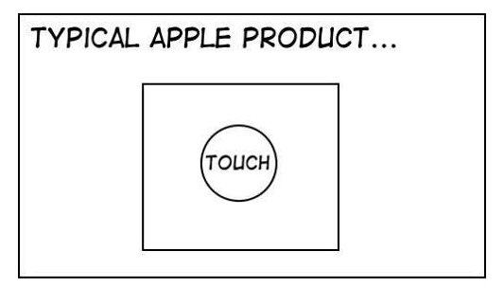

Slide 5
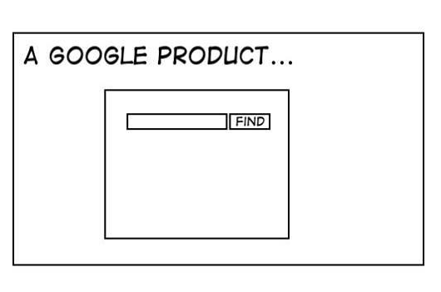

Slide 6
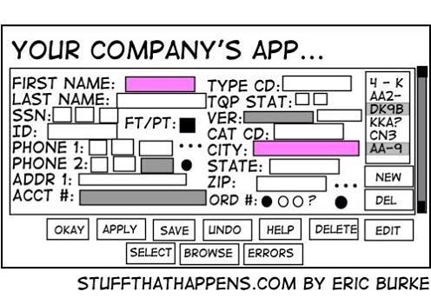

Slide 7
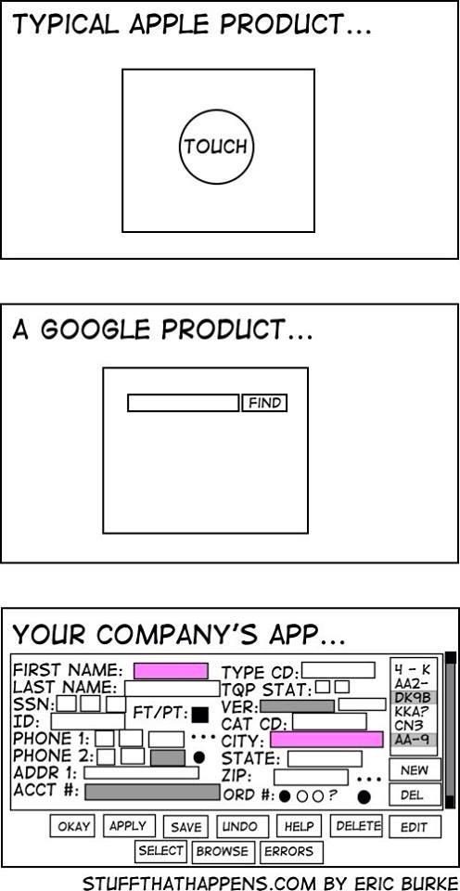

Slide 8
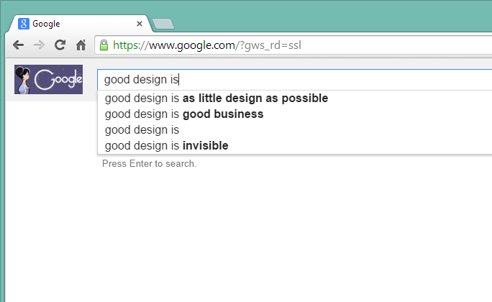

Slide 9
DevAV
Responsive
Mobile-Friendly (tablets)
Beautiful (new approach)
Fast
Functional
Modern
Good practices (data layer, user controls)

Slide 10
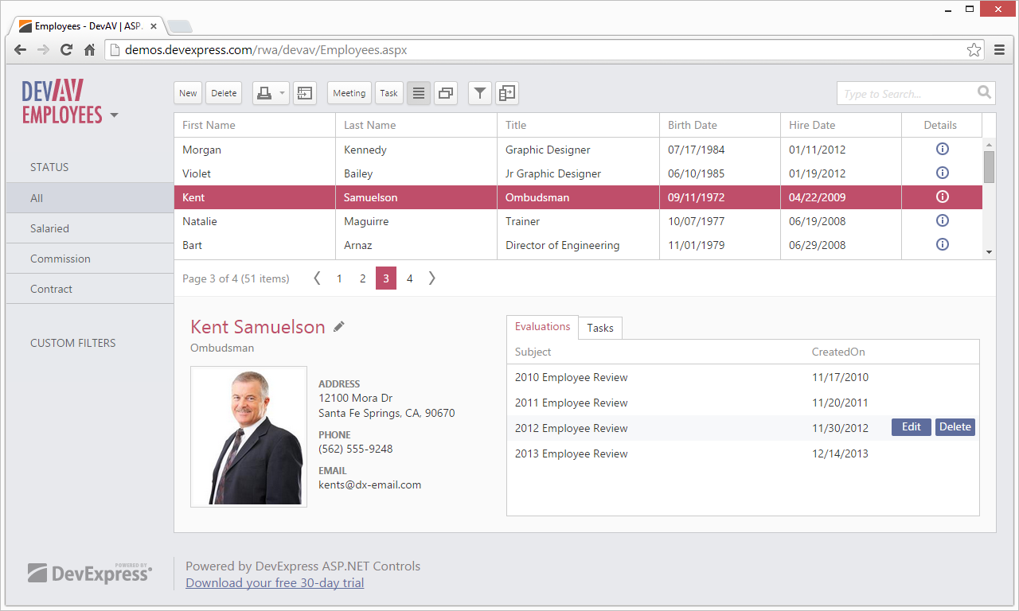

Slide 11
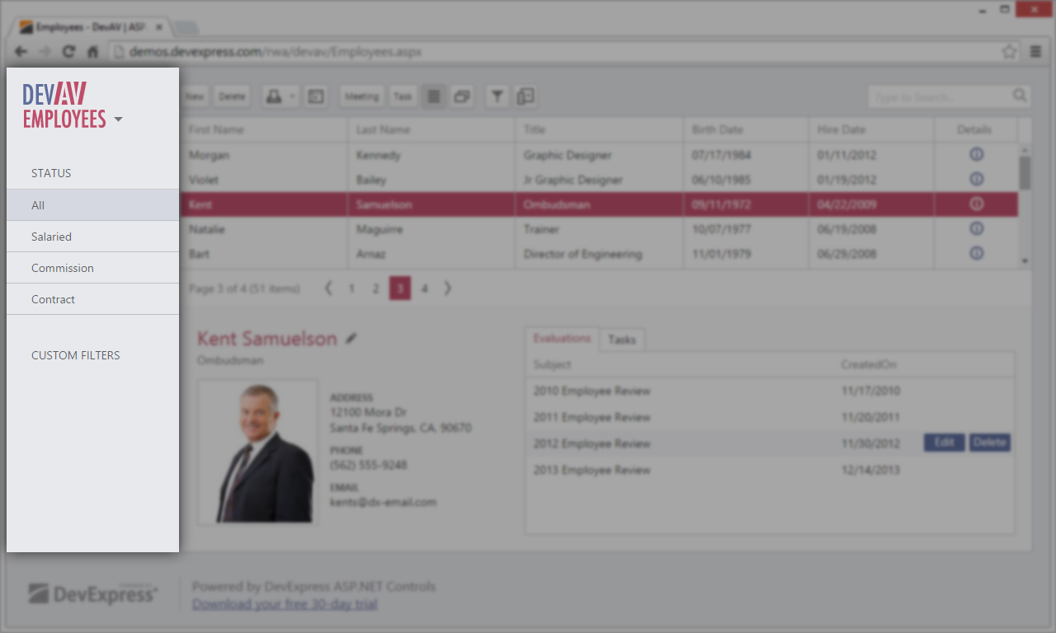

Slide 12
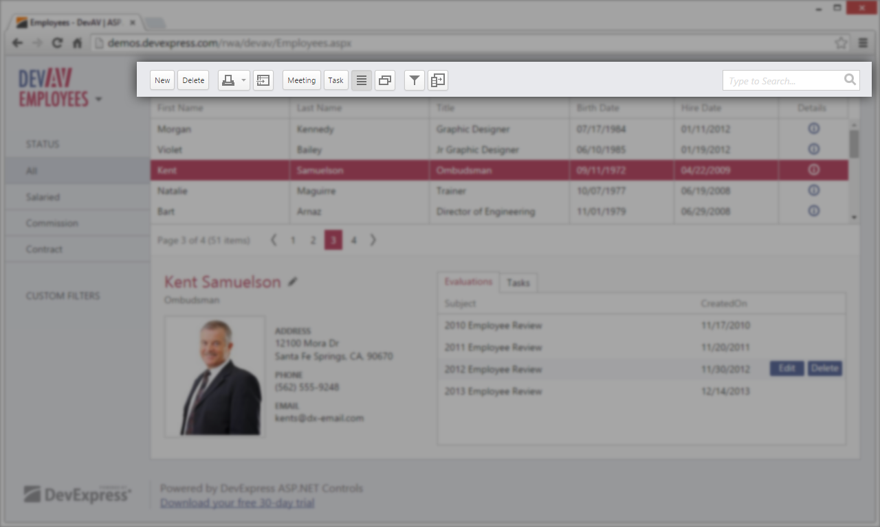

Slide 13
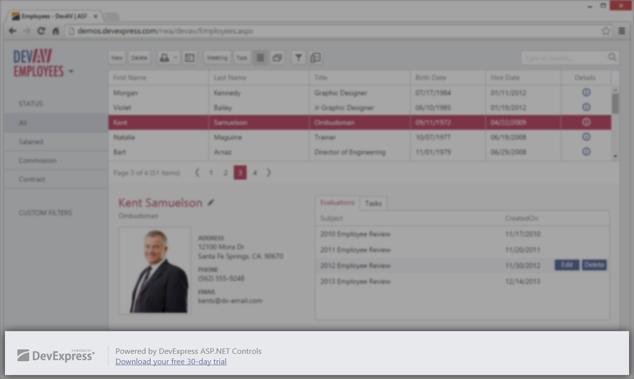

Slide 14
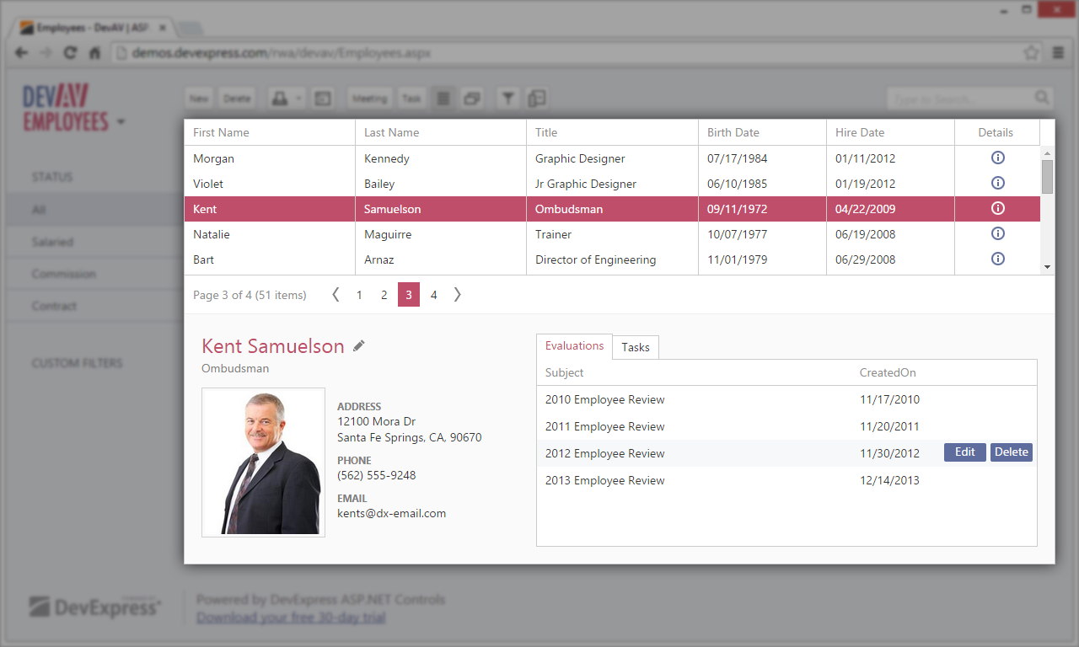

Slide 15
Let‘s Code!

Slide 16
http://demos.devexpress.com/rwa/devav/
Full source code with install

Slide 17
DevAV
https://github.com/Mehul/DevAVLite

Slide 18
Questions?
Mehul Harry
Web Program Manager, DevExpress
mharry@devexpress.com
@mehulharry

