Slide 1
WILDFIRE PREDICTION
Presented By:
Ankita Pall (c0868547)
Mehul Maru (c0870127)
Sai Samarpan Sahu (c0868567)
Sheetal (c0879889)

Slide 2


Introduction
Business problem statement:
The increasing number of wildfires and the difficulty in predicting and managing them effectively, leading to loss of lives, property damage, and environmental degradation.
Objectives:
To understand the root causes of the business problem and its impact on stakeholders.
To identify the key drivers of wildfire risk and develop a comprehensive dataset.
To apply advanced analytics and machine learning techniques to predict wildfire risk and optimize firefighting resource allocation.
To evaluate the effectiveness of the proposed solution and its potential impact on stakeholders.

Slide 3
Business Problem Analysis
Root cause analysis:
Natural factors: climate change, weather conditions, vegetation growth.
Human factors: human activity, land use changes, ignition sources.
Impact analysis:
Loss of lives and property.
Environmental damage: air pollution, soil erosion, habitat destruction.
Economic burden: direct costs (fire suppression, property damage), indirect costs (health impacts, lost productivity).
Stakeholder analysis:
Fire departments and firefighters.
Local governments and policymakers.
Residents and communities in high-risk areas.
Environmental organizations and conservation groups.

Slide 4

Data Requirements
Types of data needed:
Historical weather data (temperature, humidity, wind speed, precipitation).
Satellite imagery (vegetation health, moisture levels, fuel loads).
Fire incident data (location, size, severity, causality).
Resource availability data (firefighters, equipment, water sources).
Demographic data (population density, age distribution, income level).
Data sources:
Government databases (National Oceanic and Atmospheric Administration, National Aeronautics and Space Administration).
Public datasets (Global Fire Database, OpenStreetMap).
Sensor data from fire stations and fire trucks.
Crowdsourced data (social media, online news).

Slide 5
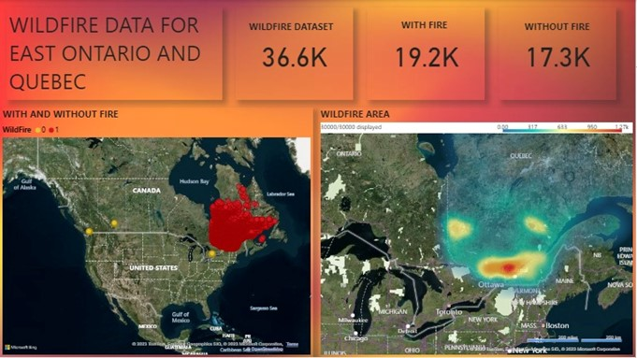
KPIs
Prediction Accuracy (PA):
Objective: Achieve 90% prediction accuracy.
Importance: Measures model effectiveness in identifying high-risk areas.
Response Time (RT):
Objective: Reduce response time by 20%.
Importance: Reflects system efficiency in providing timely information.
False Positive Rate (FPR):
Objective: Keep FPR below 5%.
Importance: Minimizes panic and optimizes resource allocation.
Data Quality Index (DQI):
Objective: Maintain DQI at 90%.
Importance: Ensures the model relies on reliable and accurate data.
Community Engagement Index (CEI):
Objective: Achieve 80% CEI.
Importance: Reflects success in awareness campaigns and public acceptance.

Slide 6
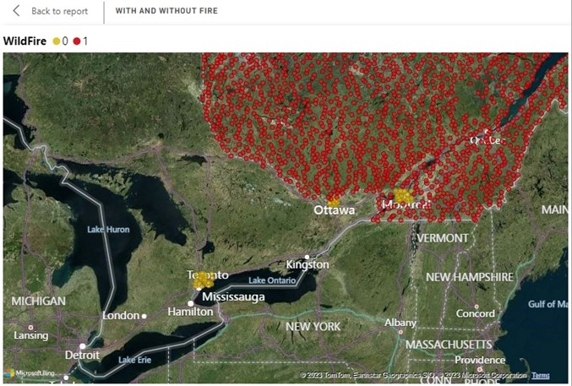
KPIs
6. Model Training Efficiency (MTE):
Objective: Reduce training time by 30%.
Importance: Ensures adaptability to changing conditions.
7. System Uptime (SU):
Objective: Maintain 99.5% uptime.
Importance: Ensures continuous monitoring and early detection.
8. Public Trust and Perception (PTP):
Objective: Achieve 75% PTP.
Importance: Vital for successful system adoption and cooperation.
9. Regulatory Compliance (RC):
Objective: Achieve 100% compliance.
Importance: Mitigates legal risks and aligns with governmental guidelines.
10. Continuous Improvement Rate (CIR):
Objective: Maintain a CIR of at least 20%.
Importance: Ensures system effectiveness in response to evolving wildfire patterns.

Slide 7
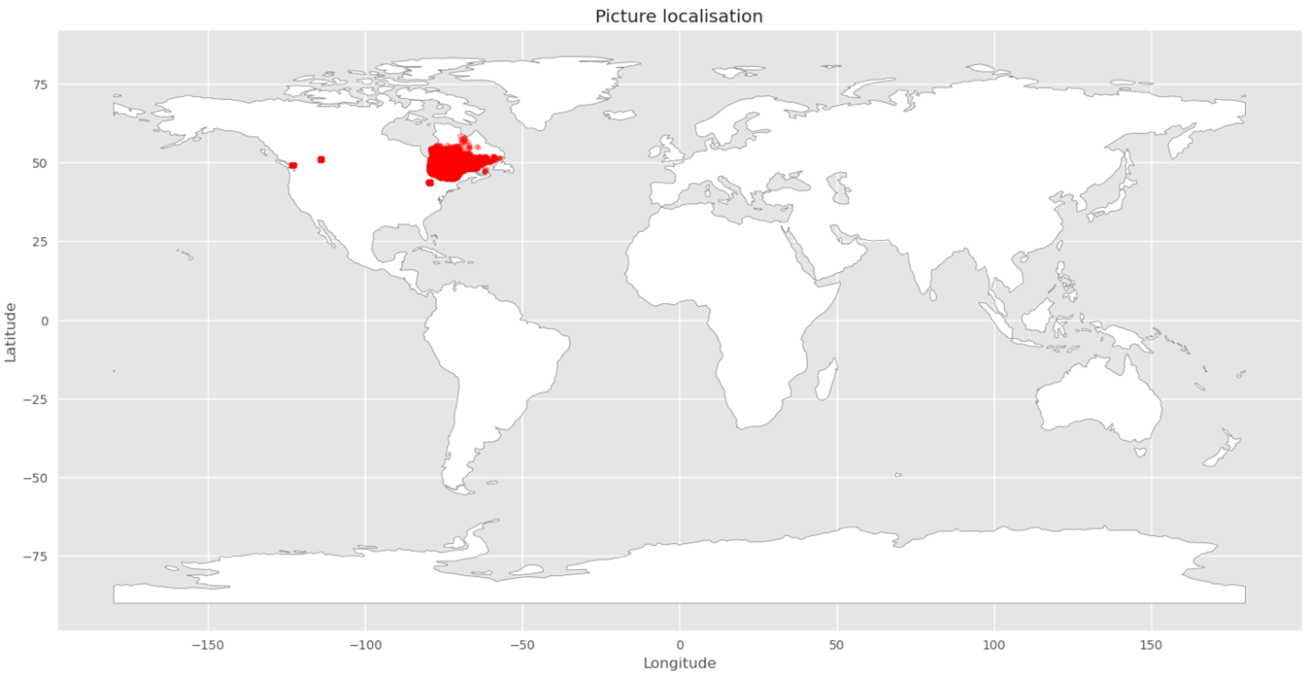
Exploratory Data Analysis

Slide 8
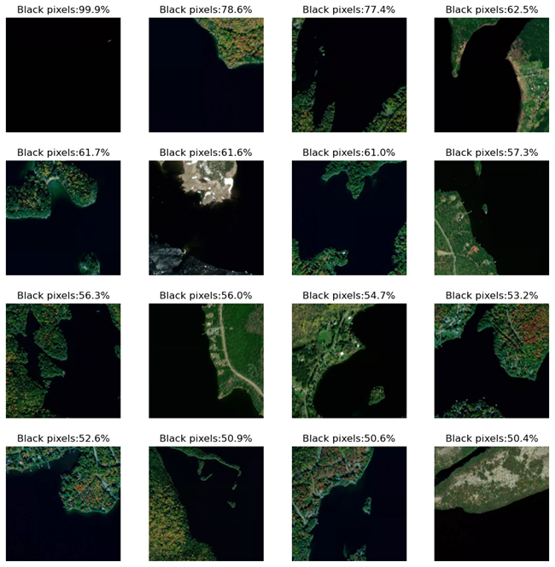
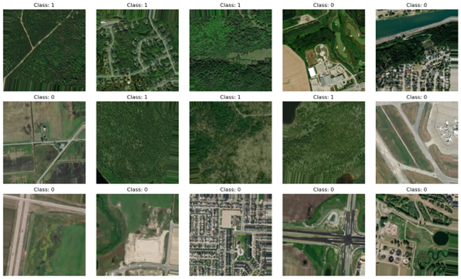
Exploratory Data Analysis

Slide 9
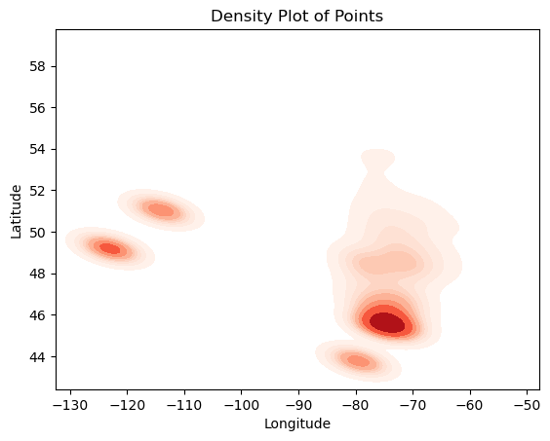
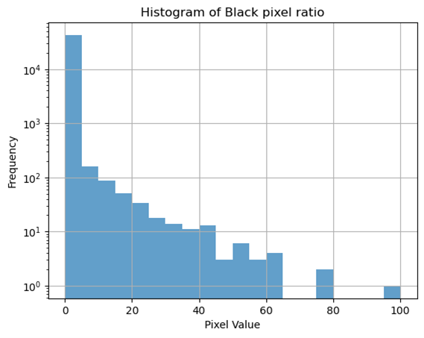
Exploratory Data Analysis

Slide 10
Analytical Techniques
Descriptive statistics and visualization:
Summarize historical weather data and satellite imagery to understand patterns and trends.
Use heat maps and scatter plots to identify high-risk areas and correlations between variables.
Machine learning algorithms:
Train random forest or gradient boosting models to predict wildfire risk based on historical data.
Use clustering algorithms (e.g., k-means) to group fires by similarity and identify common characteristics.
Spatial analysis:
Use geographic information systems (GIS) to analyze fire locations and resource availability.
Create maps to visualize fire risk and resource allocation.
Optimization techniques:
Use linear programming or genetic algorithms to allocate resources efficiently and minimize risk.

Slide 11
Knowledge Synthesis
Integrate learnings from previous courses:
Statistics and machine learning (for predictive modeling)
GIS and spatial analysis (for mapping and resource allocation)
Data visualization (for effective communication)
Apply frameworks and methodologies:
CRISP-DM (cross-industry standard process for data mining)
DMBOK (data mining body of knowledge)
Case studies and industry reports:
Review successful implementations of predictive analytics and machine learning in firefighting and related fields.
Identify best practices and lessons learned.

Slide 12
Gap Analysis
Additional data needs:
Real-time weather data
Social media data (public awareness and sentiment)
IoT sensor data (e.g., temperature, humidity sensors in forests)
Data quality issues:
Incomplete or missing data
Inconsistent formatting and errors
Solutions:
Collaborate with government agencies and private companies to obtain real-time data
Use web scraping tools to collect social media data
Install IoT sensors in high-risk areas
Technical challenges:
Handling large datasets and processing times
Ensuring model interpretability and explainability
Addressing privacy and security concerns
Integrating with existing systems and infrastructure
Organizational challenges:
Change management and adoption of new technology
Aligning different stakeholders and their interests
Managing the budget and resources for implementation
Developing a clear strategy and roadmap for AI adoption

Slide 13
Future Utility
Ongoing monitoring and update of predictive models
Integration with emergency response systems
Expansion to other regions and applications (e.g., flood risk prediction)

Slide 14
Innovative Solutions
AI-powered drones for early detection and monitoring
Mobile apps for public education and alerts
Gamification and simulation platforms for firefighter training

Slide 15
Potential Impact
Reduced number of wildfires and associated losses
01
Improved resource allocation and cost savings
02
Enhanced public safety and awareness
03

Slide 16
Conclusion
Key Findings:
Natural and human factors contribute to wildfires.
Severe impacts on lives, property, environment, and the economy.
Recommendations:
Implement predictive analytics using historical weather, satellite imagery, and fire incident data.
Utilize machine learning, spatial analysis, and optimization techniques.
Call to Action:
Collaborate among stakeholders for data-driven solutions.
Adopt real-time data, social media insights, and IoT sensors for accuracy.
Future Research Opportunities:
Explore real-time data integration, social media sentiment analysis, and IoT sensor networks.
Address data quality, technical challenges, and organizational hurdles.
Innovative Solutions:
AI-powered drones, mobile apps, and gamification for early detection, public education, and firefighter training.
Potential Impact:
Reduce wildfires and associated losses.
Improve resource allocation for cost savings.
Enhance public safety, awareness, and community resilience.

