Slide 1
Software Engineering (MC03094021)
Unit-4 Introduction to agile methodology

Slide 2

Looping
Outline
What is Agility?
Agile Process
Agility Principles
Where agile methodology not work?
Agile Process Models
Extreme Programming (XP)
Adaptive Software Development (ASD)
Dynamic Systems Development Method (DSDM)
Scrum
Feature Driven Development (FDD)
Crystal
Agile Modelling (AM)

Slide 3
Agility
Agility is ability to move quickly and easily.
It is a property consisting of quickness, lightness, & ease of movement.
The ability to create and respond to change in order to profit in a unstable global business environment.
The ability to quickly reprioritize use of resources when requirements, technology, and knowledge shift.
A very fast response to sudden market changes and emerging threats by intensive customer interaction.
Use of evolutionary, incremental, and iterative delivery to converge on an optimal customer solution.
Maximizing BUSINESS VALUE with right sized, just- enough, and just-in-time processes and documentation.

Slide 4


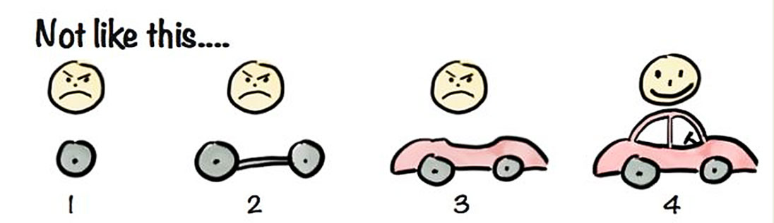

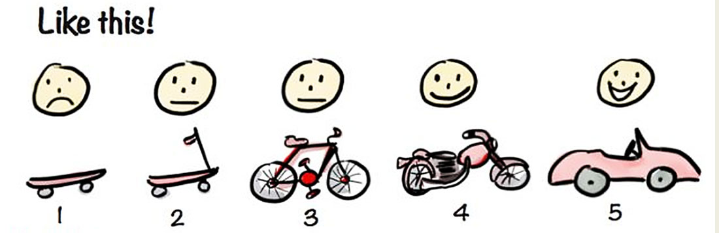

What is Agility? Cont.
Current Functionality
Rapid and Incremental delivery of software
Effective
response
to change
Change Request
Organizing a team
so that it is in control to perform
the work
Effective
communication
among all
stakeholders
Development
Team
Drawing the
customer onto
the team
Eliminate the
“us and them”
attitude
Customer

Slide 5
Agile Process
Agile software process addresses few assumptions
Difficulty in predicting changes of requirements and customer priorities.
For many types of software; design and construction are interleaved (mixed).
Analysis, design, construction and testing are not as predictable as we might like.
An agile process must adapt incrementally.
To accomplish incremental adaptation, an agile team requires customer feedback (so that the appropriate adaptations can be made).

Slide 6
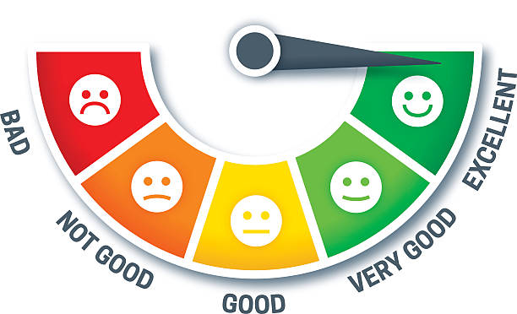


Agility Principles
Highest priority is to satisfy the customer through early & continuous delivery of software
Welcome changing requirements
Deliver working software frequently
Business people and developers must work together
Build projects around motivated individuals
Emphasize face-to-face conversation
Working software is the measure of progress
Continuous attention to technical excellence and good design
Simplicity – the art of maximizing the amount of work done
The best designs emerge from self-organizing teams
The team tunes and adjusts its behaviour to become more effective

Slide 7
1.Highest priority is to satisfy the customer through early & continuous delivery of software
The best ways to ensure you make customers happy while continuously delivering valuable software are to ship early, iterate frequently, and listen to your market continually.
Unlike traditional approaches to product development, which have notoriously long development cycles, agile principles encourage minimizing the time between ideation and launch. The idea is to get a working product in the hands of customers as soon as possible. Doing this successfully means product managers are able to quickly get a minimum viable product (MVP) out and into the world and use it to get feedback from real customers. This feedback is then fed back into the product development process and used to inform future releases.

Slide 8
2. Welcome changing requirements
In the world around us, change is the only constant. Agile principles and values support responding to these changes rather than moving forward in spite of them. Previous approaches to product development were often change adverse; detailed, well-documented plans were made before development began and were set in stone regardless of new findings. Agile principles support observing changing markets, customer needs, and competitive threats and changing course when necessary.

Slide 9
How it looks in practice:
Product teams are guided by high-level strategic goals and perhaps even themes below those goals. The product department’s success is measured against progress toward those strategic goals rather than by delivery of a predefined feature set.
Product constantly has its ear to the ground monitoring the market, customer feedback, and other factors which could influence product direction. When actionable insight is uncovered, plans are adjusted to better serve customer and business needs.
Product strategy and tactical plans are reviewed, adjusted, and shared on a regular cadence to reflect changes and new findings. As such, product needs to manage the expectations of executive stakeholders appropriately and ensure they understand the why behind changes.

Slide 10
3. Deliver working software frequently
Agile philosophy favors breaking a product’s development into smaller components and “shipping” those components frequently. Using an agile approach, therefore — and building in more frequent mini-releases of your product— can speed the product’s overall development.
This agile approach, with short-term development cycles of smaller portions of the product, results in less time spent drafting and poring over the large amounts of documentation that characterizes Waterfall product development. More importantly, this frequent-release approach creates more opportunities for you and your teams to validate your product ideas and strategies from the qualified constituencies who see each new release.

Slide 11
How it looks in practice:
Agile development cycles, often called “sprints” or “iterations” break down product initiatives into smaller chunks that can be completed in a set timeframe. Often this timeframe is between 2 and 4 weeks which truly is a sprint if you consider the marathon-like development cycles waterfall teams often follow.
Another popular alternative to agile sprints is continuous deployment. This method of shipping software frequently works less in terms of predetermined time boxes and more in terms of simply deciding what to do and doing it.

Slide 12
4. Business people and developers must work together
Communication is a critical component of any project or team’s success, and agile principles essentially mandate that it’s a daily event. It takes a village to raise a child they say, and that applies to product as well.
A successful product requires insight from the business and technical sides of an organization which can only happen if these two teams work together consistently. Regular communication between business people and developers helps improve alignment across the organization by building trust and transparency.

Slide 13
How it looks in practice:
Cross-functional agile product development teams include product people. This means that product is represented on the development team and bridges the gap between technical and business aspects of the product.
Daily update meetings, or standups, are one technique many agile shops use to put this principle in practice and keep everyone connected.

Slide 14
5. Build projects around motivated individuals
A key part of the agile philosophy is empowering individuals and teams through trust and autonomy. The agile team needs to be carefully built to include the right people and skill sets to get the job done, and responsibilities need to be clearly defined before the beginning of a project. Once the work has begun, however, there’s no place in agile for micromanagement or hand holding.
How it looks in practice:
Product must clearly ensure engineering understands strategy and requirements before development starts. This means not only sharing user stories with the cross-functional team but also the bigger picture outlined in the product roadmap.
Product is not responsible for explaining “how” something should be built. They need to share what and why, but it’s the delivery team’s job to determine the how. Furthermore, during sprints product does not micromanage outcome, instead they make themselves available to answer questions and provide support as needed.

Slide 15
6. Emphasize face-to-face conversation
With so many distributed or remote development teams these days, this principle gets a bit of critique. But at the root of it, effective communication with developers means getting these conversations out of Slack and email and favoring more human interaction (even if done by video conference calls). The overall objective behind this principle is to encourage product people and developers to truly communicate in real time about the product, requirements, and the high-level strategy driving those things.
How it looks in practice:
Daily standup meetings
Collaborative backlog grooming sessions
Sprint planning meetings
Frequent demos
Pair-programming

Slide 16
7. Working software is the measure of progress
Proponents of the agile philosophy are quick to remind us that we’re in the business of building software, and that’s where our time should be spent. Perfect, detailed documentation is secondary to working software. This mentality pushes to get products to the market quickly rather than let documentation or an “it’s not done until it’s perfect” mentality become a bottleneck. The ultimate measure for success is a working product that customers love.
How it looks in practice:
Designing and releasing “Minimum Viable Features” rather than fully-developed feature sets means thinking first and foremost about the smallest things we can ship to start getting customer feedback and validate as we continue to build software.
A fail fast mentality means moving forward even in times of uncertainty and testing ideas rapidly.
Ship software often: a useful product now is better than a perfect one later.

Slide 17
8. Continuous attention to technical excellence and good design
While the agile philosophy encourages shorter cycles and frequent releases, it also puts emphasis on the importance of keeping things neat and tidy so they don’t cause problems in the future. Product managers often forget about this aspect of development because they mostly don’t spend their days wading through their products’ codebases, but it is still of the utmost importance to them.
How it looks in practice:
The team needs to be cognizant of technical debt and the technical debt implications of any new features or initiatives added to the backlog. Developers and product need to work together to understand if and when technical debt is acceptable.
On a regular basis, product will need to allocate development resources to refactoring efforts. Refactoring cannot be an afterthought, it needs to be an ongoing consideration.

Slide 18
9. Simplicity – the art of maximizing the amount of work done
You’ve probably heard of the 80/20 rule—the concept that you can usually get 80% of your intended results with just 20% of the work. Agile principles encourage thinking this way; doing the things that can have the most impact. In a product management context this means having a laser sharp focus on organizational objectives and making some cutthroat prioritization decisions. Agile principles discourage building merely for the sake of building by emphasizing the importance of being strategic and building with purpose.

Slide 19
How it looks in practice:
Product managers need to make very focused product decisions and closely align product strategy with organizational goals while being extremely picky about what user stories and features actually make the cut. Using prioritization techniques to prioritize initiatives by effort and predicted impact is one way product teams can apply this agile principle to product development.
The short sprints that agile is characterized by present many opportunities for rapid testing and experimentation which can help reduce uncertainty around whether initiatives will truly have the predicted impact. Using experiments to validate ideas before building them up to spec is a great way to weed out bad ideas and identify good ones.

Slide 20
10. Agile processes promote sustainable development.
Keeping up with a demanding, rapid release schedule can be taxing on a team. Especially if expectations are set too high. Agile principles encourage us to be mindful of this and set realistic, clear expectations. The idea is to keep morale high and improve work-life balance to prevent burnout and turnover among members of cross functional teams.

Slide 21
How it looks in practice:
Before every sprint, careful consideration of the amount of work that can be committed to is made. Development teams don’t over promise on what they can and cannot deliver. Effort estimations are a common practice in setting output expectations for development teams.
Everyone agrees on what will get done during a sprint. Once a sprint has begun, no additional tasks are to be added except in rare cases.
Product managers should act as gatekeepers to reduce the noise from other stakeholders and to avoid squeezing in additional unplanned work during an ongoing sprint.
Product people should do their part in promoting a sense of psychological safety across the cross-functional team that encourages open communication and freely flowing feedback.

Slide 22
11. The best designs emerge from self-organizing teams
In traditional software development methodologies, you’ll often see pyramid shaped teams where management makes key decisions for contributors. Agile principles suggest the use of self-organizing teams which work with a more “flat” management style where decisions are made as a group rather than by a singular manager or management team. The concept ties into agile’s value of teams and interactions over processes and tools, and the intent behind the concept is to empower teams to work together as they need to.
How it looks in practice:
Self-organizing teams are autonomous groups within the organization who take control and responsibility over their respective projects and have ownership of those areas. Different organizations practice this principle differently. Spotify, for example uses “product squads” to practice this.

Slide 23
12. The team tunes and adjusts its behaviour to become more effective
If you’re truly living by agile principles, there is no place for “we can’t change because we’ve always done it this way.” Just like we’re always learning new things about our customers and markets, we’re also learning from the processes we’re using to learn those things. Agile is not about following a strictly-defined process for every sprint and release, it’s about continuous improvement. And that continuous improvement must also extend to processes and teams.

Slide 24
How it looks in practice:
Experimentation and testing is not limited to the product only. Agile teams are encouraged to experiment with their processes. You may think you’re already doing something well only to experiment with a revised version of the process and discover an even more effective method. Experimenting with your process and team is just as important as experimenting with the software you’re building.
Regular retrospectives are opportunities for the team to discuss what went well, what didn’t go so well, and where the process can be tweaked to improve things in the future. They’re an excellent place for product managers and product owners to learn if they are communicating effectively with developers and giving them the support they need before, during, and after sprints.
Another consideration to make regarding this agile principle is that in order to practice it effectively you need to create a culture of trust and transparency that encourages openness and frequent sharing of feedback.

Slide 25
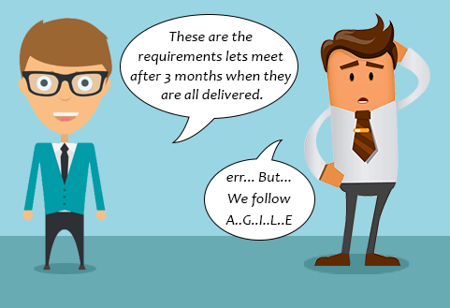
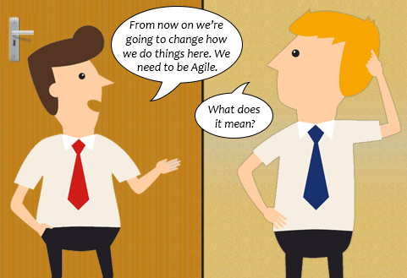

Where agile methodology not work
Project plan & requirements are clear & unlikely to change
Unclear understanding of Agile Approach among Teams
Big Enterprises where team collaboration is tough

Slide 26
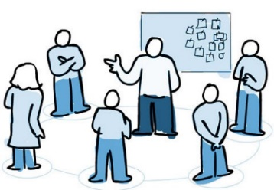


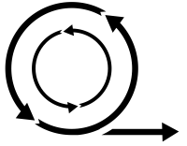
Agile Process Models
Extreme Programming (XP)
Adaptive Software Development (ASD)
Dynamic Systems Development Method (DSDM)
Feature Driven Development (FDD)
Crystal
Agile Modelling (AM)

Slide 27
Extreme Programming (XP)
The most widely used approach to agile software development
A variant of XP called Industrial XP (IXP) has been proposed to target process for large organizations
It uses object oriented approach as its preferred development model
XP Values
Communication: To achieve effective communication, it emphasized close & informal (verbal) collaboration between customers and developers
Simplicity: It restricts developers to design for immediate needs not for future needs
Feedback: It is derived from three sources the implemented software, the customer and other software team members, it uses Unit testing as primary testing
Courage: It demands courage (discipline), there is often significant pressure to design for future requirements, XP team must have the discipline (courage) to design for today
Respect: XP team respect among members

Slide 28
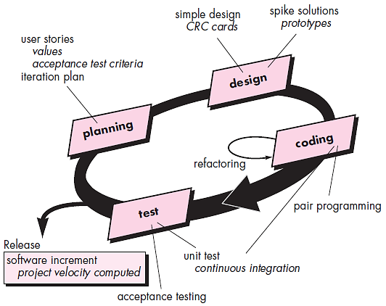
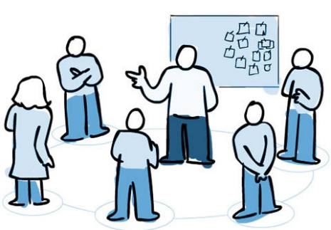
The XP Process
It considers four framework activities
Planning
1. Planning  2. Design  3. Coding  4. Testing
User Stories
Customers assigns value (priority)
Developers assigns cost (number of development weeks)
Project velocity
Computed at the end of first release
Number of stories implemented in first release
Estimates for future release
Guard against over-commitment

Slide 29
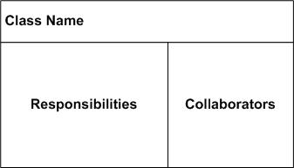
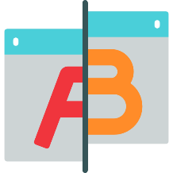
The XP Process cont.
Design
CRC card
Keep-it-Simple (Design of extra functionality is discouraged)
Preparation of CRC card is work project
CRC cards identify and organize object oriented classes
Spike Solutions (in case of difficult design problem is encountered)
Operational prototype intended to clear confusion
Refactoring
Modify internals of code, No observable change
Coding
Develops a series of Unit test for stories included in current release
Complete code perform unit-test to get immediate feedback
XP recommend pair-programming, “Two heads are better than one”
Integrate code with other team members, this “continuous integration” helps to avoid compatibility & interfacing problems, “smoke testing” environment to uncover errors early
Testing
Unit test by developers & fix small problems
Acceptance tests - Specified by customer
This encourages regression testing strategy whenever code is modified

Slide 30
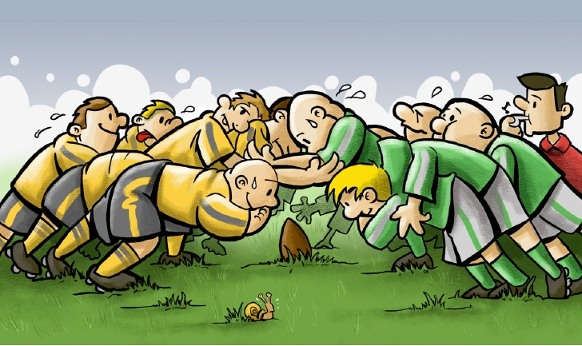
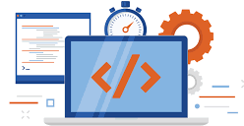


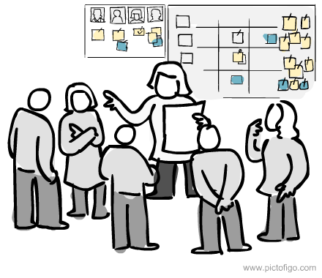
What is Scrum?
Scrum is an agile process model which is used for developing the complex software systems.
It is a lightweight process framework.
Lightweight means the overhead of the process is kept as small as possible in order to maximize the productivity.
Product Backlog
Product Owner
Product
A scrum is a method of restarting play in rugby that involves players packing closely together with their heads down and attempting to gain possession of the ball.
Daily Scrum Meeting
Sprint

Slide 31

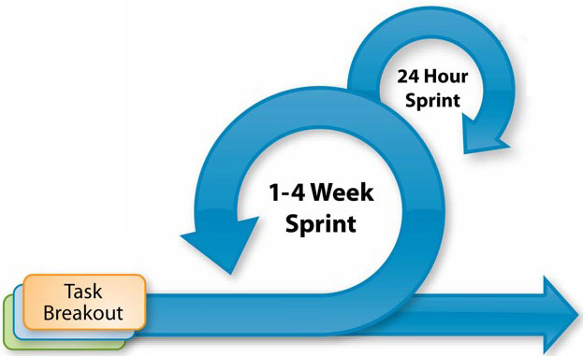





Scrum framework at a glance
Inputs from Customers, Team, Managers
Team Selects starting at top as much as it can commit to deliver by end of sprint
Scrum Master
Daily Scrum Meetings
Sprint Review
Product Owner
Finished Work
Product Backlog
Sprint Planning Meeting
Sprint Backlog
Sprint end date and team deliverable do not change
Sprint Retrospective
Prioritized list of what is required: features, bugs to fix...

Slide 32

Scrum cont.
Backlog
It is a prioritized list of project requirements or features that must be provided to the customer.
The items can be included in the backlog at any time.
The product manager analyses this list and updates the priorities as per the requirements.
Sprint
These are the work units that are needed to achieve the requirements mentioned in the backlogs.
Typically the sprints have fixed duration or time box (of 2 to 4 weeks, 30 days).
Change are not introduced during the sprint.
Thus sprints allow the team members to work in stable and short-term environment

Slide 33
Scrum cont.
Scrum Meetings
There are 15 minutes daily meetings to report the completed activities, obstacles and plan for next activities.
Following are three questions that are mainly discussed during the meetings.
What are the tasks done since last meeting ?
What are the issues that team is facing ?
What are the next activities that are planned?
The scrum master leads the meeting and analyses the response of each team member.
Scrum meeting helps the team to uncover potential problems as early as possible
It leads to “knowledge socialization” & promotes “self-organizing team structure”
Demo
Deliver software increment to customer
Implemented functionalities are demonstrated to the customer

Slide 34
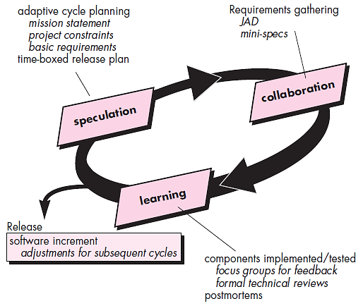
Adaptive Software development (ASD)
This is a technique for building complex software systems using iterative approach.
ASD focus on working in collaboration and team self-organization.
ASD incorporates three phases
Speculation
1. Speculation, 2. Collaboration & 3. Learning
The adaptive cycle planning is conducted.
In this cycle planning mainly three types of information is used
Customer’s mission statement
Project constraints
(Delivery date, budgets etc…)
Basic requirements of the project

Slide 35
Adaptive Software development (ASD) cont.
Collaboration
Learning
In this, collaboration among the members of development team is a key factor.
For successful collaboration and coordination it is necessary to have following qualities in every individual
Emphasize is on learning new skills and techniques.
There are three ways by which the team members learn
Focus groups
The feedback from the end-users is obtained.
Assist each other without resentment (offense)
Formal technical review
This review is conducted for better quality.
Work hard
Posses the required skill set
Postmortems
Team analyses its own performance and makes appropriate improvements.
Communicate problems and help each other
Criticize without any hate

Slide 36
Dynamic Systems Development Methods (DSDM)
Various phases of this life cycle model
Feasibility study: By analysing the business requirements and constraints the viability of the application is determined
Business study: The functional and informational requirements are identified and then the business value of the application is determined
Functional model iteration: The incremental approach is adopted for development
Design and build iteration: If possible design and build activities can be carried out in parallel
Implementation: The software increment is placed in the working environment

Slide 37
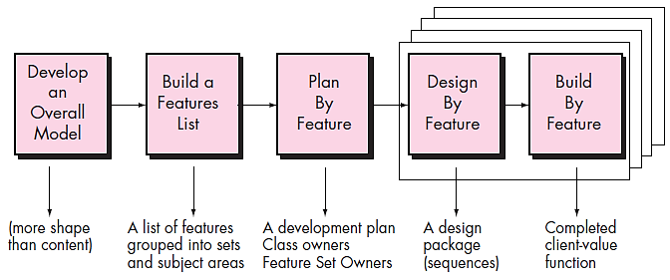
Feature Driven Development (FDD)
It is practical process model for object oriented software engineering
In FDD, the feature means client valued function.

Slide 38
Feature Driven Development (FDD) cont.
1. Develop overall model
Design by feature
The high-level walkthrough of scope and detailed domain walkthrough are conducted to create overall models.
For each feature the sequence diagram is created
Build by feature
2. Build feature list
Finally the class owner develop the actual code for their classes
List of features is created and expressed in the following form
<action> the <result> <by for of to> a(n) <object>
For Ex. “Display product-specifications of the product”
3. Plan by feature
After completing the feature list the development plan is created

