Slide 1
Software Engineering (MC03094021)
Unit-3 Design Concepts

Slide 2

Looping
Outline
What is Design?
Software design work products
Characteristics of good Design
Design Models
The FURPS quality attributes
Design Concepts
Design Principles
Architectural Design & Styles
Component Level or Procedural Design
Cohesion & Coupling
User Interface Design
Golden Rules of User Interface Design
Web Application Design

Slide 3
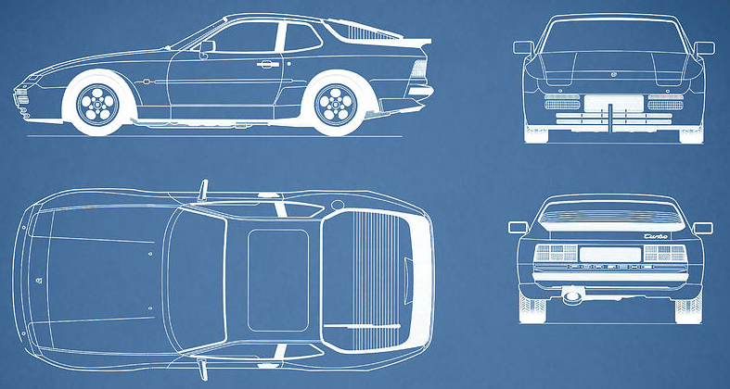
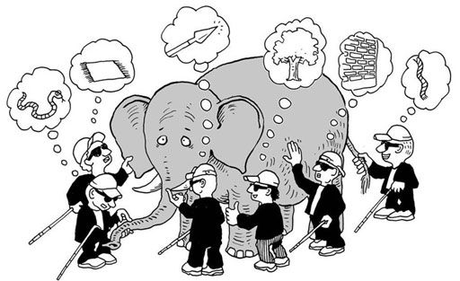
What is Design?
A meaningful representation of something to be built
It's a process by which requirements are translated into blueprint for constructing a software
Blueprint gives us the holistic view (entire view) of a software
SRS
Design
Process
Software
Design
Problem
Domain
Solution
Domain

Slide 4


Software Design Process?
Software design is the most creative part of the development process
Requirement
Engineering
Analysis
Model
Design
Engineering
Design
Model
Process involves
Diversification & Convergence
Blue Print for Constructing Software

Slide 5
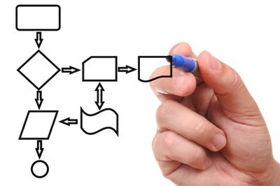
Software design work products
Characteristics of good Design
For a design to be easily implemented in a conventional programming language, the following items must be designed during the design phase.
The design must implement all explicit requirements available in requirement model
The design must accommodate all implicit requirements given by stakeholders
The design must be readable & understandable
The good design should provide complete picture of the software, addressing the data, functional and behavioral domains.
Different modules required to implement the design solution.
Control relationship among the identified modules. The relationship is also known as the call relationship or invocation relationship among modules.
Interface among different modules. The interface among different modules identifies the exact data items exchanged among the modules.
Algorithms required to implement each individual module.
Data structures of the individual modules.

Slide 6
Design Models
It is creative activity. It is most critical activity during system development
Analysis Models
Has great impact on testing and maintenance
Scenario-based elements
Use cases - text
Use-case diagrams
Activity diagrams
Swimlane diagrams
Design document forms reference for later phases
Flow-oriented elements
Data flow diagrams
Control-flow diagrams
Processing narratives
Procedural
Design
Procedural description of Software components
Behavioral elements
State diagrams
Sequence diagrams
Interface Design
Human computer interaction
Architectural Design
Relationship among structural elements
Class-based elements
Class diagrams
Analysis packages
CRC models
Collabortion diagrams
Data/Class Design
Data Structure

Slide 7


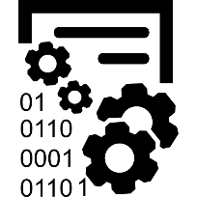

Design Models Cont.
Data Design
Architectural Design
Interface Design
Procedural Design
It transforms structural elements of software into procedural description of software components
It transforms class models into design class realization and prepares data structure (data design) required to implement the software.
It defines the relationship between major structural elements of the software
It defines how software communicates with systems & with humans. An interface implies flow of information & behavior.

Slide 8
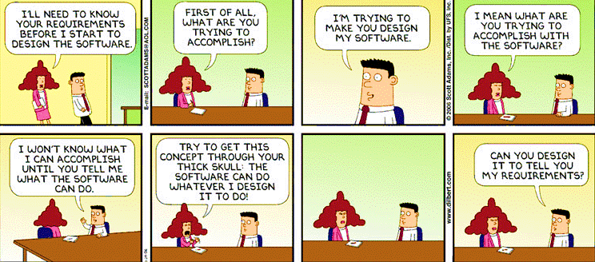
Gentle overview of – F U R P S
“Quality is not an act, it is a habit.”— Aristotle

Slide 9
Quality attributes of software design
The FURPS quality attributes
F
Functionality
U
Usability
assessed by feature set and capabilities of the program, generality of the functions & security of overall system
assessed by considering human factors, overall aesthetics, consistency & documentations
R
Reliability
P
Performance
assessed by measuring frequency & severity of failures, accuracy of outputs, mean-time-of-failure (MTTF), ability to recover from errors
measured by processing speed, response time, resource consumption, throughput and efficiency
S
Supportability
Ability to extend program, adaptability, serviceability, testability, compatibility

Slide 10
Design Concepts
The beginning of wisdom for a software engineer is to recognize the difference between getting program to work and getting it right
Fundamental software design concepts provide the necessary framework
for
“getting it right.”
Each design concept helps to answer the following questions
What criteria can be used to partition software into individual components?
How is function or data structure detail separated from a conceptual representation of the software?
What uniform criteria define the technical quality of a software design?
Reinvent the Wheel

Slide 11
Important Software Design Concepts
Abstraction
Architecture
Pattern
Separation of Concern
Modularity
Information Hiding
Refactoring
Refinement
Aspects
Functional Independence
Abstraction
At the highest level of abstraction, a solution is stated in broad terms using the language of the problem environment. At lower levels of abstraction, a more detailed description of the solution is provided. Finally, at the lowest level of abstraction, the solution is stated in a manner that can be directly implemented.
Creation of procedural and data abstractions are done.
A procedural abstraction refers to a sequence of instructions that have a specific and limited function. A data abstraction is a named collection of data that describes a data object.

Slide 12
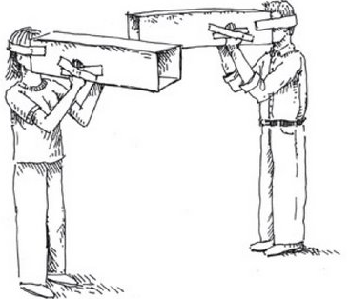
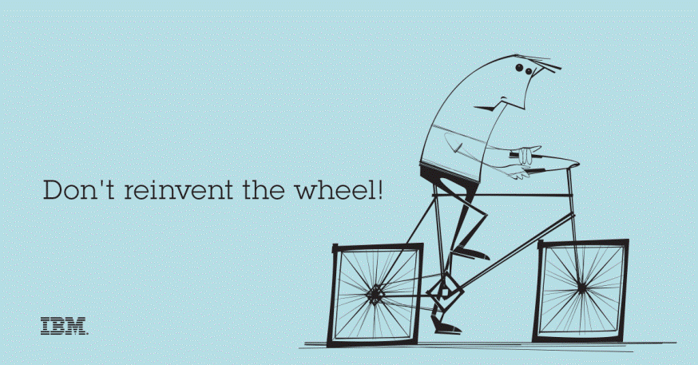

Design Principles
Design process should not suffer from “tunnel vision”
Design should be structured to degrade gently, even when abnormal data, events, or operating conditions are encountered
Design should be traceable to the analysis model
Design should not reinvent the wheel
Design is not coding, coding is not design
Design should “minimize the intellectual distance” between the software and the real world problem
Design should be assessed for quality as it is being created, not after the fact
Design should exhibit (present) uniformity and integration
Design should be reviewed to minimize conceptual (semantic) errors
Design should be structured to accommodate change
Tunnel Vision
Reinvent the Wheel
Coding
Design

Slide 13
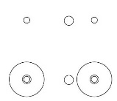
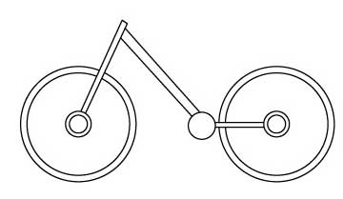
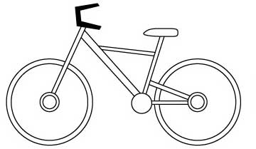
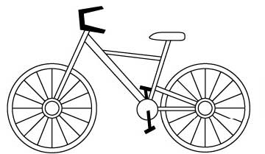
Design Process Rough View
Informal Design Outline
Informal Design
More formal Design
Finished Design
Design Process
Requirements Specification
Design Activities
Architectural
Design
Abstract
Specification
Interface
Design
Component
Design
Data Structure
Design
Algorithm
Design
System
Architecture
Software
Specification
Interface
Specification
Component
Specification
Data Structure
Specification
Algorithm
Specification
Design Product

Slide 14
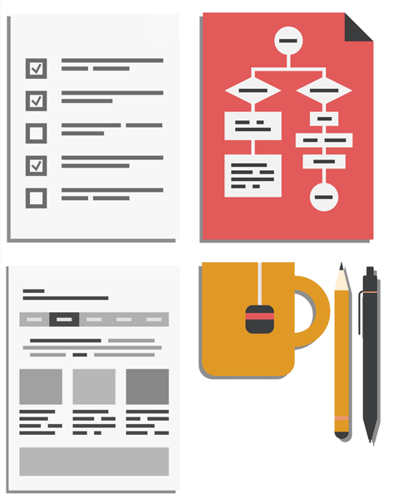

Architectural Design
Software Architecture & Design
Large systems are decomposed into subsystems
Sub-systems provide related services
Initial design process includes
Identifying sub-systems
Establishing a framework for sub-system control and communication
Why to document the Architecture?
Stakeholder Communication: High-level presentation of system
System Analysis: Big effect on performance, reliability, maintainability and other –ilities (Usability, Maintainability, Scalability, Reliability, Extensibility, Security, Portability)
Large-scale Reuse: Similar requirements similar architecture

Slide 15

Software Architecture & Design
Architectural design represents the structure of data and program components
It considers
Architectural style that the system will take
Structure and properties of the components that constitute the system
Marry in haste
repent at leisure
Interrelationships that occur among all architectural components of a system
Representations of software architecture are an enabler for communication between all parties (stakeholders).
Architecture “constitutes a relatively small, intellectually graspable model of how the system is structured and how its components work together”
True for Software Architecture Design

Slide 16
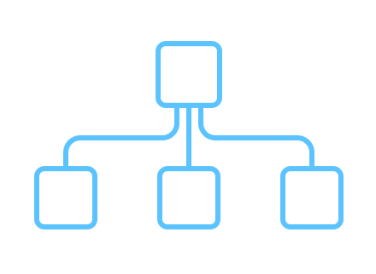

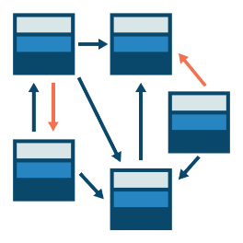
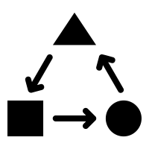
Architectural Styles
Each style describes a system category that encompasses
Data-centered architecture style
Data-flow architectures
A set of components (Ex., a database, computational modules) that perform a function required by a system.
Call and return architecture
Object-oriented architecture
A set of connectors that enable “communication, coordination and cooperation” among components.
Layered architecture
Constraints that define how components can be integrated to form the system.
Semantic models that enable a designer to understand the overall properties of a system.

Slide 17
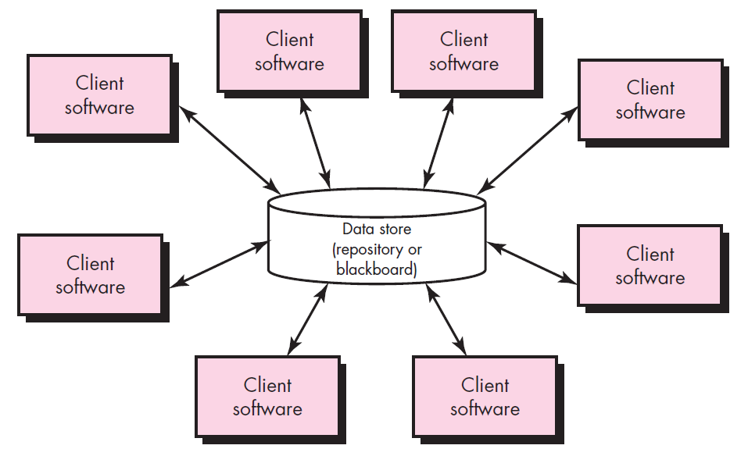
Data-centered architecture style
A data store (Ex., a file or database) resides at the center of this architecture and is accessed frequently by other components.
Client software accesses a central repository.
In some cases the data repository is passive
That is, client software accesses the data independent of any changes to the data or the actions of other client software.

Slide 18
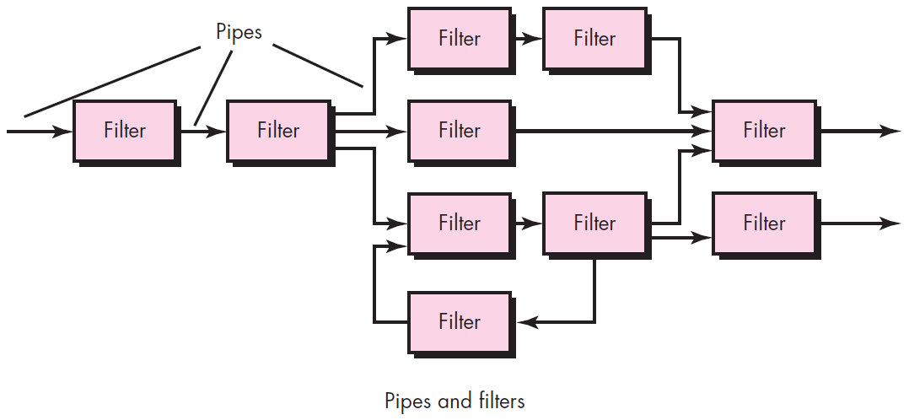
Data-flow architectures
This architecture is applied when input data are to be transformed.
A set of components (called filters) connected by pipes that transmit data from one component to the next.
Each filter works independently of those components upstream and downstream, is designed to
expect data input of a certain form, and
produces data output (to the next filter) of a specified form.

Slide 19
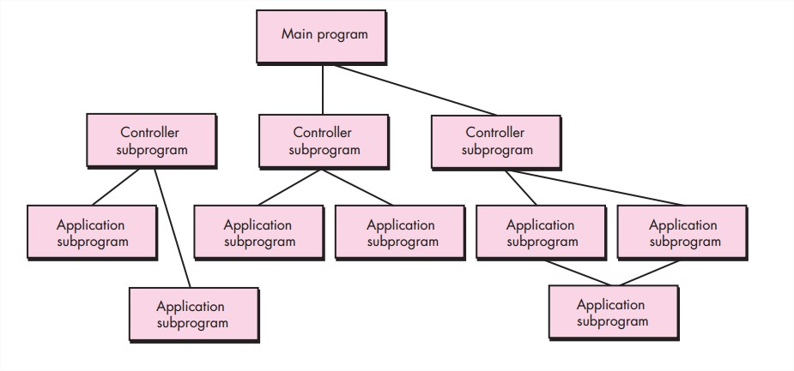
Call and return architecture
This architectural style enables a software designer (system architect) to achieve a program structure that is relatively easy to modify and scale.
A number of sub styles exist within this category as below.
Main program/subprogram architectures
This classic program structure decomposes function into a control hierarchy where a “main” program invokes a number of program components, which in turn may invoke still other components.
Remote procedure call architectures
The components of a main program/subprogram architecture are distributed across multiple computers on a network.

Slide 20
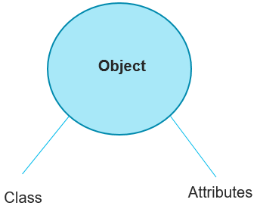
Object-oriented architecture
The components of a system encapsulate data and the operations that must be applied to manipulate the data.
Communication and coordination between components is accomplished via message passing.

Slide 21
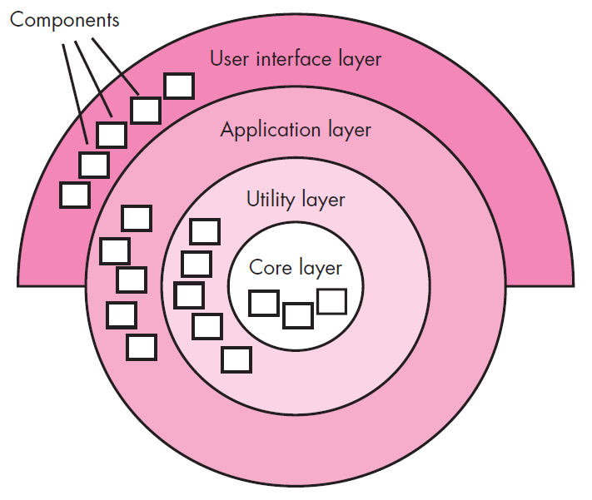
Layered architecture
A number of different layers are defined, each accomplishing operations that progressively become closer to the machine instruction set.
At the outer layer, components service user interface operations.
At the inner layer, components perform operating system interfacing.
Intermediate layers provide utility services and application software functions.

Slide 22

Component Level or Procedural Design
Component is a modular, deployable and replaceable part of a system that encapsulates implementation and exposes a set of interfaces.
Component-level design occurs after data, architectural and interface designs have been established.
It defines the data structures, algorithms, interface characteristics, and communication mechanisms allocated to each component.
The intent is to translate the design model into operational software.
But the abstraction level of the existing design model is relatively high and the abstraction level of the operational program is low.
Effective programmers should not waste their time in debugging, they should not introduce bug to start with

Slide 23
Function Oriented Approach
The following are the features of a typical function-oriented design approach:
A system is viewed as something that performs a set of functions.
Starting at this high level view of the system, each function is successively refined into more detailed functions.
For example, consider a function create-new-library member
which essentially creates the record for a new member, assigns a unique membership number to him, and prints a bill towards his membership charge.
This function may consist of the following sub-functions:
assign-membership-number, create-member-record and print-bill
Each of these sub-functions may be split into more detailed sub-functions and so on.
The system state is centralized and shared among different functions.
For Ex., data such as member-records is available for reference and updating to several functions such as:
create-new-member
delete-member
update-member-record

Slide 24
Object Oriented Approach
In the object-oriented design approach, the system is viewed as collection of objects (i.e., entities).
The state is decentralized among the objects and each object manages its own state information.
For example, in a Library Automation Software,
each library member may be a separate object with its own data and functions to operate on these data.
In fact, the functions defined for one object cannot refer or change data of other objects.
Objects have their own internal data which define their state.

Slide 25
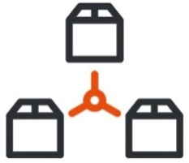



Cohesion & Coupling
A good software design implies clean decomposition of the problem into modules, and the neat arrangement of these modules in a hierarchy.
The primary characteristics of neat module decomposition are high cohesion and low coupling.
A cohesive module performs a single task, requiring little interaction with other components.
A Coupling is an indication of the relative interdependence among modules.

Slide 26
Cohesion represent detail design and it describe how the elements in a particular module are closely related to each other and it should be high for better software design.
Coupling:
We represent coupling in “Top level Design”(means single software divide in different module) and its describe the inter-dependency and interaction between the module of the software and coupling should be low for better software.
Dependency should be very low.

Slide 27
Cohesion
Classification of Cohesion
Cohesion is an indication of the relative functional strength of a module.
A cohesive module performs a single task, requiring little interaction with other components.
Stated simply, a cohesive module should (ideally) do just one thing.
A module having high cohesion and low coupling is said to be functionally independent of other modules.
By the term functional independence, we mean that a cohesive module performs a single task or function.
Classification of Cohesion
Coincidental
Low
Logical
Temporal
Procedural
Communicational
Sequential
Functional
High

Slide 28
Classification of Cohesion cont.
Coincidental cohesion
Logical cohesion
A module is said to have coincidental cohesion, if it performs a set of tasks that relate to each other very loosely.
In this case, the module contains a random collection of functions.
It is likely that the functions have been put in the module out of pure coincidence without any thought or design.
For Ex., in a transaction processing system (TPS), the get-input, print-error, and summarize-members functions are grouped into one module
At the outer layer, components service user interface operations.
A module is said to be logically cohesive, if all elements of the module perform similar operations.
For Ex., error handling, data input, data output, etc.
An example of logical cohesion is the case where a set of print functions generating different output reports are arranged into a single module In this case, the module contains a random collection of functions.

Slide 29
Classification of Cohesion cont.
Temporal cohesion
Procedural cohesion
When a module contains functions that are related by the fact that all the functions must be executed in the same time span.
For Ex., the set of functions responsible for initialization, start-up, shutdown of some process, etc.
If the set of functions of the module are all part of a procedure (algorithm) in which certain sequence of steps have to be carried out for achieving an objective
For Ex., the algorithm for decoding a message.
Communicational cohesion
If all functions of the module refer to the same data structure
For Ex., the set of functions defined on an array or a stack.

Slide 30
Classification of Cohesion cont.
Sequential cohesion
If the elements of a module form the parts of sequence, where the output from one element of the sequence is input to the next.
For Ex., In a Transaction Processing System, the get-input, validate-input, sort-input functions are grouped into one module.
Functional cohesion
If different elements of a module cooperate to achieve a single function.
For Ex., A module containing all the functions required to manage employees’ pay-roll exhibits functional cohesion.

Slide 31
Coupling
Classification of Coupling
Coupling between two modules is a measure of the degree of interdependence or interaction between the two modules.
A module having high cohesion and low coupling is said to be functionally independent of other modules.
If two modules interchange large amounts of data, then they are highly interdependent.
The degree of coupling between two modules depends on their interface complexity.
The interface complexity is basically determined by the number of types of parameters that are interchanged while invoking the functions of the module.
Classification of Coupling
Data
Low
Stamp
Control
Common
Content
High

Slide 32
Classification of Coupling Cont.
Data coupling
Stamp coupling
Two modules are data coupled, if they communicate through a parameter.
An example is an elementary (primal) data item passed as a parameter between two modules, e.g. an integer, a float, a character, etc.
This is a special case (or extension) of data coupling
Two modules (``A'' and ``B'') exhibit stamp coupling if one passes directly to the other a composite data item - such as a record (or structure), array, or (pointer to) a list or tree.
This occurs when ClassB is declared as a type for an argument of an operation of ClassA
Different module share the same type of data structure
Control coupling
If data from one module is used to direct the order of instructions execution in another.
An example of control coupling is a flag set in one module and tested in another module

Slide 33
Classification of Coupling Cont.
Common coupling
If data from one module is used to direct the order of instructions execution in another.
An example of control coupling is a flag set in one module and tested in another module.
When we share global data between two module, if we change in global data it will reflect in both the module.
Content coupling
Content coupling occurs when one component secretly modifies data that is internal to another component.
This violets information hiding – a basic design concept
Content coupling exists between two modules, if they share code.
Bad Coupling because of higher inter dependency

Slide 34
Differences between Coupling and Cohesion
Aspect | Cohesion | Coupling
Definition | Cohesion refers to the degree to which elements within a module work together to fulfill a single, well-defined purpose. | Coupling refers to the degree of interdependence between software modules. High coupling means that modules are closely connected and changes in one module may affect other modules.
Module Dependency | Cohesion is the concept of an intro-module. | Coupling is the concept of inter-module.
Purpose | Cohesion represents the relationship within a module. | Coupling represents the relationships between modules.
Quality | Increasing cohesion is good for software. | Increasing coupling is avoided for software.
Focus | Cohesion represents the functional strength of modules. | Coupling represents the independence among modules.

Slide 35
Relationship | Highly cohesive gives the best software. | Whereas loosely coupling gives the best software.
Example | In cohesion, the module focuses on a single thing. | In coupling, modules are connected to the other modules.
Creation | Cohesion is created between the same module. | Coupling is created between two different modules.
Types | Types of Cohesion Functional Cohesion. Procedural Cohesion. Temporal Cohesion. Sequential Cohesion. Layer Cohesion. Communication Cohesion. | Types of Coupling Data Coupling Stamp Coupling Control Coupling External Coupling Common Coupling Content Coupling

Slide 36




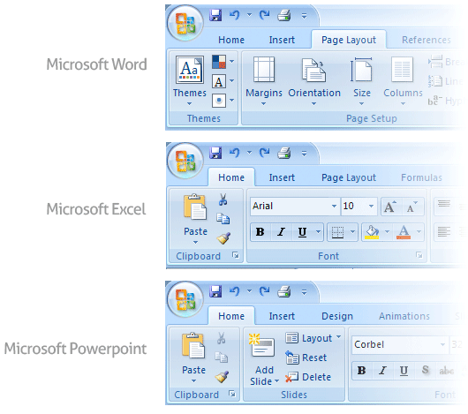
User Interface Design
Golden Rules of User Interface Design
Place the User in Control
Reduce the User’s Memory Load
Make the Interface Consistent

Slide 37
Golden Rules of User Interface Design Cont.
Place the User in Control
During a requirements-gathering session for a major new information system, a key user was asked about.
Following are the design principles that allow the user to maintain control:
Define interaction modes in a way that does not force a user into unnecessary or undesired actions.
Provide for flexible interaction
Allow user interaction to be interruptible and undoable.
Streamline interaction as skill levels advance and allow the interaction to be customized.
Hide technical internals from the casual user.
Design for direct interaction with objects that appear on the screen.

Slide 38

Golden Rules of User Interface Design Cont.
Reduce the User’s Memory Load
The more a user has to remember, the more error-prone the interaction with the system will be.
Following are the design principles that enable an interface to reduce the user’s memory load:
Reduce demand on short-term memory.
Establish meaningful defaults
Define shortcuts that are intuitive
The visual layout of the interface should be based on a real-world metaphor
Disclose information in a progressive fashion

Slide 39
Golden Rules of User Interface Design Cont.
Make the Interface Consistent
The interface should present and acquire information in a consistent fashion.
Following are the design principles that help make the interface consistent
Maintain consistency across a family of applications
If past interactive models have created user expectations, do not make changes unless there is a compelling (convincing) reason to do so

Slide 40

User Interface Analysis and Design Models
User profile model – Established by a software engineer
Establishes the profile of the end-users of the system
based on age, gender, physical abilities, education, cultural background, motivation, goals, and personality.
Design model – Created by a software engineer
Derived from the analysis model of the requirements.
Incorporates data, architectural, interface, and procedural representations of the software.
Implementation model – Created by the software implementers
Consists of the look and feel of the interface combined with all supporting information (books, videos, help files) that describe system syntax and semantics.
User's mental model – Developed by the user when interacting with the application
Often called the user's system perception.
Consists of the image of the system; that users carry in their heads.
The role of the interface designer is to merge these differences and derive a consistent representation of the interface.

Slide 41

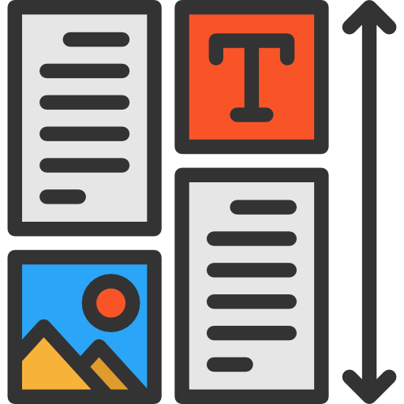
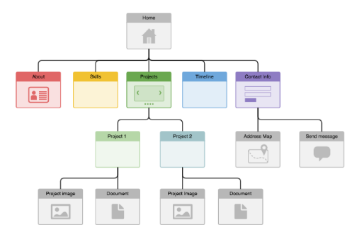


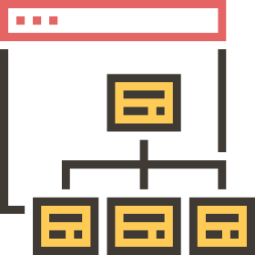
Web Application Design
Design for WebApp encompasses technical and nontechnical activities that include:
Establishing the look and feel of the WebApp
Defining the overall architectural structure
Developing the content and functionality that reside within the architecture
Planning the navigation that occurs within the WebApp

Slide 42
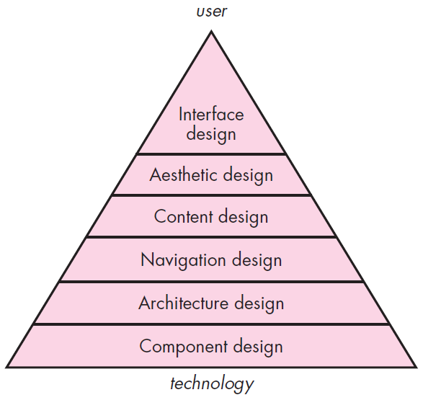
Web App Interface Design
Design pyramid for WebApps
The objectives of a WebApp interface are to
Establish a consistent window into the content and functionality provided by the interface.
Guide the user through a series of interactions with the WebApp.
Organize the navigation options and content available to the user
Interface Design
One of the challenges of interface design for WebApps is the nature of the user’s entry point.

Slide 43
Design pyramid for WebApps Cont.
Aesthetic Design
Content Design
Architecture Design
Also called graphic design, is an artistic endeavor (offer) that complements the technical aspects of WebApp design.
Generate content and design the representation for content to be used within a WebApp.
It is tied to the goals established for a WebApp, the content to be presented, the users who will visit, and the navigation that has been established.
Component-Level Design
Navigation Design
Modern WebApps deliver increasingly sophisticated processing functions that
Define navigation pathways that enable users to access WebApp content and functions.
Perform localized processing to generate content and navigation capability in a dynamic fashion
Provide computation or data processing capability that are appropriate for the WebApp’s business domain
Provide sophisticated database query and access
Establish data interfaces with external corporate systems

