Slide 1
UNIT – 1 Introduction to Web
PRESENTED BY : PROF.HIMANI KHODIFAD

Slide 2
Introduction to Web
The World Wide Web (WWW or Web) is a decentralized information system of interlinked, multimedia documents and resources (text, images, video) accessed via the Internet using URLs and HTTP.
Invented by Tim Berners-Lee in 1989/1990 at CERN, it functions through a client-server model, where web browsers (clients) request content from web servers.

Slide 3
Key Components and Concepts
The Web vs. The Internet: The Internet is the underlying physical network of computers. The Web is an application that runs on top of the internet, allowing users to browse linked pages.
HTTP (HyperText Transfer Protocol): The set of rules used to transfer data between web browsers and servers.
URL (Uniform Resource Locator): The unique address used to find any specific resource on the web (e.g., https://www.example.com).
HTML (HyperText Markup Language): The standard language used to create and structure web page content.
CSS (Cascading Style Sheets): Used for styling, layout, and visual presentation of HTML elements.
JavaScript: A programming language that enables interactive, dynamic, and complex behaviors on web pages.
Web Browser: Software applications (e.g., Chrome, Firefox, Safari) used to navigate, view, and interact with websites.
Web Server: Computers that store website files and send them to users' browsers upon request.

Slide 4
Server - Client
What is a Client?
A client is a computer hardware device or software that accesses a service made available by a server. The server is often (but not always) located on a separate physical computer.
What is a Server?
A server is a physical computer dedicated to run services to serve the needs of other computers. Depending on the service that is running, it could be a file server, database server, home media server, print server, or web server.

Slide 5
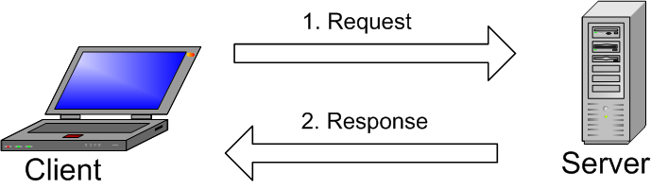
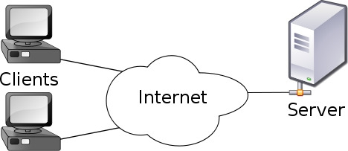
What is the difference between server and client?
Simply, client services request to the server where server services response to the client after server check data from data store.
Your web browser is an example of a web client .A client and server communicate using a special language (a protocol)is called HTTP.

Slide 6
Client-Server Model
The Client-Server Model is a network architecture in which clients send requests for resources or services, and servers process these requests, returning the required responses.
Client: A device or program that requests data or services (e.g., web browser).
Server: A system that stores resources, manages data, and responds to client requests.
Request–response mechanism: Communication follows a structured cycle — client requests, server responds.
Centralized management: Data and services are controlled from servers, improving security and consistency.

Slide 7
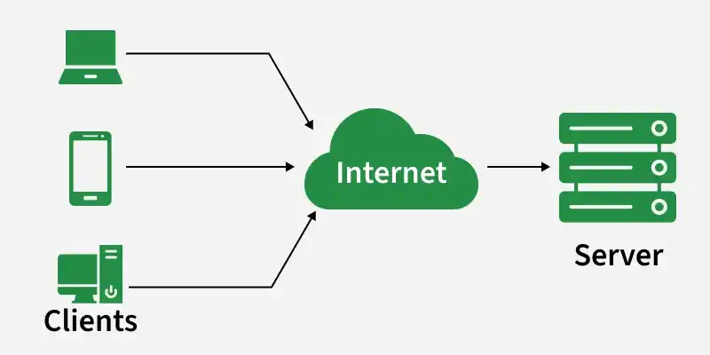
Working
The client-server model works on a request–response flow where a client requests a service/data and the server processes that request and returns a response.
Client is a device/app that requests services from a server, like a web browser or email app.
Server is a system that listens for requests and responds by sending data or performing operations.
Servers can handle many clients at the same time using concurrent request handling.
Example client apps include Chrome/Firefox and Gmail/Outlook.
Example servers include web servers (Apache/Nginx), email servers, and database servers.

Slide 8
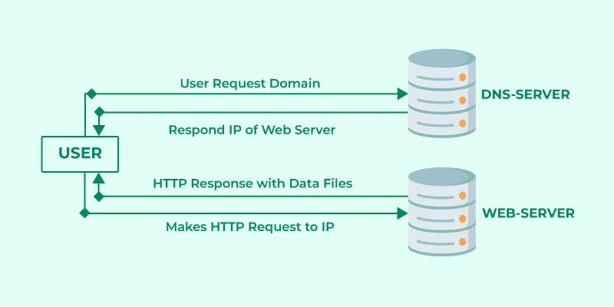
How a Browser Interacts With a Server
User enters a URL in the browser (example: www.example.com).
Browser performs a DNS lookup to convert the domain name into an IP address.
Browser establishes a connection and sends an HTTP/HTTPS request to the server using that IP.
Server responds with website resources like HTML, CSS, JavaScript, and images.
Browser renders the webpage by processing these files and displaying the content.

Slide 9
Types of Client-Server Architecture
Client-server architecture is commonly classified by how many layers handle presentation, logic, and data.
1. 2-Tier Architecture
In a 2-tier architecture, the client communicates directly with the server, which is typically responsible for both processing and data storage.
It consists of two layers: the client layer and the server layer.
The client handles the user interface and may perform some processing before sending requests.
The server processes client requests and manages the database.
This architecture is suitable for small applications and environments with limited users.
However, it becomes difficult to scale and manage when many clients connect to the server simultaneously.
2. 3-Tier Architecture
In a 3-tier architecture, the system is divided into three layers to improve performance, security, and scalability.
It consists of the presentation layer (client), application layer (business logic), and data layer (database server).
The client interacts with the application server instead of communicating directly with the database.
The application server processes requests, applies business logic, and retrieves or stores data in the database.
This structure enhances security because the database is not directly exposed to clients.
It is widely used in web applications and enterprise systems due to its flexibility and easier maintenance.

Slide 10
Communication Protocol (HTTP)

Slide 11
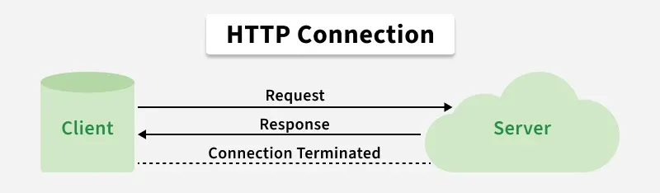
HTTP (Hypertext Transfer Protocol) is a core Internet protocol that defines how data is exchanged between clients and servers on the web.
Enables communication between web browsers and web servers.
Forms the foundation of data transfer on the World Wide Web.
Defines rules for requesting and delivering data between systems.
Note: HTTP is an application-layer protocol used implicitly by web browsers to transfer text, images, and multimedia across distributed, hypermedia-based web systems.

Slide 12
Features
HTTP defines a standardized communication mechanism that enables clients and servers to exchange resources efficiently over the web.
Stateless: Each request is independent and the server doesn't retain previous interactions' information.
Text-Based: Messages are in plain text, making them readable and debuggable.
Client-Server Model: Follows a client-server architecture for requesting and serving resources.
Request-Response: Operates on a request-response cycle between clients and servers.
Request Methods: Supports various methods like GET, POST, PUT, DELETE for different actions on resources.
Note: It was renamed as Hyper-Text Transfer Protocol QUIC (HTTP/3) and developed by Google.

Slide 13
Methods of HTTP
HTTP methods define the type of action a client wants to perform on a resource hosted by a server.
GET: Retrieves data without modifying the resource.
POST: Submits data for processing or resource creation.
PUT: Creates or replaces a resource completely.
PATCH: Partially updates a resource.
DELETE: Removes a resource from the server.
HEAD: Retrieves response headers only.
OPTIONS: Returns supported methods and communication options.
TRACE: Echoes the request for debugging (rarely used due to security risks).
CONNECT: Establishes a tunnel, typically for HTTPS via proxies.

Slide 14
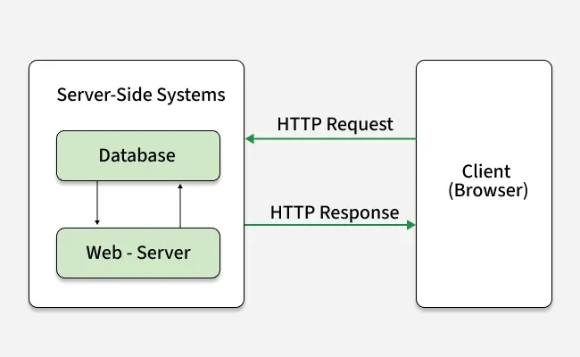
HTTP Request/Response:
HTTP follows a request-response model where each client request is answered by a server response, following a defined communication flow.
Client sends request: Sends an HTTP request with method, URL, headers, and optional body.
Server processes request: Handles the request and performs required operations.
Server sends response: Returns status code, headers, and optional data.
Client processes response: Renders or handles the received content.

Slide 15
HTTP Request Circle
Explains how HTTP requests work when you visit a webpage and what happens behind the scenes.
Requested Resource: Specifies the type of content being requested, such as HTML, CSS, images, or JavaScript.
Resource Type: Indicates the format of the requested content (HTML, CSS, image, JS, JSON, XML, etc.).
Server Response: The server returns the appropriate file or data based on the request.
Requested Resource | Resource Type | Server Response
HTML Page | HTML | Server sends HTML file
Style Sheet (CSS) | CSS | Server sends CSS file
Image (JPG) | Image (JPG) | Server sends JPG image
JavaScript Code | JavaScript (JS) | Server sends JS file
Data (XML or JSON) | Data | Server sends XML/JSON data

Slide 16
HTTP Request and Response Components
Concept | Description
HTTP Request Headers | Key-value pairs sent with the request that provide client details, preferences and request metadata.
HTTP Request Body | Contains data sent to the server, such as form data, credentials, or payload content.
HTTP Response | Server’s reply to a request, including status code, headers, and an optional body.
HTTP Status Codes | Three-digit codes indicating request results (1xx informational, 2xx success, 3xx redirection, 4xx client error, 5xx server error).
HTTP Response Headers | Metadata describing the response, such as content type, language, and encoding.
HTTP Response Body | Actual content returned by the server, such as HTML, JSON, images, or other data.

Slide 17
Structure of HTML Documents

Slide 18
What is an HTML Document?
HTML is a markup language used for structuring content on the web. It consists of elements (tags) that describe the content and structure of a webpage.
These elements are enclosed in angle brackets (< >) and come in pairs, such as opening and closing tags.
HTML helps browsers interpret and display content like text, images, links, videos, and more.
Structure of an HTML Document
An HTML document is essentially a series of nested elements that work together to form a complete webpage.
The document follows a standard structure to ensure consistency and compatibility across different browsers.
<!DOCTYPE html> <html lang="en"> <head> <meta charset="UTF-8" /> <meta name="viewport" content= "width=device-width, initial-scale=1.0" /> <title>Structure of HTML Document</title> </head> <body> <!-- Main content of website --> <h1>GeeksforGeeks</h1> <p>A computer science portal for geeks</p> </body> </html>

Slide 19
each part of this structure to understand its function and importance.
1. <!DOCTYPE html>: Declaring the Document Type
The <!DOCTYPE html> declaration is used to specify the version of HTML. In this case, it indicates that the document is written in HTML5, which is the latest version of HTML.
2. <html>: The Root Element
The <html> element is the root element of the HTML document. Everything inside this element is considered part of the HTML document.
3. <head>:Metadata of the Document
The <head> section contains metadata about the document that isn't displayed on the webpage. This section includes important elements like:
<meta charset="UTF-8">: Specifies the character encoding for the document (UTF-8 supports most characters from all languages).
<meta name="viewport" content="width=device-width, initial-scale=1.0">: Controls the layout on mobile devices by setting the viewport width and scaling.
4. <body>:Visible Content of the Webpage
The <body> tag contains the actual content of the webpage that will be visible to users, such as text, images, and links.

Slide 20
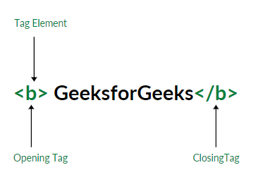
Tags and Elements for Structuring an HTML Document
HTML tags are structural components enclosed in angle brackets. They are typically opened and closed with a forward slash (e.g., <h1></h1>). Some tags are self-closing, while others support attributes like width, height, and controls for defining properties or storing metadata.
There are generally two types of tags in HTML
Paired Tags: These tags come in pairs i.e. they have both opening(< >) and closing(</ >) tags.
Empty Tags: These tags are self-closing and do not require a closing tag.”
Below is an example of a <b> tag in HTML, which tells the browser to bold the text inside it.

Slide 21
Understanding these key tags will allow you to organize content effectively and create more readable and accessible webpages.
Headings (<h1> to <h6>): Headings are important for structuring the content within the <body> section. They define the hierarchy of information, where <h1> is the highest-level heading.
Paragraphs (<p>): The <p> tag is used for creating paragraphs, which help to group text into readable sections. This tag automatically adds some spacing between paragraphs to improve readability.
Images (<img>): The <img> tag is used to add images to a webpage. It requires the src attribute to specify the image path and the alt attribute for accessibility.
Links (<a>):Links are created with the <a> tag. The href attribute defines the destination URL, and the text within the <a> tag serves as the clickable link text.
Lists (<ul>, <ol>, <li>): Lists allow you to organize items in bullet points (<ul>) or numbered order (<ol>). Each item within a list is wrapped in <li> tags.
Divisions (<div>): The <div> tag is a container used to group other elements together, often for layout. It does not add any style or structure on its own but is useful for applying CSS styles to sections of content.

Slide 22
Basic Markup tags

Slide 23
HTML (HyperText Markup Language) is used to create web pages. It uses tags to structure content. Tags are written inside angle brackets < >. Most tags have an opening and a closing tag.
Example:
<p>This is a paragraph</p>
1. Structure Tags These tags define the basic structure of an HTML document. (1) <!DOCTYPE html> Defines the document type and version of HTML (HTML5). (2) <html> Root element of the HTML page. (3) <head> Contains meta-information like title, CSS links, etc. | (4) <title> Defines the title shown in the browser tab. (5) <body> Contains the visible content of the web page. Example: <!DOCTYPE html> <html> <head> <title>My First Page</title> </head> <body> Welcome to GTU HTML Page </body> </html>

Slide 24
3. Paragraph and Formatting Tags
(1) <p> – Paragraph Tag
<p>This is a paragraph.</p>
(2) <br> – Line Break Tag
Hello <br> World
(3) <hr> – Horizontal Line<hr>
(4) Text Formatting Tags
Example:
<b>Bold</b>
<i>Italic</i>
<u>Underline</u>
Tag | Meaning
<b> | Bold text
<i> | Italic text
<u> | Underline
<strong> | Important text
<em> | Emphasized text

Slide 25
4. List Tags (1) Unordered List <ul> <ul> <li>Apple</li> <li>Mango</li> </ul> (2) Ordered List <ol> <ol> <li>Step 1</li> <li>Step 2</li> </ol> <li> is used for list items. | 5. Link and Image Tags (1) Anchor Tag <a> Used to create hyperlinks. <a href="https://www.gtu.ac.in">Visit GTU</a> (2) Image Tag <img> Used to display images. <img src="image.jpg" alt="Sample Image">
6. Division and Span Tags (1) <div> Block-level container. <div>This is a division block</div> | (2) <span> Inline container. <span>This is inline text</span>

Slide 26
Working with Text and Images with CSS

Slide 27
Working with text and images using CSS involves common layout techniques such as positioning text over images, placing them side-by-side, or allowing text to wrap around images. These methods use properties like position, float, flexbox, grid, and background-image.
Key Techniques and Properties
1. Overlay Text on Images
This technique wraps both the image and text inside a container set to position: relative. The text is positioned using position: absolute.
Example
HTML
<div class="image-container">
<img src="image.jpg" alt="Sample Image">
<div class="overlay-text">Overlay Text</div>
</div>

Slide 28
.image-container {
position: relative;
width: 300px;
}
.image-container img {
width: 100%;
display: block;
}
.overlay-text {
position: absolute;
bottom: 10px;
left: 10px;
color: white;
background: rgba(0, 0, 0, 0.6);
padding: 8px;
}
✔ position: relative on container ✔ position: absolute on text ✔ Semi-transparent background improves readability

Slide 29
2. Wrap Text Around Images
The float property allows text to flow around an image.
Example
HTML
<img src="image.jpg" alt="Sample Image" class="float-img">
<p>
This paragraph wraps around the image. The float property allows
text to flow beside the image naturally.
</p>
CSS
.float-img {
float: left;
width: 150px;
margin: 10px;
}
✔ Use float: left or float: right ✔ Add margin to create spacing

Slide 30
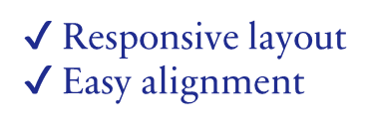
3. Place Images and Text Side-by-Side (Flexbox)
Flexbox is a modern and responsive layout method.
Example
HTML <div class="flex-container"> <img src="image.jpg" alt="Sample"> <div class="text"> <h2>Title</h2> <p>This text appears beside the image.</p> </div> </div> | CSS .flex-container { display: flex; align-items: center; gap: 20px; } .flex-container img { width: 200px; }

Slide 31
4. Side-by-Side Using Inline-Block
For simple layouts, display: inline-block can be used.
CSS .inline { display: inline-block; width: 45%; vertical-align: top; } | HTML <img src="image.jpg" class="inline"> <div class="inline"> <p>Text beside the image using inline-block.</p> </div>
5. Use Images as Text Backgrounds
CSS properties like -webkit-background-clip: text and -webkit-text-fill-color: transparent allow images to fill text.
Example
HTML <h1 class="image-text">IMAGE TEXT</h1> | CSS .image-text { font-size: 80px; font-weight: bold; background: url("image.jpg") center/cover; -webkit-background-clip: text; -webkit-text-fill-color: transparent; } | ✔ Best with large bold fonts ✔ Add fallback color if needed

Slide 32
Styling and Responsiveness
6. Responsive Images To make images responsive: img { max-width: 100%; height: auto; } ✔ Prevents overflow ✔ Maintains aspect ratio | 7. Styling Text CSS text properties improve readability and design. p { color: #333; font-family: Arial, sans-serif; font-size: 16px; text-align: center; } h2 { text-shadow: 2px 2px 5px gray; } ✔ Enhances presentation ✔ Improves accessibility

Slide 33
CSS Selectors

Slide 34
Introduction
A CSS selector is used to select HTML elements so that styles can be applied to them.
Selectors define which elements the CSS rules will affect.
Basic Syntax:
selector {
property: value;
}
Example:
p {
color: blue;
}
This selector applies blue color to all <p> elements.

Slide 35
2. Types of CSS Selectors
2.1 Element Selector
The element selector selects all elements of a specific HTML tag.
Syntax:
element {
property: value;
}
Example:
h1 {
color: red;
}
✔ All <h1> elements will be red.

Slide 36
2.2 ID Selector
The ID selector selects a single unique element using the id attribute. An ID must be unique within a webpage.
Syntax:
#idname {
property: value;
}
Example:
<p id="para1">Hello GTU</p>
#para1 {
color: green;
}
✔ Only the element with id="para1" will be styled.

Slide 37
2.3 Class Selector
The class selector selects elements having a specific class attribute. Multiple elements can share the same class.
Syntax:
.classname {
property: value;
}
Example:
<p class="text">Paragraph 1</p>
<p class="text">Paragraph 2</p>
.text {
color: blue;
}
✔ Both paragraphs will be blue.

Slide 38
2.4 Universal Selector
The universal selector selects all elements in the document.
Syntax:
* {
property: value;
}
Example:
* {
margin: 0;
}
✔ Removes default margin from all elements.

Slide 39
2.5 Grouping Selector
Used to apply the same style to multiple elements.
Syntax:
selector1, selector2 {
property: value;
}
Example:
h1, h2, p {
color: purple;
}
✔ Applies same style to h1, h2 and p.

Slide 40
3. Combinator Selectors
Combinator selectors define relationships between elements.
3.1 Descendant Selector (space) Selects elements inside another element. Example: div p { color: orange; } ✔ Selects all <p> inside <div>. | 3.2 Child Selector (>) Selects only direct child elements. Example: div > p { color: red; } ✔ Selects only direct <p> children of <div>.
3.3 Adjacent Sibling Selector (+) Selects the immediate next sibling. Example: h1 + p { color: brown; } ✔ Selects first <p> immediately after <h1>. | 3.4 General Sibling Selector (~) Selects all sibling elements after a specific element. Example: h1 ~ p { color: gray; } ✔ Selects all <p> after <h1>.

Slide 41
4. Attribute Selector Selects elements based on attribute values. Syntax: element[attribute="value"] { property: value; } Example: input[type="text"] { border: 2px solid blue; } ✔ Selects only text input fields. | 5. Pseudo-Class Selector Used to define special states of elements. Example: a:hover { color: red; } ✔ Changes color when mouse hovers over link. Other Examples: :active :focus :first-child
6. Pseudo-Element Selector Theory: Used to style specific parts of an element. Example: p::first-letter { font-size: 30px; color: red; } ✔ Styles the first letter of paragraph. Other Examples: ::before ::after ::first-line | 7. CSS Selector Specificity (Priority) Specificity determines which selector has higher priority. Priority Order (High → Low): Inline CSS ID Selector Class Selector Element Selector Universal Selector Example: #id { color: red; } .class { color: blue; } p { color: green; } ✔ ID selector has highest priority.

Slide 42
8. Advantages of CSS Selectors
Easy to target specific elements
Improves code reusability
Reduces repetition
Makes styling efficient
Helps in maintaining large websites

Slide 43
CSS Flexbox

Slide 44
The Flexible Box Layout module introduces a one-dimensional layout system that handles space distribution and item alignment effectively. It works seamlessly for horizontal (row) or vertical (column) arrangements, making it a go-to solution for responsive designs.
Flexbox eliminates the need for floats or complex positioning, enabling responsive and dynamic layouts.
It aligns items efficiently, distributing space within a container, even when their sizes are dynamic or unknown.
Flexbox is supported in all modern browsers, making it a reliable choice for creating flexible designs.
<html> <head> <style> .flex-container { display: flex; background-color: #f2f2f2; padding: 10px; } .flex-item { background-color: #4CAF50; color: white; margin: 5px; padding: 20px; text-align: center; flex: 1; } </style> | </head> <body> <div class="flex-container"> <div class="flex-item">Item 1</div> <div class="flex-item">Item 2</div> <div class="flex-item">Item 3</div> </div> </body> </html>

Slide 45
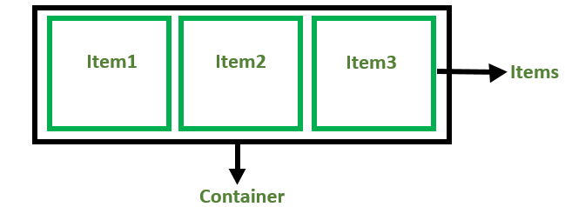
The .flex-container class applies display: flex;, designating the div as a flex container.
Each .flex-item is styled to have equal width within the container, with margins and padding for spacing.
Before the Flexbox Model
Block: Sections in web pages
Inline: Text
Table: Two-dimensional table data
Positioned: Explicit position of an element
Flexbox Components
Flex Container: The parent div containing various divisions.
Flex Items: The items inside the container div.

Slide 46
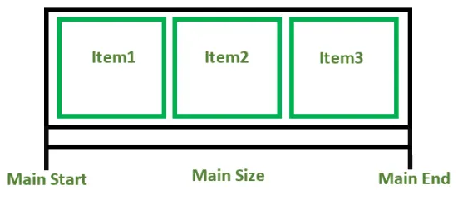
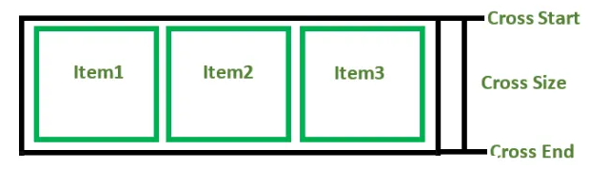
Flexbox Axes
Flexbox operates on two axes:
1. Main Axis:
Main Start: The start of the main axis.
Main Size: The length between Main Start and Main End.
Main End: The endpoint of the main axis.
2. Cross Axis:
The cross axis will be perpendicular to the main axis.
Cross Start: The start of the cross axis.
Cross Size: The length between Cross Start and Cross End.
Cross End: The endpoint of the cross axis.

Slide 47
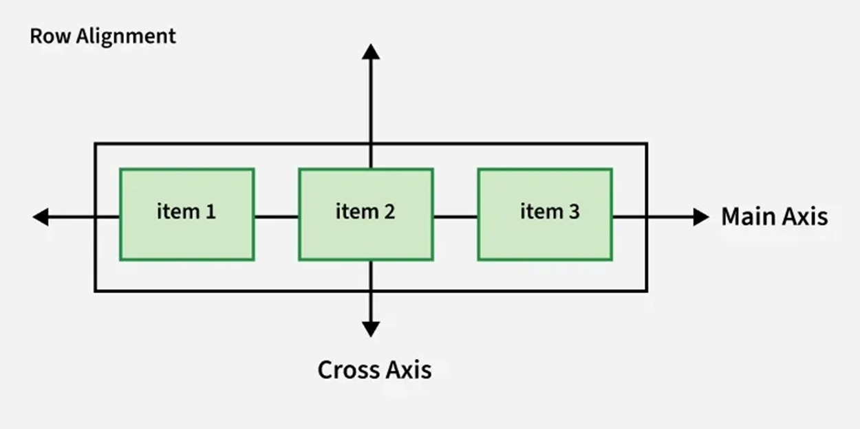
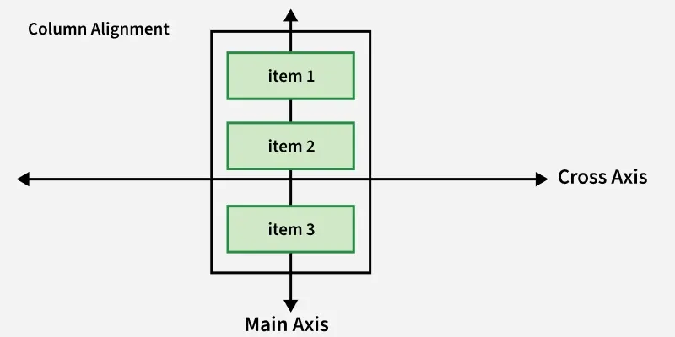
For Row:- For Column:-

Slide 48
Flex Direction Properties
Left to Right: flex-direction: row;
Right to Left: flex-direction: row-reverse;
Top to Bottom: flex-direction: column;
Bottom to Top: flex-direction: column-reverse;
Aligning and Justifying Content
Flexbox provides several properties for aligning and justifying content within the container:
justify-content: Aligns items along the main axis (e.g., flex-start, flex-end, center, space-between, space-around).
align-items: Aligns items along the cross axis (e.g., stretch, center, flex-start, flex-end).
align-content: Aligns rows within a flex container when there is extra space on the cross axis.

Slide 49
JavaScript: Data Types and Variables

Slide 50
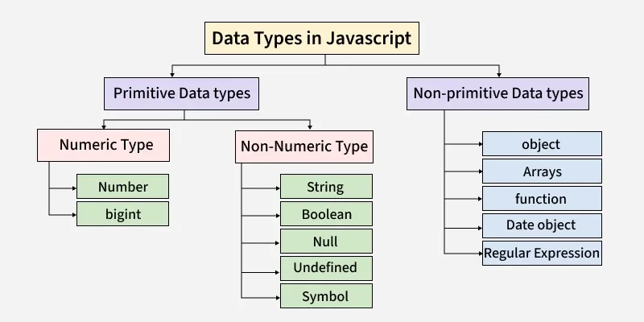
JavaScript is a scripting language used to create dynamic and interactive web pages. In JavaScript, variables are used to store data values. These values can be numbers, text, true/false values, objects, arrays, etc.
JavaScript is a dynamically typed language, which means the data type of a variable is determined automatically at runtime. The programmer does not need to specify the type explicitly.

Slide 51
Variables
A variable is a container that stores data which can be used and modified during program execution.
Syntax:
keyword variableName = value;
JavaScript provides three keywords to declare variables:
var
let
Const
2.1 var
Function scoped
Can be redeclared
Can be updated
Used in older versions of JavaScript
Example:
var name = "GTU";
var name = "University"; // Redeclaration allowed

Slide 52
JavaScript Data Types
JavaScript data types are classified into:
Primitive Data Types
Non-Primitive (Reference) Data Types
2.2 let Block scoped Cannot be redeclared in same scope Can be updated Introduced in ES6 Example: let age = 20; age = 21; // Allowed | 2.3 const Block scoped Cannot be redeclared Cannot be updated Used for constant values Example: const pi = 3.14;

Slide 53
Primitive Data Types
Primitive data types store single values.
4.1 Number
Used to store numeric values (integer and decimal).
let marks = 85;
let price = 99.99;
4.2 String
Used to store text. Written inside single or double quotes.
let name = "Rahul";
4.3 Boolean
Represents logical values: true or false.
let isPassed = true;
4.4 Undefined
A variable declared but not assigned a value.
let x;
4.5 Null
Represents an empty or unknown value.
let data = null;
4.6 BigInt
Used to store very large integers beyond Number limit.
let bigNumber = 1234567890123456789n;
4.7 Symbol
Used to create unique identifiers.
let id = Symbol("id");

Slide 54
Non-Primitive (Reference) Data Types
Reference types store collections of data.
5.1 Object
An object stores data in key-value pairs.
let student = {
name: "Amit",
age: 22,
course: "BCA"
};
5.2 Array
An array stores multiple values in a single variable.
let subjects = ["HTML", "CSS", "JavaScript"];
5.3 Function
A function is a block of reusable code used to perform a specific task.
function greet() {
console.log("Hello GTU");
}

Slide 55
Difference Between var, let and const
Example Program
let name = "Rahul";
let age = 21;
let isStudent = true;
console.log("Name: " + name);
console.log("Age: " + age);
console.log("Student: " + isStudent);
Feature | var | let | const
Scope | Function | Block | Block
Redeclaration | Allowed | Not Allowed | Not Allowed
Reassignment | Allowed | Allowed | Not Allowed

Slide 56
JavaScript: Functions

Slide 57
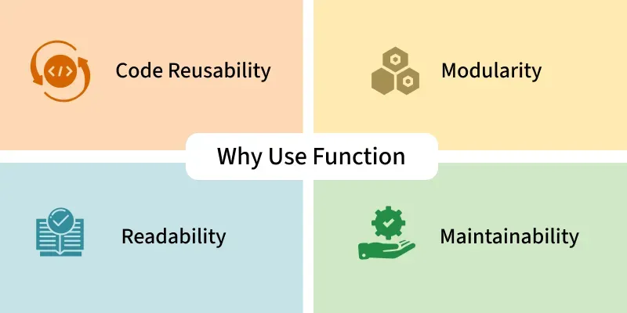
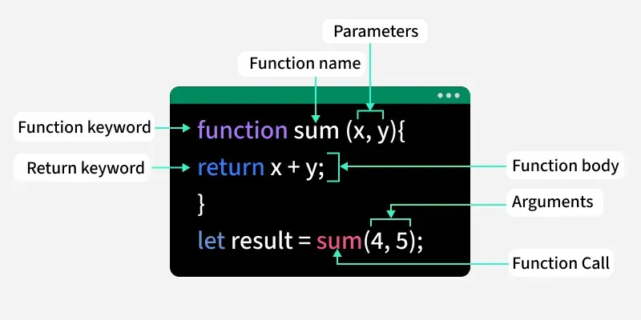
Functions in JavaScript are reusable blocks of code designed to perform specific tasks. They allow you to organize, reuse, and modularize code. It can take inputs, perform actions, and return outputs.
In functions, parameters are placeholders defined in the function, while arguments are the actual values you pass when calling the function.
Example:
function greet(name) { // 'name' is a parameter
console.log("Hello " + name);
}
greet("Alice"); // "Alice" is the argument
Parameter: name (placeholder inside the function).
Argument: "Alice" (real value given at call time).

Slide 58
Default Parameters
Default parameters are used when no argument is provided during the function call.
If no value is passed, the function automatically uses the default value.
function greet(name = "Guest") {
console.log("Hello, " + name);
}
greet();
greet("Aman");
Return Statement
The return statement is used to send a result back from a function.
When return executes, the function stops running at that point.
The returned value can be stored in a variable or used directly.
function add(a, b) {
return a + b; // returns the sum
}
let result = add(5, 10);
console.log(result);

Slide 59
Type of Functions
No. | Type of Function | Description | Example (Syntax)
1 | Named Function | A function declared with a name. It can be reused and easily debugged. | function greet() { return "Hello!"; }
2 | Anonymous Function | A function without a name. Usually assigned to a variable or used as a callback. | const greet = function() { return "Hi!"; };
3 | Function Expression | A function assigned to a variable. Can be named or anonymous. | const add = function(a,b){ return a+b; };
4 | Arrow Function (ES6) | Shorter syntax using =>. Does not have its own this binding. | const square = n => n*n;
5 | IIFE (Immediately Invoked Function Expression) | A function that runs immediately after being defined. Used to create private scope. | (function(){ console.log("Run"); })();
6 | Callback Function | A function passed as an argument to another function and executed later. | function num(n, cb){ return cb(n); }

Slide 60
7 | Constructor Function | Used to create multiple objects using new keyword. | function Person(name){ this.name=name; }
8 | Async Function | Declared with async. Returns a Promise and supports await. | async function fetchData(){ return "Data"; }
9 | Generator Function | Declared using function*. Uses yield to pause execution. | function* nums(){ yield 1; yield 2; }
10 | Recursive Function | A function that calls itself until a condition is satisfied. | function fact(n){ return n===0?1:n*fact(n-1); }
11 | Higher-Order Function | A function that takes another function as argument or returns a function. | function multiplyBy(x){ return y=>x*y; }
12 | Nested Function | A function defined inside another function. | function outer(){ function inner(){} }
13 | Pure Function | Returns same output for same input and has no side effects. | function add(a,b){ return a+b; }
14 | Default Parameter Function | Function with default parameter values. | function greet(name="Guest"){ return name; }
15 | Rest Parameter Function | Uses ... to accept multiple arguments as an array. | function sum(...nums){ return nums.reduce((a,b)=>a+b); }

Slide 61
JavaScript: Events

Slide 62
JavaScript Events are actions or occurrences that happen in the browser. They can be triggered by various user interactions or by the browser itself.
<html>
<script>
function myFun() {
document.getElementById(
"gfg").innerHTML = "GeeksforGeeks";
}
</script>
<body>
<button onclick="myFun()">Click me</button>
<p id="gfg"></p>
</body>
</html>
The onclick attribute in the <button> calls the myFun() function when clicked.
The myFun() function updates the <p> element with id="gfg" by setting its innerHTML to "GeeksforGeeks".
Initially, the <p> is empty, and its content changes dynamically on button click.

Slide 63
Event Types
JavaScript supports a variety of event types. Common categories include:
Mouse Events: click, dblclick, mousemove, mouseover, mouseout
Keyboard Events: keydown, keypress, keyup
Form Events: submit, change, focus, blur
Window Events: load, resize, scroll
Common JavaScript Events
Event Attribute | Description
onclick | Triggered when an element is clicked.
onmouseover | Fired when the mouse pointer moves over an element.
onmouseout | Occurs when the mouse pointer leaves an element.
onkeydown | Fired when a key is pressed down.
onkeyup | Fired when a key is released.
onchange | Triggered when the value of an input element changes.
onload | Occurs when a page has finished loading.
onsubmit | Fired when a form is submitted.
onfocus | Occurs when an element gets focus.
onblur | Fired when an element loses focus.

Slide 64
// Mouse Event
document.addEventListener("mousemove", (e) => {
console.log(`Mouse moved to (${e.clientX}, ${e.clientY})`);
});
// Keyboard Event
document.addEventListener("keydown", (e) => {
console.log(`Key pressed: ${e.key}`);
});
The mousemove event tracks cursor movement.
The keydown event captures key presses.

Slide 65
JavaScript Event Handlers
Event handlers can be used to handle and verify user input, user actions, and browser actions:
Things that should be done every time a page loads
Things that should be done when the page is closed
Action that should be performed when a user clicks a button
Content that should be verified when a user inputs data
And more ...
Many different methods can be used to let JavaScript work with events:
HTML event attributes can execute JavaScript code directly
HTML event attributes can call JavaScript functions
You can assign your own event handler functions to HTML elements
You can prevent events from being sent or being handled
And more ...

Slide 66
Event Handling Methods
1. Inline HTML Handlers
<button onclick="alert('Button clicked!')">Click Me</button>
2. DOM Property Handlers
let btn = document.getElementById("myButton"); btn.onclick = () => { alert("Button clicked!"); };
3. addEventListener() (Preferred)
btn.addEventListener("click", () => { alert("Button clicked using addEventListener!"); });
addEventListener() is the most versatile and recommended method as it supports multiple event listeners and removal of listeners.

Slide 67
Event Propagation
JavaScript events propagate in two phases:
Capturing Phase: Event travels from the root to the target element.
Bubbling Phase: Event travels from the target element back to the root.
document.querySelector("div").addEventListener("click", () => {
console.log("Div clicked");
}, true); // Capturing phase
button.addEventListener("click", (e) => {
console.log("Button clicked");
e.stopPropagation(); // Stops propagation
});
Setting true in addEventListener makes it capture events during the capturing phase.
stopPropagation() halts further propagation.

Slide 68
Event Delegation
Event delegation allows you to handle events efficiently by attaching a single listener to a parent element.
document.querySelector("ul").addEventListener("click", (e) => {
if (e.target.tagName === "LI") {
console.log(`Clicked on item: ${e.target.textContent}`);
}
});
Events are delegated to list, reducing the need to add listeners to each list items.
Preventing Default Behavior
Certain elements have default actions (e.g., links navigating to URLs). Use preventDefault() to override them.
document.querySelector("a").addEventListener("click", (e) => {
e.preventDefault();
console.log("Link click prevented");
});
preventDefault() stops the link from navigating.

Slide 69
AJAX: GET and POST

Slide 70
AJAX stands for Asynchronous JavaScript and XML. It is used to send and receive data from a server without reloading the webpage.
AJAX allows web pages to update content dynamically in the background using:
JavaScript
XMLHttpRequest (XHR)
Fetch API
Key Differences between AJAX GET and POST
Feature | GET | POST
Primary Purpose | Retrieving data. | Submitting/updating data.
Data Location | Appended to the URL as query strings. | Sent in the HTTP request body.
Data Size | Limited by URL length (~2,000 chars). | No size limitations for most cases.
Security | Less secure; data is visible in URL/logs. | More secure for sensitive info (not in URL).
Caching | Frequently cached by browsers. | Never cached.

Slide 71
What is GET Method?
Definition:
The GET method is used to request data from the server.
It retrieves data and appends it to the URL as query parameters.
Characteristics of GET:
Used to retrieve data
Data is sent in the URL
Less secure (data visible in URL)
Limited data length
Can be cached
Faster than POST
Example of AJAX GET (Using XMLHttpRequest)
var xhr = new XMLHttpRequest();
xhr.open("GET", "https://api.example.com/data", true);
xhr.onload = function() {
if (xhr.status === 200) {
console.log(xhr.responseText);
}
};
xhr.send();
Example Using Fetch API (GET)
fetch("https://api.example.com/data")
.then(response => response.json())
.then(data => console.log(data));

Slide 72
var data = JSON.stringify({
name: "Rahul",
age: 21
});
xhr.send(data);
Example Using Fetch API (POST)
fetch("https://api.example.com/data", {
method: "POST",
headers: {
"Content-Type": "application/json"
},
body: JSON.stringify({
name: "Rahul",
age: 21
})
})
.then(response => response.json())
.then(data => console.log(data));
What is POST Method?
Definition:
The POST method is used to send data to the server.
It is commonly used to submit form data.
Characteristics of POST:
Used to send data
Data is sent inside request body
More secure than GET
No data length limitation
Cannot be cached
Used for inserting or updating data
Example of AJAX POST (Using XMLHttpRequest)
var xhr = new XMLHttpRequest();
xhr.open("POST", "https://api.example.com/data", true);
xhr.setRequestHeader("Content-Type", "application/json");
xhr.onload = function() {
if (xhr.status === 200) {
console.log(xhr.responseText);
}
};

Slide 73
3. The Flexible $.ajax() Method
For full control over headers, timeouts, and error handling, use the jQuery.ajax() method.
$.ajax({
url: "api/resource",
type: "POST", // Can be "GET" or "POST"
data: { key: "value" },
success: function(result) { console.log("Success!"); },
error: function(err) { console.error("Error occurred"); }
});

Slide 74
Advantages of AJAX
No page reload required
Faster user experience
Asynchronous communication
Reduces server load
Improves performance

Slide 75
Thank you

