Slide 1

Midterm Status Presentation
Exploring Optimal Machine Learning Models for Predicting Crop Yield at Township Level

Slide 2
TEAM MEMBERS:
Mayukha Bheemavarapu
Mehul Bhargava
Navdeep Singh Saini
Val Veeramani

Slide 3
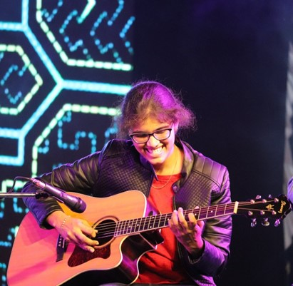
Mayukha Bheemavarapu
From Warangal, Telangana, India
Guitarist and a Bibliophile
Love travelling and hiking
Major fan of long walks!!!

Slide 4
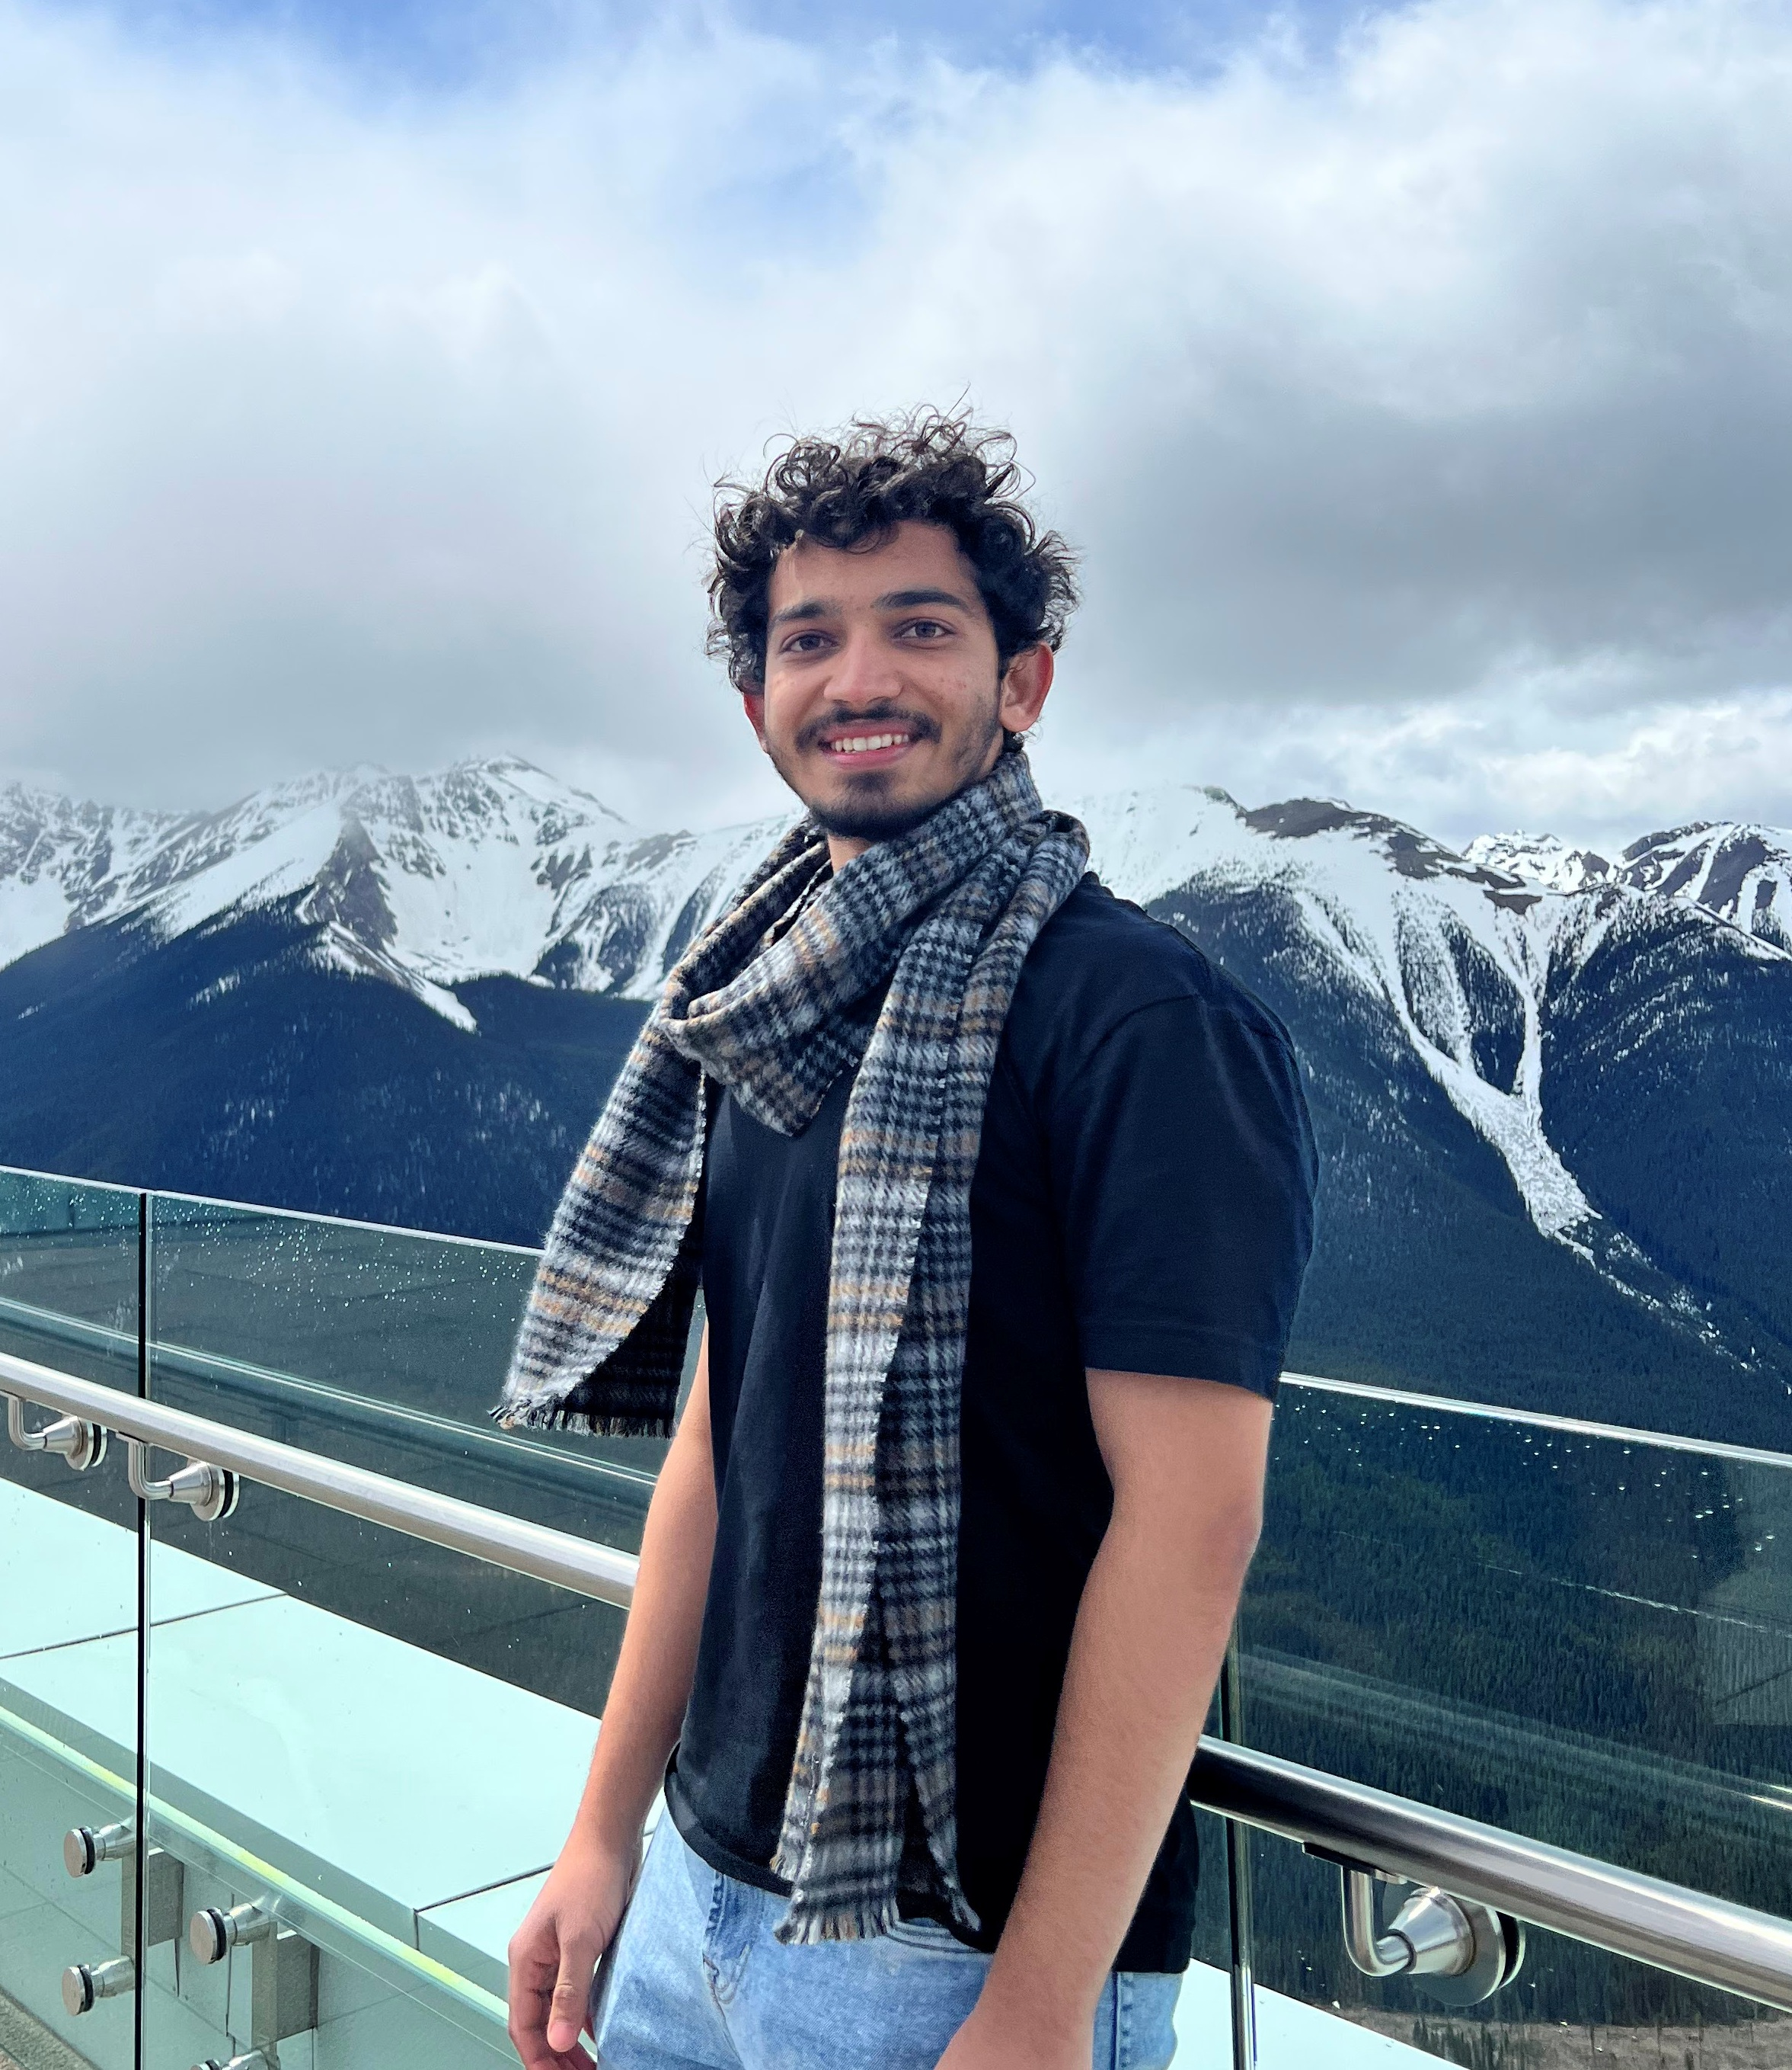
Mehul Bhargava
From Jaipur, Rajasthan, India
Loves gardening, wildlife viewing, marker art, birding, collections, and being a phillumenist
Bachelor of Technology in Computer Science Engineering

Slide 5
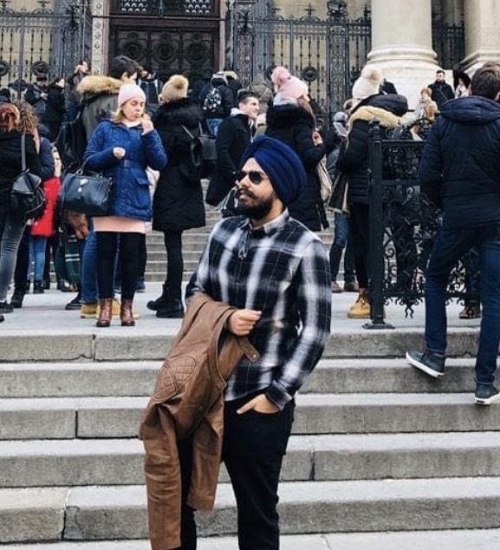
Navdeep Singh Saini
New Delhi, India to Kelowna, British Columbia
Previously Technical Consultant at Adobe Systems, India
Bachelors, Computer Science Engineering, India
Loves Travelling, developed interest in cooking recently!

Slide 6

Val Veeramani
B.S. in Management Information Systems & M.S. in Business Analytics
Lived in 6 countries so far
Used to speak 5 languages at one point
Loves travelling, experiencing different cultures, and reading about psychology

Slide 7

Introduction to AAFC
Mission
Driving innovation and ingenuity to build a world leading agricultural and food economy for the benefit of all Canadians
Vision
Provides leadership in the growth and development of a competitive, innovative and sustainable Canadian agriculture and agri-food sector

Slide 8
Our Clients
Dr. Aston Chipanshi - The PI for this project with Dr. Daneshfar as co-lead and will guide the reporting and ensuring that project objectives are met.
Dr. Bahram Daneshfar - Geostatistical analyst and co-lead of this project. Areas of expertise are mathematical modeling and ML as applied to crop type identification.
Dr. Yinsuo Zhang - An experienced biophysical modeller with skills in climate science and remote sensing.
Dr. Catherine Champagne - A remote sensing specialist with vast experience on the use of optical and non-optical products (new and old) in soil moisture, drought and crop productivity studies.

Slide 9
Project Introduction
Aim
To explore optimal machine learning models for predicting crop yield based on growing patterns at the township level.
Research Questions
What are the factors most responsible for predicting the crop yield at the township level?
How does crop yield vary over time?

Slide 10
Workflow
Data Wrangling
Exploratory Data Analysis
Resampling and Model Selection
Feature Selection

Slide 11
Data Wrangling
Crop Yield
(YieldKgAcre)
NDVI_MODIS
(NDVI)
ECV_SMOS
(mean soil moisture values)
Climate
1. Precipitation
2. EGDD
3. HeatD
4. FrostD
5. AvgSI
TWP_ID, Year
TWP_ID, Year

Slide 12
Exploratory Data Analysis
Techniques Used
Research Question 1
Research Question 2
Feature Selection
Dimensionality Reduction
Time Series Plots of crop yield

Slide 13
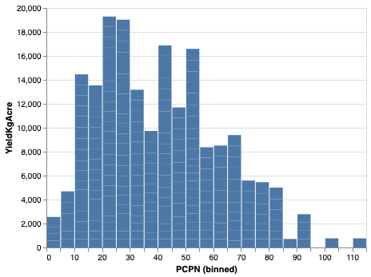
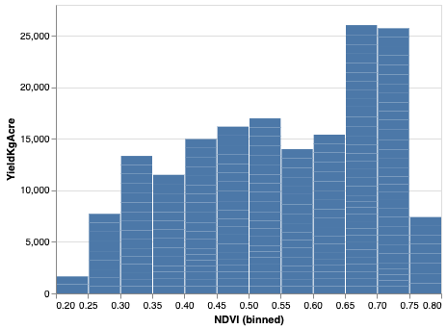
Exploratory Data Analysis (cont.)
Key predictors – (Precipitation, NDVI, Avg. Soil Moisture Ratio)
Normalized Difference Vegetation Index (NDVI) quantifies vegetation by measuring the difference between near-infrared (which vegetation strongly reflects) and red light (which vegetation absorbs)

Slide 14
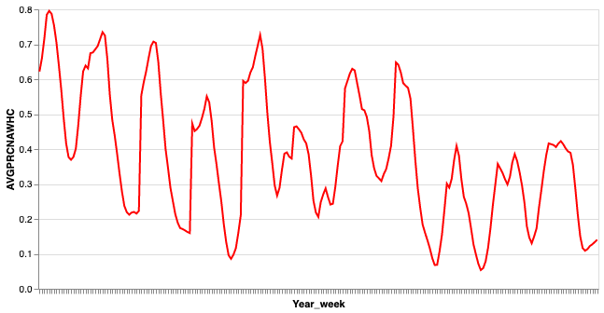
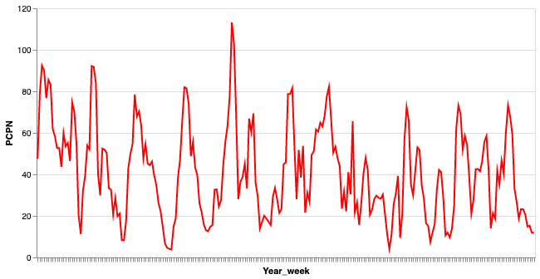
Exploratory Data Analysis (cont.)
PrcnAWHC: soil water content expressed as percentage of plant available soil water holding capacity
PrcnAWHC over the years 2010-2020
Precipitation over the years 2010-2020
Possible effects of global warming seen in our data

Slide 15

Feature Selection/Dimensionality Reduction
Important features: 46
Top features:
NDVI28_30
SumEGDD_C21_23
SumEGDD_C28_30
SumFrostD18_20
NDVI29_31
Important features: 152
Top features:
SumEGDD_C28_30
AvgPrcnAWHC24_26
NDVI28_30
SumFrostD18_20
SumEGDD_C21_23
Random Forest
XGBoost
Important features: 118
Top features:
SumEGDD_C34_36
SumEGDD_C19_21
SumEGDD_C20_22
SumEGDD_C35_37
AvgPrcnAWHC19_21
Principal Components: 40
Explained variance: 95.2%
LASSO
PCA

Slide 16
Potential Roadblocks/Challenges
Change in project requirements
As per the recent client meeting, it was suggested to build 144 different models for each Eco district, instead of one consolidated model
Running model for each Eco District
Need to run machine learning models for each 144 Eco districts, thereby requiring high computational power
Communication
Though we have established new communication paradigms with client, it still is not the most efficient of ways

Slide 17
Questions?

Slide 18
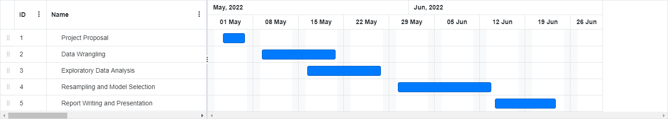
Timeline and Next steps
Working on any possible optimal strategy/code to fit 144 models
Exploring Optimal Machine Learning Models/Algorithms
Performing different Resampling Methods for Model Accuracy
** We are here

Slide 19
Thank You! ☺

