Slide 1
Bike Crash Detection

Slide 2
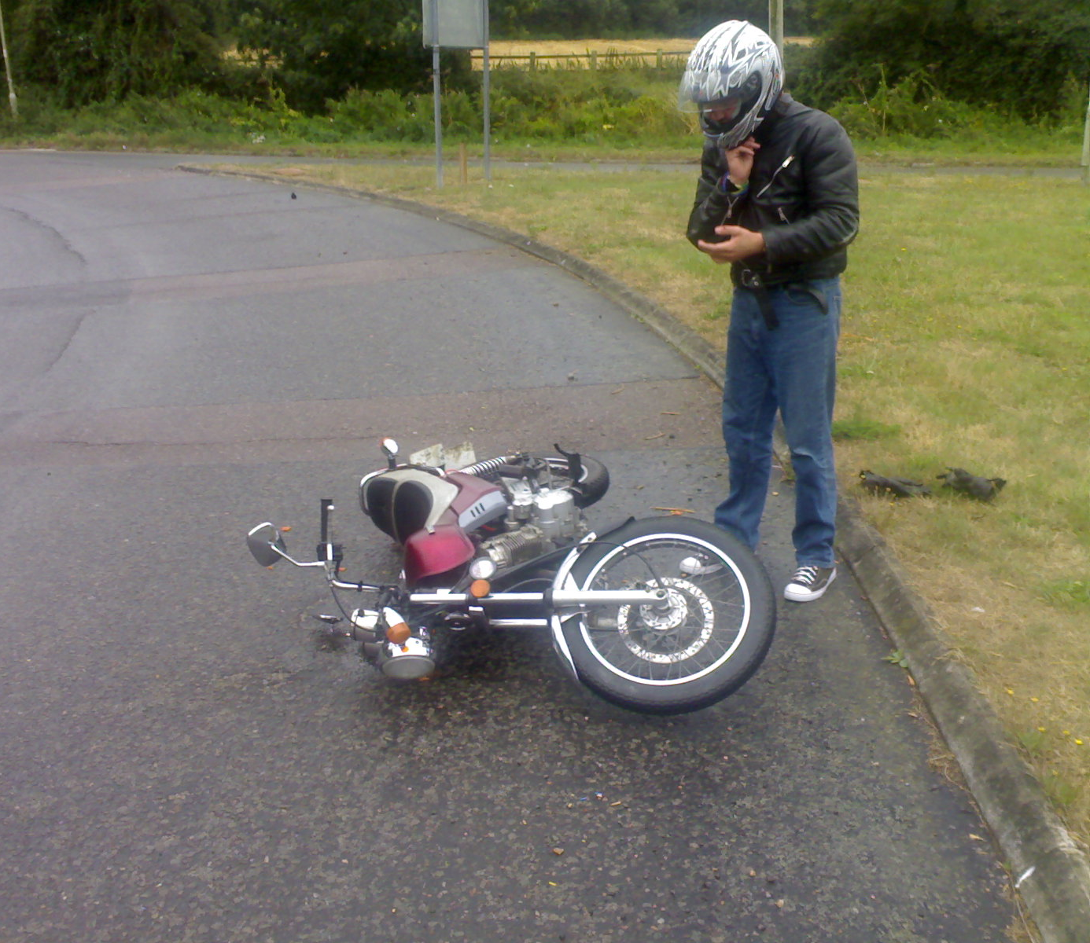
Hello!
We are Team – 11
Working on a product which can help detect Bike Crash and inform nearest Police station and Hospital about the accident and provide the accurate location through which immediate action can be taken.

Slide 3
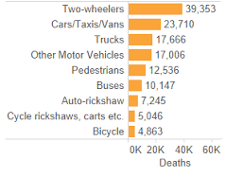
39,353
Bikers died in 2018 due to accidents.

Slide 4
Ideology of Product
This section will cover the ideology behind the product.
1

Slide 5
A small embedded unit can be fitted in the safest position in the vehicle which will be the bottleneck of the proposed idea.
An accident can be detected with the help of 3 parameters - Acceleration / Deceleration, Tilt of the Vehicle, Pressure change / Impact.
GPS Technology will be used to identify the location of the accident.
An alert message will be sent through GSM network to emergency services with the coordinates of the vehicle and an emergency alarm to alert the nearby people.
Mobile Application will also be built for all those having the system embedded in their bikes.

Slide 6
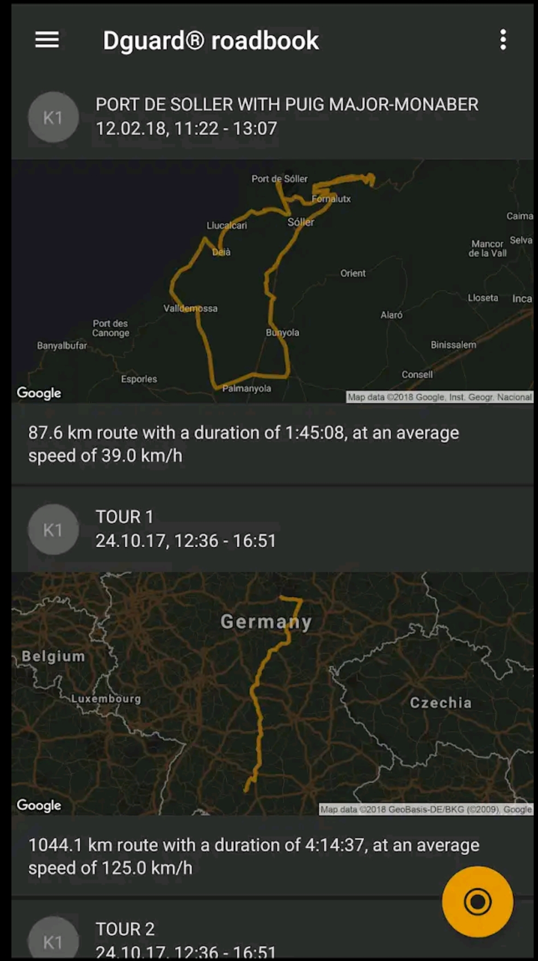
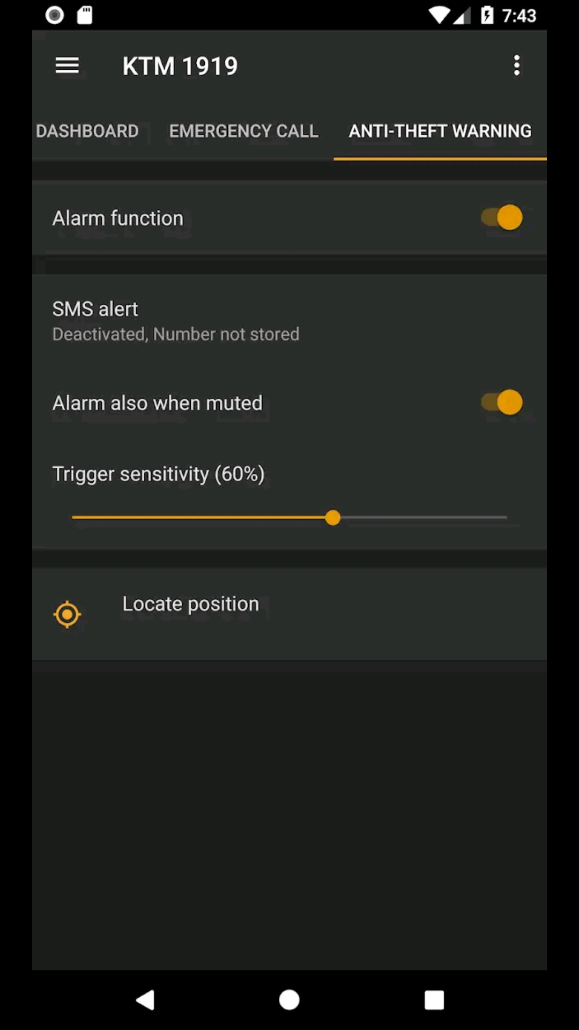
Mobile Application
The Mobile application will be having some additional features like complete route travelled, bike condition and anti-theft locking feature. It will also be able to track the location of the bike.
Mobile app will be available in Android and iOS platform.
Place your screenshot here
Place your screenshot here

Slide 7
Our process is Easy
First
Second
Third
Last
Crash detection using sensors
Location tracking of bike using GPS
Informing Emergency Services using GSM
Immediate Care of the driver can be done

Slide 8
Feasibility
2
This section will discuss the feasibility of our product in Indian Market.

Slide 9
It will come Pre-Installed
The device will be directly embedded in the motorcycle before selling in a single box.
Cheap but Safe
A small module won’t increase the cost of the bike but will increase the driver’s safety by a large amount.
Immediate Actions
Once an accident is reported to emergency services, immediate actions can be taken.
Anti-theft Security
The mobile will be able to track the location of the bike using GPS and also the application will be able to lock the vehicle.
Will track entire bike health
Details like oil, Petrol capacity and other details will be tracked and can be viewed in the Mobile application.

Slide 10
Why We Are Different
&
Our Target Audience
3
This section will discuss about the target crowd which we would like to cover and uniqueness of our product in Indian Market.

Slide 11
Two wheeler manufacturers are our main focus.
We will also launch this product and sell it to accessories dealers so that those who are interested can additionally install our product.
New technology aims in reducing accident rate.
Currently, in Indian market a similar product is not available.
So our product is unique as well as cost efficient which can save lives of many.

Slide 12
Team Members
Ankit Singh Vohra
BT17CSE116
Aditi Khobragade
BT17CSE111
Supriya Venkatesh
BT17CSE106
Samyak Borkar
BT17CSE103
Mehul Patni
BT17CSE089

Slide 13
Thanks!
Any questions?

