Slide 1




Slide 2
Introduction
OpenStack is a cloud OS that is used to control the large pools of computing, storage, and networking resources within a data center. OpenStack is an open-source and free software platform. This is essentially used and implemented as an IaaS for cloud computing.

Slide 3
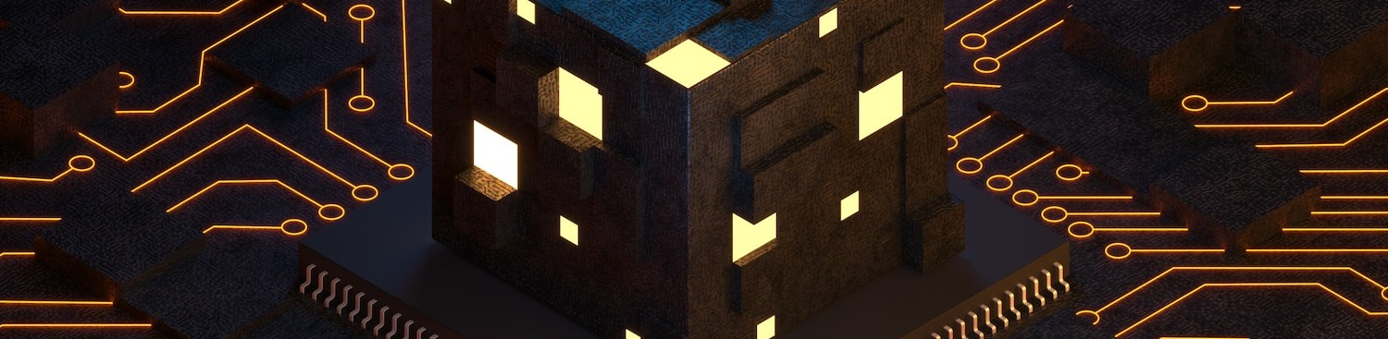
We can call the OpenStack a software platform that uses pooled virtual resources to create and manage private and public cloud. OpenStack offers many cloud-related services (such as networking, storage, image services, identity, etc.) by default.

Slide 4
Basic Principles
Open Source: Under the Apache 2.0 license, OpenStack is coded and published. Apache allows the community to use it for free.
Open Design: For the forthcoming update, the development group holds a Design Summit every 6 months.
Open Development: The developers maintain a source code repository that is freely accessible through projects like the Ubuntu Linux distribution via entig100s.
Open Community: OpenStack allows open and transparent documentation for the community.

Slide 5
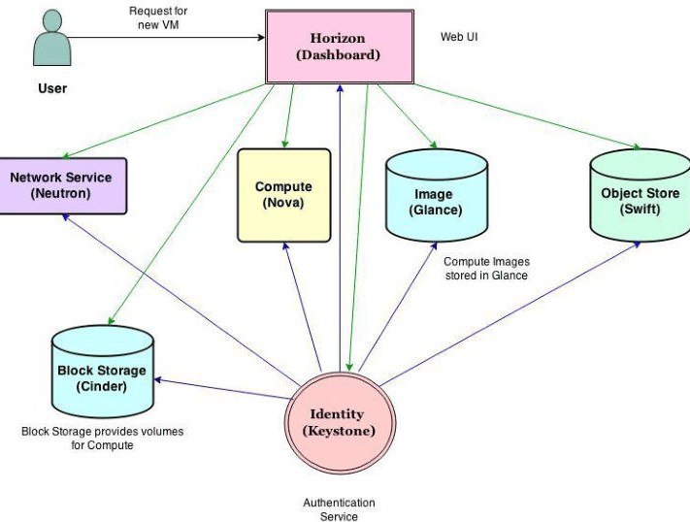
Architecture

Slide 6


Componenets
Nova (compute service) Neutron (networking service) Swift (object storage)
Cinder (block storage)
Keystone (identity service provider)
Glance (image service provider) Horizon (dashboard)
Ceilometer (telemetry) Heat (orchestration)

Slide 7

Nova (compute service)
It manages the compute resources like creating, deleting, and handling the scheduling. It can be seen as a program dedicated to the automation of resources that are responsible for the virtualization of services and high- performance computing.

Slide 8

Neutron (networking service)
It is responsible for connecting all the networks across OpenStack. It is an API driven service that manages all networks and IP addresses.

Slide 9

Swift (object storage)
It is an object storage service with high fault tolerance capabilities and it used to retrieve unstructured data objects with the help of Restful API. Being a distributed platform, it is also used to provide redundant storage within servers that are clustered together. It is able to successfully manage petabytes of data.

Slide 10

Cinder (block storage)
It is responsible for providing persistent block storage that is made accessible using an API (self- service). Consequently, it allows users to define and manage the amount of cloud storage required.

Slide 11
Keystone (identity service provider)
It is responsible for all types of authentications and authorizations in the OpenStack services. It is a directory- based service that uses a central repository to map the correct services with the correct user.

Slide 12
Glance (image service provider)
It is responsible for registering, storing, and retrieving virtual disk images from the complete network. These images are stored in a wide range of back-end systems.

Slide 13
Horizon (dashboard)
It is responsible for providing a web- based interface for OpenStack services. It is used to manage, provision, and monitor cloud resources.

Slide 14
Ceilometer (telemetry)
It is responsible for metering and billing of services used. Also, it is used to generate alarms when a certain threshold is exceeded.

Slide 15
Heat (orchestration)
It is used for on-demand service provisioning with auto-scaling of cloud resources. It works in coordination with the ceilometer.

Slide 16
Advantages
It boosts rapid provisioning of resources due to which orchestration and scaling up and down of resources becomes easy.
Deployment of applications using OpenStack does not consume a large amount of time.
Since resources are scalable therefore they are used more wisely and efficiently.
The regulatory compliances associated with its usage are manageable.

Slide 17
Disadvantages
OpenStack is not very robust when orchestration is considered.
Even today, the APIs provided and supported by
OpenStack are not compatible with many of the hybrid cloud providers, thus integrating solutions becomes difficult.
Like all cloud service providers OpenStack
services also come with the risk of security breaches.

Slide 18
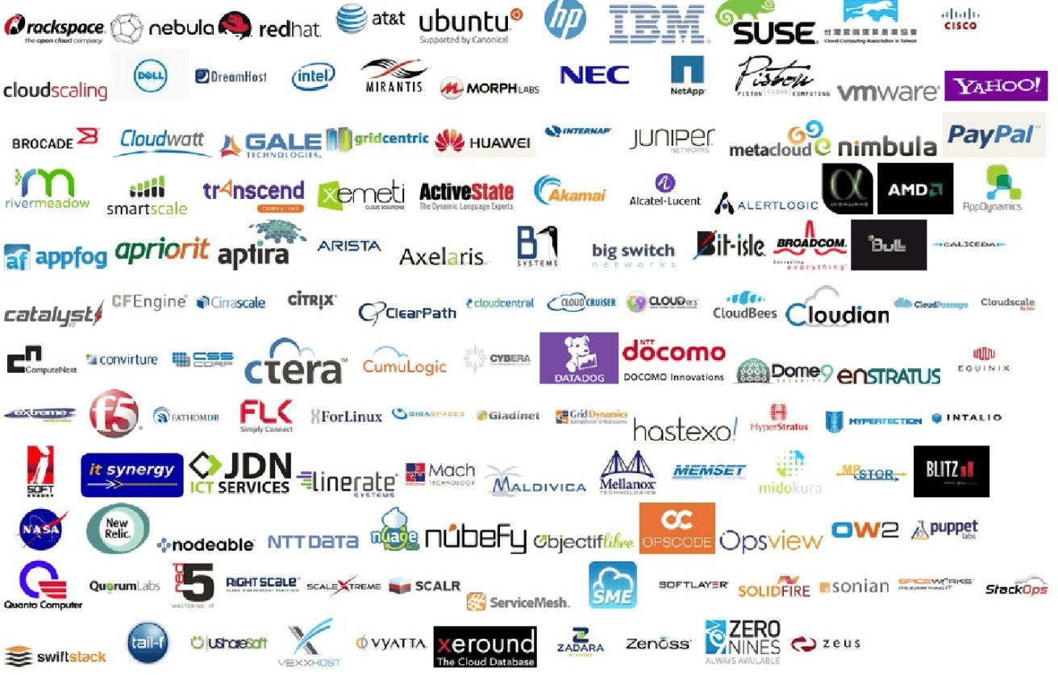
Companies of OpenStack

Slide 19


