Slide 1
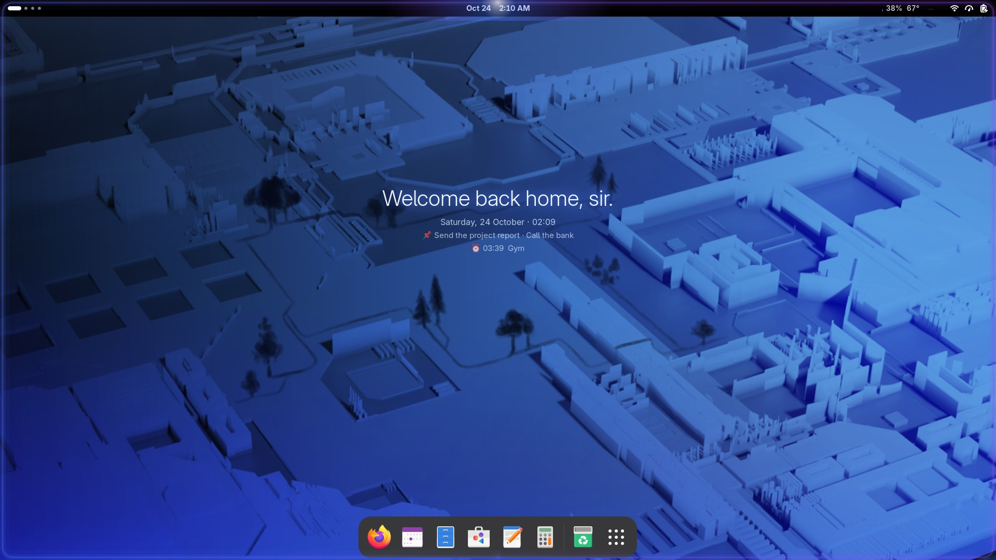
Fedora, finished
MK WORKSTATION
One command turns a fresh Fedora Workstation into a fast, good-looking desktop that already works the way you do.
Free and open source · Fedora 44 · GNOME 50
Notes:
MK Workstation is a set of scripts and small apps that set up Fedora Workstation in one go: settings, extensions, apps, codecs, shortcuts. The rest of this deck walks through what you get.

Slide 2


Great foundation, bare walls
WHY IT EXISTS
Fedora is one of the best Linux systems you can install. Out of the box it's a blank canvas: few apps, missing video codecs, and a desktop that works differently from the one you came from.
1
~15 min
command sets up
the whole desktop
from fresh install
to finished
Before
a weekend of forum posts, extensions and settings
0
100%
After
one command, a coffee, a finished desktop
settings you need
to look up
open source, scripts
you can read
Notes:
Fedora is a great base but bare. Setting it up by hand takes a weekend; MK does it in one command and about fifteen minutes, and everything stays a normal GNOME setting you can undo.

Slide 3
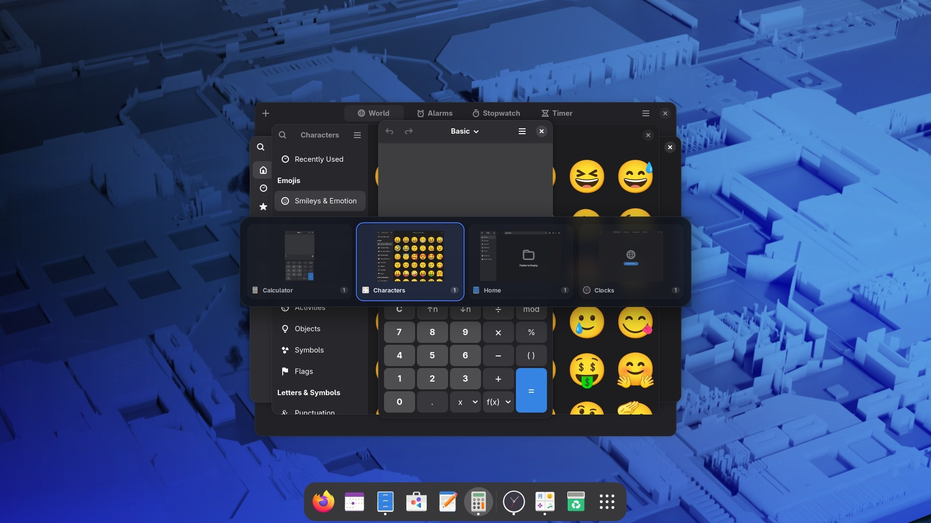




Every window, live, one swipe away
MOVING BETWEEN APPS
Live previews
titles, icons, which desktop
Three fingers
same finger travel per window
Move as you go
1–9 sends it to that desktop
As fast as GNOME
measured, frame for frame
A compact card of live windows that appears at once
Notes:
Alt+Tab and the three-finger swipe open a compact card of live windows, at once. Each window takes the same finger travel, the mouse works too, and 1 to 9 sends the selected window to that desktop.Alt+Tab and the three-finger swipe show one switcher with a ring that follows your fingers. Each window takes the same finger travel however many are open, so fast swipes land where you expect.

Slide 4
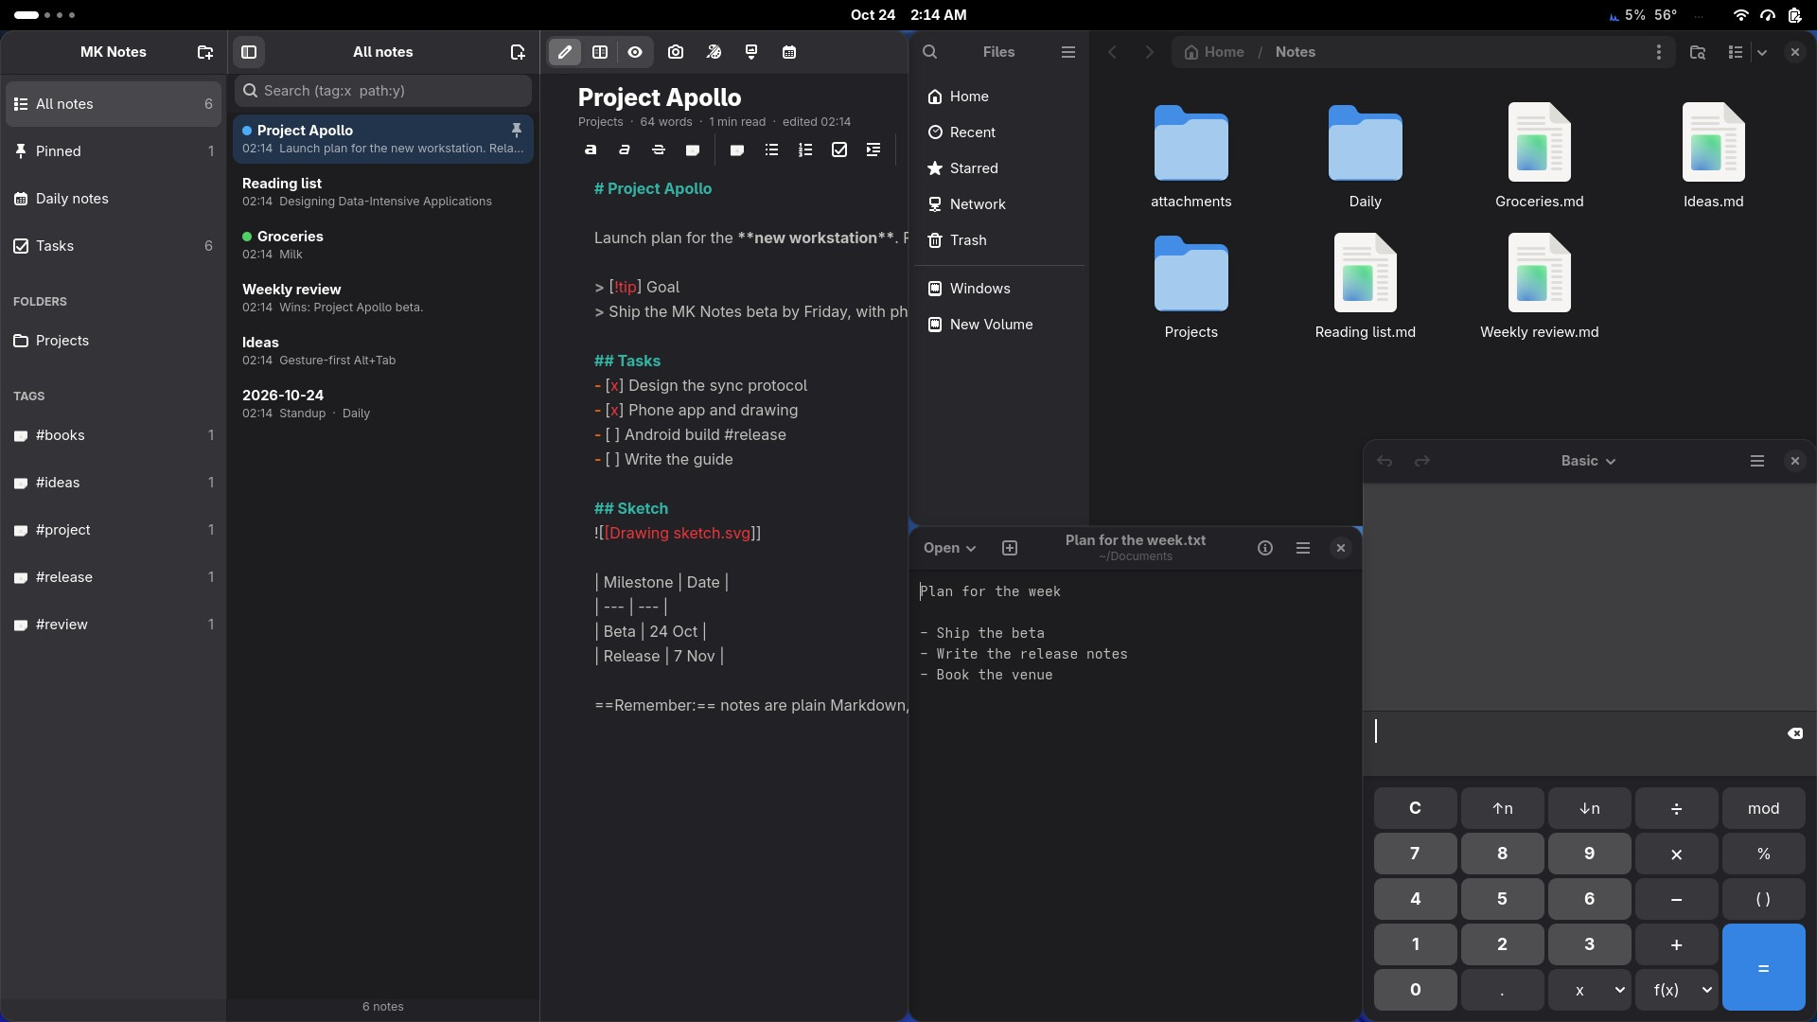


Snap, tile, focus. No dragging.
WINDOWS THAT BEHAVE
Snap layouts
Super+Z, pick one, the rest fill in
Snap Assist
offers your other windows for the space
Always on top
Super+Ctrl+T for a video or a calculator
New desktop
Super+Ctrl+D, Shift takes the window
Halves and quarters with Super and the arrow keys
Notes:
Windows-style snapping: Super and the arrows for halves and quarters, Super+Z for layouts, Snap Assist offers the other windows for the free space.

Slide 5



A desktop that says hello, and remembers
AFTER YOU LOG IN
Light on time
plays once the desktop is ready
What's waiting
pinned tasks and today's next reminder
Never the same twice
morning, Friday, birthday, or your lines
Your colours
taken from your wallpaper
The greeting lands with the light, your tasks underneath
Notes:
After login the light runs round the screen once the desktop is ready, and the greeting shows your pinned tasks and next reminder. The colours across the desktop come from your wallpaper.

Slide 6
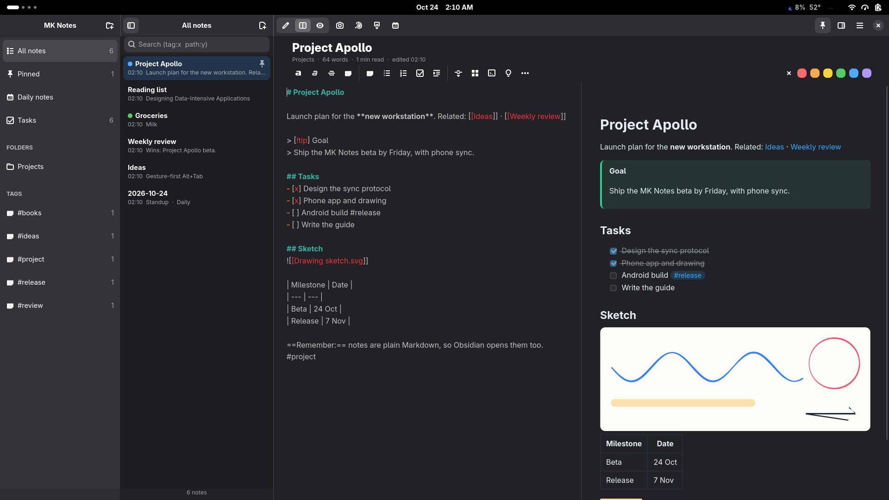
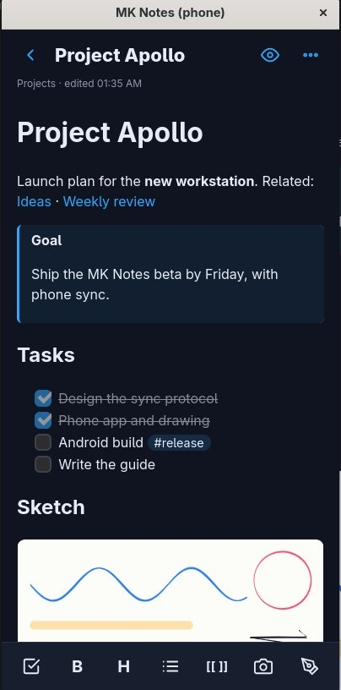




MK Notes: write, link, draw, find
SUPER + N
Your files
plain Markdown you own
Linked
links, backlinks, graph
Drawn
pen with pressure
Pasted
screenshots straight in
Live preview on the laptop, the same notes on your phone
Notes:
MK Notes keeps notes as plain Markdown files. Links, backlinks and a graph; draw with a pen; paste screenshots; edit with a live preview. The same notes are on your phone.

Slide 7




The features you'd normally pay for
MK NOTES
Phone sync
browser or Android, offline, encrypted
PDF export
one click, with pictures
Your website
publish notes as web pages
Version history
how a note looked this morning
Daily notes
a calendar of the days you wrote
Tasks view
every checkbox, in one list
Quick capture
Super+Ctrl+N from anywhere
Your look
theme, font, size, spacing
Notes:
Sync to your phone over Wi-Fi, PDF export, publishing as a website and version history are built in, plus a tasks view, a daily-notes calendar, focus mode and your own look.

Slide 8
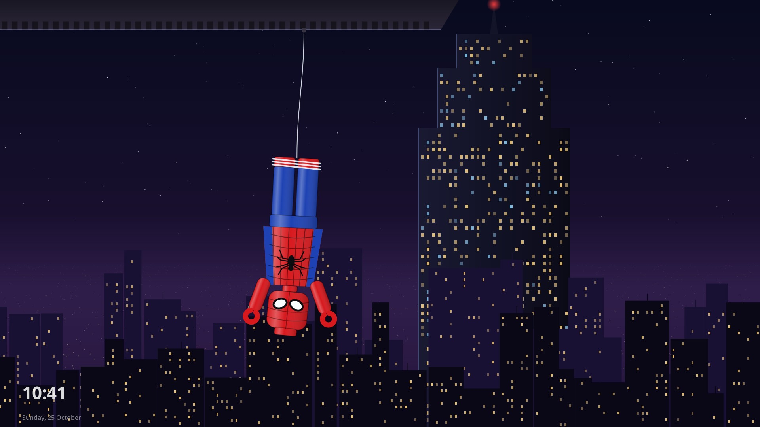
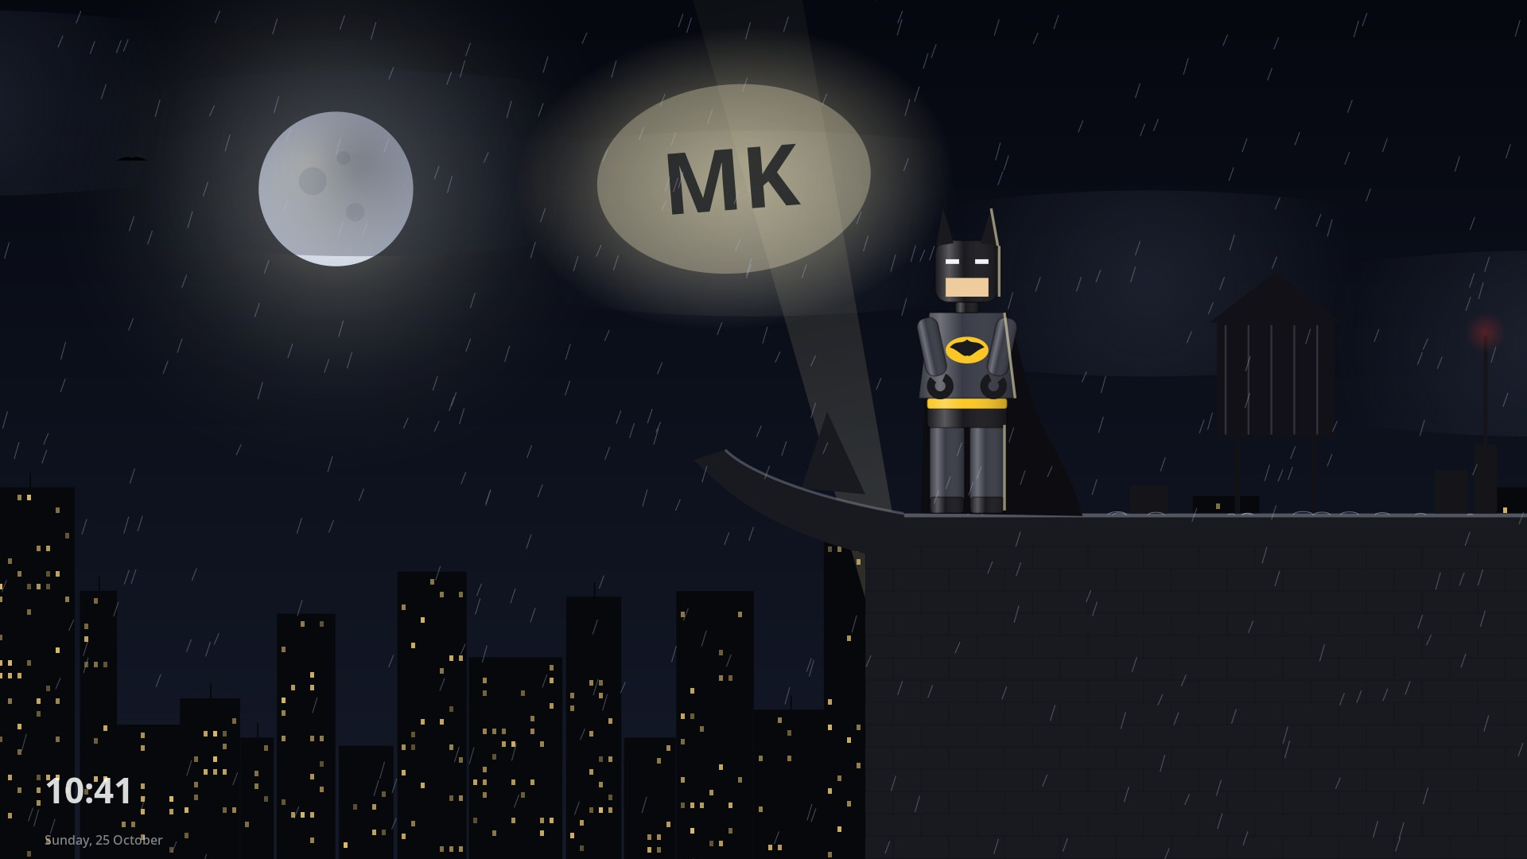
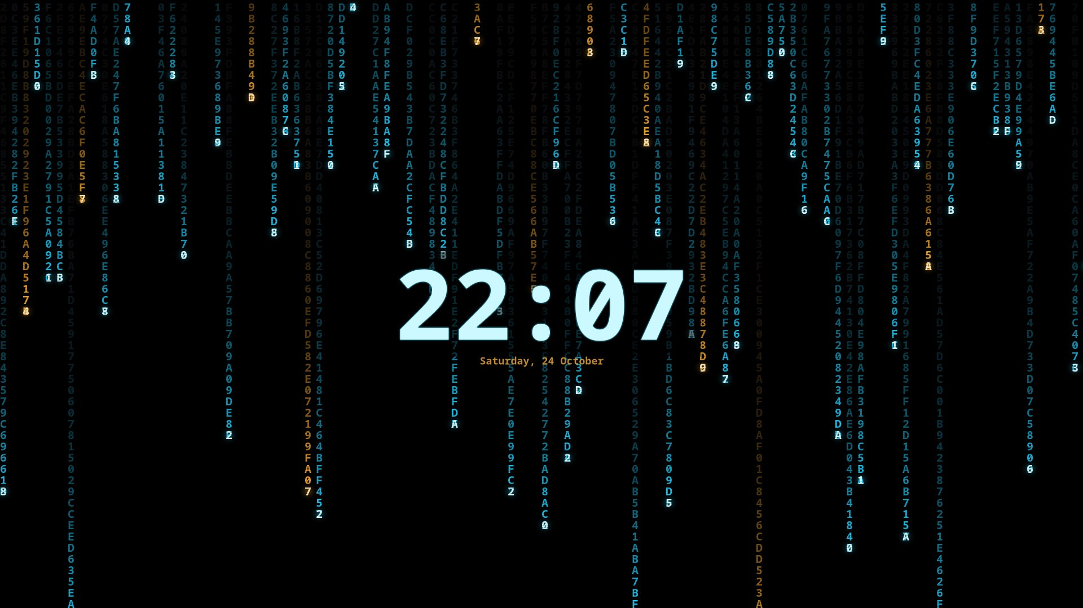


Screensavers worth stepping away for
STEP AWAY
Web Hang · Night Watch · Terminal Stream
When you step away
after a few idle minutes; any touch ends it
Never over a film
videos and calls keep it away
Focus timer
countdown in the top bar, then a little party
Light on the machine
30 fps, still parts drawn once
Notes:
Step away for a few minutes and a scene plays: a brick-built masked hero hanging beside a skyscraper, a brick-built caped knight in the rain, or hexadecimal rain that decodes the time. A video or call keeps it away; any touch brings you back.

Slide 9
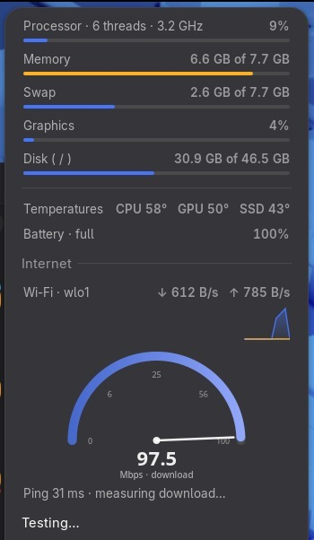
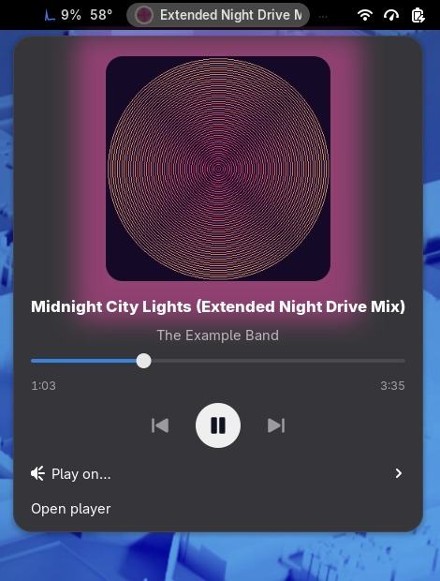

Everything you check, one click away
THE TOP BAR
System monitor
CPU, memory, temperatures, battery
Speed test
ping, download, upload on a gauge
Your music
art, seek, skip, choose speakers
Clipboard history
Super+V brings back what you copied
Speed test and your music
Notes:
The top bar has a light system monitor with a speed test, a media tile for Spotify or any player with seek and speaker choice, and clipboard history on Super+V.

Slide 10







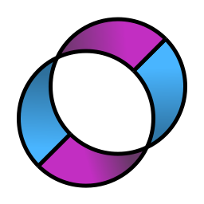

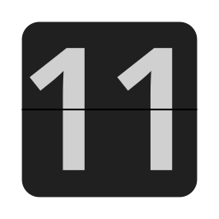

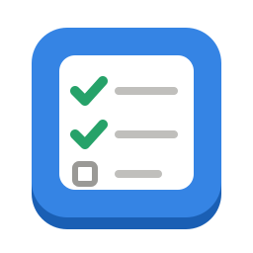

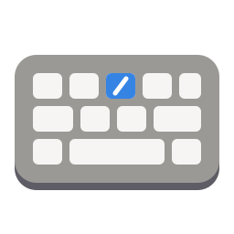
Installed and ready on first login
APPS
Zen Browser
Joplin
ONLYOFFICE
VS Code
Spotify
Lutris
Extensions
SonoBus
Frog
FlipClock
MK Notes
Companion
Focus Timer
Shortcuts
Plus video and audio codecs, hardware video decoding, a modern terminal toolkit, gaming helpers and developer tools. Every app list is a plain text file: add a line and it's yours. Bold ones are made for MK Workstation.
Notes:
The apps people ask for are there on first login, including Joplin, ONLYOFFICE, Zen and VS Code. The app lists are plain text files you can edit.

Slide 11



It looks at your hardware, then tunes for it
YOUR COMPUTER
Fingerprint and face
log in with a touch or a glance
Battery that lasts
fast on power, gentle on battery
Speakers with body
warmth, real bass, clearer voices
Touch and 2-in-1s
rotation, tablet mode, pen
Right graphics driver
hardware video for Intel, AMD, NVIDIA
Older machines too
mk effects lite keeps it smooth
Notes:
It checks the hardware first: fingerprint or face unlock where there's a reader, power profiles on battery, speaker tuning, touch and 2-in-1 support, the right video driver.

Slide 12
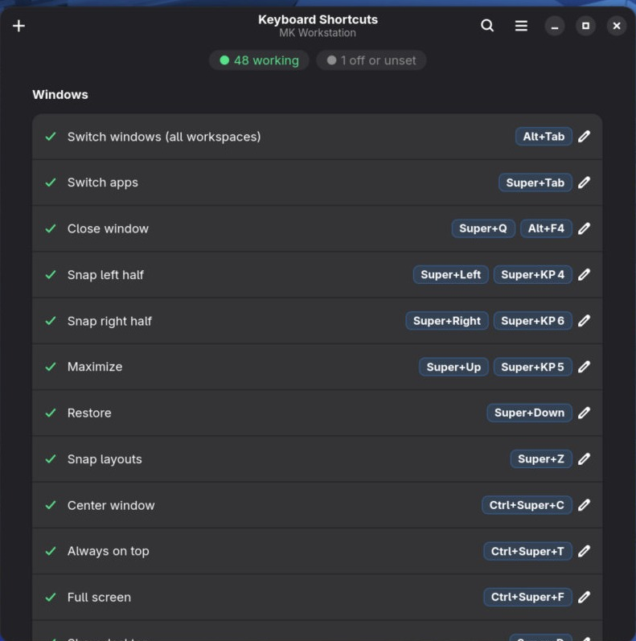
Your hands already know these
KEYBOARD
Super+E
Files
Super+N
MK Notes
Super+B
Web browser
Super+V
Clipboard history
Super+Shift+S
Screenshot an area
Super+Z
Snap layouts
Ctrl+Shift+Esc
System Monitor
Super+L
Lock
Ctrl+Alt+End
Shut down
Ctrl+Alt+Home
Restart
Super+/ shows every shortcut, live, and lets you change any key
Notes:
Shortcuts follow Windows and macOS habits. Super+/ shows every one live and lets you change any key.

Slide 13
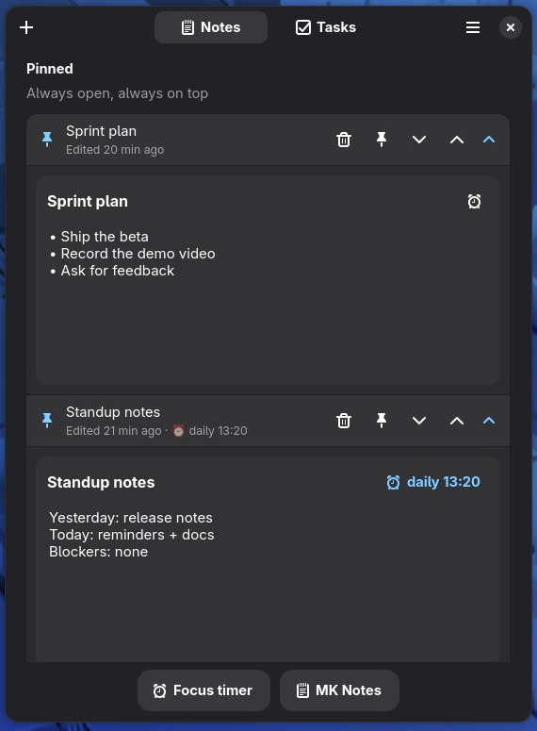

Try it, change your mind, nothing breaks
NO RISK
A snapshot every time
mk restore puts your settings back
One-line uninstall
mk uninstall removes MK's tools
Health check
mk doctor finds problems and says how to fix them
Readable
plain shell and Python, every change in git
One update
mk update does system, apps and settings
The Companion: quick notes, tasks, reminders
Notes:
Every change is snapshotted, mk restore undoes it and mk uninstall removes MK's tools. mk doctor checks health; mk update updates everything.

Slide 14
Get it in three commands
GET STARTED
1 git clone https://github.com/MehulK-techie/fedora-workstation-config.git
2 cd fedora-workstation-config
3 sudo ./setup.sh
On a fresh Fedora Workstation. Then log out and back in. That's it.
Source code and issues Getting started guide Every feature
Notes:
Clone, change into the folder, run setup with sudo. It asks before anything optional, like face unlock. Then log out and back in.

