Slide 1



Decentralized CrowdFunding App using Ethereum
Activity - IA2
1914005 - Shubham Bhadra
1914031 - Harsh Khona
1914038 - Hemil Mehta
1914044 - Mehul Parekh
Guide - Mrs. Yogita Borse
Subject - Blockchain Development Frameworks

Slide 2
Problem Statement
Crowdfunding platforms have revolutionized the way startups and small businesses raise capital, but traditional platforms still face significant issues in terms of transparency, security, and trust. Investors often lack transparency about how their funds are being used, and the centralized nature of the platforms makes them vulnerable to hacking and fraudulent activities. Additionally, many countries have regulations on the transfer of funds, making it difficult for people to invest in startups located in different countries.

Slide 3
Justification on why blockchain is suitable solution
Crowdfunding allows businesses with really great products and service ideas to raise funds from regular people in small investment amounts. Blockchain makes the funding process safe and offers completely transparent access from anywhere in the world, maximizing the success of a project.
The Magic of Decentralization: Startups no longer be beholden to the rules, regulations, and whims of the most popular crowdfunding platforms on the internet. Decentralization eliminates the problem of fees and offers any project a chance of getting visibility and funded. This makes crowdfunding less expensive for creators and investors.
Tokenization: Blockchain could rely on asset tokenization to provide investors with equity or some similar concept of ownership,for example Initial Coin Offering (ICO). Startups could save money on hiring employees by compensating them partially in fractional ownership of the business, converting it into an employee-owned enterprise.
High availability and Immediate provision: Any project using a blockchain-based crowdfunding model can potentially get funded. Also, any person with an internet connection can contribute to those projects. Blockchain-based crowdfunders wouldn’t have to worry about the “fraud” that have plagued modern-day crowdfunding projects.
Smart Contracts to Enforce Funding Terms: Smart contracts provide greater accountability by enforcing funding terms and preventing large sums of money from being squandered by those who are ill-intended or not qualified. Primarily, these contracts would provide built-in milestones that would prevent funds from being released without provenance as to a project or campaign’s legitimacy.

Slide 4
Technologies used
Solidity - Solidity is a high-level programming language used to write smart contracts on the Ethereum blockchain. Here we use Solidity to write the smart contracts that power the crowdfunding platform.
Thirdweb sdk - Thirdweb SDK utilizes JavaScript and the Solidity programming language, and is designed to make it easy for developers to build and deploy dApps that leverage the benefits of decentralization, such as improved security, privacy, and transparency.
MetaMask - MetaMask is a browser extension that allows users to interact with Ethereum-based applications from their web browsers. Here we use MetaMask to connect to the Ethereum network and interact with the crowdfunding platform.
React - React is a JavaScript library used for building user interfaces.
Web3.js - Web3.js is a JavaScript library used to interact with the Ethereum blockchain. Here we use Web3.js to connect the frontend of the crowdfunding platform to the smart contracts on the Ethereum network

Slide 5
Justify type of blockchain used is most suitable
Ethereum smart contract capabilities allow for advanced automation and security in crowdfunding applications, reducing the need for third-party intermediaries and ensuring transparency.
The large developer community surrounding Ethereum has created an ecosystem of tools and libraries that make building and deploying crowdfunding applications much easier.
Ethereum's interoperability and tokenization features make it easy to integrate with other systems and create custom digital assets for payment and investment.
Ethereum is highly versatile and suited to the needs of crowdfunding applications, giving it an edge over other blockchains.
Ethereum's integration with the widely-used programming language JavaScript makes it accessible and easy to use for developers with a range of backgrounds and skill levels.

Slide 6
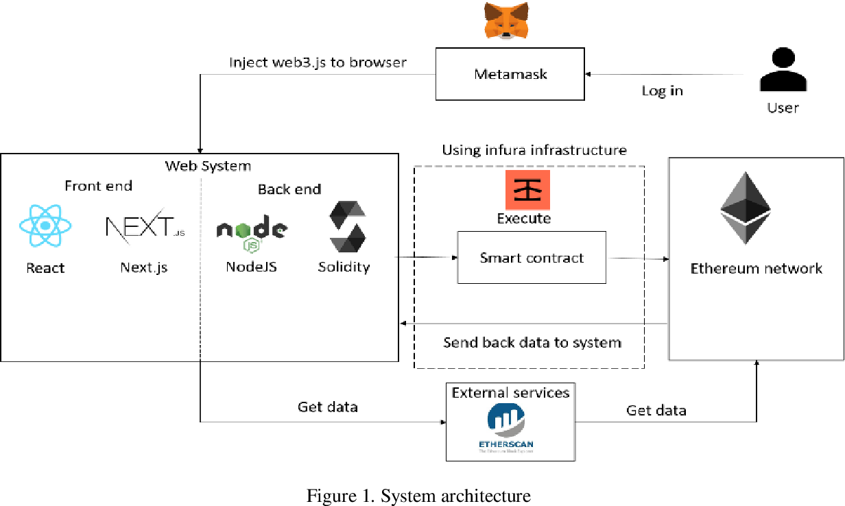
System Architecture

Slide 7
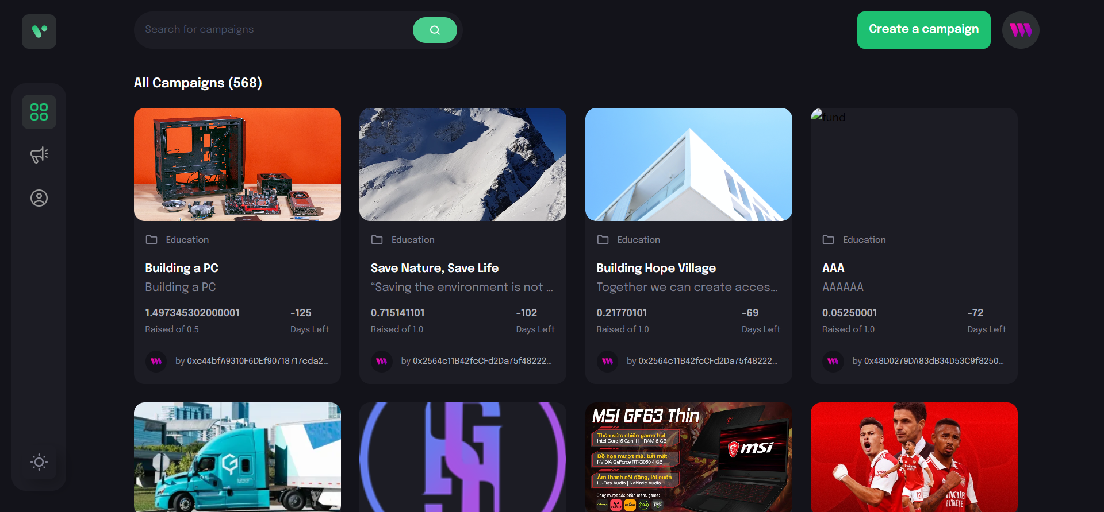
Demo

Slide 8

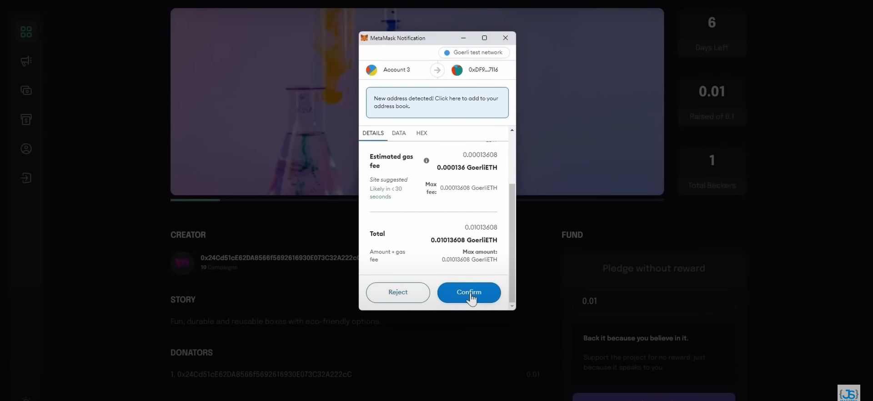
Demo

Slide 9
Conclusion
The development of a blockchain-based crowdfunding platform using the Web3.js has demonstrated the potential of blockchain technology in enabling decentralized and transparent fundraising processes. The platform leverages the benefits of Ethereum blockchain, including its ability to host smart contracts and store transaction data securely, The platform's decentralized and transparent nature ensures fairness and trust in the crowdfunding process, while providing a more efficient and cost-effective alternative to traditional fundraising methods

Slide 10
References
https://solidity.readthedocs.io/
https://www.warse.org/IJATCSE/static/pdf/file/ijatcse83932020.pdf
https://ethereum.org/en/developers/docs/
https://www.youtube.com/playlist?list=PLzb46hGUzitDd39YzB1YvZqeIXXtmBrHX
https://www.youtube.com/watch?v=BQ4bJrvSi-E

