Slide 1

ETL System for Inventory Management

Slide 2


Project Overview
Automated Data Flow
Seamlessly integrate data from customer, product, and sales sources, ensuring daily updates to our data warehouse for timely insights.
2
SCD Type 2 Management
Implement Slowly Changing Dimension Type 2 for customer and product data, enabling comprehensive historical tracking and analysis.
Inventory Tracking
Develop a precise system for monitoring inventory movements, providing accurate stock levels at any given time to optimize operations.
Analytical Foundation
Lay the groundwork for advanced analytics, historical reporting, and deep insights into product performance and trends, empowering data-driven decisions.

Slide 3


Technology Used
SQL Server
Microsoft SQL Server Integration Services (SSIS)

Slide 4
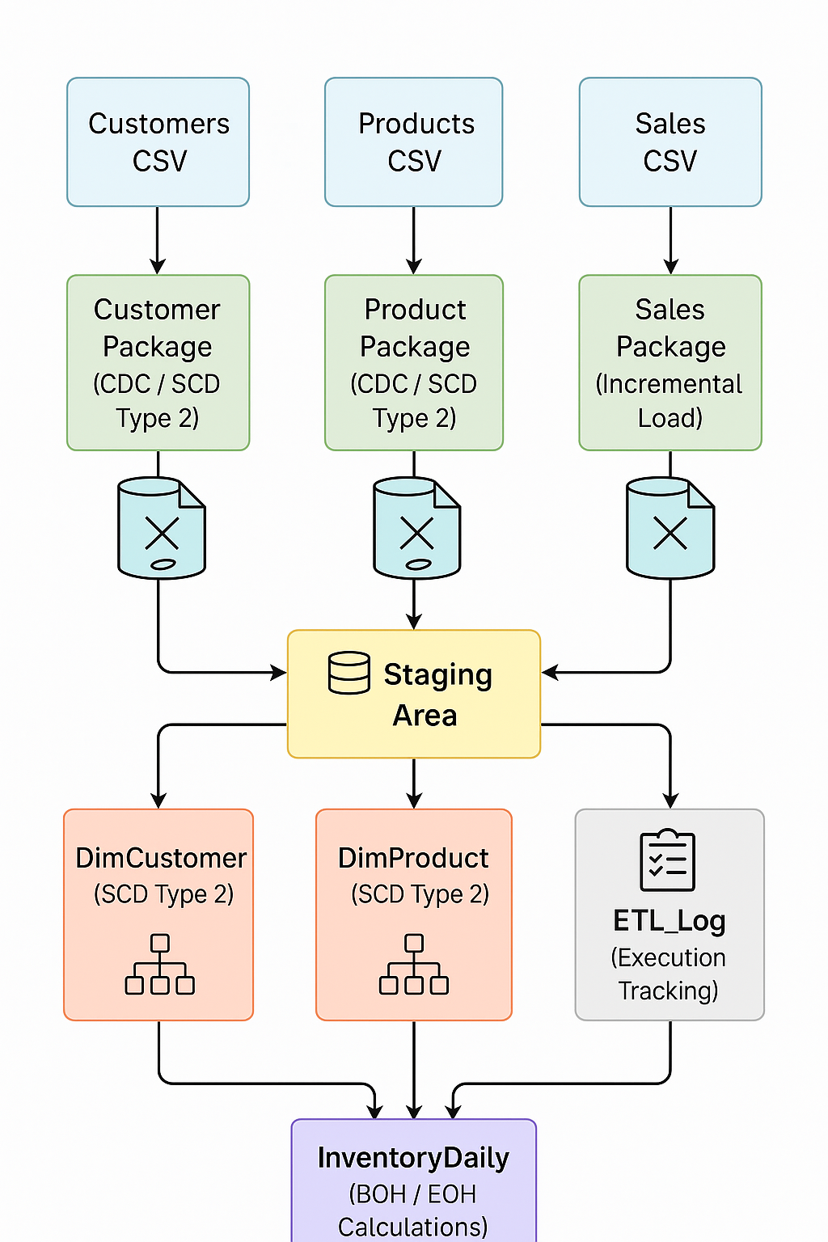
System Architecture

Slide 5





Customer & Product: Managing Slowly Changing Dimensions (SCD Type 2)
Source
Raw customer/product events are ingested, capturing all changes as they occur in the operational systems.
CDC Process
A Change Data Capture (CDC) process detects all Inserts, Updates, and Deletes, ensuring no data modification is missed.
Inserts → New Records
New records are loaded with a StartDate, EndDate NULL, and IsActive = true, marking them as current.
Updates → Inactivate + Insert
For updates, the old record's EndDate is set and IsActive = false; a new record is inserted with a fresh StartDate.
Deletes → Mark Inactive
For logical deletes, the record's EndDate is set and IsActive = false, preserving historical context.
.

Slide 6




Sales Feed Processing
Load New Transactions
Deduplication
Only new sales transactions are extracted and loaded into the data warehouse, optimizing processing time and resource utilization.
Robust logic is implemented to prevent duplication, even if daily files are re-sent, ensuring data uniqueness and integrity.
Currency Conversion
Watermark Tracking
All sales amounts are converted from USD to NPR (Nepalese Rupees) during the ETL process to provide a standardized currency for reporting.
Processing is driven by a sales_date watermark to ensure accurate incremental loads and maintain data consistency over time.

Slide 7


Inventory Management: Daily Balance Tracking
Beginning of Day (BOH)
The BOH for the current day is consistently set equal to the End of Day (EOH) from the previous day, ensuring a continuous inventory record.
End of Day (EOH) Calculation
EOH is calculated as BOH - QuantitySold + QuantityReceived.
First-Time Products
For newly introduced products, the BOH will default to 0 on their initial entry
into the system, establishing a baseline for tracking.
Output: InventoryDaily
All calculated inventory data, including BOH and EOH, is stored in the InventoryDaily table for easy access and analysis of stock trends.

Slide 8

Final Product Dimension
Latest Active Record
Total Quantity Sold
Each product entry represents the most current active SCD2 record, ensuring up-to-date data for analysis and decision-making regarding product status.
The total_qty_sold attribute aggregates the sum of quantities sold from the FactSales table, providing a vital performance metric for each product.

Slide 9


Target Data Model
FactSales
DimCustomer
DimProduct
Manages incremental loads and converts all sales amounts from USD to NPR, ensuring consistent currency for financial reporting.
Utilizes SCD2 to track customer history and aggregates total_amt_spent, enabling deeper customer lifetime value analysis.
Also uses SCD2 for product history and tracks total_qty_sold, essential for product performance and inventory optimization.
InventoryDaily
ETLAudit
Records daily Beginning of Day (BOH) and End of Day (EOH) stock levels, providing granular insights into inventory movements.
Monitors and tracks the success or failure of ETL processes, offering critical audit trails for data governance and troubleshooting.

Slide 10

Logging & Monitoring
ETL_Log Fields
Records include PackageName, StartTime, EndTime, Status, and ErrorMessage for detailed traceability and quick identification of issues.
SSIS Event Handlers
Leverage SSIS Event Handlers to capture critical events throughout the ETL process, providing real-time visibility into workflow execution.

Slide 11







Key Takeaways
Enhanced Data Quality
Accelerated Insights
Streamlined Operations
.

Slide 12

Thank You!
Appreciated your time and attention.
Any Questions?

