Slide 1
Dashboard On Indian Premier League (IPL)
Tableau by MEHUL SONI

Slide 2
Winning Team
In HOmeground
3. Player of Match
in every Season
Indian Premier League
IPL
5. Performance of Team in each quarter
2. Match – Toss
Winning Percentage
E
1. Numbers of Matches in City
C
A
D
B

Slide 3
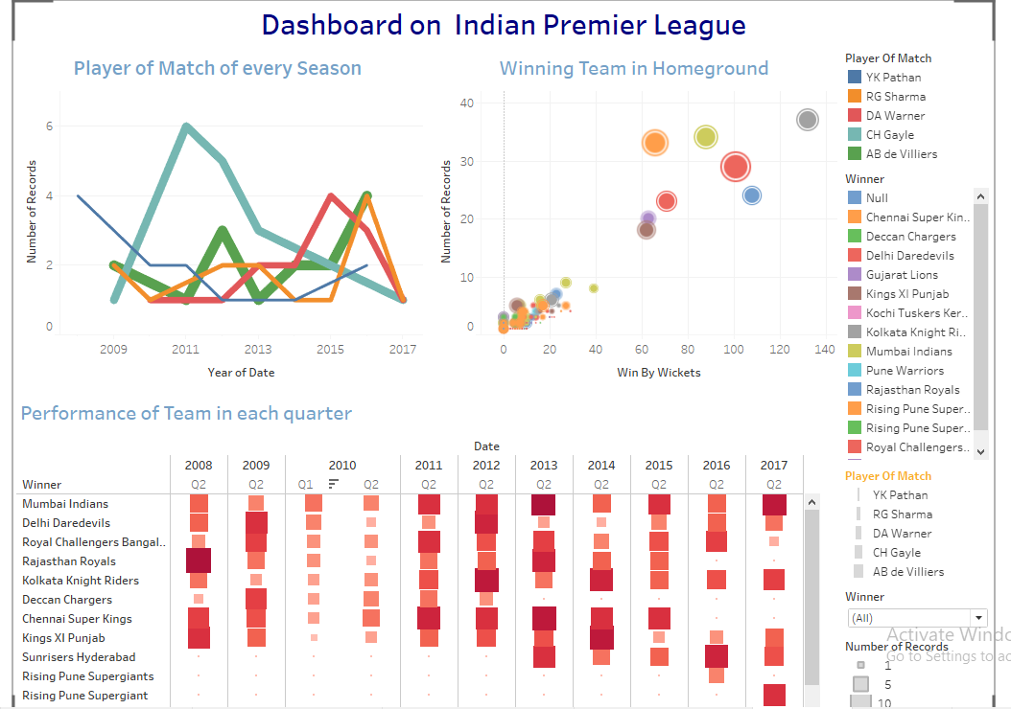

Slide 4
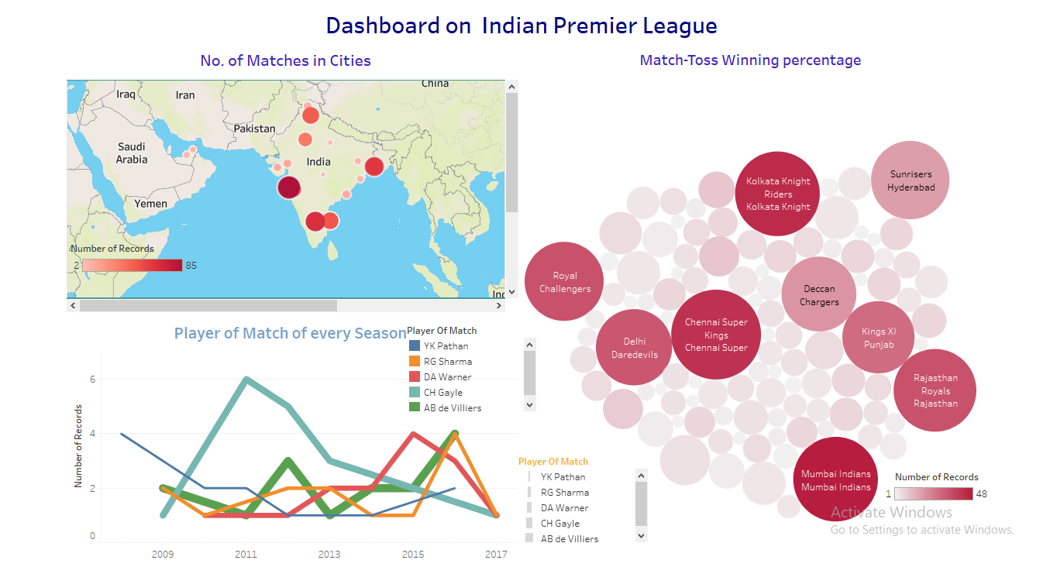

Slide 5
Conclusion

