Slide 1
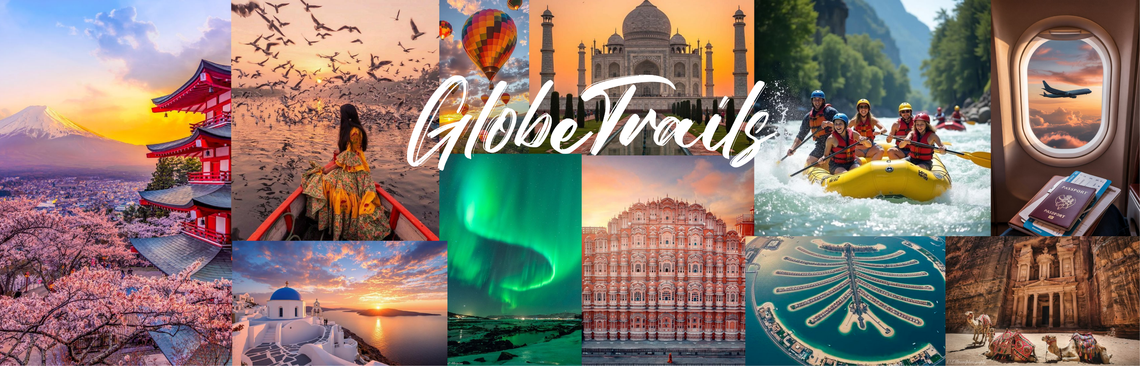


GlobeTrails-Tour & Travel app
Domestic & International Packages

Slide 2
Group No : 242
Guided by : Prof. Disha Nalwala
BCA SEM 5 A.Y. 2025-26
SDJ INTERNATIONAL COLLEGE (VESU)
Exam NO. | Roll NO. | Name of student
9884 | 310 | Rana Mehul Chandrakantbhai.
7271 | 372 | Tiwari Shani Pappubhai.
6713 | 037 | Agarwal Samarth Rajkumar.

Slide 3

TABLE OF CONTENTS
01
02
Introduction
SYSTEM OVERVIEW
03
04
Client Profile
Agent Profile
05
06
Property Schema
Database Structure

Slide 4
TABLE OF CONTENTS
07
08
property Uploads
Property Management
09
09
Technical Architecture
Technical Stacks
09
Scalibility & Future Enhancement

Slide 5


introduction
The Problem:
Challenges in Traditional Tourism Systems
Manual booking processes requiring phone calls or physical visits
Fragmented tour information across multiple platforms
Lack of real-time inventory updates for tour operators
No centralized dashboard for business management
Poor mobile experience for travelers on-the-go
Our Solution: GlobeTrails:
A unified digital platform connecting travelers with curated tour experiences through a modern web application.
What We Built :
A full-stack web application featuring secure user Authentication system, detailed tous listings, advanced search, and a scalable database—all designed to make finding and managing tours easier than ever before.

Slide 6

System Overview
What is GlobeTrails?
Web-based tour booking and management system
Serves as intermediary between travelers and tour operators
Single Page Application (SPA) for seamless user experience
Complete digital workflow: discovery → booking → management
Key Features:
User authentication (Email + Google OAuth)
Advanced tour catalog with filtering
Booking inquiry system
Comprehensive admin dashboard
Mobile-responsive design
Tour Management Admin Dashboard
Admin can easily manages tour packages , inserting,updating,deleting and approving booked tours etc.

Slide 7

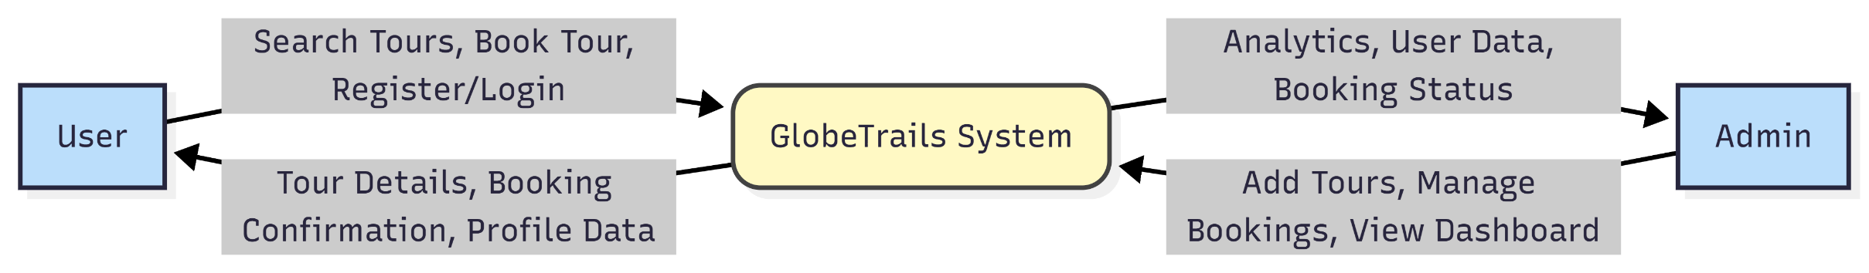
System Architecture
Client–Server architecture
React frontend communicates via REST APIs
Express server handles business logic
MongoDB stores application data
Supabase used for image storage

Slide 8
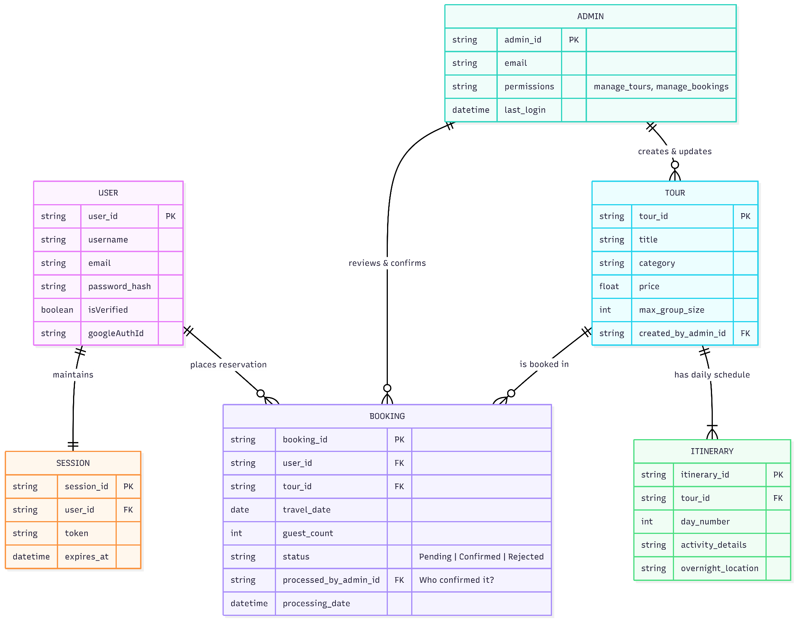
System Flow Diagram

Slide 9
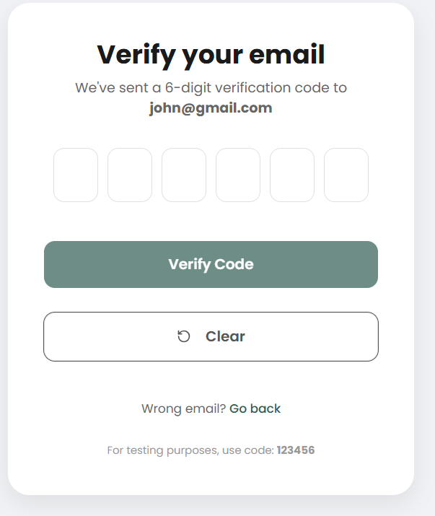
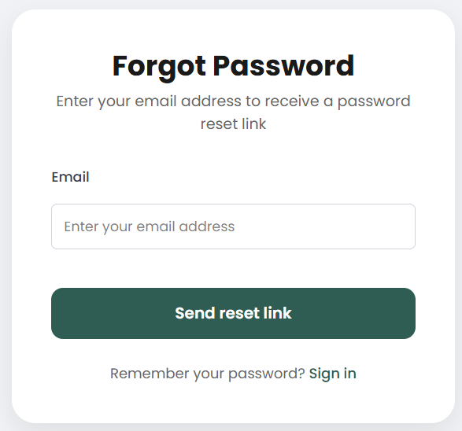
Athentication & Security
User registration using email and password
Google OAuth integration for social login
Passwords encrypted using BCrypt hashing
JWT tokens used for secure session management
Role-based access for admin and users

Slide 10
Tour Package Module
Tour booking Module
Core Tour Details:
Basic Info: Tour Title, Tour Description, Tour Category (Adventure, Wildlife, Heritage, etc.)
Tour Specs: Duration (Days/Nights), Price per Person, Maximum Group Size
Itinerary Details
Day-wise Plan: Day Number, Activities Description
Inclusions: Meals, Transport, Accommodation (if applicable)
Media Management
Images: Tour Images uploaded and stored via Supabase
Image URLs: Stored in MongoDB and displayed in tour catalog
Listing Control
Tour Status: Active / Inactive
Visibility: Show or hide tour from public users
Admin Link
Created & managed by: Connected to Admin Profile who created the tour
Booking Information
Basic Info: Selected Tour, Preferred Start Date, Number of Guests
Price Calculation: Total Price = Price per Person × Guests
User Link
Booked By: Connected to registered User Profile
Authentication: Booking allowed only for logged-in users
Booking Status
Inquiry Status: Pending / Confirmed / Rejected
Status Update: Managed by Admin through dashboard
Transaction Control
Booking ID: Auto-generated unique identifier
Booking Date: Timestamp of booking request
User Access
Booking History: Users can view all their past and current bookings
Status Tracking: Real-time booking status visibility

Slide 11
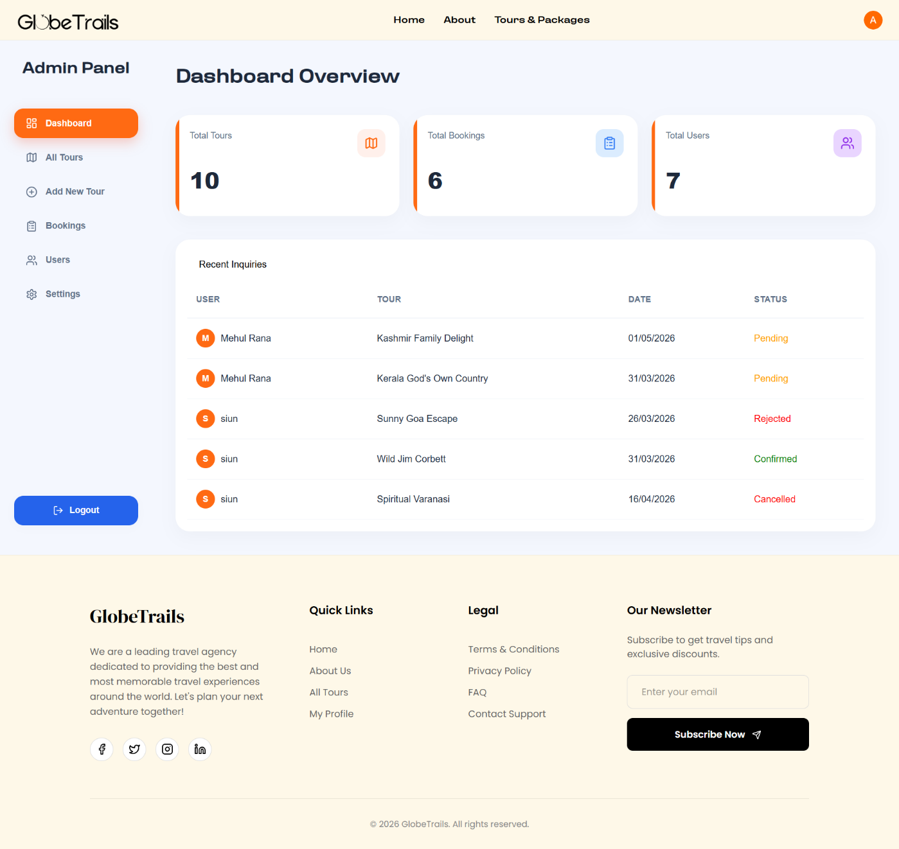
Admim Dashboard Module
Authentication & Access
Admin Login: Secure login using JWT authentication
Role Control: Admin-only access using Role-Based Access Control (RBAC)
Dashboard Overview
Statistics Cards: Total Users, Total Tours, Total Bookings
Quick Insights: Recent booking inquiries and tour activity
Tour Management
Create Tour: Add new tour with itinerary and images
Update Tour: Modify tour details and pricing
Delete Tour: Remove tour from system
Booking Management
View Bookings: List of all booking requests
Status Control: Confirm or reject bookings
User-Tour Mapping: View which user booked which tour
System Control
User Management: View registered users
Data Monitoring: Centralized control of system data

Slide 12
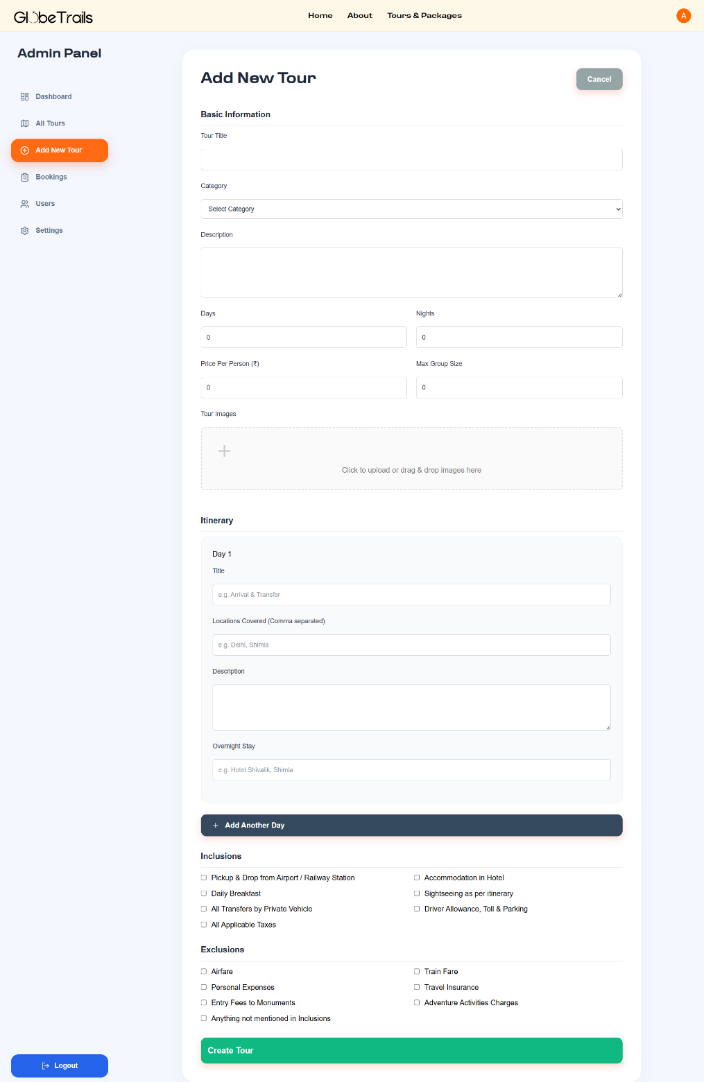
Tour Uploads
Admin Association
Created By: Linked to Admin Profile who uploads the tour
Created Date: Auto-generated timestamp
Basic Tour Information
Title: Tour Name
Description: Detailed tour overview and highlights
Category: Adventure / Wildlife / Heritage / Beach / Cultural
Tour Configuration
Duration: Number of Days and Nights
Price Info: Price per Person
Group Size: Maximum allowed travelers
Itinerary Details
Day-wise Plan:
Day Number
Daily Activities Description
Media Upload
Tour Images: Upload multiple tour images
Storage: Images stored in Supabase cloud storage
Reference: Image URLs saved in MongoDB

Slide 13
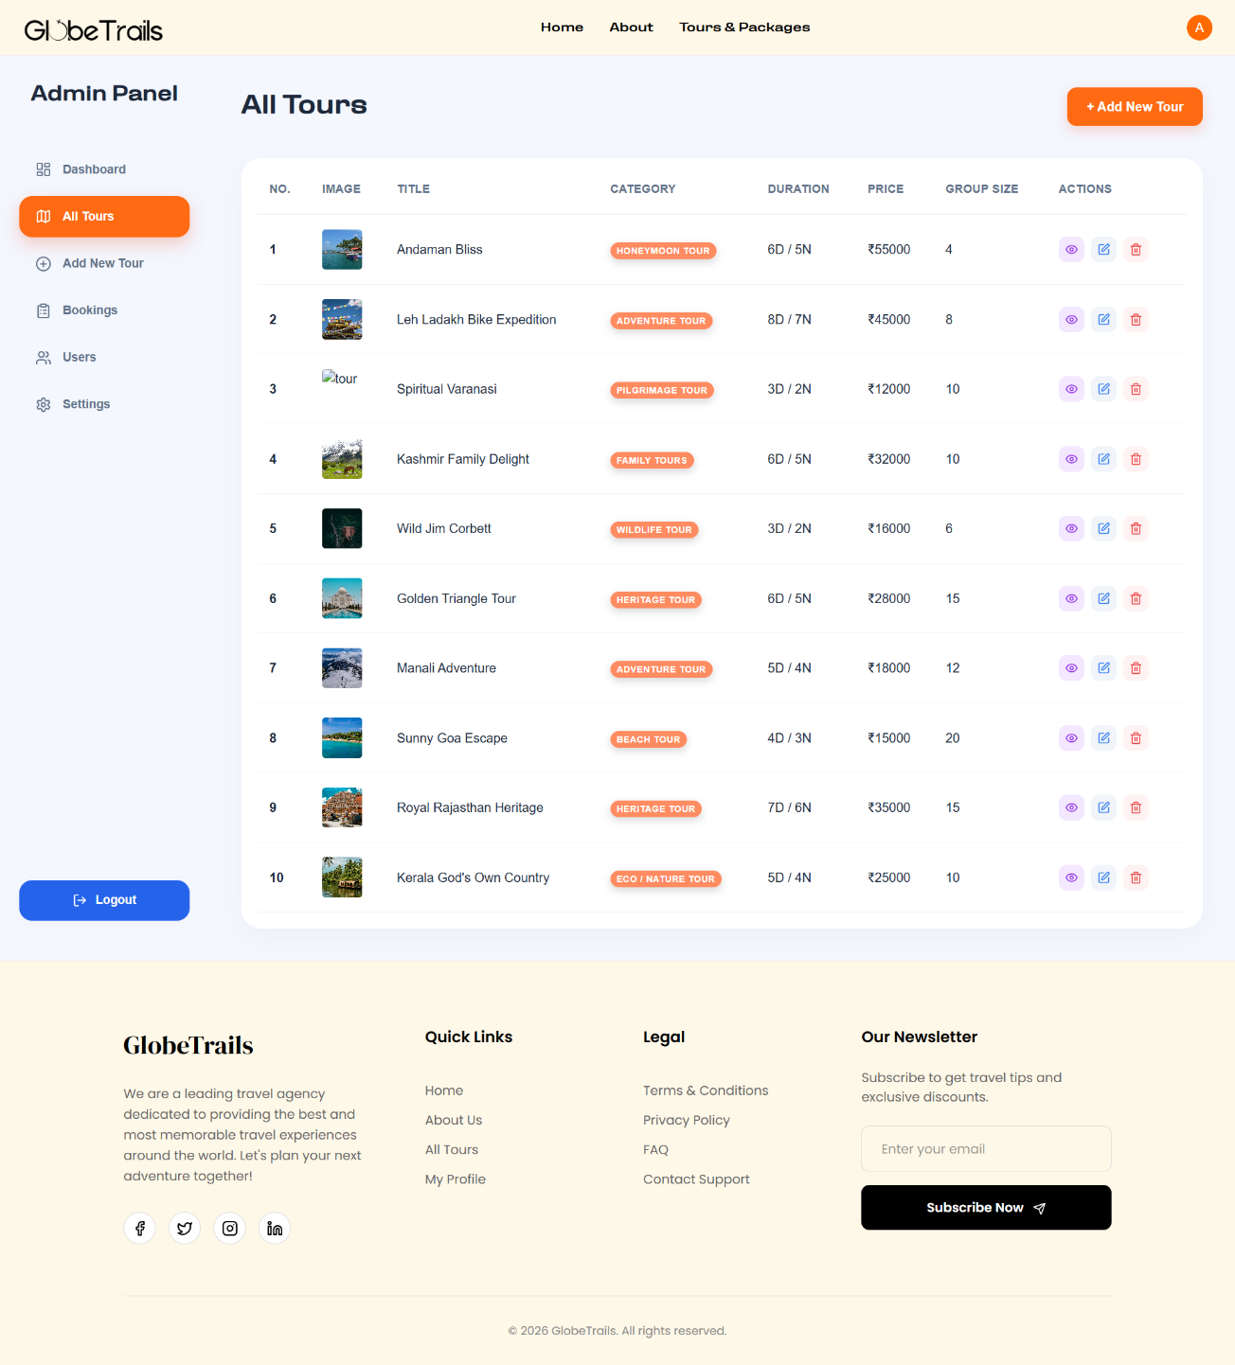
Tour Management
Tour Listing Management
View Tours: Display all uploaded tours in tabular/card format
Search & Filter: Filter tours by category or status
Update Tour Details
Edit Info: Modify title, description, price, duration
Edit Itinerary: Update day-wise travel plan
Update Images: Add or remove tour images
Delete Tour
Remove Tour: Permanently delete tour from system
Catalog Sync: Tour removed instantly from user view
System Integrity
Data Validation: Ensures correct and complete tour data
Real-Time Update: Changes reflected immediately across platform

Slide 14




Technical Architecture
Modular & Component based Design
The system follows a clean, layered architecture ensuring separation between frontend, backend, and database. It provides enhanced security through role-based access and secure authentication while supporting scalability and easy future enhancements.
The system is divided into independent modules such as authentication, tour management, booking, and admin dashboard. This modular approach improves maintainability and allows easy updates or feature additions.
Enhanced Security
Secure authentication is implemented using JWT and encrypted passwords. Role-based access control ensures that only authorized users can access sensitive admin functionalities.
Scalability & Performance
The stateless backend architecture supports horizontal scaling. Optimized database design ensures fast tour retrieval and smooth handling of increased user traffic.

Slide 15


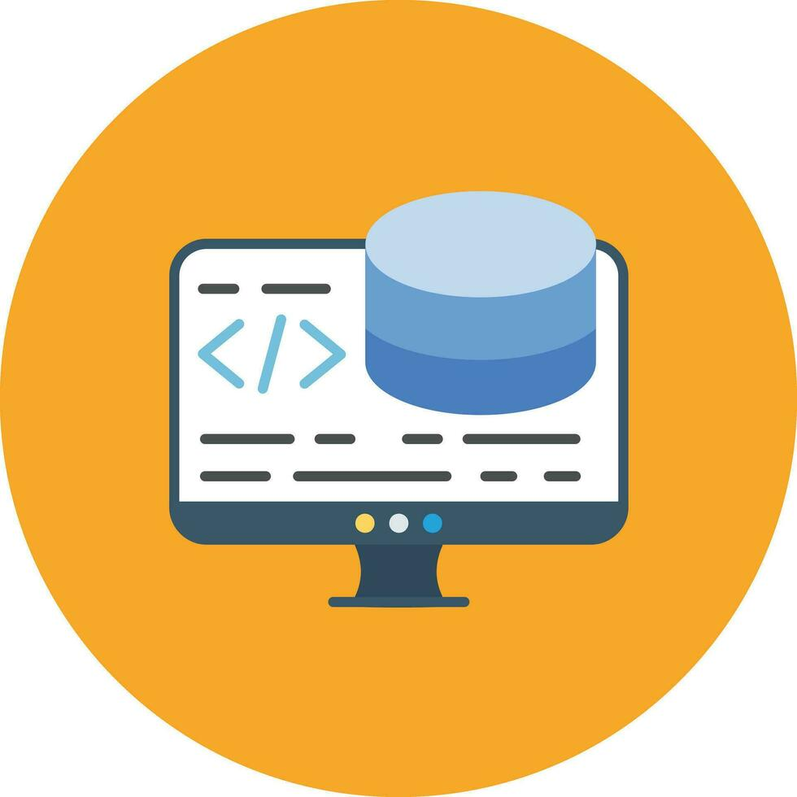
Technology Stacks
frontend:
React.js - Interactive user interface
CSS3 - Responsive design
HTML5 - Semantic structure
Backend
Nodejs - Server environment
Express.js - API framework
MongoDB - Database management
Storage
Supabase - Cloud image storage
Mongodb – For Data Storage

Slide 16
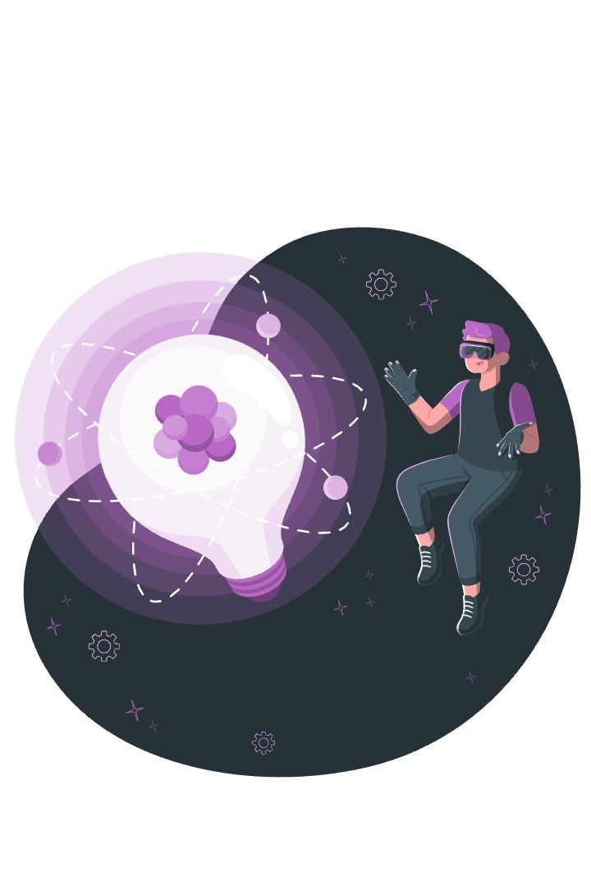
Scalability & Future Enhancement
5. AI-Powered Features
Personalized tour recommendations
Chatbot for customer support
Dynamic pricing based on demand
Platform Expansion
Multi-language support
International payment methods
Integration with hotel/flight booking
Enhanced User Features
Review and rating system for tours
Wishlist/favorites functionality
Social sharing capabilities
3. Mobile Application
React Native development
Push notifications
Offline tour browsing

Slide 17
GlobeTrails-Tour & Travel app
Domestic & International Travel Packages
Thank You

